Slide 1
Sentiment analysis for co-relating aT&T retail store performance
AT&T Big Data Case Competition 2016
Presented by-
Purandare, Aditya
Satpathy, Alok
Phulse, Swapnil
Tahir, Atif

Slide 2
Agenda
Motivation
Interest in ROI from Customer experience
Business problem
Proposed process
Architecture
Data exploration
Data warehouse
Visualization
Key recommendations

Slide 3

Motivation

Slide 4
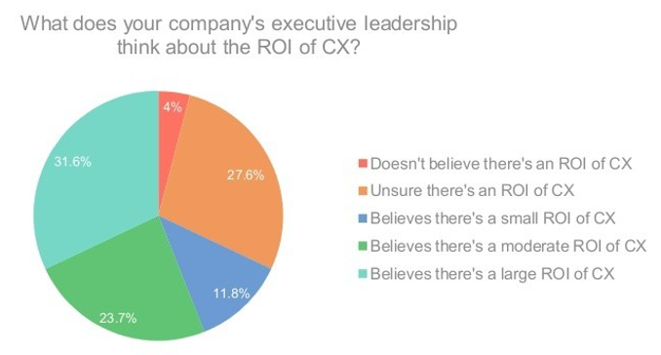
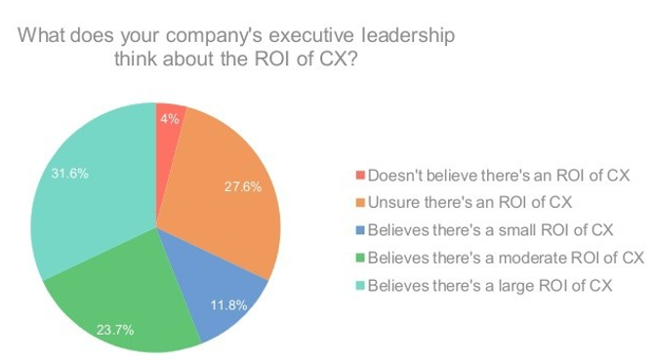
Companies realize roi in customer experience
Source: New measurement in bottom-line analytics – BLA(Bottom line analytics)

Slide 5

Business problem
Winner Vs Loser store analysis
Product and Service based analysis
Timeline analysis

Slide 6
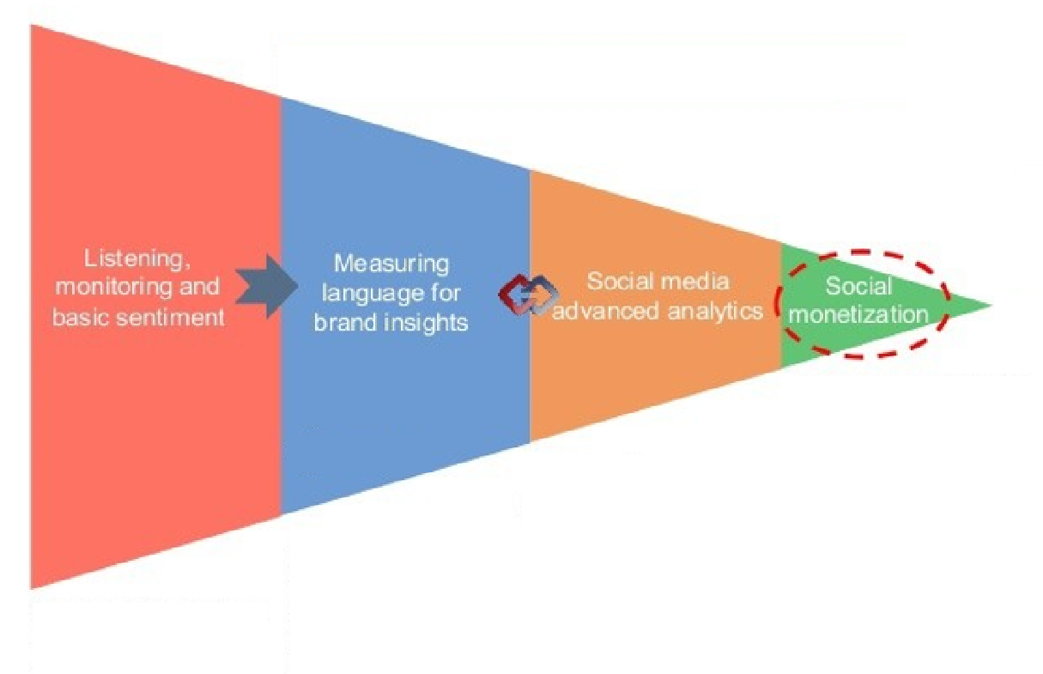
Proposed PROCESS
Real world incentives to high performers
Use of Big Data to engineer analytics
Sentiment calculation
Varied sources data

Slide 7
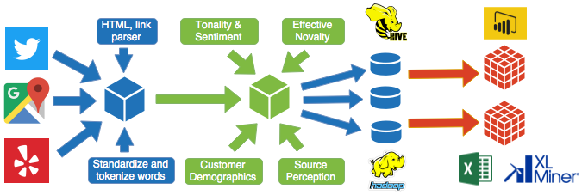
Architecture

Slide 8
DATA exploration
Data consolidation from sources such as
Twitter
Google reviews
Yelp
Consolidate data
Preprocessing
Gather exploratory insights
External data sources
Novelty of messages
Population census
Economic census
Housing information
Source perception/reliability index
Preprocessing post consolidation
Remove duplicates/erroneous records/inconsistancies
Categorize variables
Create advanced predictor variables
Add external factors

Slide 9
DATA exploration
Customer reviews
Original
Product
Service
Retweets
Product
Service
Two kinds of reviews
Original
Tweet
Segmentation by products and services
Three types of sentiments
Positive
Neutral
Negative
Two types of stores
Authorized retail
Corporate retail

Slide 10
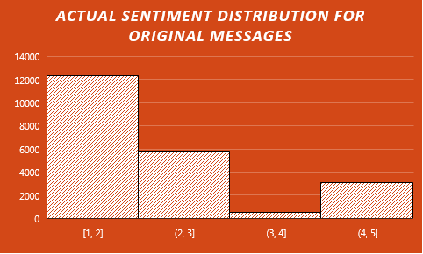
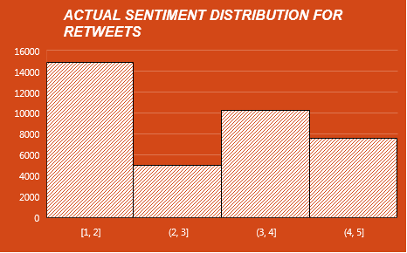
DATA exploration
Initially we started off just analyzing the message and calculating sentiments.
But careful observation(histograms) above show that the distribution and number of original/retweeted messages is altogether different
We believe AT&T should definitely weigh the kind of message in such ways like, but not limited to Original/Retweets, Critics review/User review, Promotional content/User content etc.

Slide 11
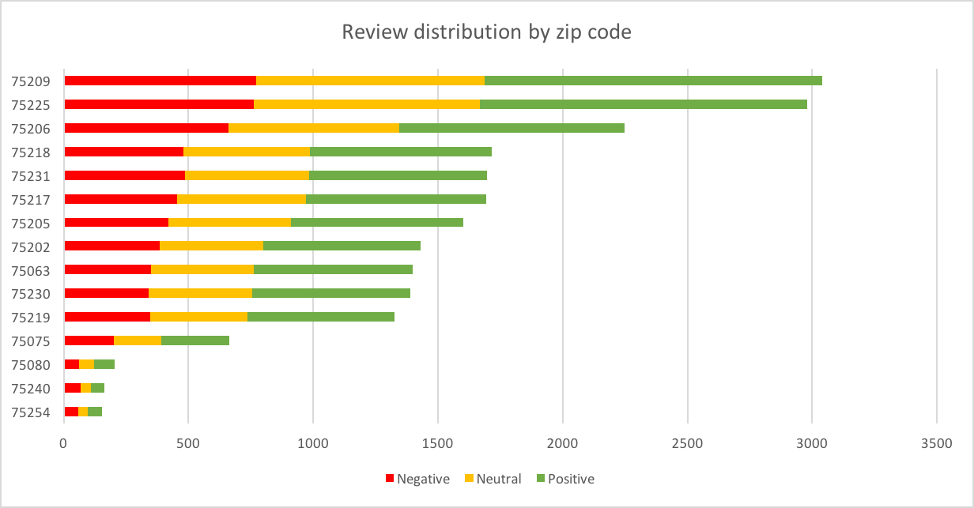
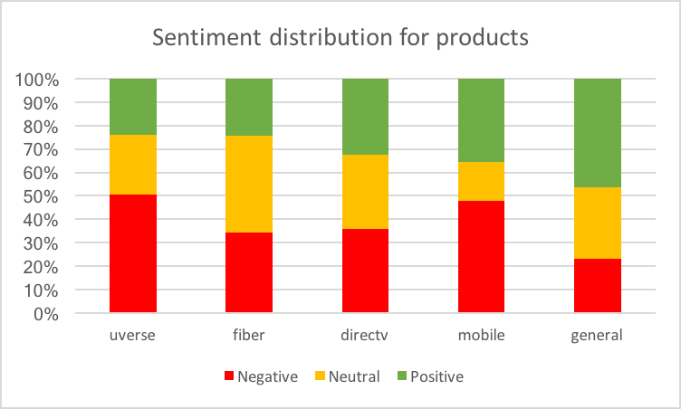
Other data explorations
Imperative to concentrate analysis on stores from these zips

Slide 12
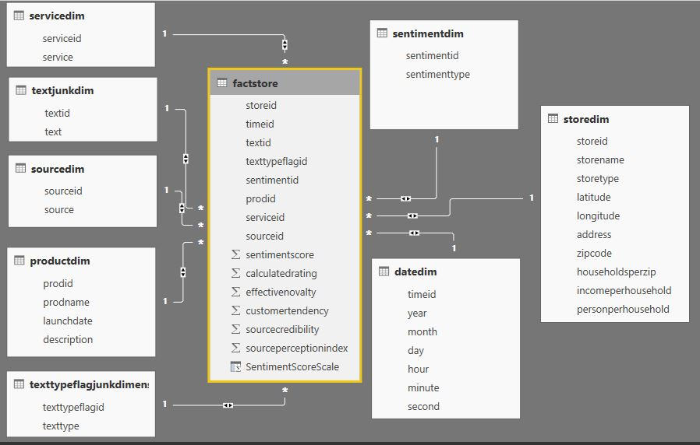
DATA WAREHOUSING (HIVE)
Warehouse helps with quick and efficient data transformations for actionable insights
Interactive charting functionalities
Facts and dimensions enable flexible slicing and dicing
Facts and Dimensions in Data-warehouse

Slide 13
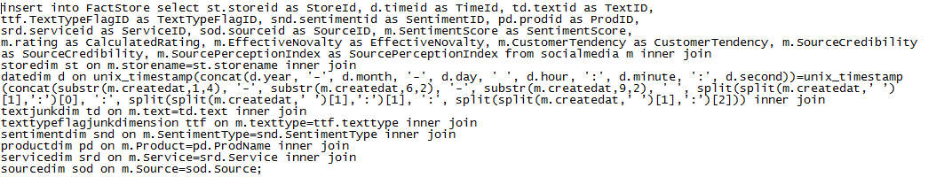
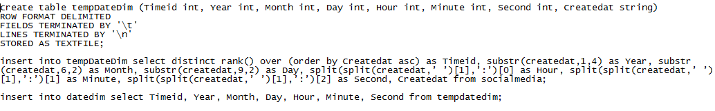
Data warehousing(Hive)
Sample Hive SQL script to load FACT table FactStore
Sample Hive SQL script to load DIMENSION table Date

Slide 14
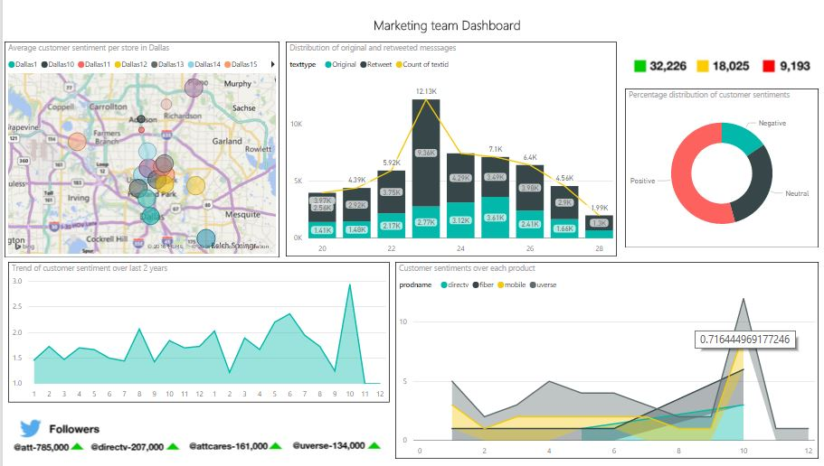
VISUALIZATION through dashboards

Slide 15
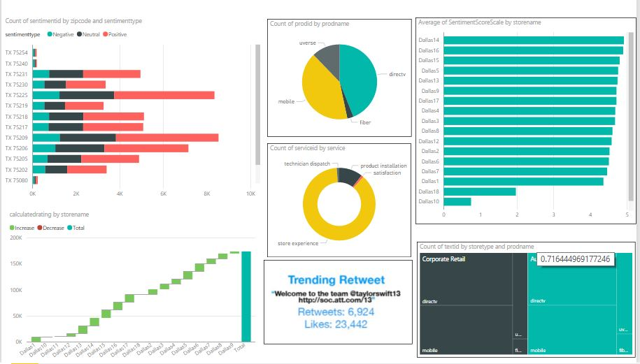
VISUALIZATION through dashboards

Slide 16
RECOMMENDATIONS – DATA COLLECTION
Ensure correct sampling rate
Complex customer reviews that talk about two different products
Different languages like Spanish, Chinese and Japanese in tweets
Unclear products/services derived from message had to be categorized as “General”
Promotional content tend to skew the overall sentiment score
Very limited sources and various restrictions on how the data is collected using APIs
Data collection issues
Social media aggregator

Slide 17

RECOMMENDATIONS – OVERALL
Keep a tab on winners/losers analysis
Incorporate timeline analysis that
Tracks store performance over a long period
Tracks stores performing inconsistently
Tracks stores doing consistently bad on CX
Model factors that weigh in event-triggers viz an upcoming Iphone sale, holidays, Superbowl
Incentivize stores that perform well consistently on CX
Try to enhance store productivity by having larger (and fewer if geographically collocated) stores

Slide 18
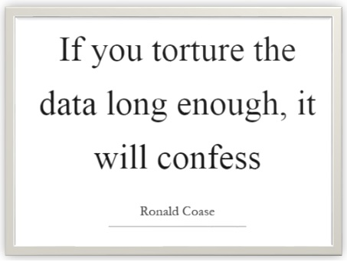
KEY TAKEAWAY FROM DATA CHALLENGE
You use this confession to rest your business case
Data rearranged yields Tada!

Slide 19


Slide 20
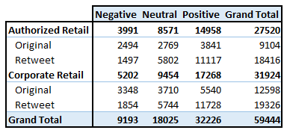
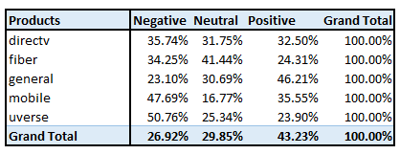
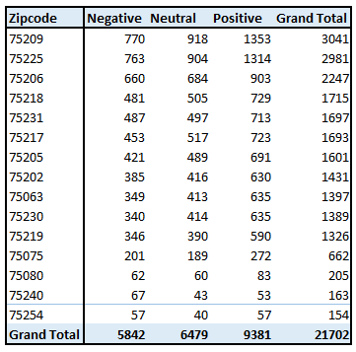
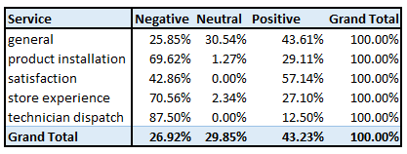
Appendix

Slide 21
Appendix

