Slide 1

Foreword
By
Asha
C.E.O. Admin

Slide 2

All Core Members

Slide 3

First meet of Spiritual Tablet Organization conducted on 31st December 2012 at DMC site, Kadthal with core team members

Slide 4
Work Progress for the year 2013
After 1st Core meet –It took 6 months of time to decide Website team.
Next 6 months Website Handover & commencement.
In Dhyanamahachakram 2013 at Kadthal Organized stall for 14 days.

Slide 5
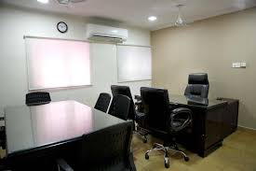
Work Progress for the year 2014
February 2014-Gopalapatnam office Inauguration
CONTD.,

Slide 6
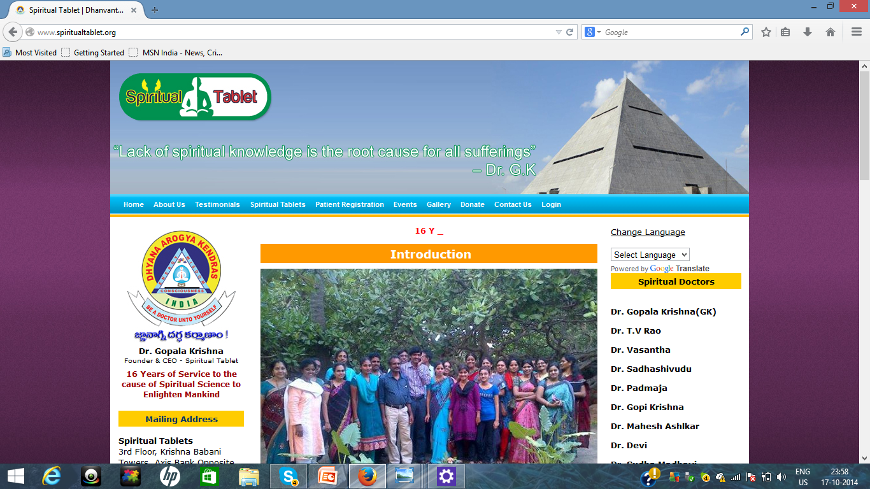
15th March 2014 Pancharatna Seva Program & Website Static content launching

Slide 7

Mile stones for the year 2014
3 Short Films started
Shooting of 150 patients experiences completed including primary editing.
60 pocket books in progress

Slide 8
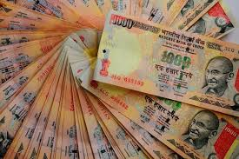
Expenditure
Office maintenance
Shooting Expenses
Material Purchases

Slide 9
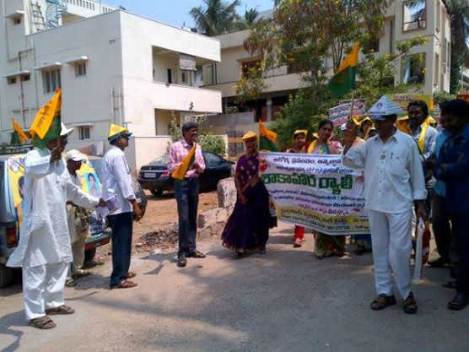
Support to PSS Movement
Our Team Worked for Pyramid Party from 7th April 2014 to 7th May 2014

Slide 10
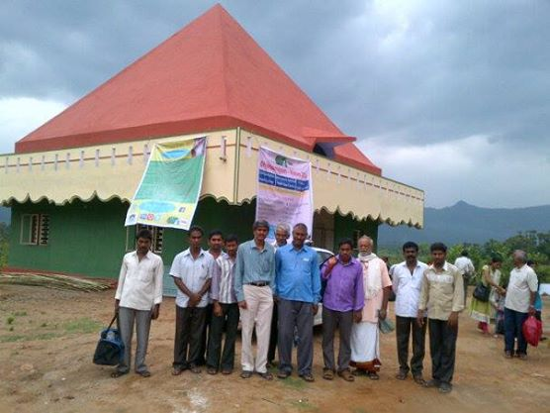
Assistance and monitoring of Prakruthi Valley Developments
Establishing Platforms for Academy, ESA,IFSS as part of Mega Pyramid Formula.

Slide 11
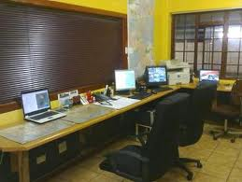
Spiritual Tablet Administration Office
Inaugurated- Administration office at Gajuwaka in June 2014
Actively started work from 1st July 2014.
CONTD.,

Slide 12
Vision of Spiritual Tablet Administration Office
Platform for performing works of following wings:
Workshops
Counseling
Website
New Center’s Establishment
Cultural Programs
Center’s Maintenance

Slide 13

ACTIVITES AT GOPALAPATNAM OFFICE
Pocket books
Audio books
Audio visuals
Short films
Aboard ESA trips
Organization Registration Works
Website Meetings

Slide 14

Targets
The Whole Work done till date was completed
In the span of 1 year 8 months period.
So far achieved 50% of project.
Total project is supposed to be completed in next 1 year.

Slide 15


