Slide 1
CsI 223 : Database Sessional
LAB-1

Slide 2
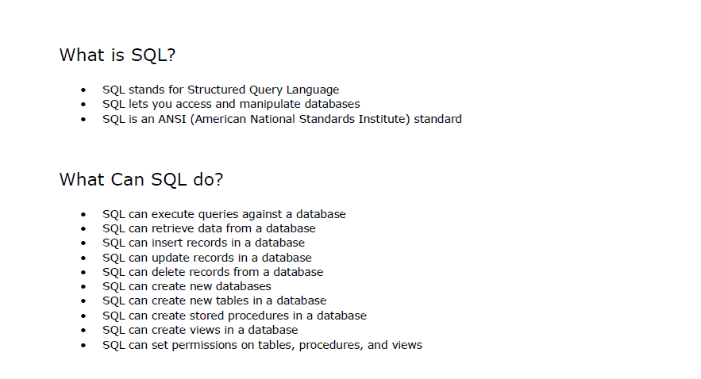

Slide 3
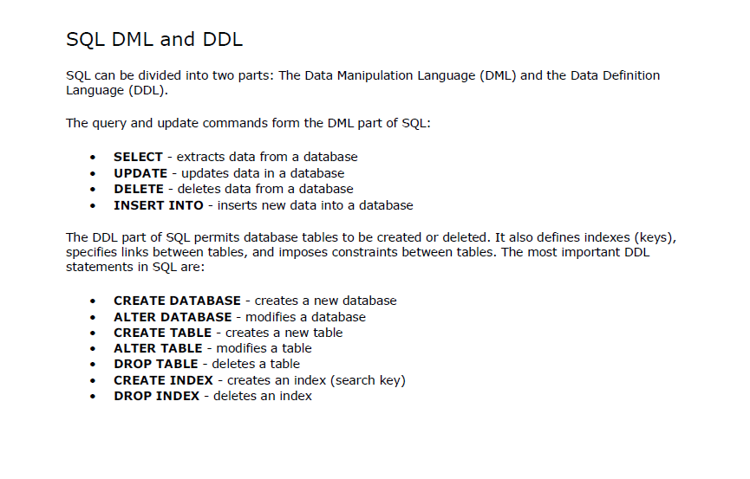

Slide 4
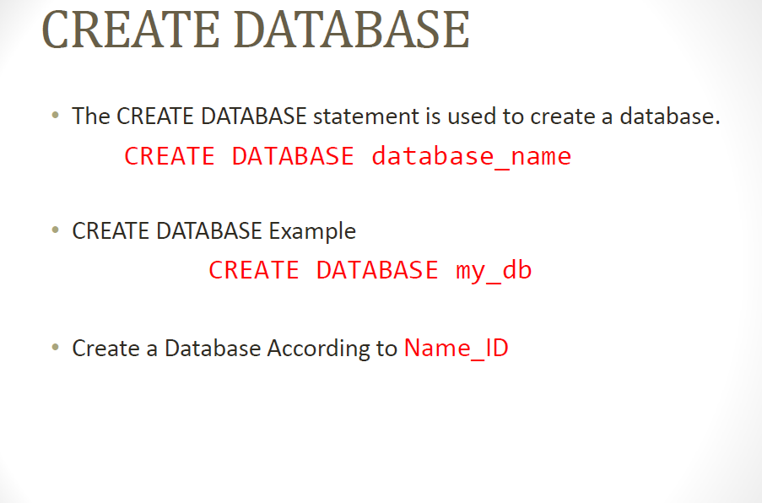

Slide 5
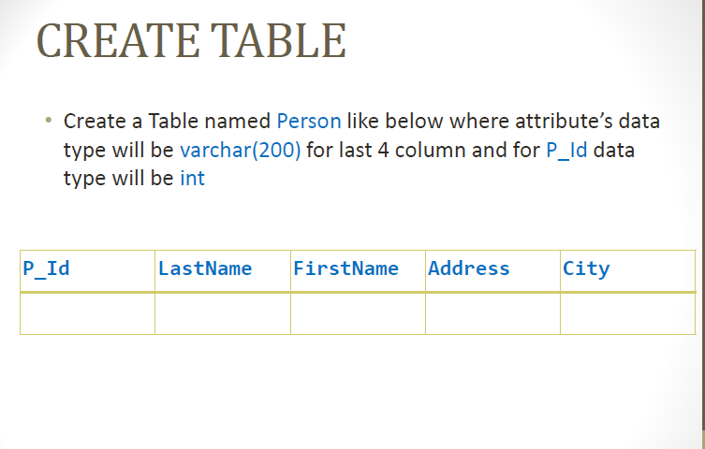

Slide 6
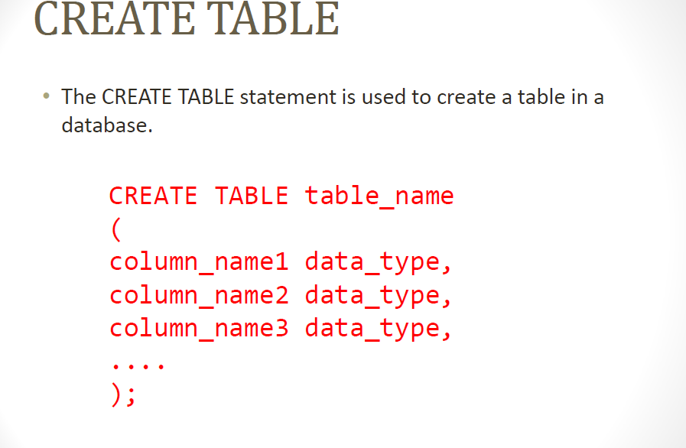

Slide 7
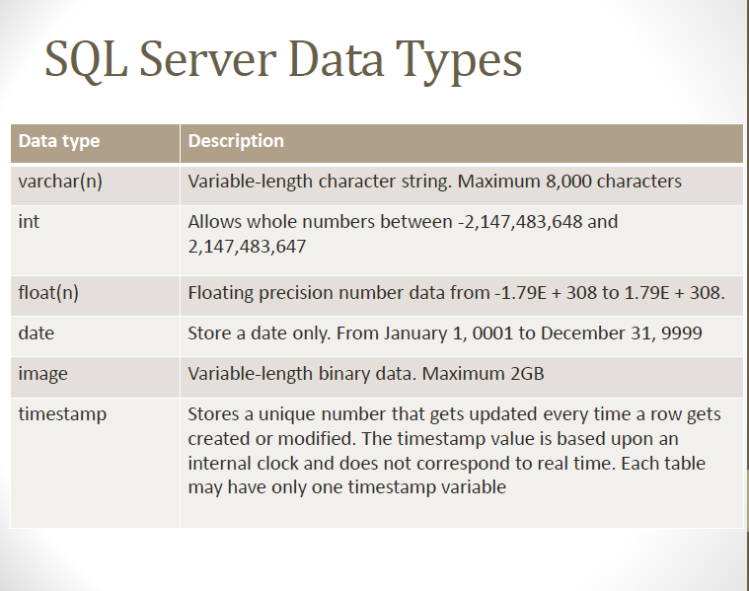

Slide 8
CREATE TABLE Persons ( PersonID int, LastName varchar(255), FirstName varchar(255), Address varchar(255), City varchar(255) );

Slide 9
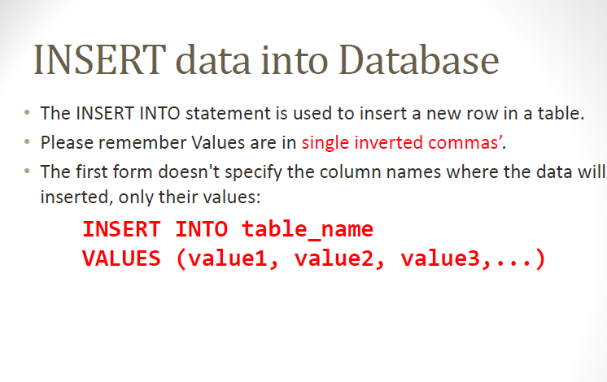

Slide 10
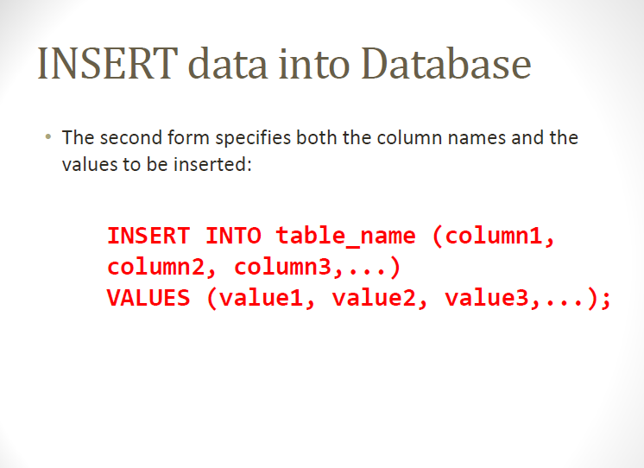

Slide 11
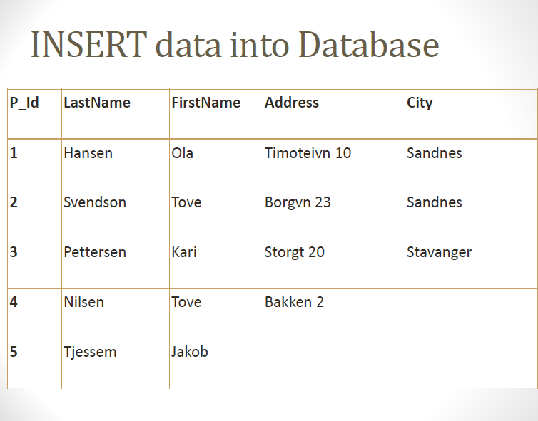

Slide 12
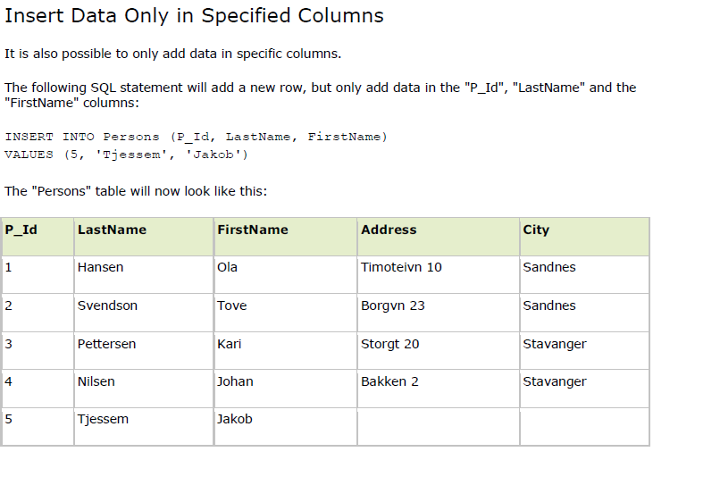

Slide 13
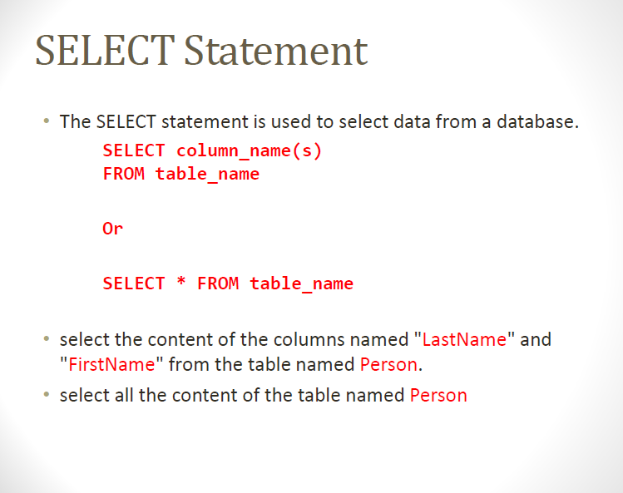

Slide 14
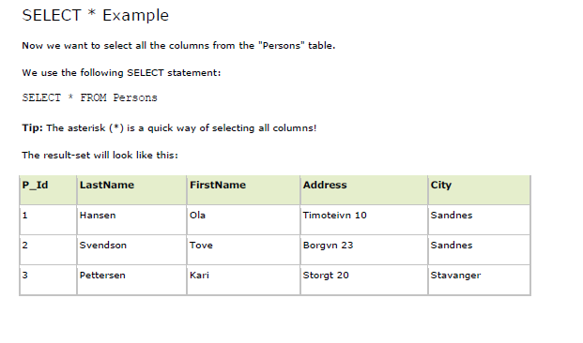

Slide 15
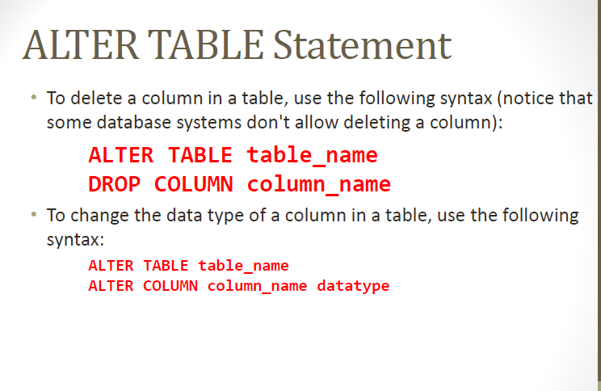

Slide 16
ALTER TABLE Statement
• Add a column named “Age" in the "Persons" table
• Change the data type “int” of the column named “age" in the "Persons" table.
• we want to delete the column named “Age" in the
"Persons" table.

Slide 17
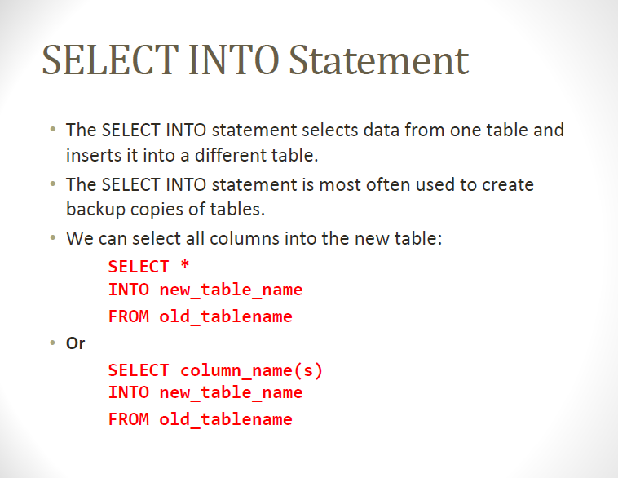

Slide 18
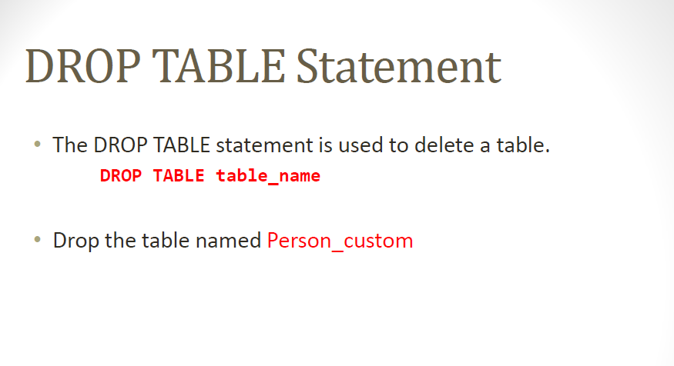

Slide 19
