Slide 1
CsI 224 : Dbms Sessional

Slide 2
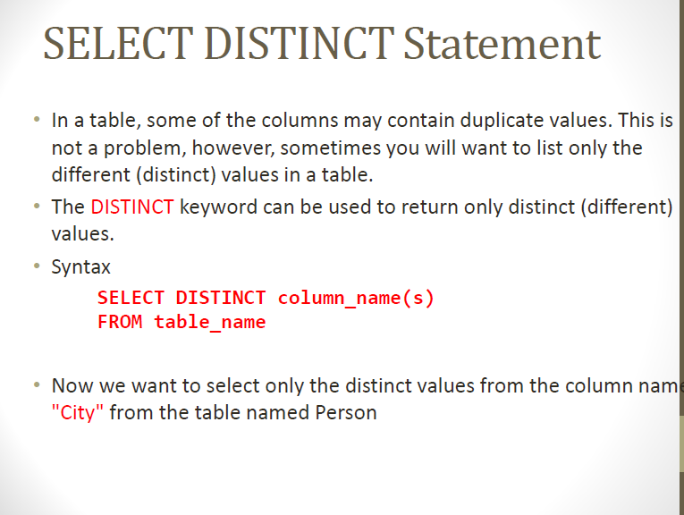

Slide 3
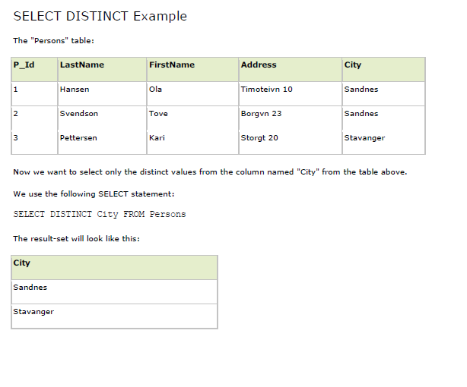

Slide 4
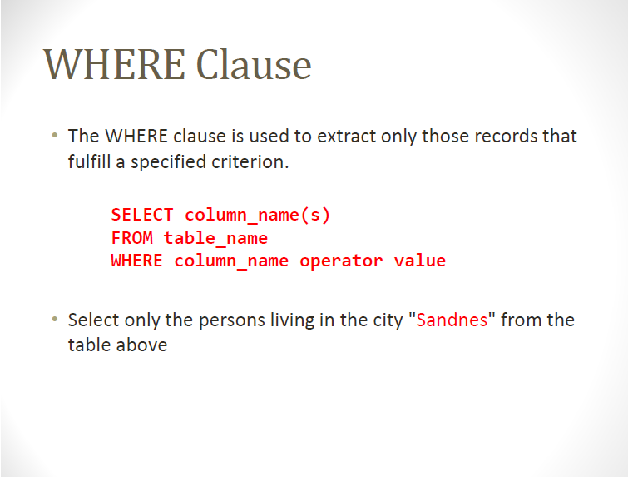

Slide 5
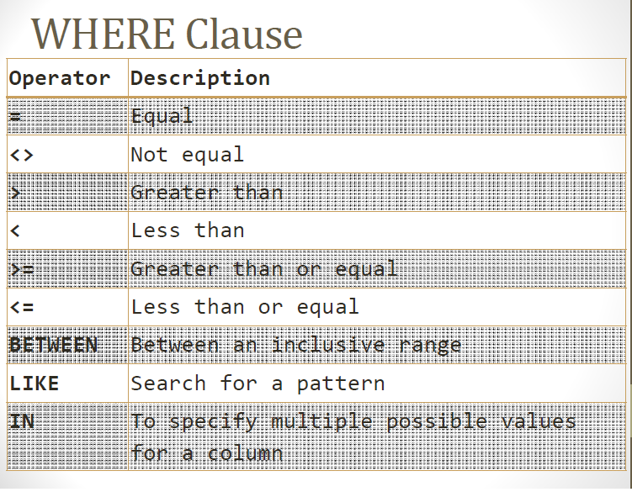

Slide 6
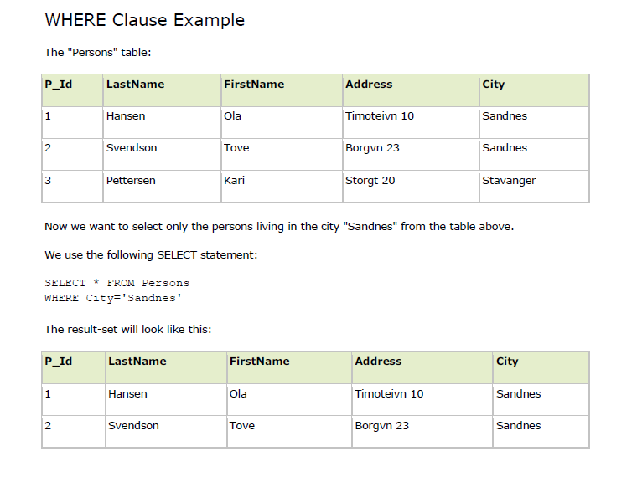

Slide 7
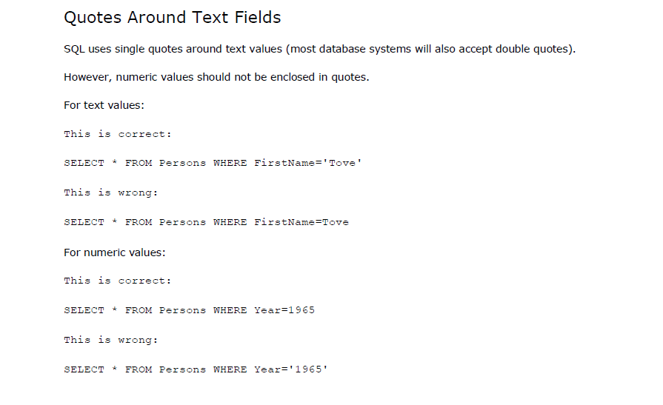

Slide 8
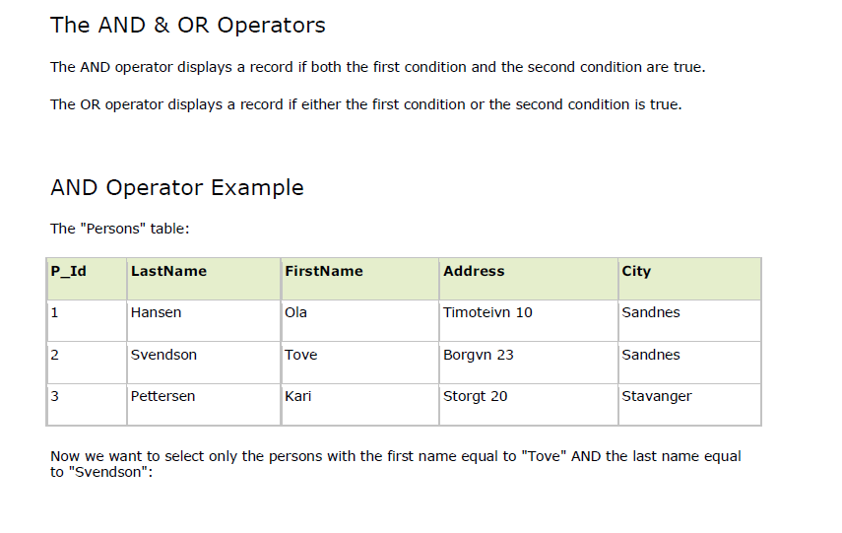

Slide 9
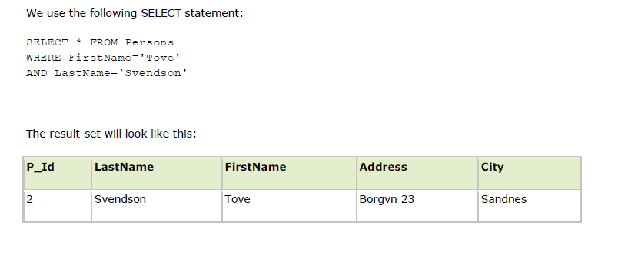

Slide 10
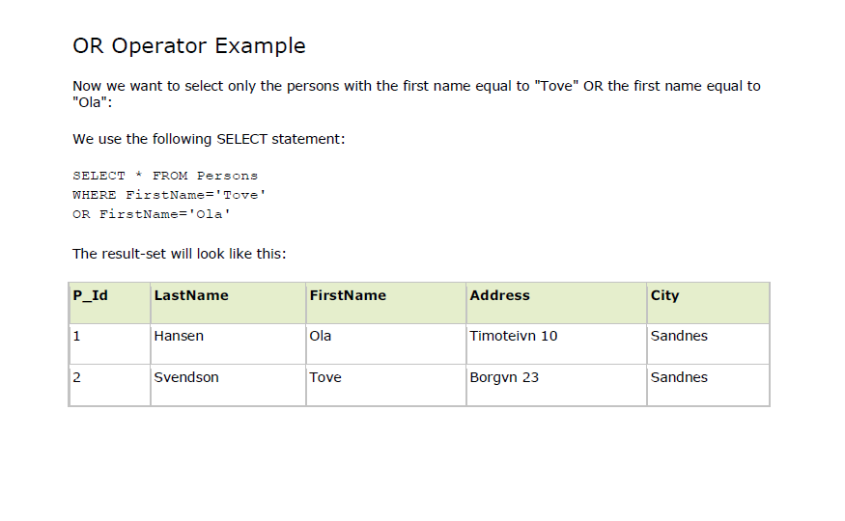

Slide 11
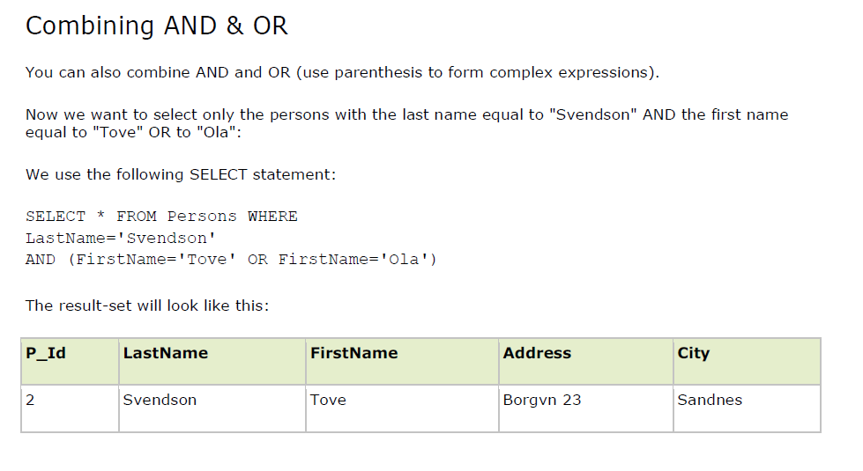

Slide 12
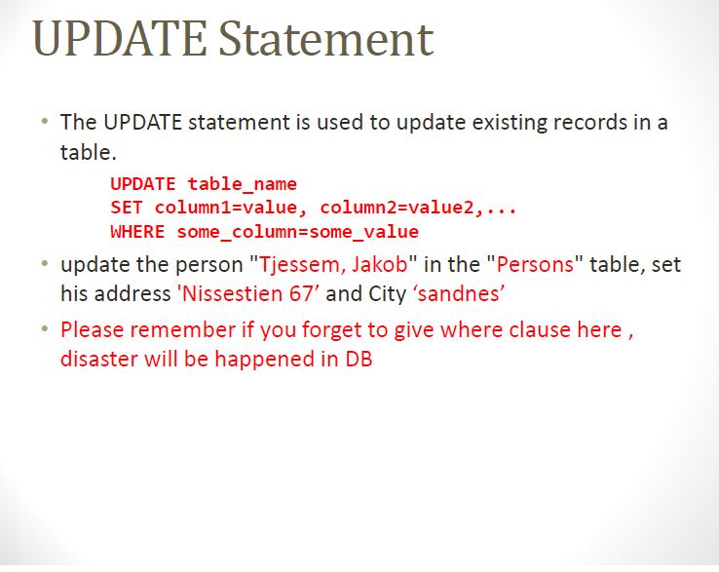

Slide 13
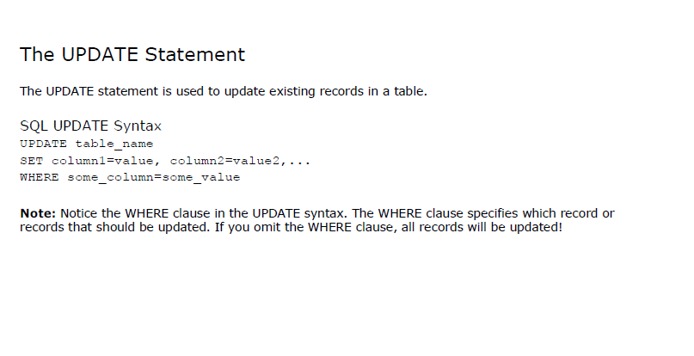

Slide 14
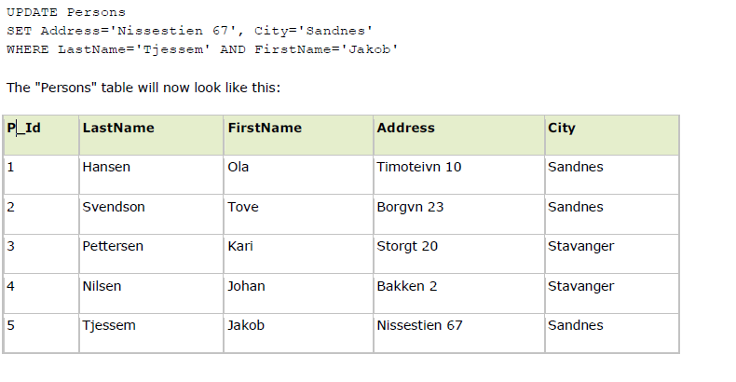

Slide 15
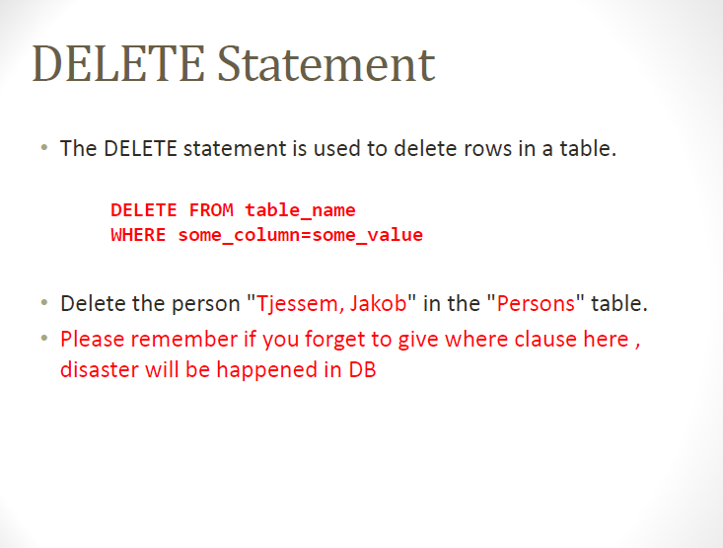

Slide 16
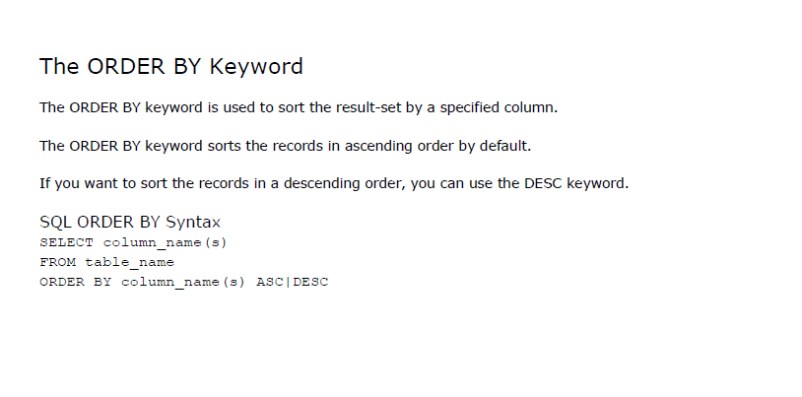

Slide 17
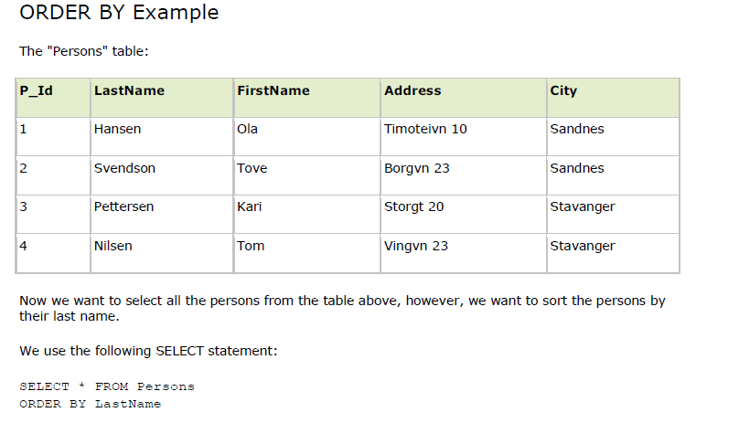

Slide 18
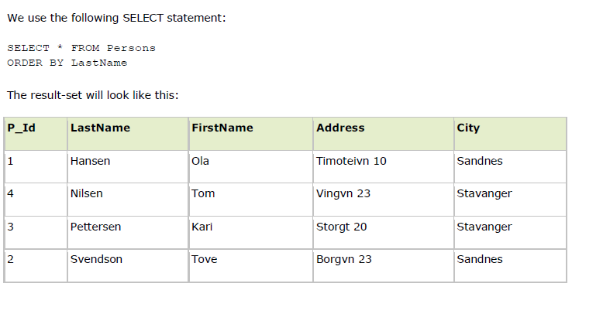

Slide 19
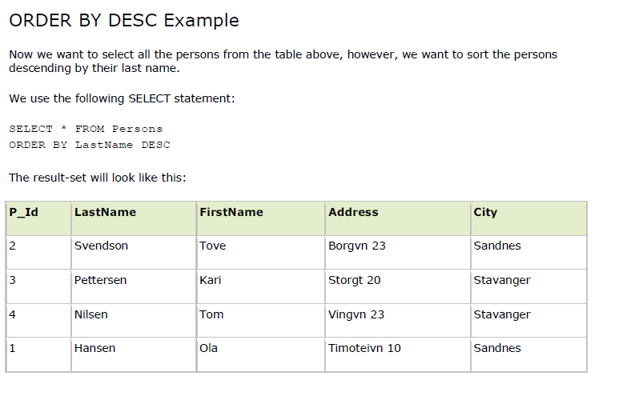

Slide 20
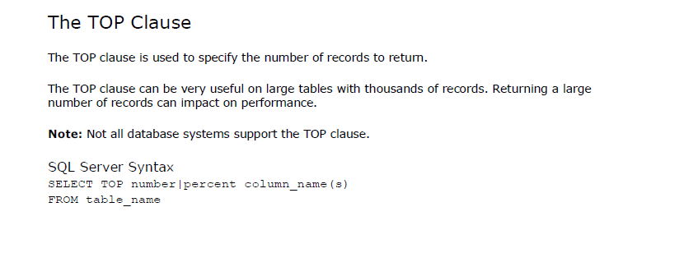

Slide 21
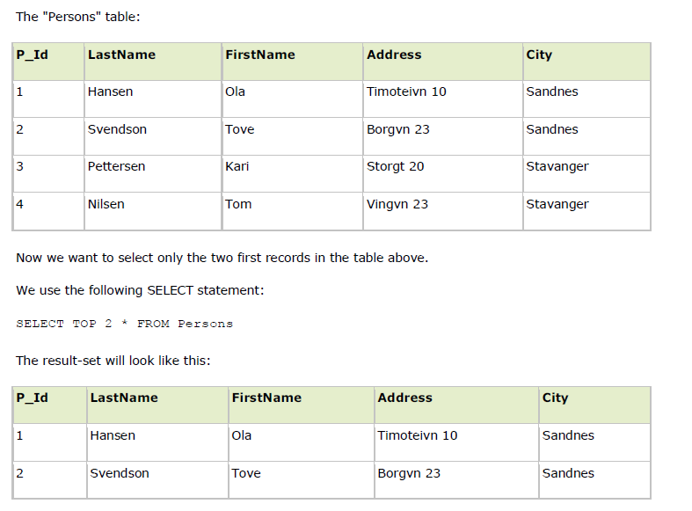

Slide 22
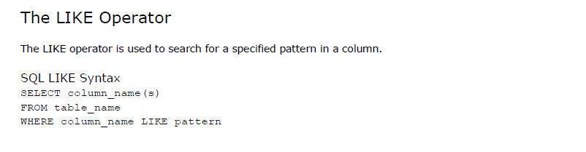

Slide 23
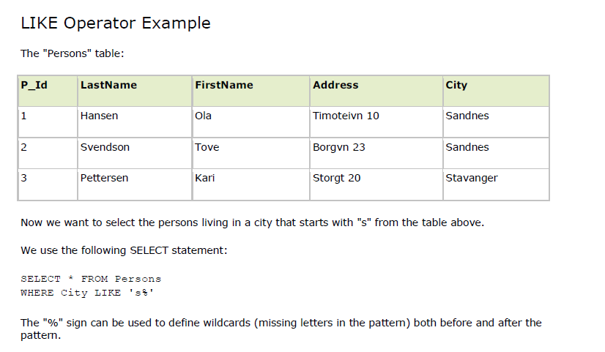

Slide 24
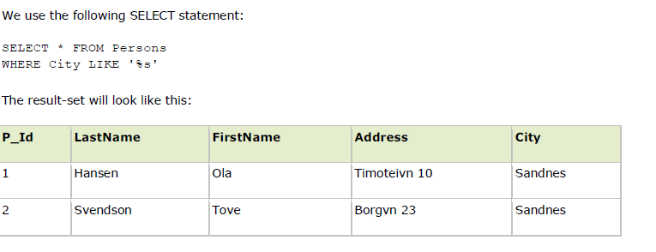

Slide 25
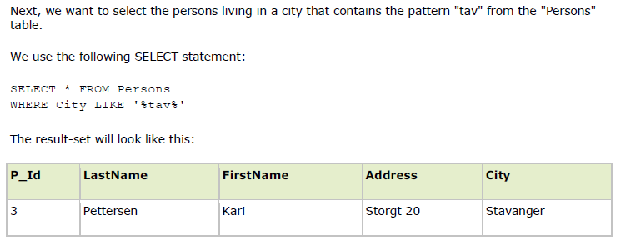

Slide 26
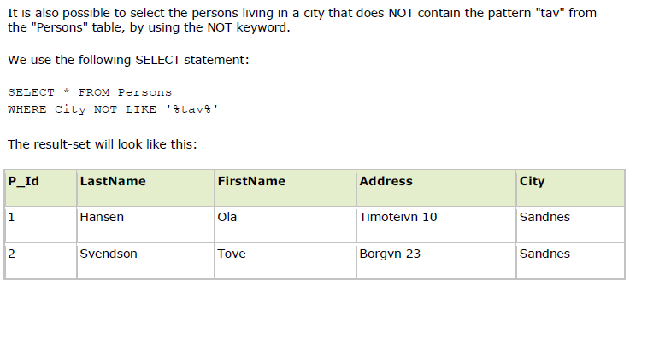

Slide 27
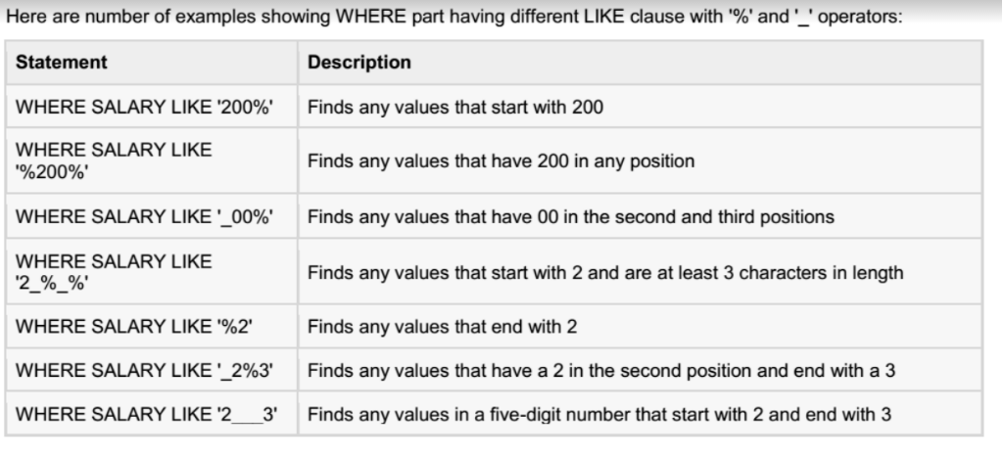

Slide 28
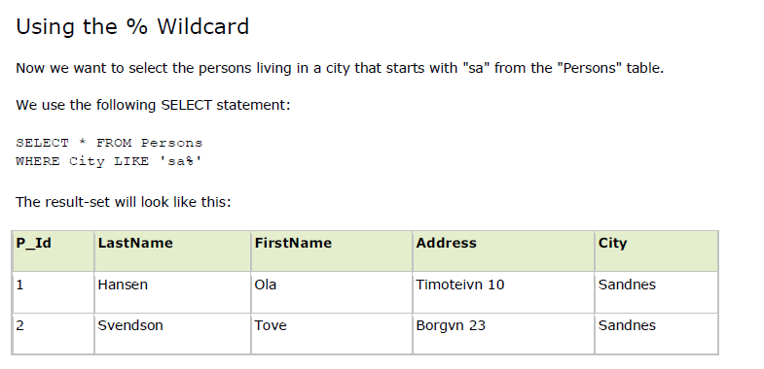

Slide 29
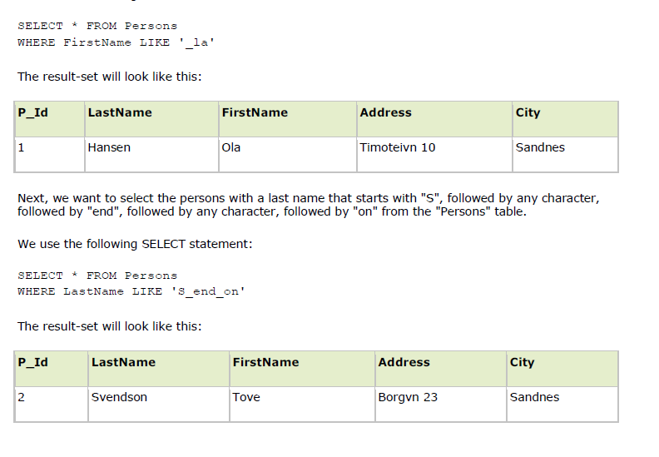

Slide 30
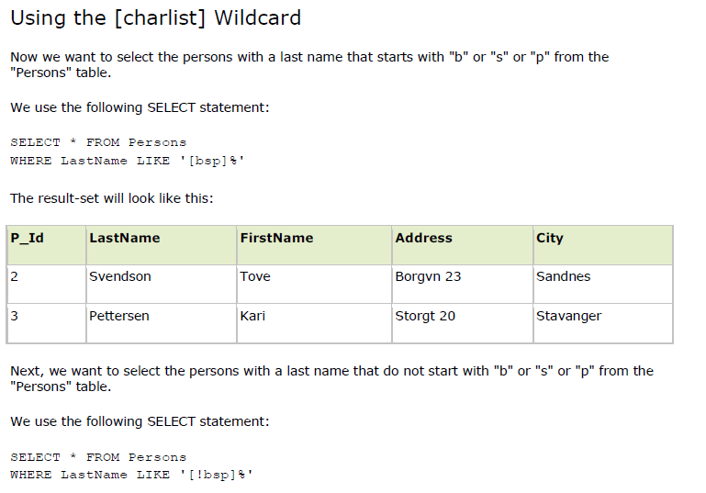

Slide 31
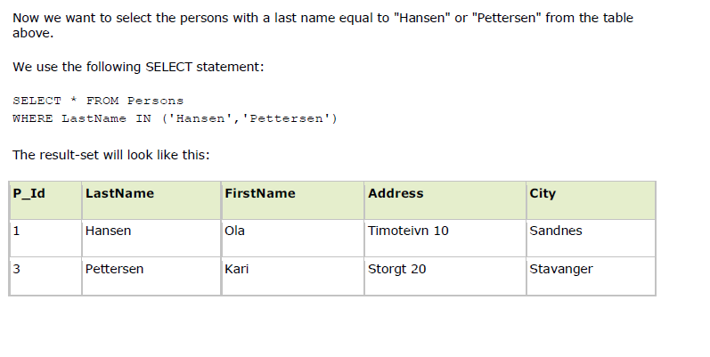

Slide 32
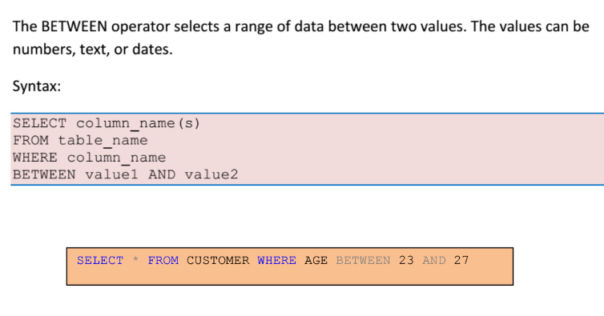

Slide 33
Create the following table.
E_ID | Name | Age | Salary | Dept
1 | Karim | 25 | 10000 | HR
2 | John | 28 | 20000 | HR
3 | Abdul | 23 | 30000 | Sales
4 | Rahim | 24 | 25000 | Account
5 | Adam | 26 | 850000 | Sales
6 | Rayhan | 26 | 51000 | Account

Slide 34
Update the salary of the employee whose id is 1.
Find the top 3 name of the employee according to their salary. ( high to low).
Find age of the employees whose salary is between 50K – 100K.
Find the id of the employee who is either from sales or account department and earn more than 25k.
Search the name of the employee whose name end with ‘m’.
Find all the id with 6 digit salary.
List the name of the employee from account , sales, or hr department.

