Slide 1
CsI 224: DBMS Sessional
LAB-4

Slide 2
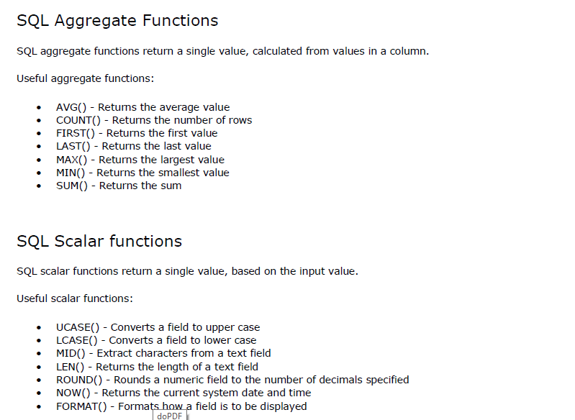

Slide 3
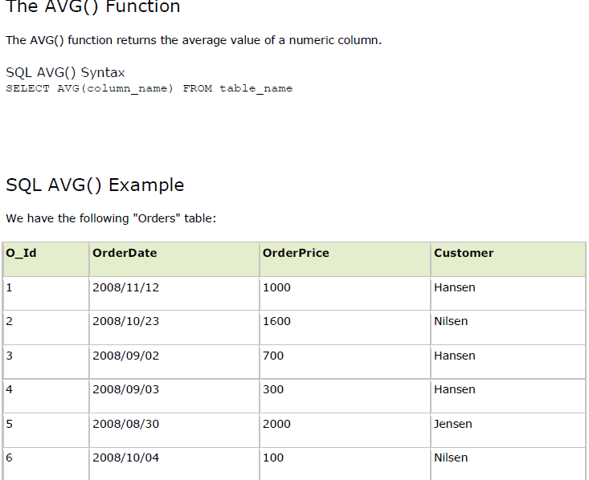

Slide 4
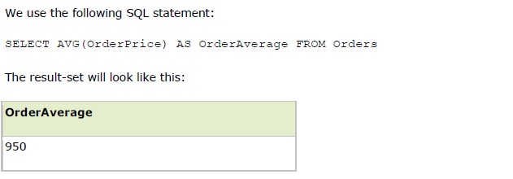

Slide 5
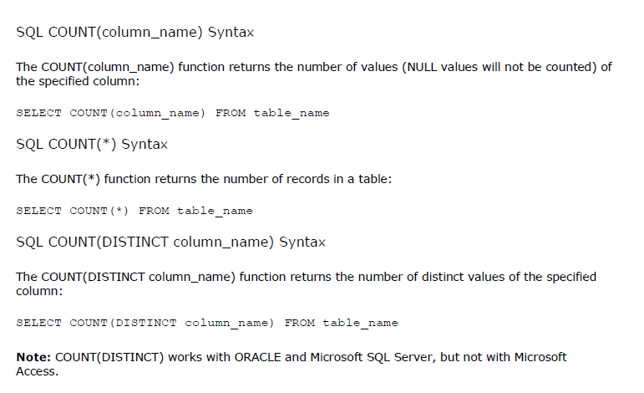

Slide 6
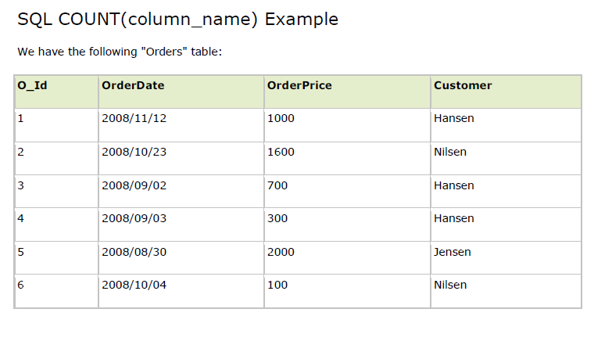

Slide 7
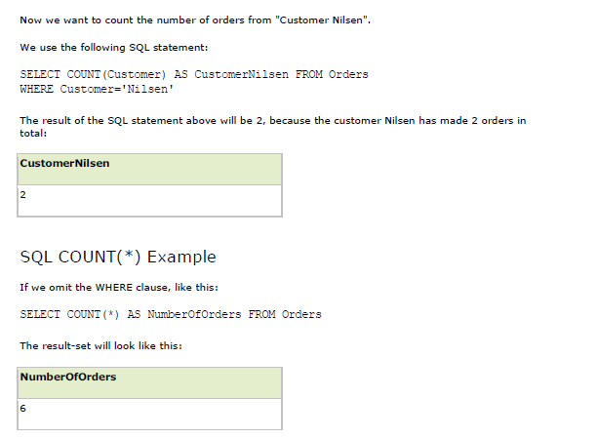

Slide 8
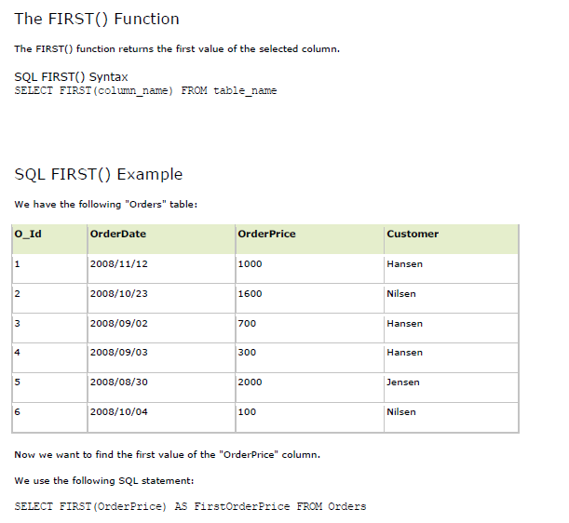

Slide 9
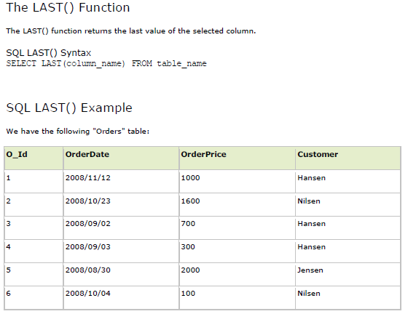

Slide 10
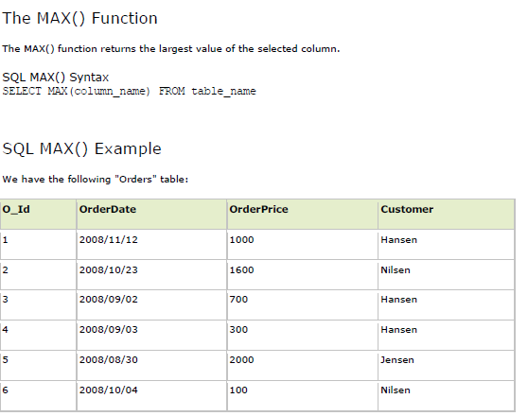
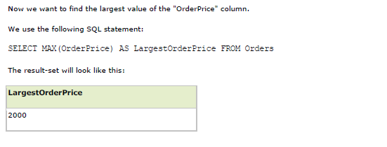

Slide 11
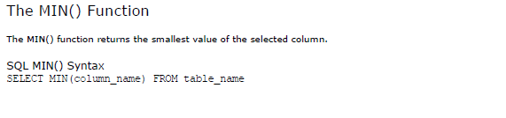

Slide 12
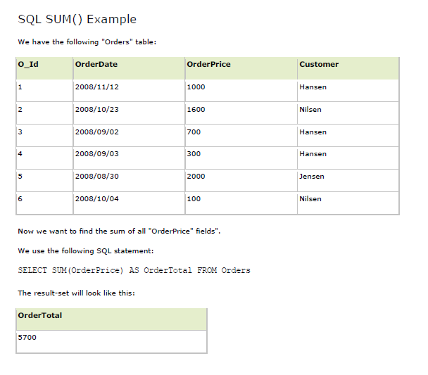

Slide 13
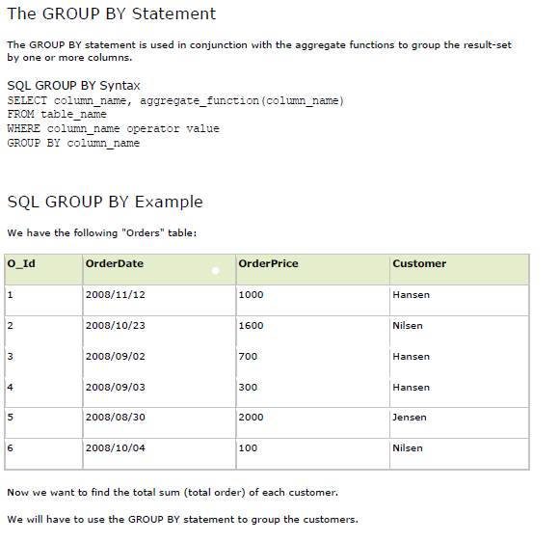

Slide 14
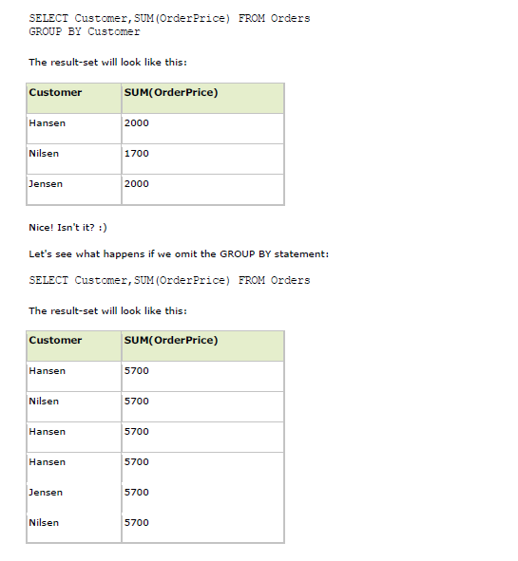

Slide 15
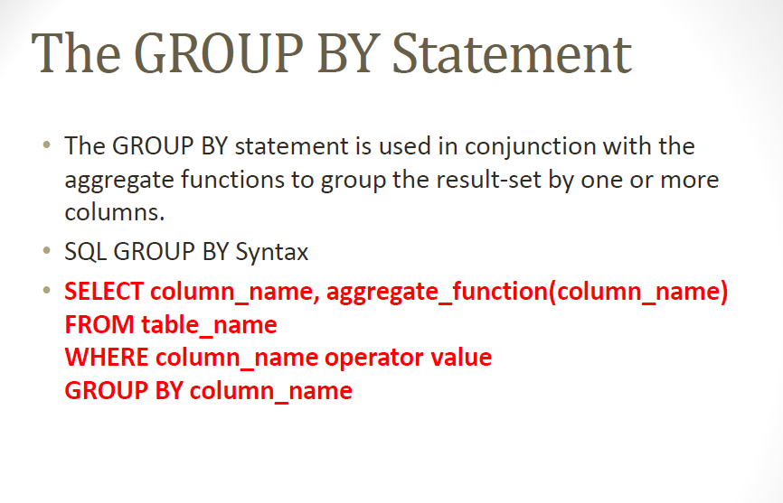

Slide 16
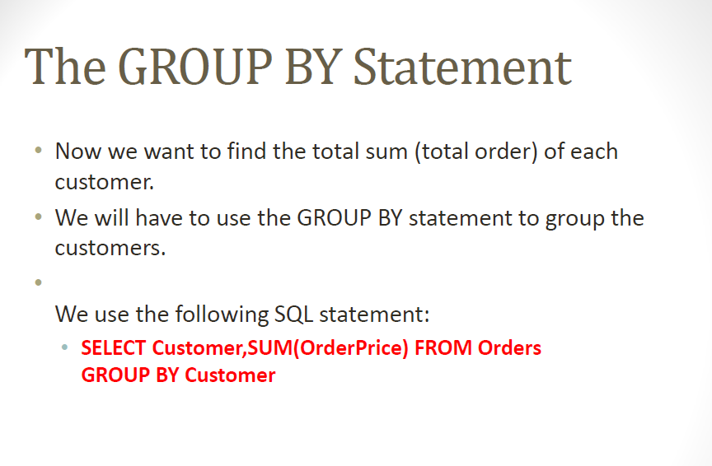

Slide 17
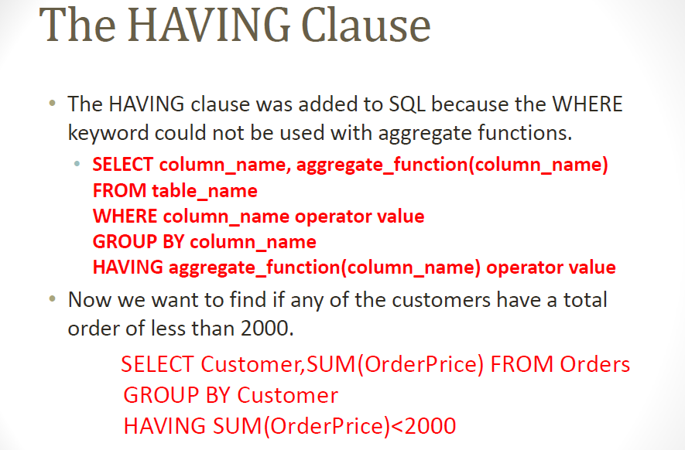

Slide 18
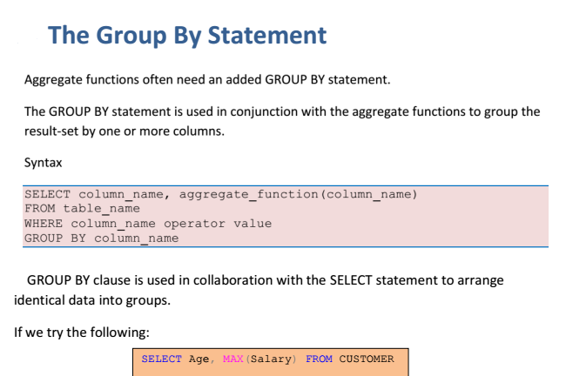

Slide 19
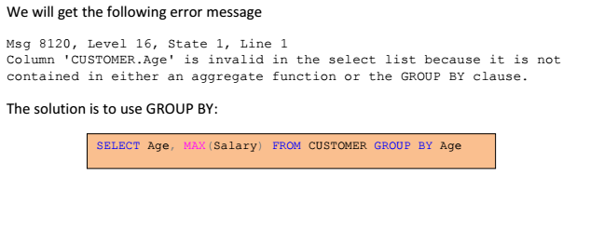

Slide 20
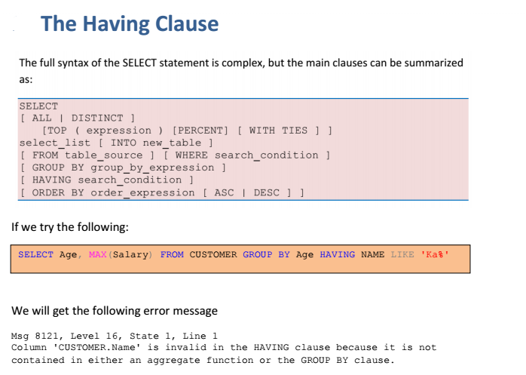

Slide 21
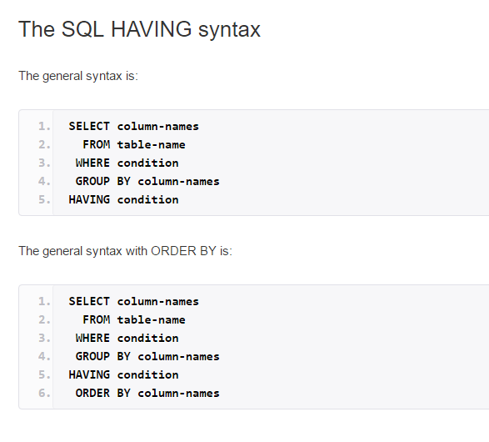

Slide 22

ID | Firstname | Lastname | City | Country | Phone
1 | Adam | Smith | Melbourne | AUS | 982992
….. | ….. | ….. | ….. | ….. | …..

Slide 23
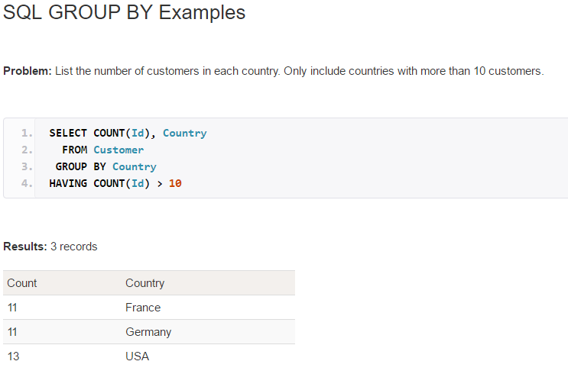

Slide 24
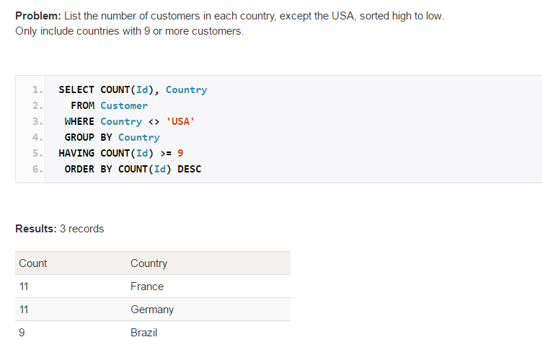

Slide 25
Exercise
Find the total number of customers from order table.
Find the average order amount by each customer.
Find the name of the customer whose average order amount is higher than 1000.
Find the number of orders by each customer.
Find the number of order by each customer from highest to lowest.
Find the name of the customer with lowest number of order,
Find the order_date of the customers who order at least two items.
Find the name of the customers who orders avg order is greater than 1000 and name starts with ‘H’.

Slide 26
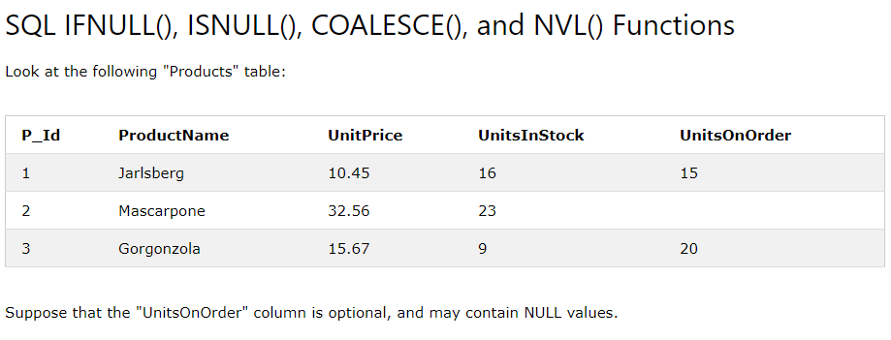

Slide 27
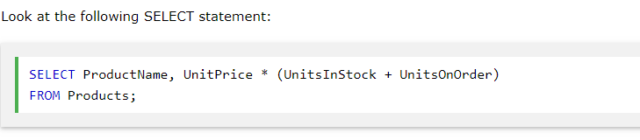

Slide 28
