Slide 1
CsI 224 : Database Sessional Lab-5

Slide 2
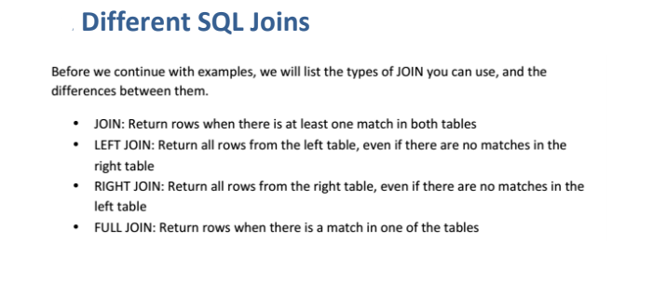

Slide 3
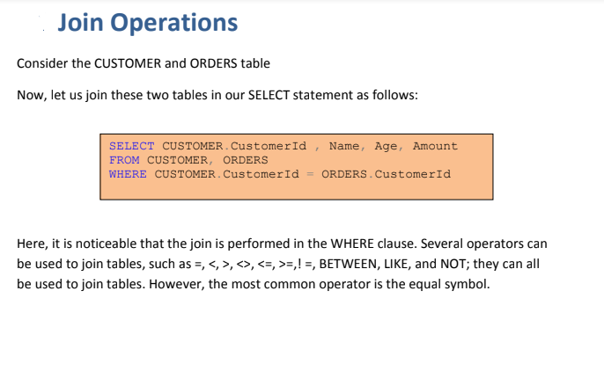

Slide 4
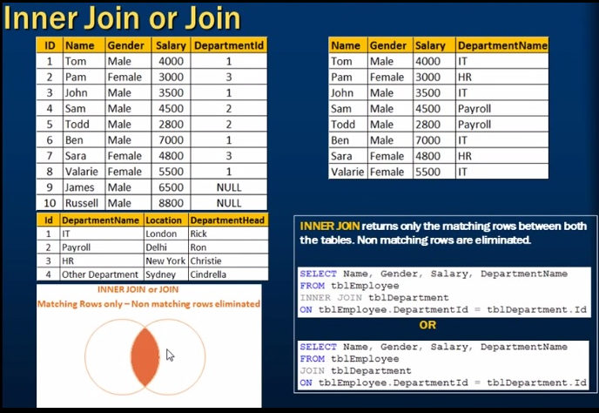

Slide 5


Slide 6
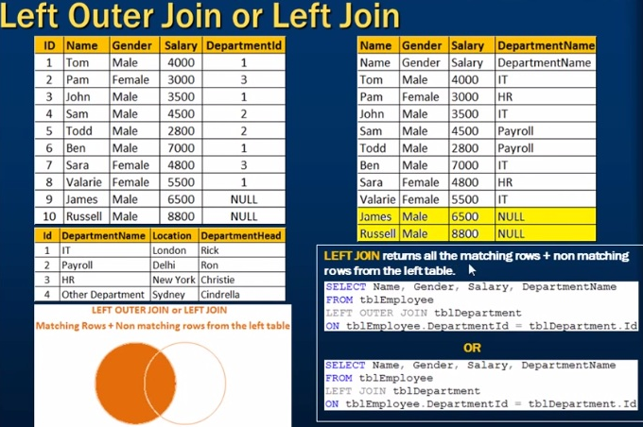

Slide 7
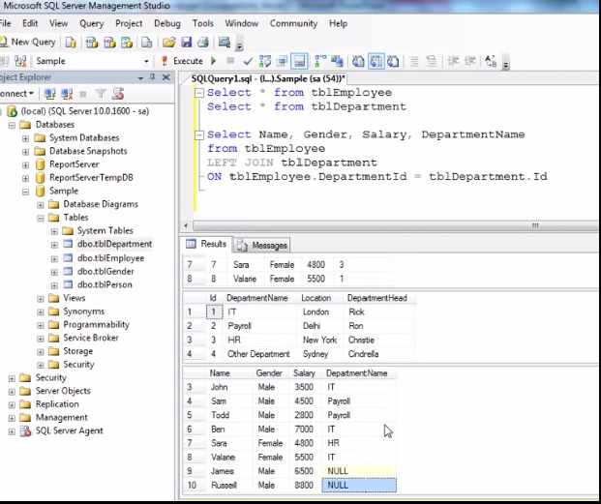

Slide 8
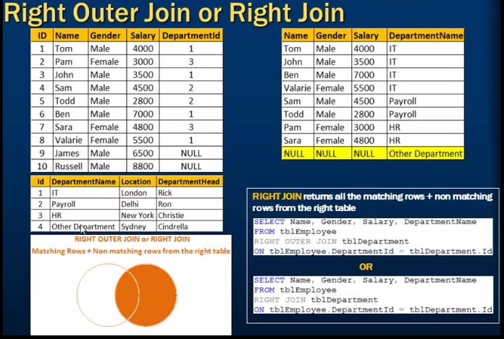

Slide 9
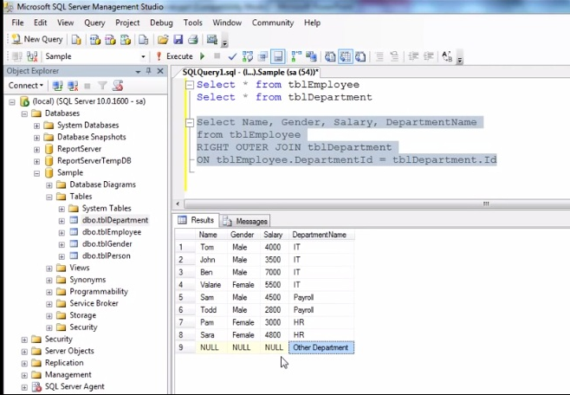

Slide 10
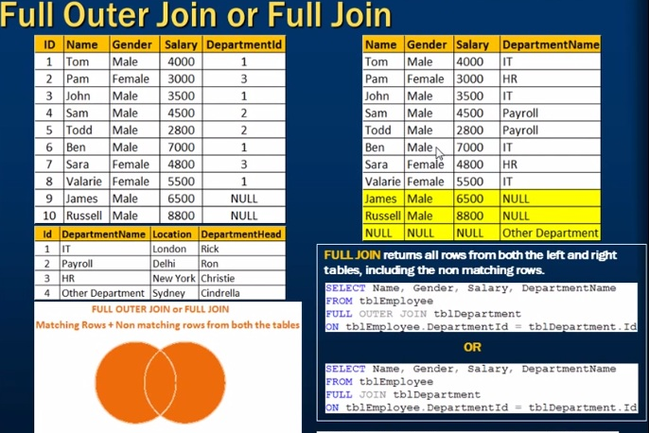

Slide 11
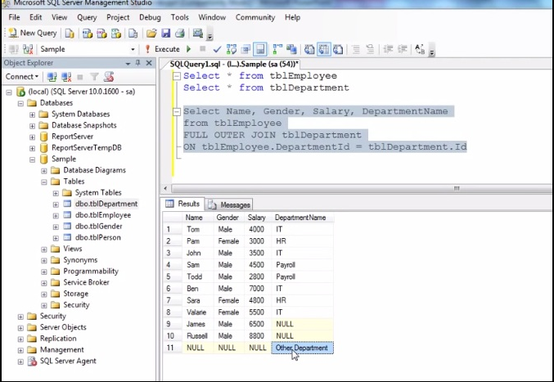

Slide 12
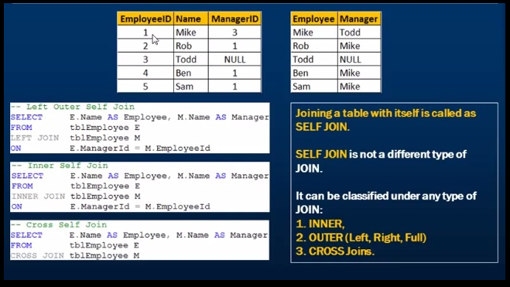

Slide 13

Employee_ID | Name | Manager_id
1 | Mike | 3
2 | Rob | 1
3 | Todd | NULL
4 | Ben | 1
5 | Sam | 1
Employee_ID | Name | Manager_id
1 | Mike | 3
2 | Rob | 1
3 | Todd | NULL
4 | Ben | 1
5 | Sam | 1
E
M

Slide 14
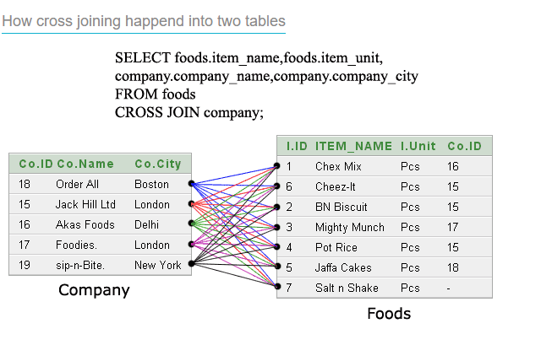

Slide 15
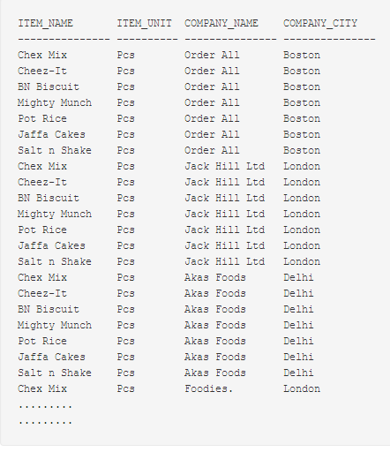

Slide 16
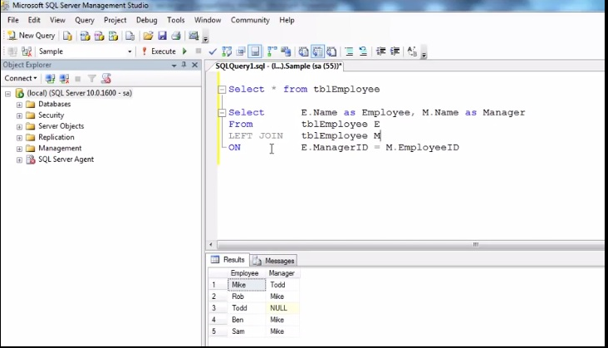

Slide 17
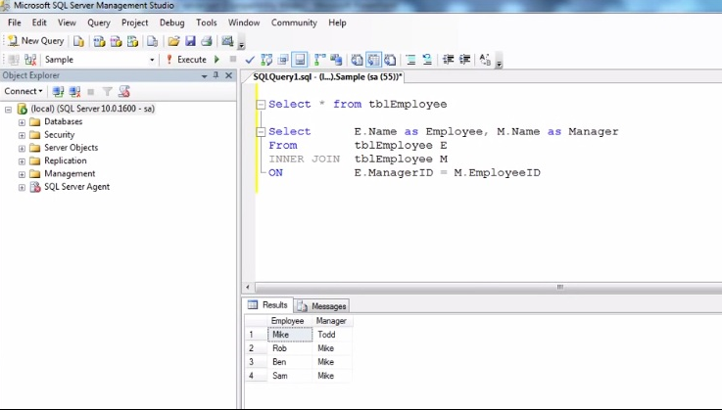

Slide 18
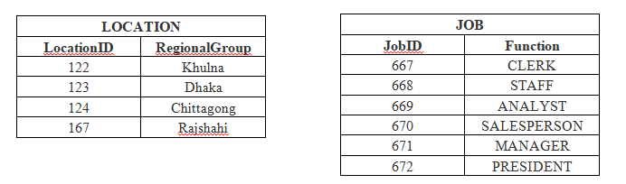
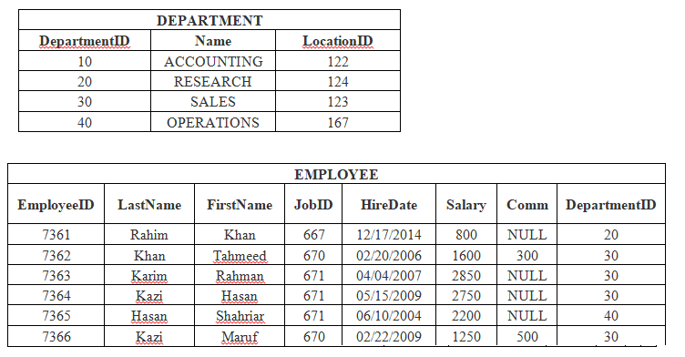

Slide 19
Join Exercise
List only the job positions in this company.
Display the employees who are working in Sales department.
Display the employees who are working in "Dhaka".
Display the employees with their department name and regional groups.
How many employees are working in different departments and display with department name.
Display the department having greater than 3 employees and display the department names in ascending order.

