Slide 1

EMAIL SPAM DETECTTION WITH NAIVE BAYES
Supervisor: Nguyen Nhat Quang Group 8:
Nguyen Thanh Long - 20180128
Ngo Viet Tung - 20184326

Slide 2
Outline
Problem Statement
Model selection
Data preparation
Training and Evaluation
Conclusion
1
2
3
4
5

Slide 3

Problem Statement
We get dozens of spam emails every day unless you use well-trained filters
These spam emails may be harmful, annoying, space-consuming, containing viruses, fishing attempts.

Slide 4
Outline
Problem Statement
Model selection
Data preparation
Training and Evaluation
Conclusion
1
2
3
4
5

Slide 5

Model selection - Naive Bayes classification
Naive Bayes classification:
This type of “classifier” assigns a probability that a new sample is in one class or another (spam or ham).
From the words in the message and the words not in the message, compute the probability of spam or ham.
It is based on Bayes rule, frequency analysis of occurrences of words and an independence assumption (the naive part).
Prior
Likelihood
Posterior
Normalizing constant
Equation for finding probability email is spam

Slide 6

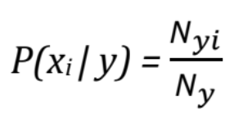
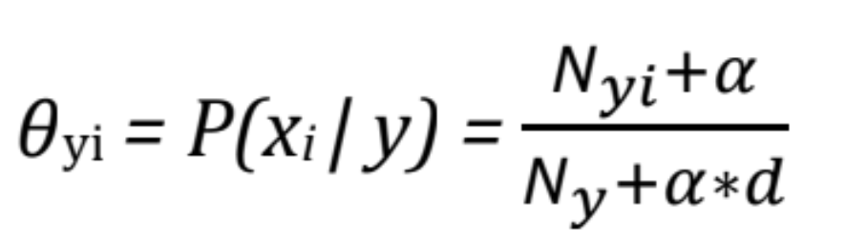

Model selection - Multinomial Naive Bayes
Multinomial Naive Bayes:
MultinomialNB is used in the text classification that features vectors calculated in Bags of Words(BoW).
At this time, each document is represented by a vector of the length d, which is the number of features (in text classification, the size of the vocabulary).
The value of the ith component in each vector is the frequency of it in that text.
With α is a positive number, usually equal to 1, to avoid the result equal to 0.
Laplace Smoothing
Conditional probabilities for MultinomialNB

Slide 7
Outline
Problem Statement
Model selection
Data preparation
Training and Evaluation
Conclusion
1
2
3
4
5

Slide 8
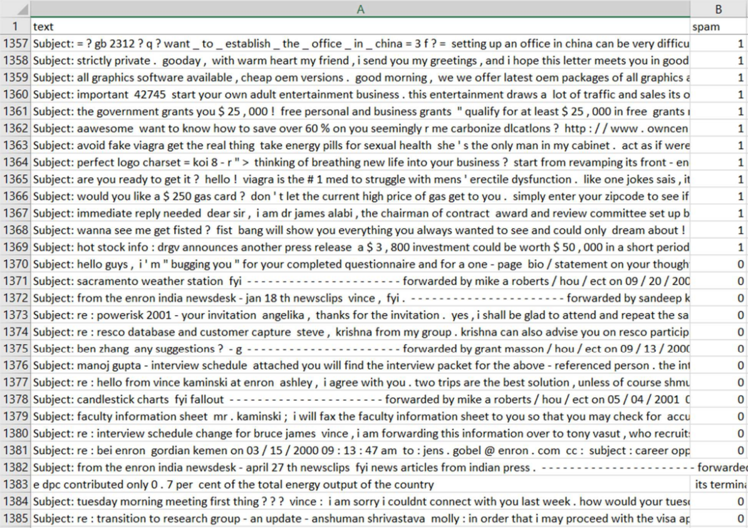
Data preparation
1. Data Description
The Email spam collection is a set of tagged messages that have been collected for Spam filter research. It contains one set of messages in English of messages, tagged according being ham (legitimate) or spam.
0 – ham
1 – spam

Slide 9
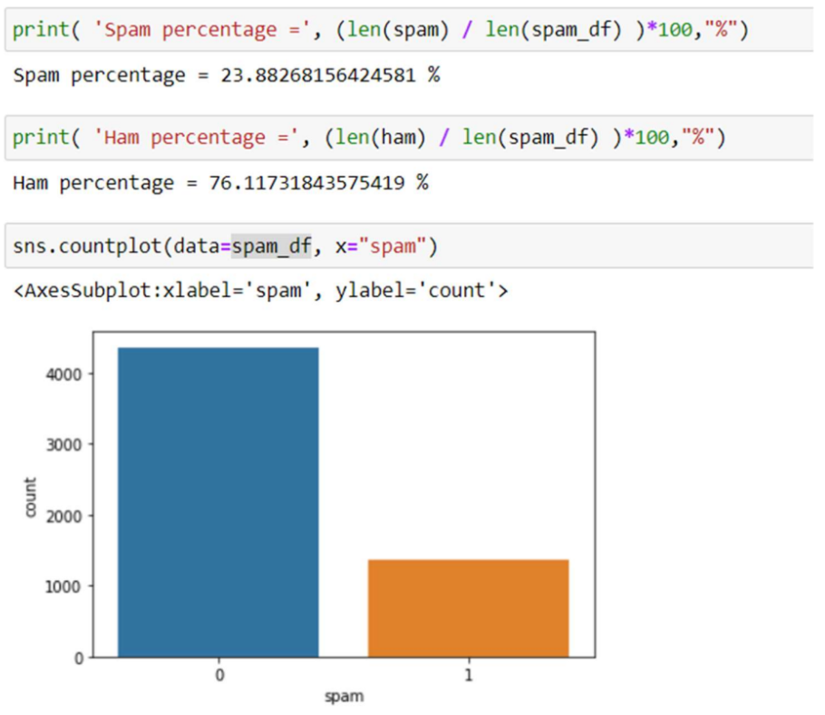
Data preparation
2. Data Exploration
The mentioned dataset contains 5728 records of different messages together with 1368 spam messages.

Slide 10
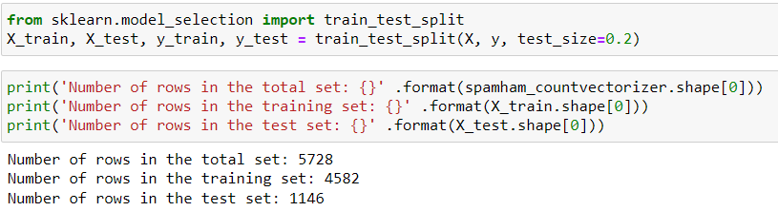
Data preparation
3. Data Preparation
Convert all text to lowercase and remove all the punctuation and stop-words
Create a vector counting the number of times each word occurs using CountVectorizer.
Splitting the dataset to training and testing set: 80% and 20%

Slide 11
Outline
Problem Statement
Model selection
Data preparation
Training and Evaluation
Conclusion
1
2
3
4
5

Slide 12
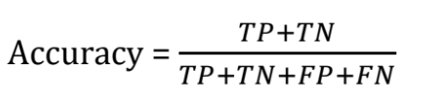
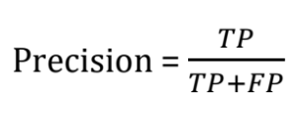
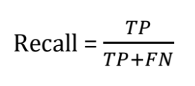
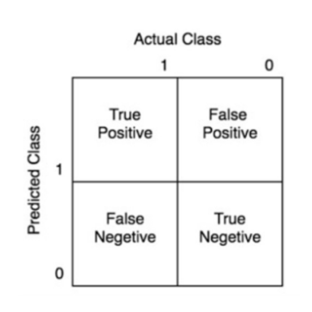

Training and Evaluation - mechanisms
Accuracy
Precision
Recall(sensitivity)
F1 – score
Support
Confusion matrix
 | Actual Positive | Actual Negative
Predicted Positive | True Positive / TP | True Negative / TN
Predicted Negative | False Positive / FP | False Negative / FN
→ how often the classifier makes the correct prediction.
→ proportion of messages we classified as spam, were spam.
→ proportion of messages that spam classified by us as spam.
→ a weighted harmonic mean of precision and recall such that the
best score is 1.0 and the worst is 0.0.
→ the number of actual occurrences of the class in the specified dataset.
This assessment is usually applied to classification problems with two layers of data to check if a prediction is positive or negative.
More specifically, in these two data layers, there is a serious layer than the other and needs to be accurately predicted. → In the problem of filtering email, giving the ham email to the spam box is more serious than determining a spam email is normal email.
Compute confusion matrix to evaluate
the accuracy of a classification.

Slide 13
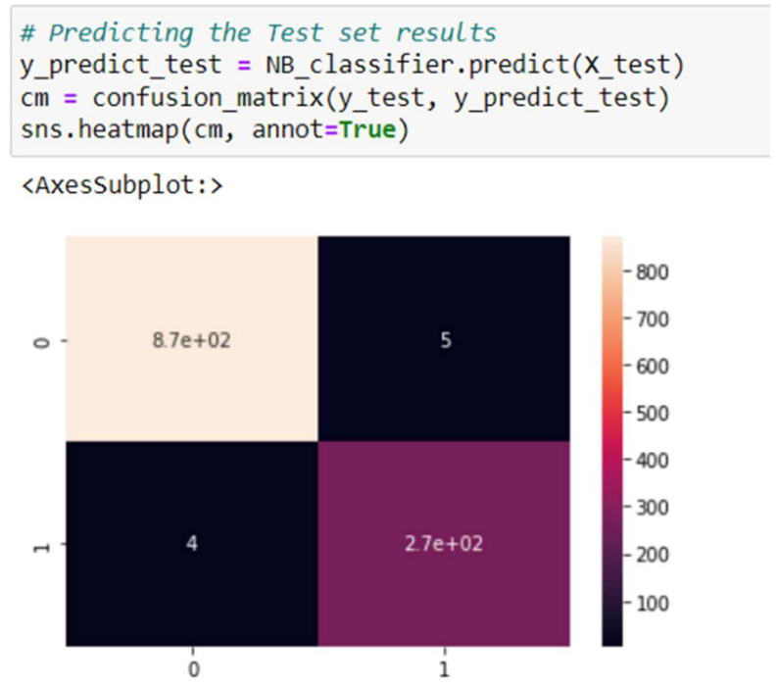

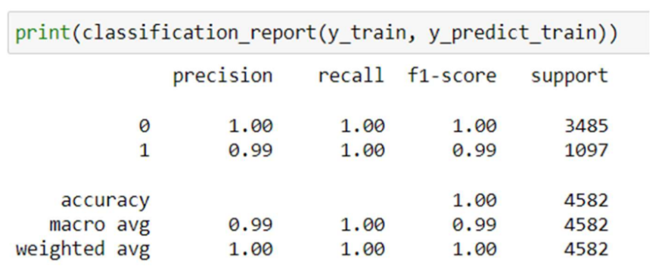
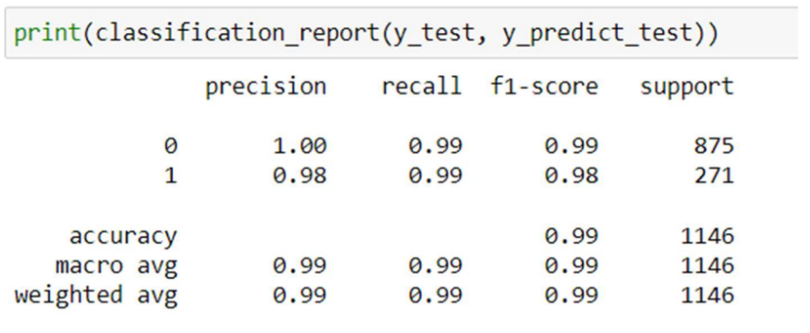
Training and Evaluation - RESULTS
After training phase:
After testing phase:

Slide 14
Outline
Problem Statement
Model selection
Data preparation
Training and Evaluation
Conclusion
1
2
3
4
5

Slide 15
Conclusion
We have used a supervised machine learning techniques Naive Bayes for email spamming filter problem.
Additionally, we can observe that MultinomialNB's classification report produced results with good accuracy, recall, and precision.
Regarding the future development direction, we need to choose some larger and more multiform of dataset, as well as implement classification algorithms in various places (Speech Recognition, Identifications of Cancer tumor cells, Drugs Classification, ...) to get more perspectives on classification application.

Slide 16
Reference
Dataset: https://www.kaggle.com/datasets/tungnv01/spam-ham-emails
medium/@kohlishivam5522/understanding-a-classification-report-for-your-machine-learning-model
Naive_Bayes-https://scikit-learn.org/stable/modules/naive_bayes.html
Naive_Bayes_Classifier-https://machinelearningcoban.com/2017/08/08/nbc/
https://scikit-learn.org/stable/modules/feature_extraction.html#the-bag-of-words-representation

Slide 17



THANK YOU FOR LISTENING

