Slide 1
SetupStore
SHOP
Group 10: Nguyễn Mạnh Tiến - 20184312
Ngô Việt Tùng - 20184326 Đỗ Quang Khải – 20184274

Slide 2
SetupStore
PAY
01
Usecase diagram
02
Architectural model
03
Integrated modular
Demo, Q&A
04

Slide 3
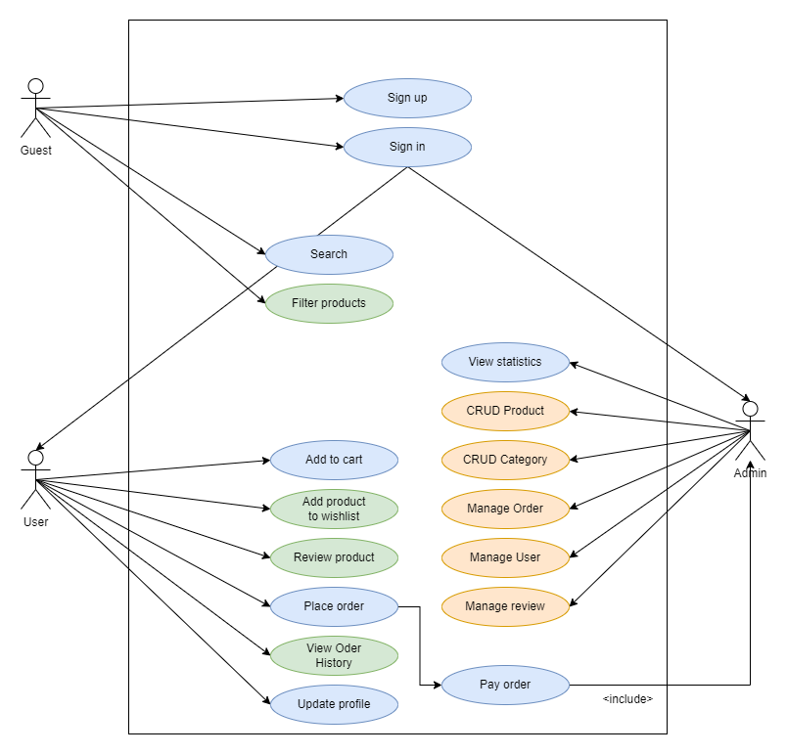
1. UseCase
Contribution:
Ngô Việt Tùng – 20184326
Signup, singin, Search, Add to cart, Place order, Update profile, View statistics.
Nguyễn Mạnh Tiến – 20184312
CRUD product, CRUD category, Manage Order, Manage User, Manage review.
Đỗ Quang Khải – 20184274
Filter products, Add product to wishlist, Review product, View order history.

Slide 4
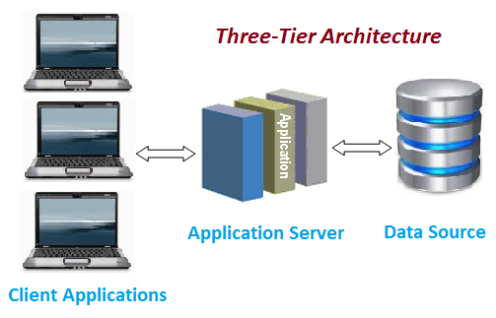
2. Architectural model
Client side: reactjs, redux tool kit
Server side: nodejs
Database: mongoDb
Server and browers communicate with each other over HTTP.

Slide 5
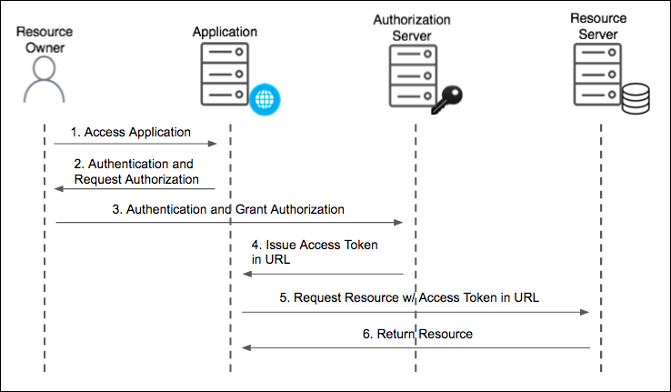
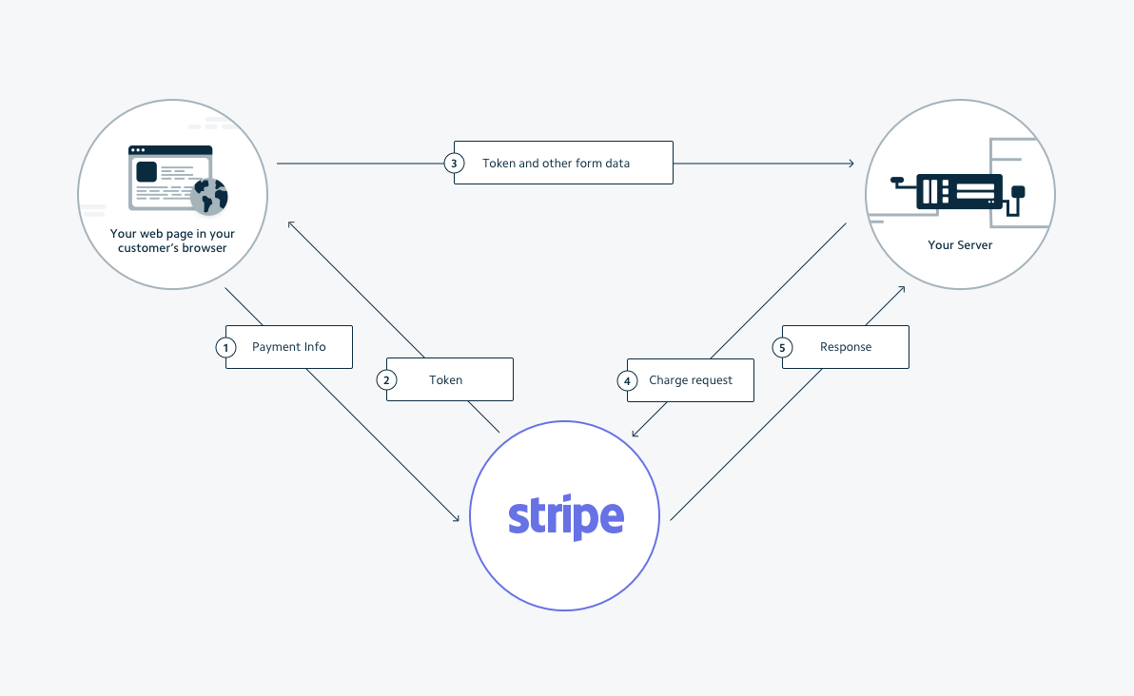
3. Integrated modular
Intergrated with Firebase authen for login/signup function
Intergrated with Stripe for payment function

Slide 6
DEMO

Slide 7


