Slide 1







IBM Data Analyst Capstone Project
Arpit Awasthi
22nd July 2024

Slide 2



OUTLINE
Executive Summary
Introduction
Methodology
Results
Visualization – Charts
Dashboard
Discussion
Findings & Implications
Conclusion
Appendix

Slide 3

EXECUTIVE SUMMARY
JavaScript, Python, HTML/CSS, SQL, and TypeScript are the most desirable programming languages for next year.
PostgreSQL, MongoDB, Redis, MySQL, and ElasticSearch are the most desirable databases for next year.
Gender gap in the IT industry.
Male = 93.7%
Female = 6.3%

Slide 4

INTRODUCTION
Stack Overflow , a popular website for developers, conducted a survey amongst developers from around the world about technology tends in 2019.
Programming Languages
Databases
Demographics
Target Audience:
IT Professionals
Anyone interested in IT field

Slide 5

METHODOLOGY
Data Sources:
Stack Overflow Developers Survey 2019
GitHub Job Posting
Programming Language and Cleaning
Data Exploration and Cleaning
Python
Data Visualization
IBM Cognos Anaytics
Presentation

Slide 6
RESULTS

Slide 7
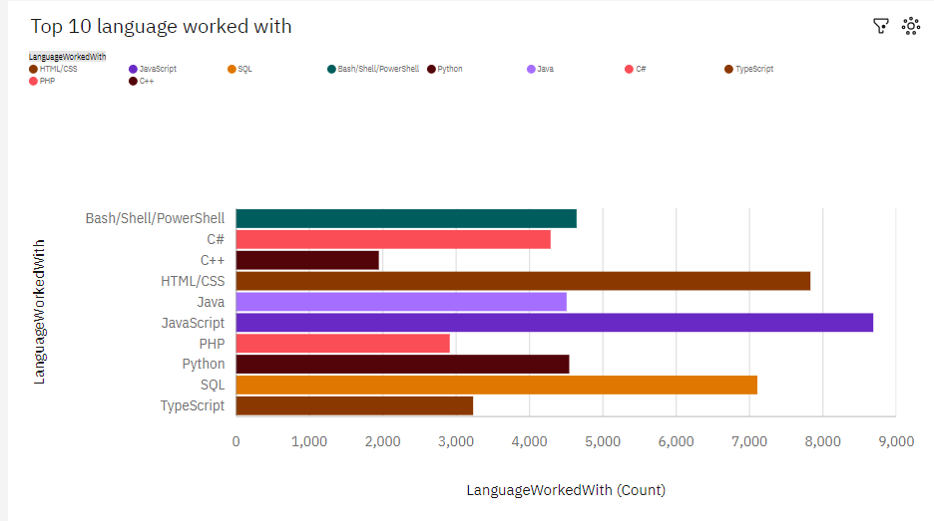
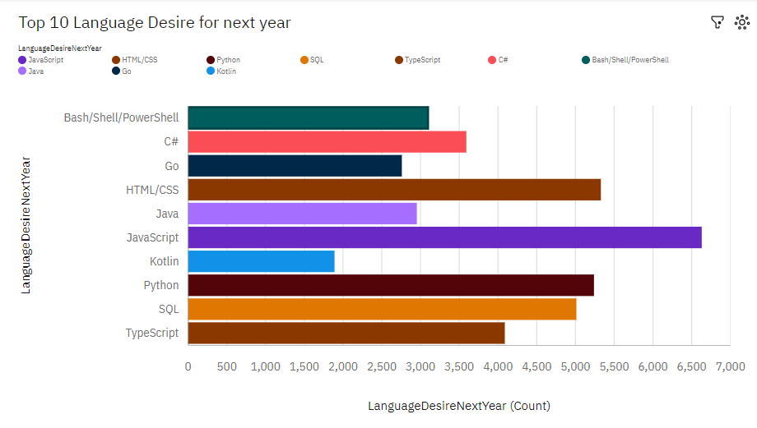
PROGRAMMING LANGUAGE TRENDS
Current Year
Next Year

Slide 8
PROGRAMMING LANGUAGE TRENDS - FINDINGS & IMPLICATIONS
Findings
JavaScript is the most in demand programming language.
Python, HTML/CSS, and SQL are other in demand programming languages.
Skills in TypeScript is more desirable than Bash/Shell/PowerShell for next year.
Implications
Python’s increase in demand may overtake JavaScript in the future.
JavaScript, Python , HTML/CSS , and SQL are consistently in demand.
Web development are in demand.

Slide 9
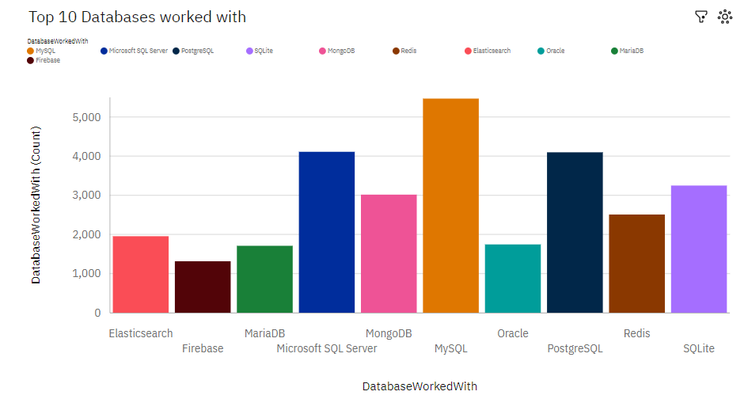
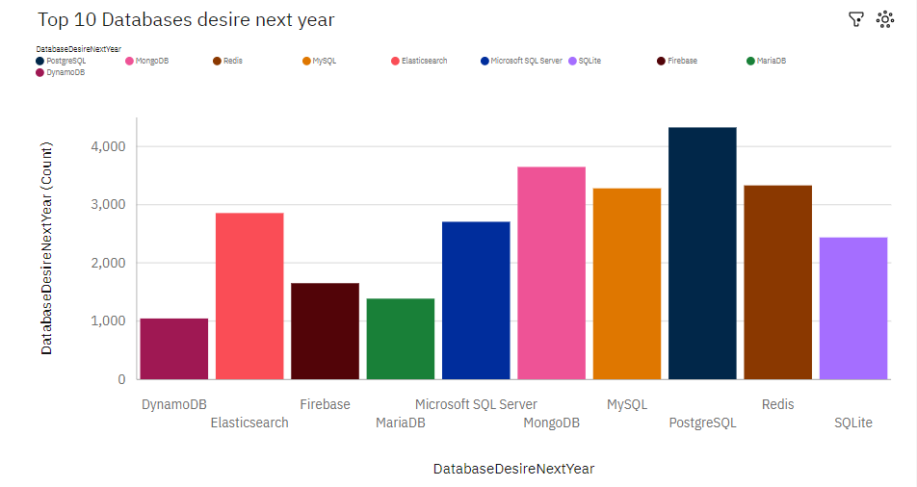
DATABASE TRENDS
Current Year
Next Year

Slide 10
DATABASE TRENDS - FINDINGS & IMPLICATIONS
Findings
PostgreSQL and MongoDB have an increase in demand.
MySQL has a decrease in demand for next year.
Skills in Redis and ElasticSearch are more desirable than Microsoft SQL Server and SQLite for next year.
Implications
PostgreSQL and MongoDB are the most consistent in demand databases.
Open source databases are preferred.
Demand is volatile.

Slide 11

DASHBOARD
<https://us3.ca.analytics.ibm.com/bi/?perspective=content&folder=.public_folders%2Fcognos%2Bdashboard>

Slide 12
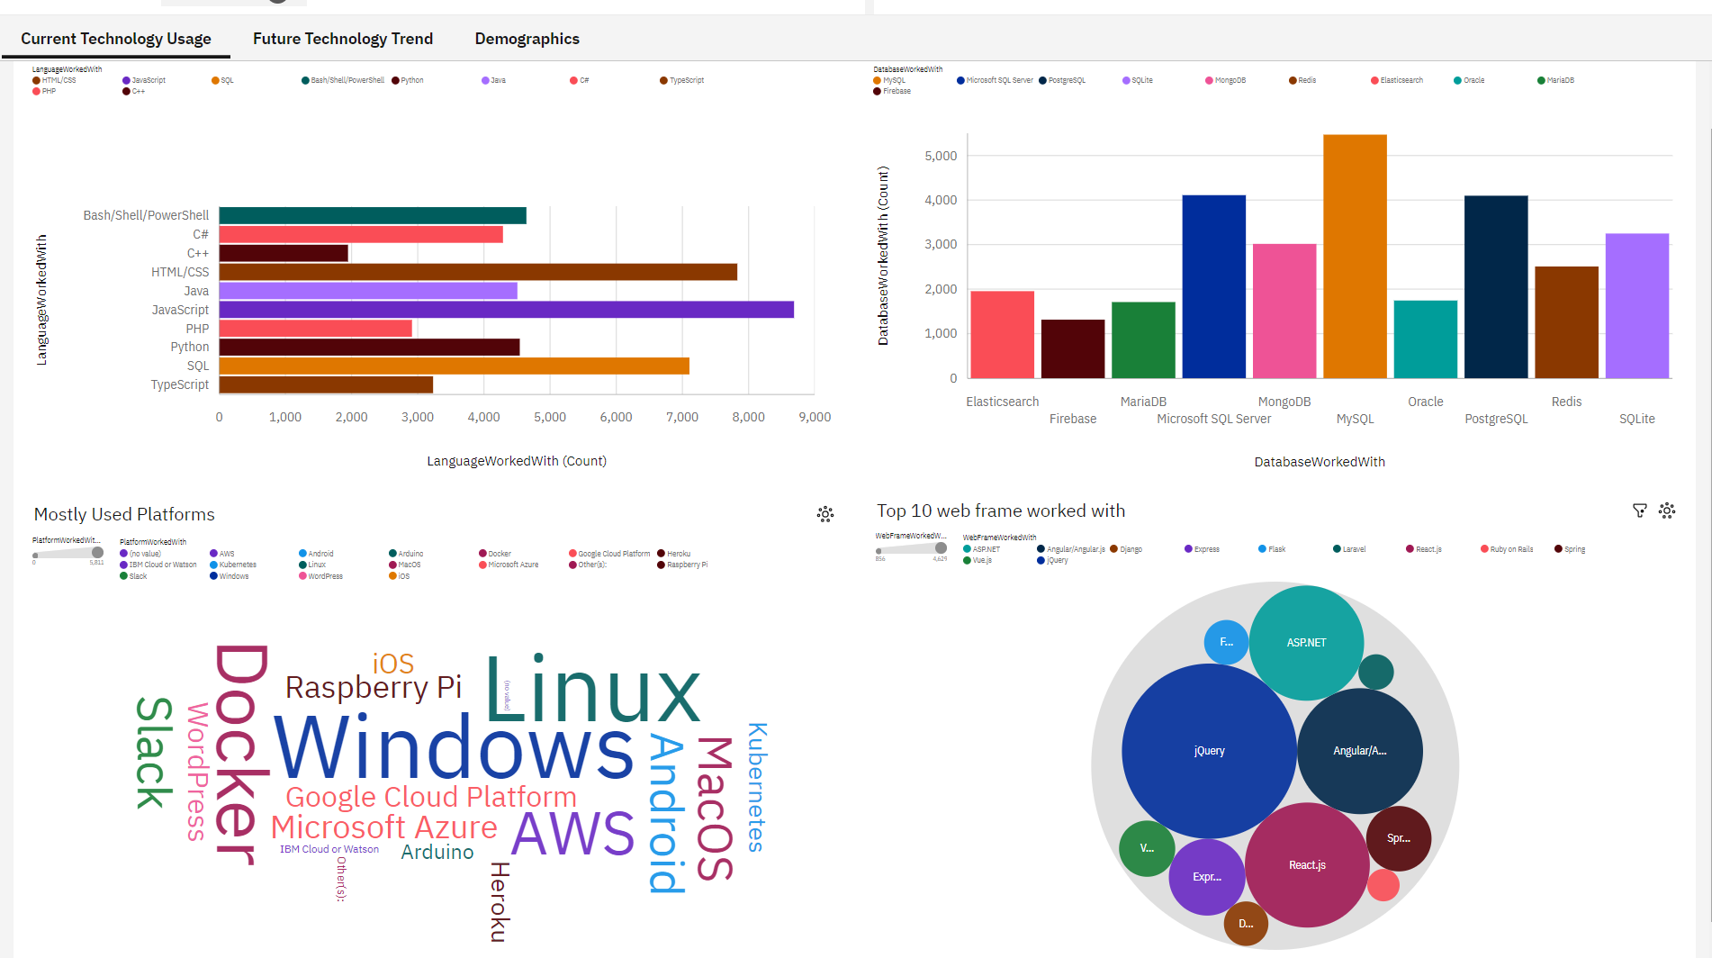
DASHBOARD TAB 1

Slide 13
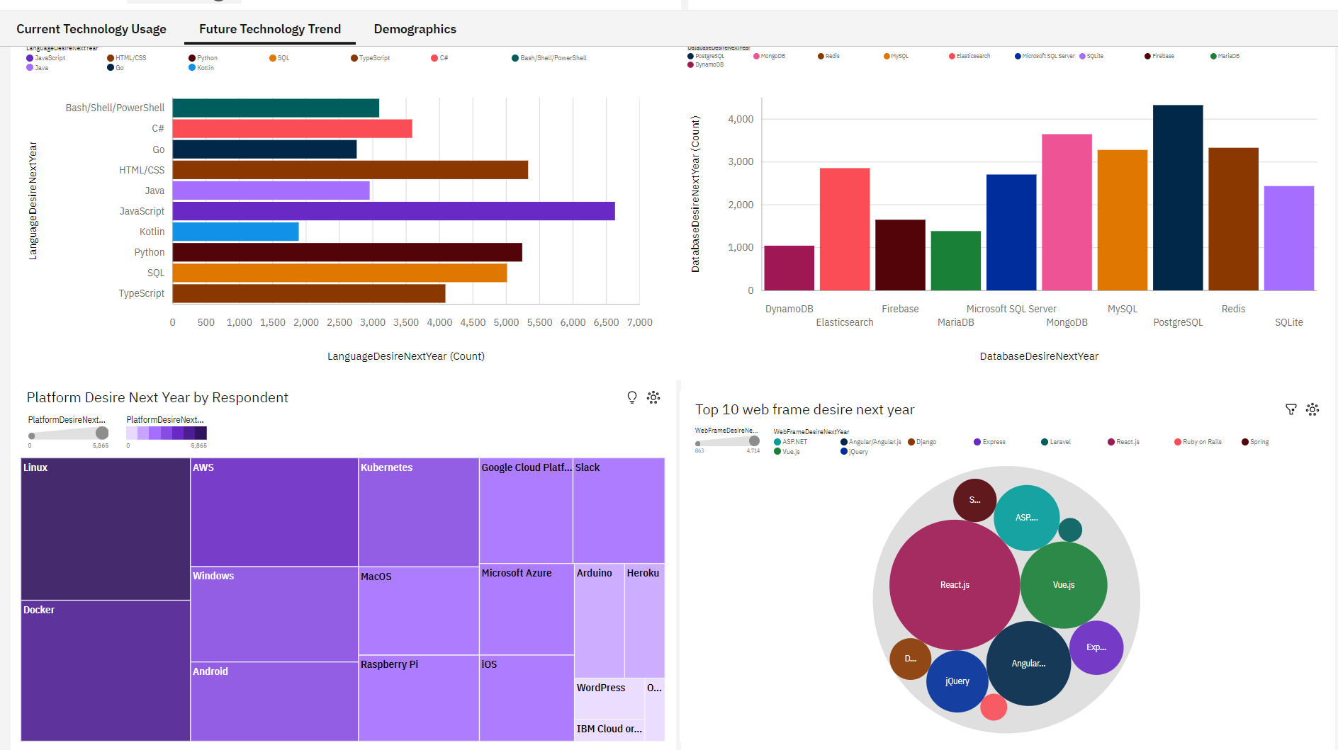
DASHBOARD TAB 2

Slide 14
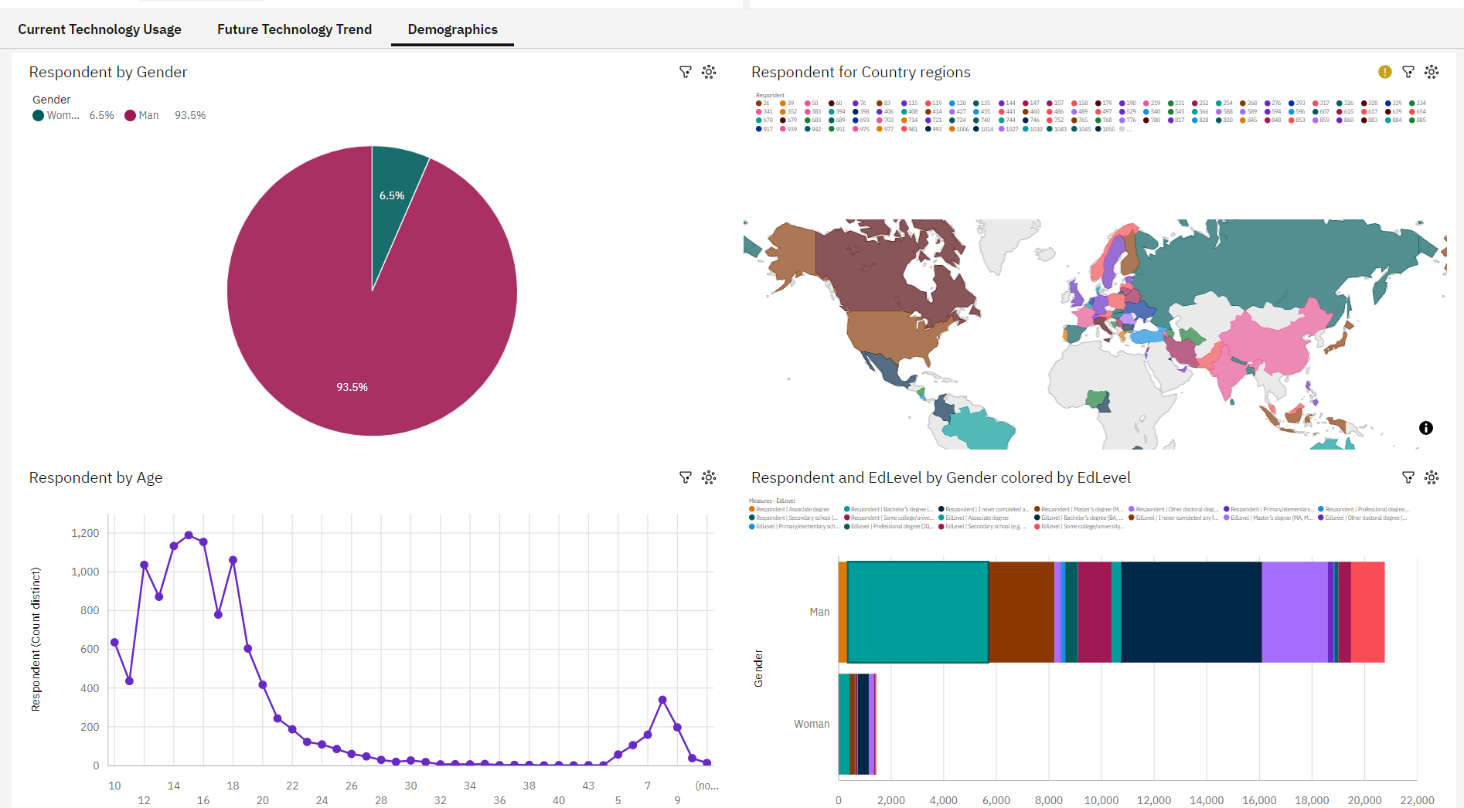
DASHBOARD TAB 3

Slide 15
DISCUSSION
New Technology constantly emerges leading to changes in demand.
The IT industry needs to diversify in order eliminate gender gap.

Slide 16
OVERALL FINDINGS & IMPLICATIONS
Findings
Trends and demands fluctuate based on news technologies.
JavaScript and Python are the most popular programming languages.
PostgreSQL is the most popular database.
Gender Gap in the IT field.
Implications
IT professionals and companies have to learn and adapt to new demand.
Having skills that are in demand leads to more job opportunities.
Gender gap will affect job hiring trend.

Slide 17

CONCLUSION
New technology leads to different trends and demands.
JavaScript and Python are the most popular programming languages.
PostgreSQL is the most popular database.
The IT industry needs to diversify.

Slide 18
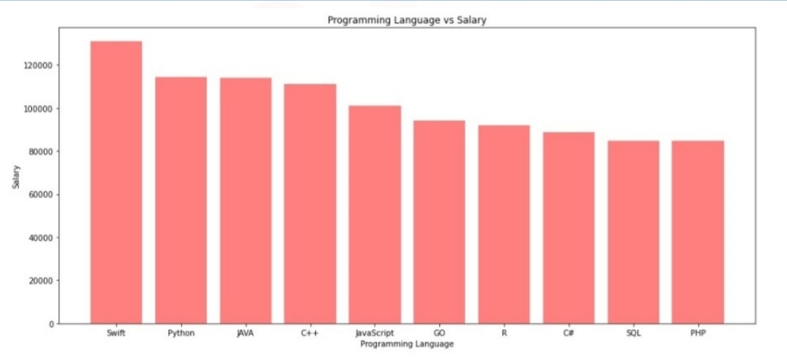
JOB POSTINGS

Slide 19
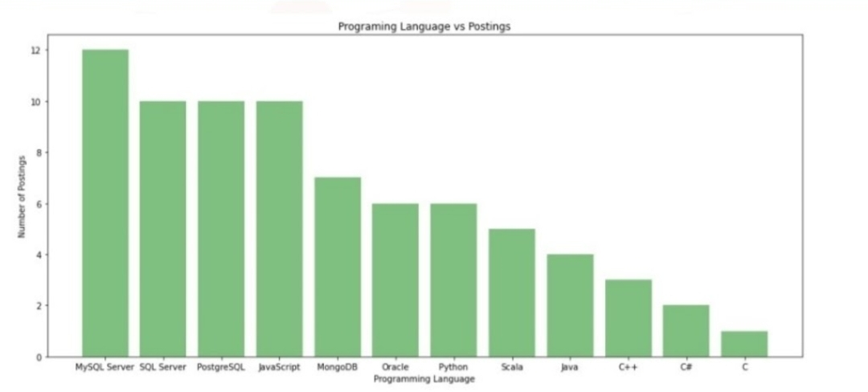
POPULAR LANGUAGES

