Slide 1
DevOps
(Development & Operations)

Slide 2
Why Devops
Traditional waterfall methodology was time consuming
Linear approach for large-scale development
Several months to integrate the new code in existing code base
Quality Assurance (QA) was hectic, as more code to test for security, vulnerabilities.
Waterfall – to – Agile

Slide 3
What is agile?
Releasing smaller chunks of features
Do not wait for complete product.
Deliver MVP always
Prevents Silos
Allow for quick changes
Focusses on people doing the work and their team
Development team prioritize what to work on
Agile is a MINDSET

Slide 4
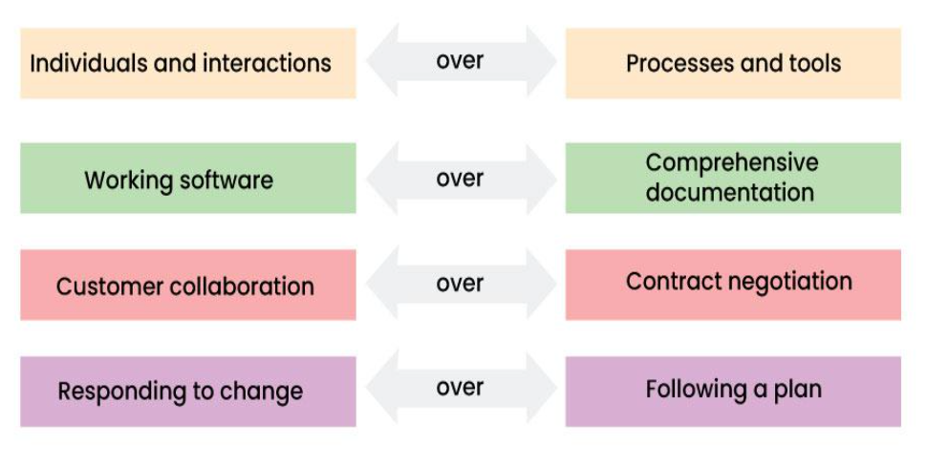
Agile Manifesto

Slide 5
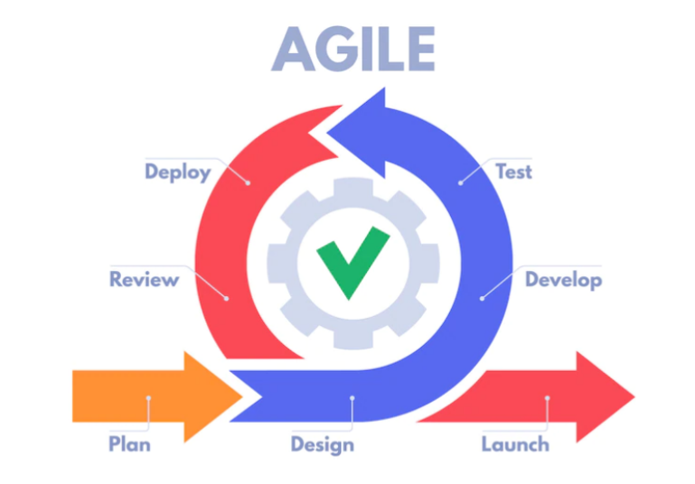
Agile Lifecycle

Slide 6
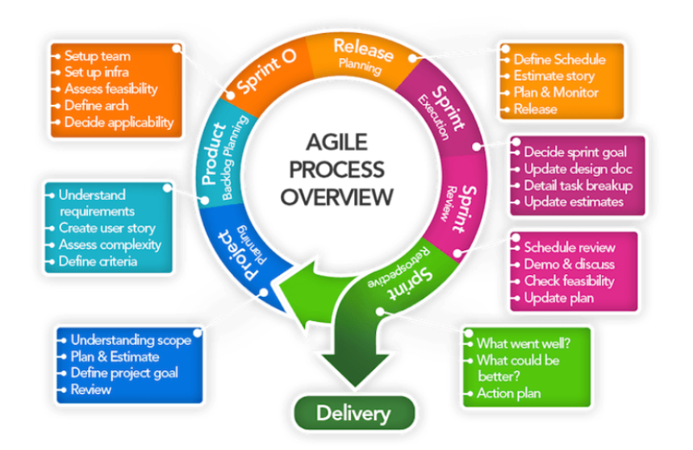
Workflow of agile iteration

Slide 7
CI/CD
Automated process that involves frequent code integration, automated testing, and continuous deployment of software changes to the production.

Slide 8
Steps in CI/CD
Code Integration
Automated Testing
Continuous Delivery
Continuous Deployment

Slide 9
Tools in DevOps
Version Control Tool: Git
Build Tool: Maven
Testing Tool: Junit, JMeter, Selenium
CI Tool: Jenkins
Deployment: Tomcat, Docker

Slide 10
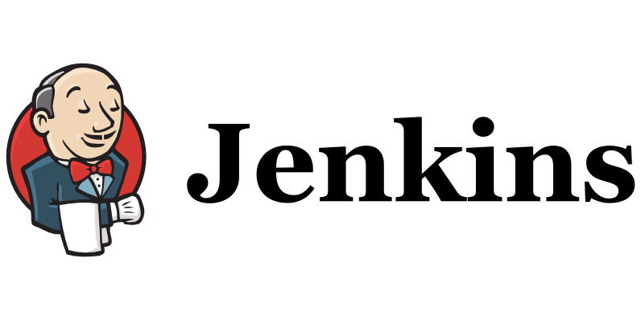
Jenkins is an open-source server that is written entirely in Java
This CI server runs in servlet containers such as Apache Tomcat.
Facilitates continuous integration and continuous delivery in software projects by automating parts related to build, test, and deployment.

Slide 11
The Architecture
Developers do the necessary modifications in the source code and commit the changes to the repository. A new version of that file will be created in the version control system that is used for maintaining the repository of source code.
The repository is continuously checked by the Jenkins CI server for any changes (either in the form of code or libraries) and changes are pulled by the server.
In the next step, we ensure that the build with the ‘pulled changes’ is going through or not. The Build server performs a build with the code and an executable is generated if the build process is successful. In case of a build failure, an automated email with a link to build logs and other build artifacts is sent to the developer.
In case of a successful build, the built application (or executable) is deployed to the test server. This step helps in realizing continuous testing where the newly built executable goes through a series of automated tests. Developers are alerted in case the changes have caused any breakage in functionality.
If there are no build, integration, and testing issues with the checked-in code, the changes and tested application are automatically deployed to the Prod/Production server.

Slide 12
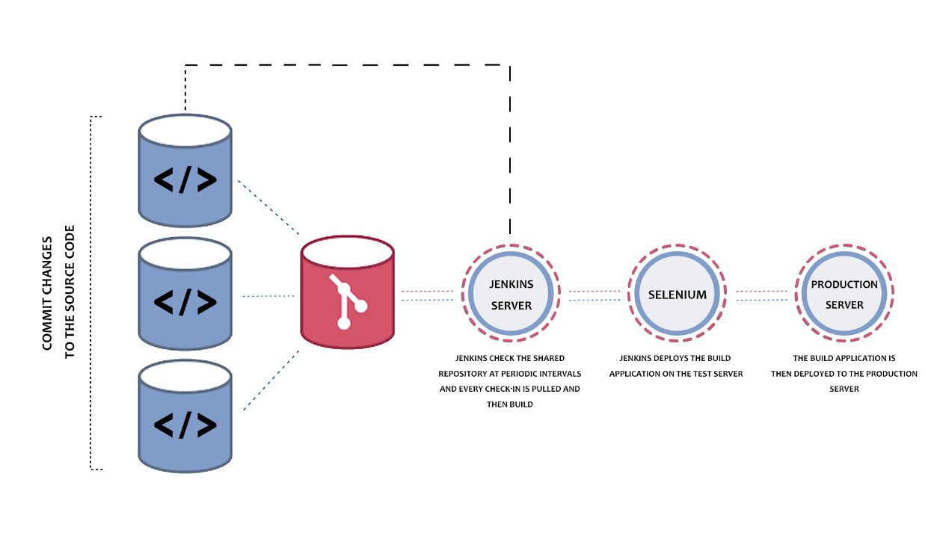

Slide 13
Installing Jenkins
Install Java17 and set the environment variable
Download the file for your OS
Install the jenkin server
Connect http://localhost:8080
Jenkins runs on default port number 8080, which can be changed from jenkins.xml

Slide 14
Types of Tasks
FreeStyle Project : General Purpose
Maven Project
Pipeline : Workflow management for software build/deploy/release
Multi-configuration project : Same job to run on different environment
Multi-branch pipeline : Use different jenkin files for different branches

Slide 15
Configuring FreeStyle : Default Workspace
Create a new Job(freestyle1) with freestyle option
In build section add the configuration for the default workspace
Hit the build and observe that the build fails (no project in the workspace)
Add the workspace folder freestyle1 and project folder in the workspace area of jenkins
C:\ProgramData\Jenkins\.jenkins\workspace
Build
Observe the console

Slide 16
Configuring FreeStyle : Custom Workspace
Create a new Job with freestyle option
Goto to general->advanced->usecustomworkspace and add the location of the existing project
In build section add the configuration
Build
Observe the console
Observe the workspace

Slide 17
Configuring FreeStyle : Periodic Building
Create a new Job with freestyle option
Goto to general->advanced->usecustomworkspace and add the location (You may choose for the default workspace option)
In build section add the configuration
In Build Periodically add the period : */1 * * * *
Make the change in the code and wait for the period
E.g. */1 * * * * is every one minute
Check with : https://crontab.guru/
Observe the build/console window
Make sure to delete the configuration once done

Slide 18
Accessing the Build remotely (Backend) - I
Go to home page of jenkins
Click on the username and selection configuration
Add token name (Token1) and click the generate token
Copy the generated text value
In the manage->configuresecurity option
Select crumb issuer
Also enable , Enable Proxy compatibility
Add the plugin : authorize project

Slide 19
Accessing the Build remotely (Backend) - II
Create new freestyle project : SG_Freestyle_workspace
Select build triggers
Copy the text of the token, copied earlier in trigger build remotely
Open postman
Use, GET and hit :http://localhost:8080/crumbIssuer/api/json
Apply the basic authorization using the jenkins credentials
Observe the output and copy the crumb value
Use, POST and hit : http://localhost:8080/job/SG_FreeStyle_workspace/build?token=token1
Use the basic authentication. (if you get 403 error remove the token in the URL and hit again)
Observe the build generated in the jenkins. (used for springboot etc)

Slide 20
Configuring Maven Project
Go to Manage Jenkins->tools
Maven configuration : default
JDK Installation : Add JDK, use install automatically from adoptium
Add powershell installations
Maven Installation : use install automatically from Apache

Slide 21
Creating maven project
Create a new item of type maven project(maven_project)
Create a maven project in the local drive
Select options
Build whenever a snapshot dependency is built
Build option: Give the root pom address: D:\jenkins demos\java-mvnproject\pom.xml
Set the goal as : compile test
Save and build the job
Observe the console output
Goto the project location and observe the target folder is created.

Slide 22
Maven project: continued
Update the goal with install as: compile test install
Post Step : Run only if build succeeds
Try to execute, which fails as default executable jar is not created
Update the pom.xml
Execute the build again, and observe that the jar file is created
Execute the jar file locally
Update the job for the post step as :
java -jar "D:\jenkins demos\java-mvnproject\target\java-mvnproject-1.0-SNAPSHOT.jar"

Slide 23
Setting up GITHub
Login to the github
Go to the repository (javarepo)
On the right corner of the repository click on the settings
Add the payload URL +/github-webhook/ (This is always same)
Generate this from ngrok
We need the static IP address in order to communicate with the GIT, which can be obtained from ngrok

Slide 24
Working with ngrok
Download the zip file of ngrok
Extract the zip file
Give the command as : ngrok http http://localhost:8080
This will generate the static IP address for all the request from 8080
Our jenkins, runs on 8080
This static IP address need to be passed in the payload URL of github.

Slide 25
Working with GIT project
Create a repo in the github (javarepo)
Create a maven project and add in the github repo
Create a new maven_project item in the jenkins
In sourcecode management, select GIT
Add Repository URL and credentials of the token created earlier
Add branches to build as */master
Select GitHub hook trigger for GITScm pooling
Add required mvn commands in the goal
Give Root pom for the project Project1/pom.xml

Slide 26
Setting up Jenkins for GIT
Go to : http://localhost:8080/manage jenkins/system
Edit Jenkins URL, paste the static IP address generated by ngrok (No github-webhook)
Select GitHub Pull Requests
Published JenkinURL : give the path of the github repo
sdf

Slide 27
Continuous Deployment
Tomcat
Docker

Slide 28
Deploying to Tomcat : Setting up tomcat (deployment)
Update the tomcat port from the file /conf/server.xml
<Connector connectionTimeout="20000" port="8083" protocol="HTTP/1.1" redirectPort="8443"/>
Update the user credential from the file /conf/tomcat-user.xml
<role rolename="manager-gui"/>
<role rolename="admin-gui"/>
<role rolename="manager-script"/>
<user password="tomcat" roles="manager-gui,admin-gui,manager-script,admin" username="tomcat"/>
Start the tomcat : access http://localhost:8083 to check the current status of deployment

Slide 29
Deploying to tomcat : Jenkins Configuration
Start the ngrok and generate the IP address for 80 (ngrok http 80)
Configure the github in the jenkins as provided in the earlier demonstration
Also configure the jenkin url as provided in the earlier demonstration
In Build environment
Add Root POM: Spring_Jenkins_WAR/pom.xml
Goal and option: clean package
In Post-Build Actions
WAR/EAR files: **/*.war
Build directly/make change and commit in the git(Auto Deploy)

Slide 30
Access the deployment
Access: localhost:8083
Go to Manager app and see the war file is deployed
Open the browser and connect to :
http://localhost:8083/war_file_name/display
(“display” is the endpoint created in the spring boot application”

Slide 31
Docker Deployment : Updating the project
Create Dockerfile in the project - Spring_Git_Jenkins_Integration:
FROM openjdk:17-jdk-alpine
COPY ./target/Spring_Git_Jenkins_Integration-0.0.1.- SNAPSHOT.jar ./myapp-1.0.0.jar
ENTRYPOINT ["java","-jar","myapp-1.0.0.jar"]

Slide 32
Docker Deployment: configuring Jenkins
Update GIT configuration
Set the Root POM
Goals and options: install
Post steps:
Execute Windows batch command
cd Spring_Git_Jenkins_Integration\target
docker build --tag=springimage:latest .
docker run -p 8081:8081 springimage:latest
Build

Slide 33
Docker Deployment : Access deployment
If run is already in the script:
http://localhost:8081/datas
In this case the docker never stops
If run is not present in the script
Open docker console
docker run -p 8081:8081 springimage:latest
http://localhost:8081/datas

Slide 34
Working with Jenkins Pipeline
Enables us to define complete application lifecycle
Provides one script to address all the steps in the complex workflow
Terms
Stage
Steps

Slide 35
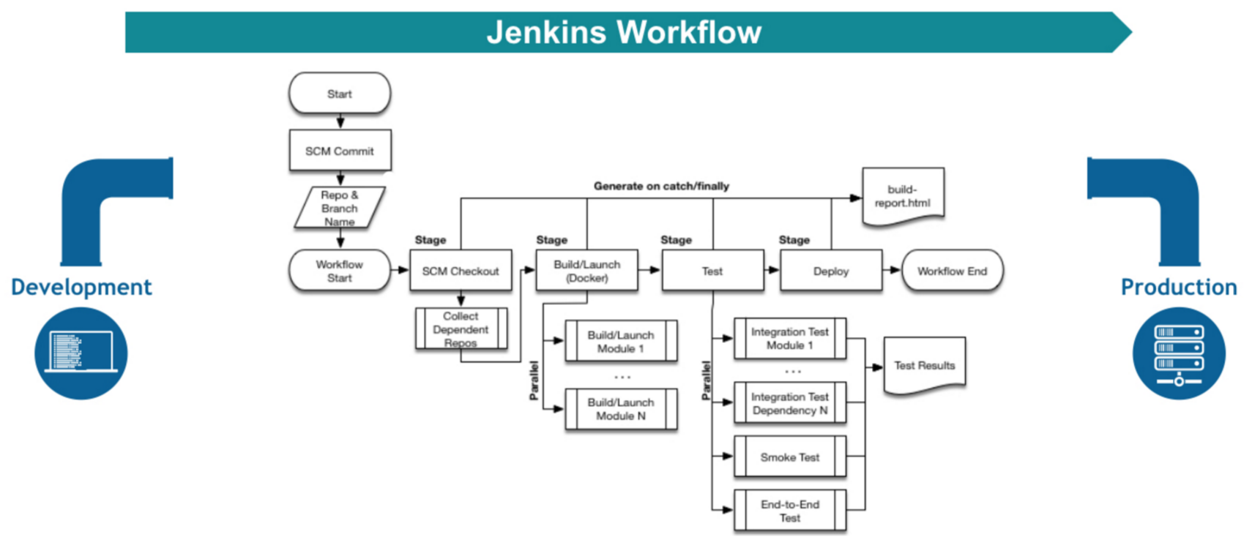
Workflow

Slide 36
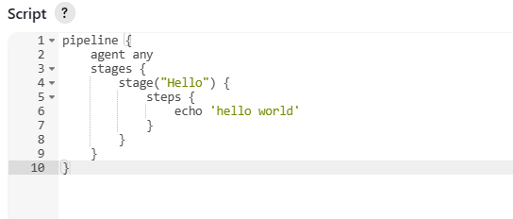
Simple Pipeline - script

Slide 37
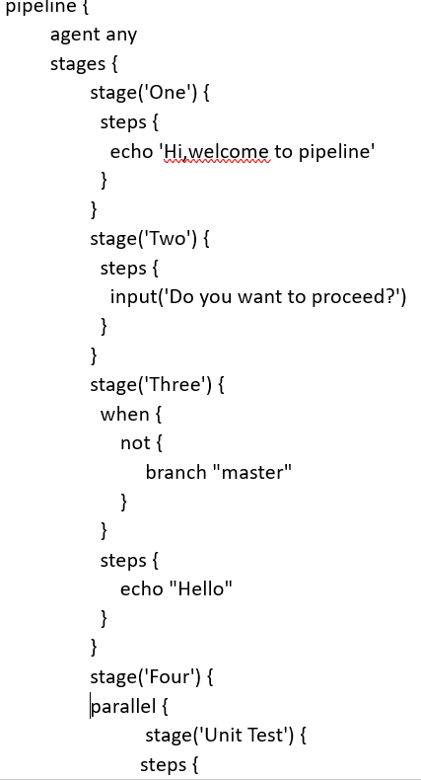
Multiple stages pipeline

Slide 38
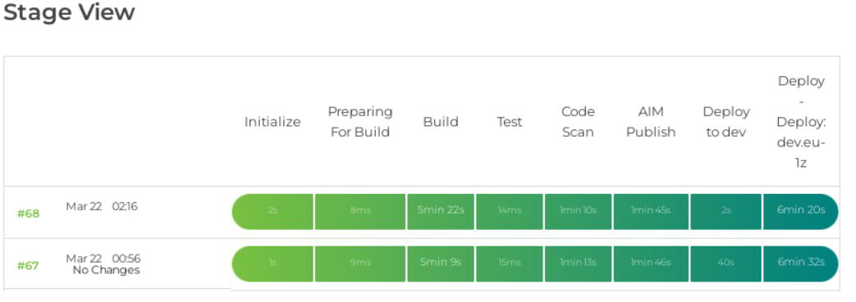
Typical Pipeline status in deplyment

Slide 39
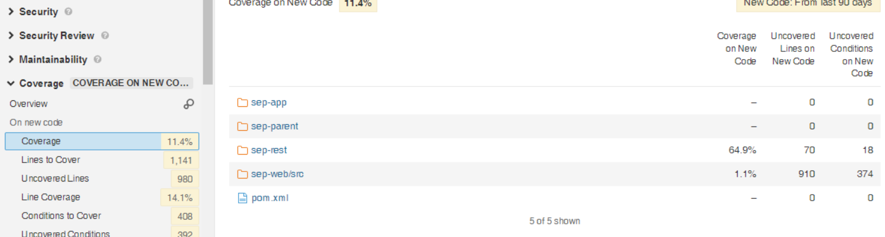

Slide 40
