Slide 1
Photo Rating Task
For this task you will see many of the same photos you saw in the tests you performed in the scanner. You will use the 1-9 keys to make your ratings.
Press [spacebar] to see the first type of rating.

Slide 2
How does the photograph make you feel?
In this part, you will use the 1-9 keys to rate how bad versus good each photo makes you feel. Given that you’ve seen each photo before, we are especially interested in how the photo made you feel the first time you saw it.
Press [spacebar] to begin.

Slide 3
Do you understand what he or she is feeling?
In this part, you will use the 1-9 keys to rate the extent to which you think you have a good understanding of what the person or animal in the photograph is feeling.
Press [spacebar] to begin.

Slide 4
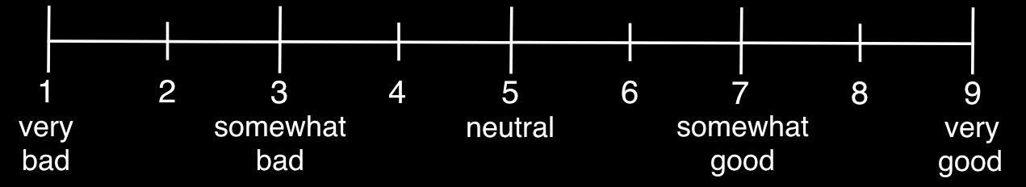
How does the photograph make you feel?

Slide 5
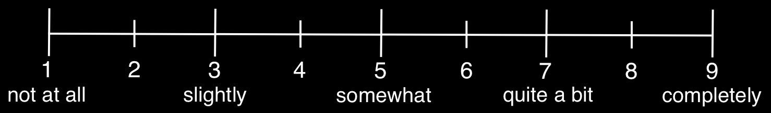
Do you understand
what he or she is feeling?

Slide 6
Can you relate to
to what he or she is feeling?

Slide 7
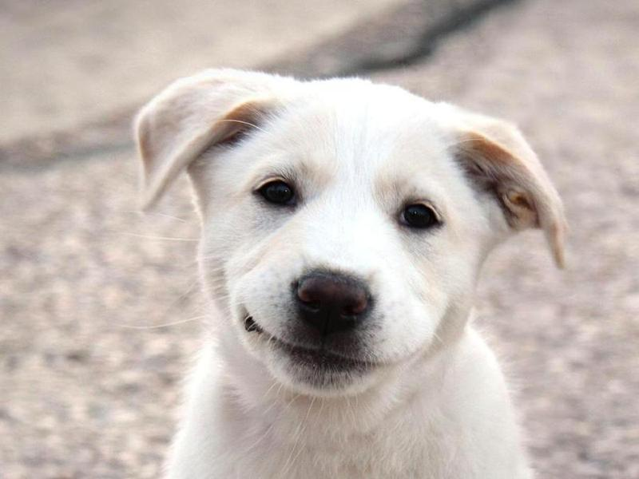
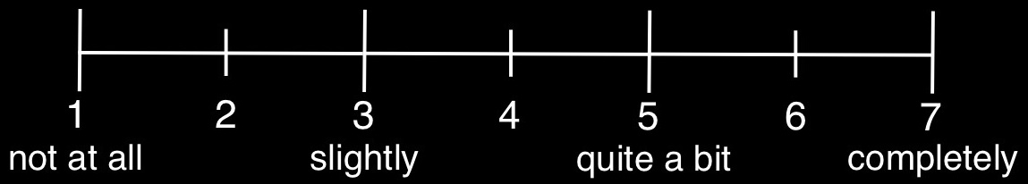
Understanding Test
For this test, you will rate photos on the extent to which you understand what the person or animal in the photograph is feeling. You will see a screen that looks like the image below.
Do you understand what this animal/person is feeling?
For each image, answer the question using the numbers 1-7 on the keyboard. The next image will appear once you have responded to the current question.
Press ‘1’ to start the test.

Slide 8
Empathizing Test
For this test, you will rate photos on the extent to which you empathize with the person or animal in the photograph. You will see a screen that looks like the image below.
Do you empathize with this animal/person?
For each image, answer the question using numbers 1-7 on the keyboard. The next image will appear once you have responded to the current question.
Press ‘1’ to start the test.

Slide 9
Understanding Test
For this test, you will rate photos on the extent to which you understand what the person or animal in the photograph is feeling. You will see a screen that looks like the image below.
Do you understand what this animal/person is feeling?
For each image, answer the question using the numbers 1-7 on the keyboard. The next image will appear once you have responded to the current question.
Press ‘1’ to start the test.

Slide 10
Empathizing Test
For this test, you will rate photos on the extent to which you empathize with the person or animal in the photograph. You will see a screen that looks like the image below.
Do you empathize with this animal/person?
For each image, answer the question using numbers 1-7 on the keyboard. The next image will appear once you have responded to the current question.
Press ‘1’ to start the test.

Slide 11
Good/Bad Test
For this test, you will rate photos on how good or bad the photograph makes you feel. You will see a screen that looks like the image below.
How good vs. bad does this photograph make you feel?
1
2
3
4
5
6
7
very bad
neutral
very good
For each image, answer the question using numbers 1-7 on the keyboard. The next image will appear once you have responded to the current question.
Press ‘1’ to start the test.

