Slide 1
1
2
3
4
5
6
7
8
9
very
bad
somewhat
bad
neutral
somewhat
good
very
good

Slide 2
1
2
3
4
5
6
7
8
9
not at all
slightly
somewhat
quite a bit
completely

Slide 3
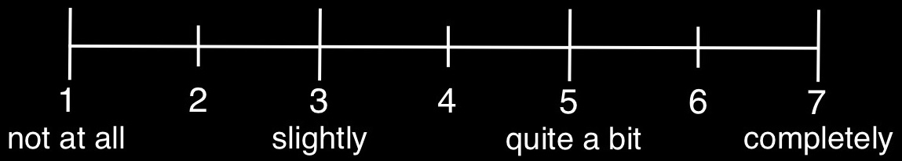
Do you understand what this animal/person is feeling?

Slide 4
Do you empathize with this person/animal?

Slide 5
How good vs. bad does this photograph make you feel?
1
2
3
4
5
6
7
very bad
neutral
very good

Slide 6
1
2
3
4
5
6
7
very bad
neutral
very good

