Slide 1
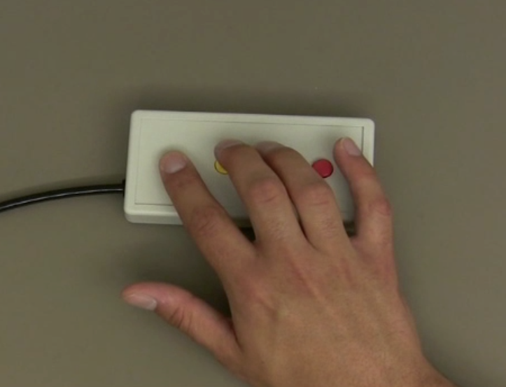
The Simon Says Task
For each trial, you will:
1
2
3
4
Watch Simon press a sequence of buttons on the button box. DO NOT move your own hand during this time.
Next, you’ll hold your entire body as still as possible. Keep your hands especially still.
Next, you’ll repeat Simon’s sequence either ONCE or TWICE on the button box
Finally, you’ll again hold your entire body as still as possible. Keep your hands especially still.
HOLD STILL
repeat ONCE
OR
repeat TWICE
HOLD STILL

Slide 2
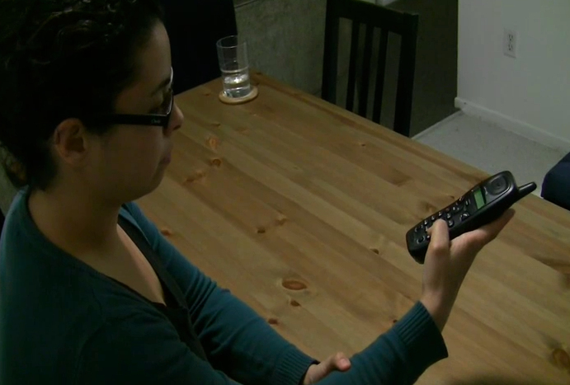
The Show and Tell Study
For each trial, you will:
1
2
3
Be told whether to answer the Why? or How? question for the trial.
Next, we will either SHOW you a behavior or TELL you about one.
Finally, there is short break between each trial with a fixation cross in the middle of the screen. Try not to think during this time and just stare at the cross.
Why is she
doing it?
+
How is she
doing it?
She is making
a phone call

Slide 3
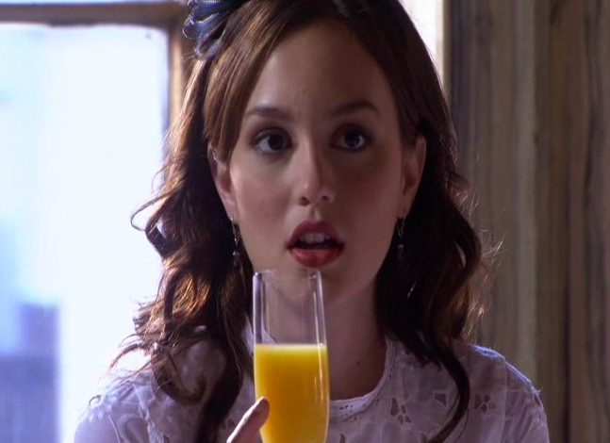
The Emotional Scenes Study
For each trial, you will:
1
2
3
Be told whether to answer the Why? or How? question for the trial.
Next, we will show you a video clip of an emotional scene.
Finally, there is short break between each trial with a fixation cross in the middle of the screen. Try not to think during this time and just stare at the cross.
Why is she
feeling it?
+
How is she
showing her
feelings?

Slide 4
The Show and Tell Study
Why trials: describe one motive for performing the action
How trials: describe one part of performing the action
Why and How trials: press #1 when you are done thinking
Match trials: choose the shape that matches

Slide 5
The Emotional Scenes Study
Why trials: describe one plausible reason the person might have for feeling the way they do
How trials: describe one part of the person’s facial expression or head movement
Why and How trials: press #1 when you are done thinking
Match trials: choose the shape that matches

