Slide 1
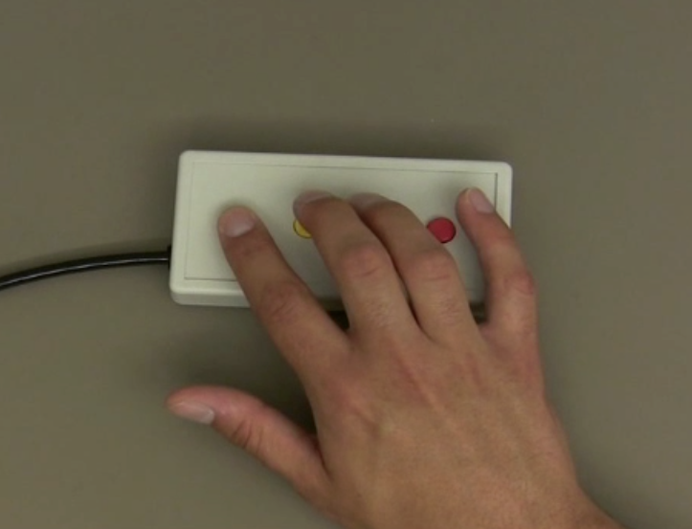
The Simon Says Task
For each trial, you will:
1
2
3
4
Watch Simon press a sequence of buttons on the button box. DO NOT move your own hand during this time.
Next, you’ll hold your entire body as still as possible. Keep your hands especially still.
Next, you’ll repeat Simon’s sequence either ONCE or TWICE on the button box
Finally, you’ll again hold your entire body as still as possible. Keep your hands especially still.
HOLD STILL
repeat ONCE
OR
repeat TWICE
HOLD STILL

