Slide 1
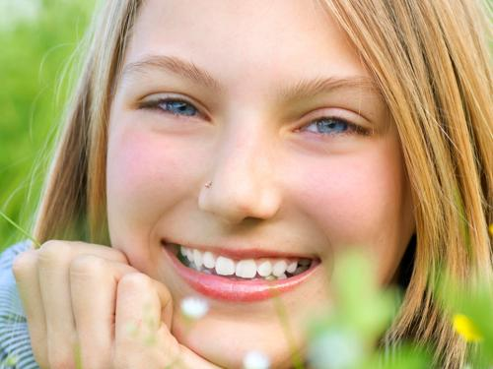
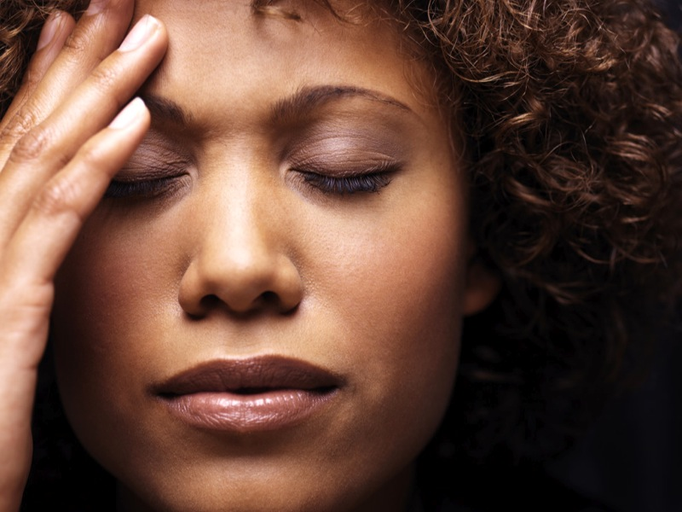
Photo Judgment Test
You will answer YES/NO questions about photos. The photos are presented in sets of 9, and for each set you will answer the same question for all photos in the set. The following shows the first two photos of an example set:
Every new set will be preceded by a crosshair like this one.
Sets will always begin with the question.
Use BUTTON 1 to answer “Yes” and BUTTON 2 to answer “No”
A reminder will appear between the photos in each set.
Use BUTTON 1 to answer “Yes” and BUTTON 2 to answer “No
+
Is the person
happy?
happy?
If you are not sure about any answer, just make your best guess. You will have a limited amount of time to respond to each photo.
Press BUTTON 1 to begin the practice

Slide 2
Photo Judgment Test
For this test, you will answer YES/NO questions about photographs. The photos will be presented in sets of 9, and for each set you will answer the same question for all photos in the set. The following shows the first two photos of an example set:
Every new set will be preceded by a crosshair like this one.
Sets will always begin with the question.
Use BUTTON 1 to answer “Yes” and BUTTON 2 to answer “No”
A reminder will appear between the photos in each set.
Respond as soon as you have your answer.
+
Is the person
happy?
happy?
You will have a limited amount of time to respond to each photo, so always just go with your first response. If you are not sure how to respond, just make your best guess.

