Slide 1

Med-Ex
For a convenient medical experience !

Slide 2
Team
Product Description
Idea Generation
CONTENTS
Business need
Competitive Advantage
Product Prototype

Slide 3



TEAM
Shruti Puranik
Elizabeth Rebello
Aditya Chebiyyam

Slide 4
PRODUCT DESCRIPTION
EXPENSE TRACKER
An easy platform to track expenses!
COMPARE MEDICAL INSURANCES
Compare and buy the best insurance!
BOOK DOCTOR APPOINTMENT
View and choose from the best doctors!
CONVENIENT PAYMENT OPTIONS
Use paypal, visa, mastercard!
Notes:
MED-EX is a convenient medical expense tracker, that allows any user to enter total medical expenses occurred which include procedural costs, insurance coverage costs, deductibles paid, amount paid by self and most importantly verifies the balance to be paid by the user.

Slide 5




IDEA GENERATION
Notes:
Independent platforms to avail services such as expense tracking (Expensify), booking doctor's appointment(ZOCDOC) & buy medical insurance (ehealth)

Slide 6
BUSINESS NEED
How do I manage all the bills?...its confusing !!
How much has the insurance paid?...
What is my share of payment?...
This is time consuming...
Notes:
Even with multiple expense tracking tools none available for medical expense tracking. Multiple bills generated from hospitals, doctor’s & insurance which are difficult & confusing to maintain. Our application will ease the trouble of the user and also save time.

Slide 7

COMPETITIVE ADVANTAGE
Features |  | eHealth
Medical Expense Tracking
Compare Insurance Plans
Book Doctors Appointment
Payments
Med-ex

Slide 8
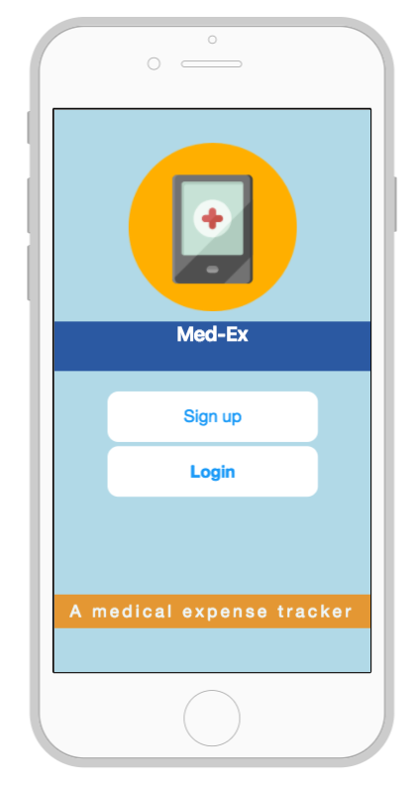
PROTOTYPE
https://pr.to/E1P7Y3/
https://elizabethrebello.proto.io/player/index.cfm?id=06f50791-6452-4bf3-9547-fb2ca9c11781

Slide 9
THANK YOU

