Slide 1
Project presentation
Natural language processing
Adrian Spurr, Dejan Mircic, Lennart Van der Goten

Slide 2
Non-learning annotator
Baseline showed promising performance
Implement a similar algorithm
For query q, candidate entities are drawn from multiple sources:
  E₁: Entities having a Wikipedia page in Bing search for q
  E₂: Entities having a Wikipedia page in Bing search for q + “wikipedia”
  E₃: Entities given by annotating top 25 snippets using TagMe annotator
  E₄: Entities having a Wikipedia page in Bing search for each of the word n-gram of q.
Let S₁ = {E₁, E₂, E₃}, S₂ = {E₁, E₂, E₃ ,E₄}, and m and e refer to a mention and entity respectively.
E = S₁ or E = S₂

Slide 3
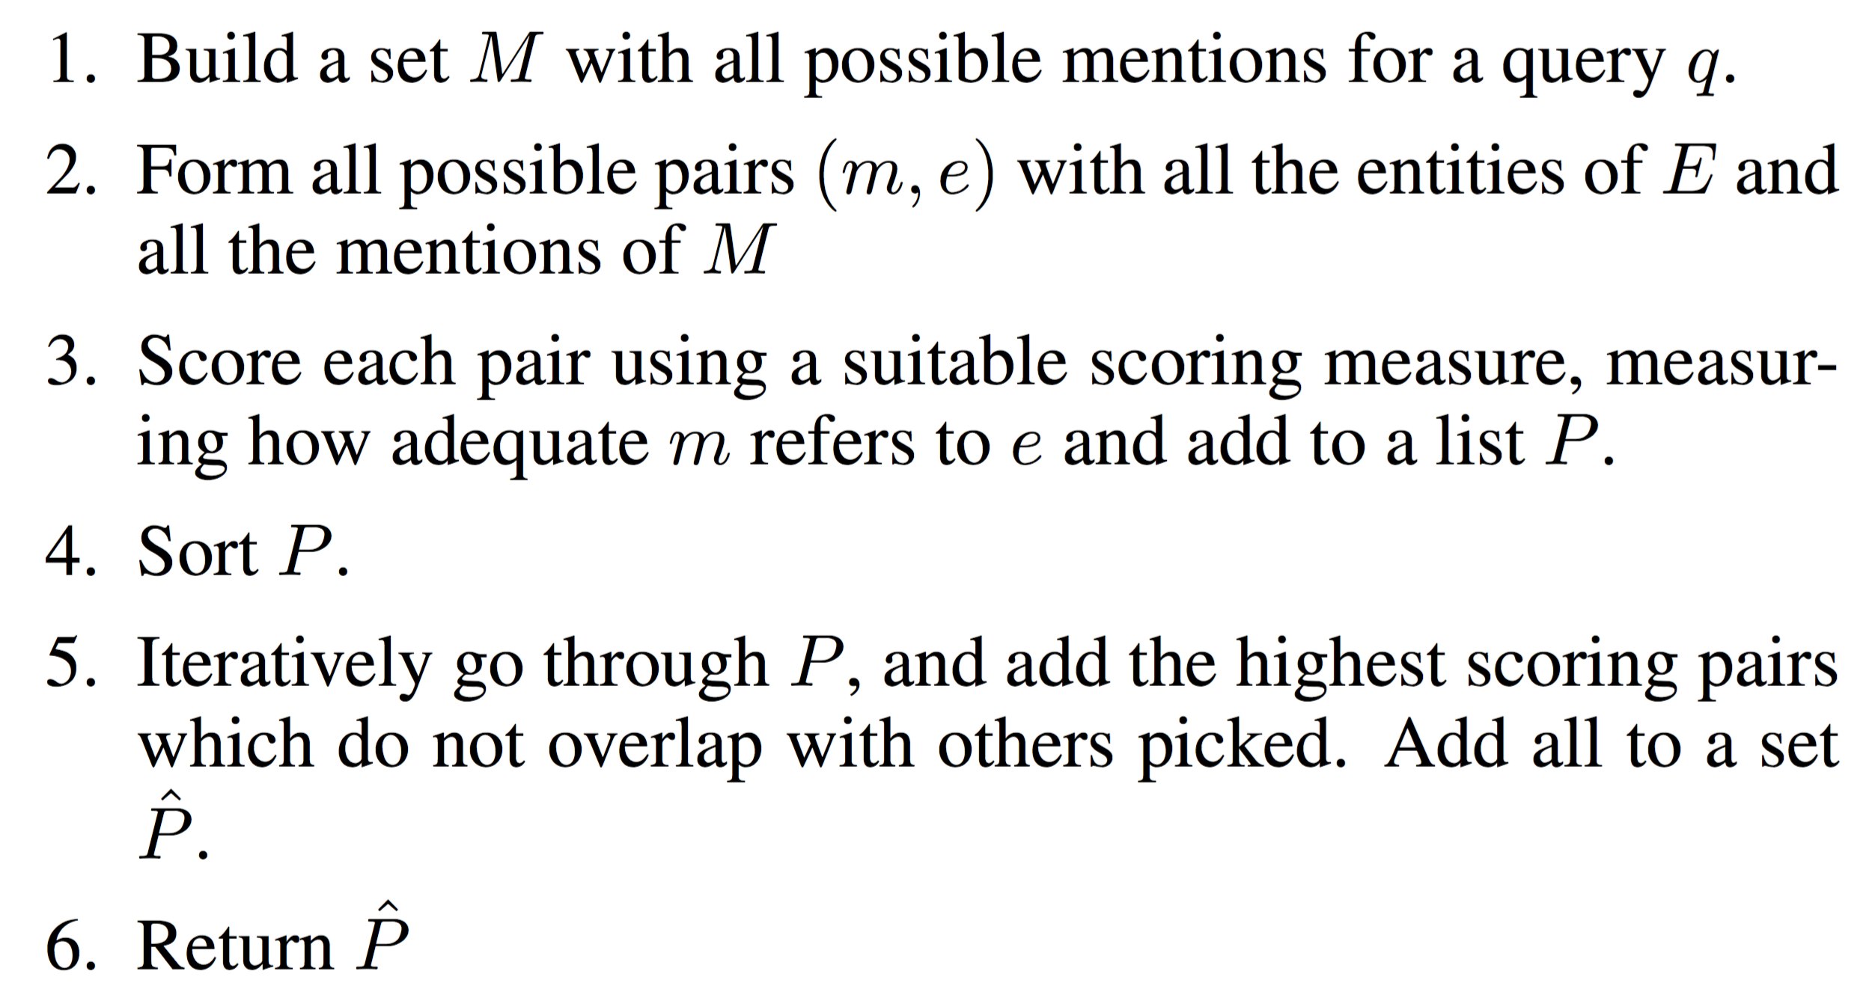
Non-learning annotator

Slide 4
Non-learning annotator
Candidate scoring measure:
  Average anchors edit distance (anchorsAvgED): weighted average edit distance between m and e.
  word2vec (w2v) cosine distance: embeds words representing similar concepts in close proximity to each other.

Slide 5
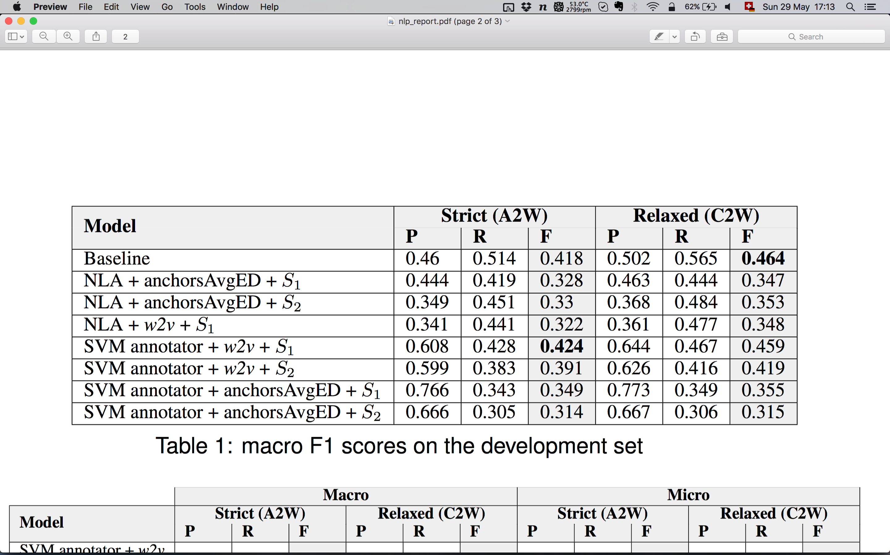
Results
Performs worse than baseline
Runs best on S₂ with anchorsAvgED

Slide 6
SVM annotator
NLA: Lower precision than recall
Idea: Use an SVM to filter the candidate entities to increase precision
Given a query q and an entity e, the SVM returns how applicable e is for q with probability estimates
Discard all entities which are under a threshold
Annotate in the same way as NLA

Slide 7
SVM annotator
Scoring candidates the same as in NLA
High number of false positives -> introduce a secondary threshold t₂ during the annotation phase
Discard all entity-mention pairs which have a lower score than t₂

Slide 8
Results
Performs better than baseline for A2W
Performs slightly worse for C2W
Runs best for w2v and S₁

Slide 9
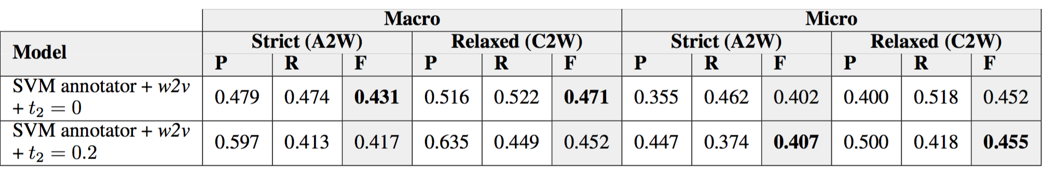
Results
Secondary threshold controls tradeoff between precision and recall

Slide 10
Thank you for your attention!
😘

