Slide 1

SHRI DHARMASTHALA MANJUNATHESHWARA COLLEGE OF ENGINEERING & TECHNOLOGY
MINI PROJECT-II
ON
PREGNANCY GUIDE ANDROID APPLICATION
Dept. Of Information Science & Engineering
Submitted by:
NAME:SPURTHI JOSHI USN:2SD16IS050
NAME:SRI GOWRI USN:2SD16IS051
NAME:ANISHA SHETTY USN:2SD16IS005
UNDER THE GUIDANCE OF
PROF.VARSHA S.J

Slide 2
INTRODUCTION
Pregnancy is a beautiful phase in a woman’s life.How many times have we not heard of miscarriages in women ! Therefore, we have come up with an application and a website which enables women to have a safe delivery.
An app that will guide pregnant women right from week one .
Includes dietary chart,exercises,list of vaccinations .
Appointment tracking

Slide 3
OBJECTIVE
The main objectives of this project work are that:
Users have access to this application on their phones.
It is easy and efficient.
This also will relieve the users from visiting the gynecologist frequently .
It helps the users to track down week-by-week progress.
Keeps the baby healthy.
An appointment reminder system is implemented.

Slide 4
METHODOLOGY
Using Android Studio
It is a software which helps in developing android applications .
It is the official IDE for android OS.

Slide 5
SOFTWARE REQUIREMENTS
Android Studio is the official integrated development environment(IDE) for Google's Android operating system, built on JetBrains' IntelliJ IDEA software and designed specifically for Android development.
Gradle -based build support
Android-specific refactoring and quick fixes
Lint tools to catch performance, usability, version compatibility and other problems

Slide 6
DESIGN
LOGIN
ENTER DATE AND LOGIN
DUE DATE.
LIST OF TRIMESTERS

Slide 7
IMPLEMENTATION
Algorithm:
Step 1: Enter username and last period date
Step 2: Click on login button
Step 3: profile appears click on Get Started button.
Step 4: Select required Trimester
Step 5: In the selected Trimester , click on Explore button of required week.
Step 6: View the Exercises ,Diet Chart ,Vaccination List
Step 7: Finally close the application.

Slide 8
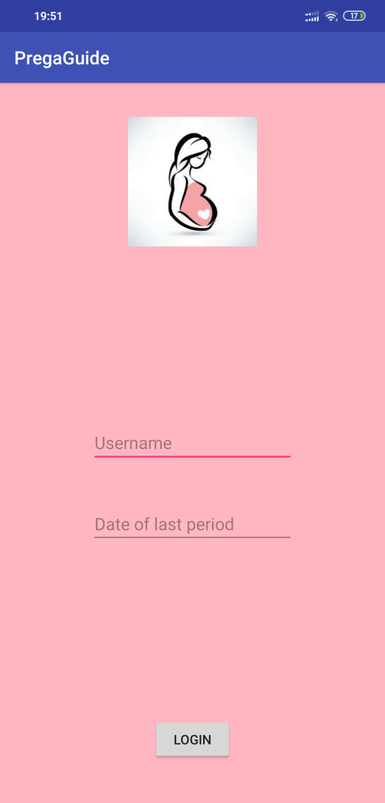
RESULT ANALYSIS

Slide 9
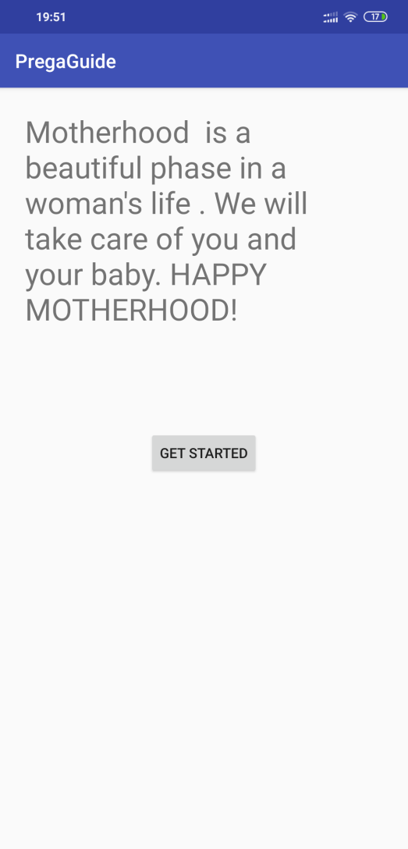

Slide 10
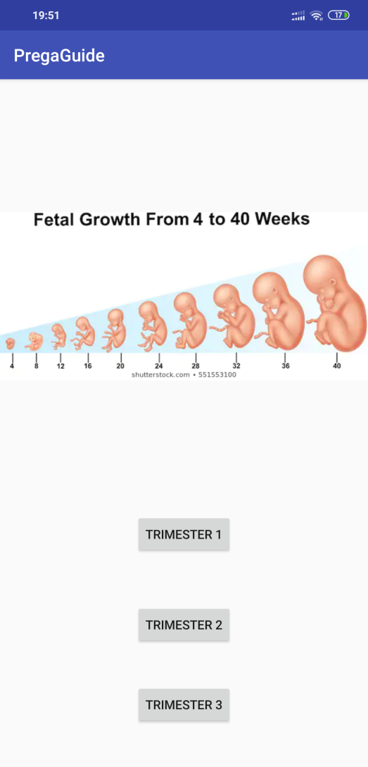

Slide 11
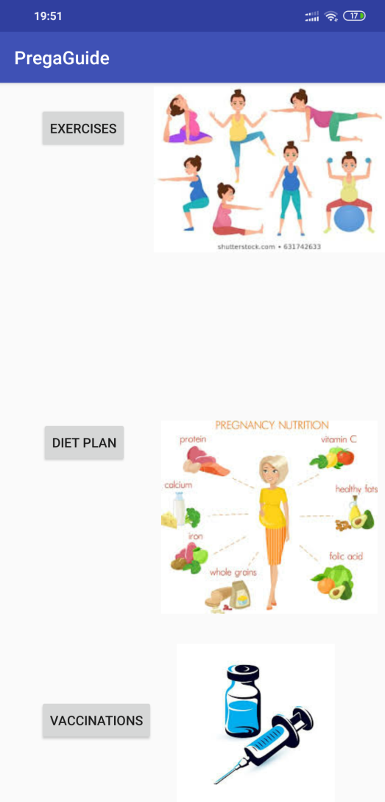

Slide 12
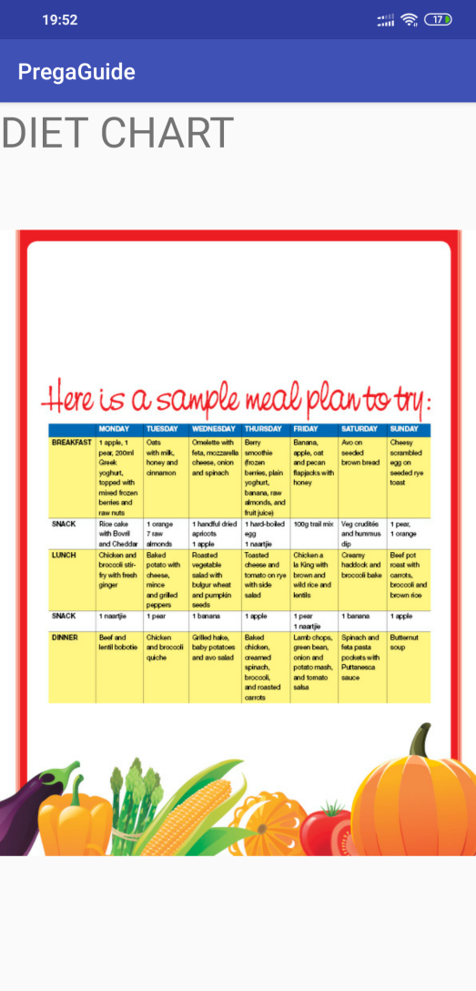

Slide 13
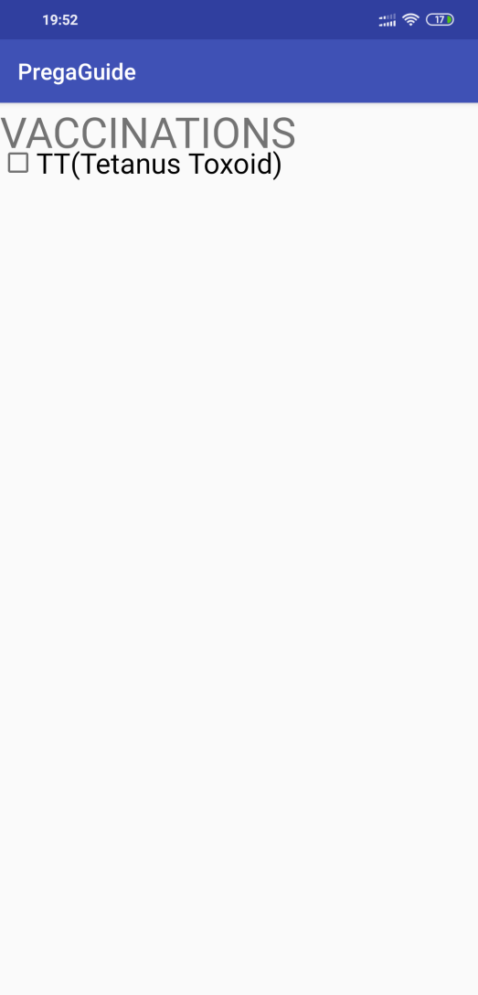

Slide 14
ADVANTAGES
A balanced healthy diet will keep the women and children properly nourished.
The list of exercises will help in maintaining good health.
Vaccination given at the right time will help the children develop immunity.

Slide 15
LIMITATIONS
Some of the limitations of the proposed system are:
The application does not give a clear idea about the development stages of the baby .
The application cannot cater to personal needs. It is rather generic. The details of users cannot be stored.

Slide 16
FUTURE SCOPE
The hospitals could collaborate and more informative user interface can be built.
An online forum for the doctors to interact with the users can be made.
Doctors can prescribe medicines online which will save time .

Slide 17
THANK YOU.

