Slide 1

IBM Disaster Recovery
The IBM Disaster Recovery project aims to ensure business continuity during unforeseen events by implementing a comprehensive plan using IBM Cloud Virtual Servers. This includes backup strategies, replication, testing, and minimal downtime.

Slide 2


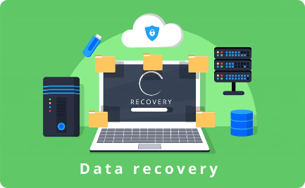
The Importance of Disaster Recovery
Protect Your Business
Ensure Business Continuity
Secure Data Backup
Implementing a robust disaster recovery plan is essential to safeguard your business against data loss, downtime, and potential financial risks.
By preparing for unexpected events, you can minimize disruptions and maintain seamless operations, ensuring your business continues to thrive.
Proper backup strategies and replication mechanisms provide reliable and secure data recovery options, protecting your valuable information.

Slide 3
The IBM Cloud Advantage
Scalability
Flexibility
Reliability
With IBM Cloud Virtual Servers, you can easily scale your infrastructure to accommodate changing disaster recovery needs.
IBM Cloud offers a wide range of services, allowing you to tailor your disaster recovery plan to your specific requirements.
IBM's powerful infrastructure and global network ensure reliable and consistent performance for your disaster recovery solution.

Slide 4

Building a Resilient Plan
1
Assess Risks and Prioritize
2
Define Recovery Objectives
Identify potential risks and prioritize critical systems to ensure effective allocation of resources for optimal recovery.
Establish clear recovery objectives regarding maximum allowable downtime and data loss to guide the development of your plan.
3
Implement Redundancy
Leverage IBM Cloud's redundancy capabilities to create backup systems and mirror critical data to minimize the impact of disruptions.

Slide 5
Testing and Validation
1
Test your Plan
Thoroughly validate your disaster recovery plan by simulating different scenarios to ensure it will effectively restore operations.
Regular Updates
2
Continuously evaluate and update your plan to address emerging threats, technological advancements, and changing business needs.
3
User Acceptance Testing
Engage stakeholders and end-users in the testing and validation process to ensure the plan meets their expectations and requirements.

Slide 6



Ensuring Continuous Improvement
Data Analysis
Proactive Monitoring
Cross-Functional Collaboration
Leverage data analytics to identify potential vulnerabilities and areas for improvement in your disaster recovery strategy.
Implement robust monitoring systems to detect and address issues proactively, minimizing the impact of potential disruptions.
Facilitate collaboration among various teams, including IT, security, and business stakeholders, to continuously enhance your disaster recovery capabilities.

Slide 7
IBM Support and Expertise
Dedicated Support
Technical Expertise
Continuous Training
Benefit from IBM's dedicated support team, available 24/7, to assist you in implementing and maintaining your disaster recovery plan.
Tap into IBM's vast pool of technical experts and industry leaders who can provide guidance and best practices for your specific needs.
Stay up-to-date with the latest advancements in disaster recovery by accessing IBM's training resources and educational programs.

Slide 8

Conclusion
IBM Disaster Recovery, powered by IBM Cloud Virtual Servers, offers a comprehensive solution to protect your business, ensure continuity, and provide peace of mind in the face of unforeseen events. With robust strategies, reliable infrastructure, and continuous support, you can confidently navigate any potential disruptions.

