Slide 1
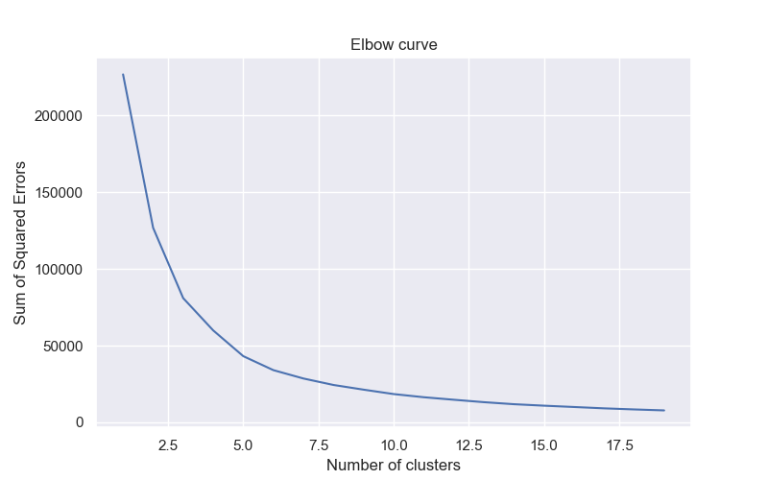
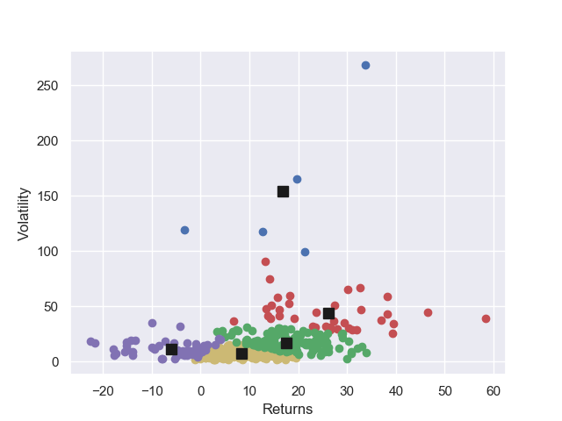
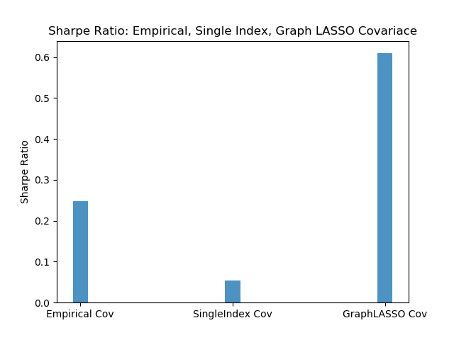
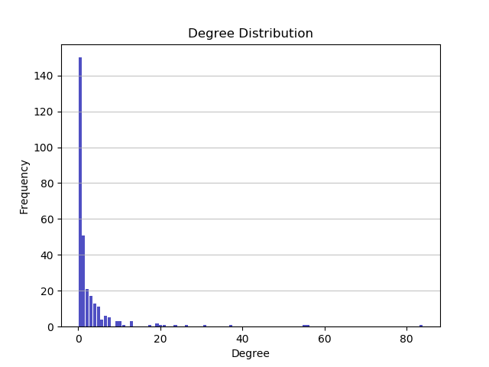
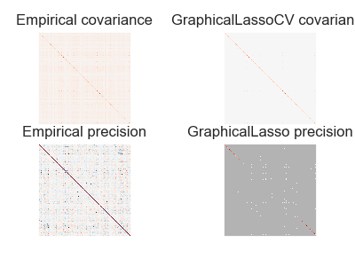
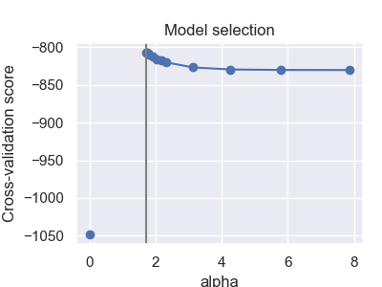
Estimating Network Connectedness among S&P Stocks using Machine Learning Techniques
Pushpak Sarkar
University of Washington, Department of Economics
Objective
Clustering: kmeans
Application: Portfolio Optimization
Objective
Typical financial assets are correlated with each other. But the degree of the correlation varies. This correlation structure acts as an important input for the construction of an optimal portfolio.
When we are dealing with N financial assets, we need to estimate in total N(N-1)/2 parameters in the correlation/covariance matrix. For large N, this can be a substantial computational requirement. Different machine learning techniques (supervised / unsupervised along with regularization) can be beneficial.
To estimate the network connectedness and correlation structure, following techniques have been used – 1) LASSO regreesion, 2) Correlated graphical LASSO, 3) Kmeans clustering
Unsupervised learning
Features – returns and volatility of 443 firms
Number of clusters - 5
To evaluate the results, an optimal portfolio based on the empirical covariance matrix S is also computed.
Use optimal weights estimated from the training set to compute the Sharpe Ratio (SR) = Portfolio return/Portfolio standard deviation
or risk adjusted return.
The Sharpe Ratio of the portfolio constructed from the sparse inverse (using GLASSO) covariance matrix is almost six-times higher than that from the portfolio based on empirical covariance matrix.
Single Index Model
The return of an asset i is a function of the market return.
Model: r_{i,t} = α_{i} + βi r_{M,t} + ε_{i}
Estimate the model and get residuals.
Estimate the covariance matrix from residuals
Sectors | Maximum % of firms in a single cluster | Maximum % of firms in two clusters
Communication Services | 33% | 61%
Consumer Discretionary | 48% | 72%
Consumer Staples | 72% | 97%
Energy | 67% | 93%
Financials | 57% | 97%
Health Care | 38% | 73%
Industrials | 42% | 81%
Information Technology | 52% | 87%
Materials | 43% | 71%
Real Estate | 41% | 72%
Utilities | 78% | 93%
Data
Returns data of stocks in the S&P 500 Index
Data source: www.kaggle.com
Frequency: Daily Span: 2013-2018
Number of stocks: 443 No. of trading days: 1258
Volatility of each stock is estimated using GARCH (1, 1)
LASSO Regression
Graphical LASSO
Model – Firm i’s current return is a function of the lagged returns of all firms -
r_{i,t} = β_{i, 1} r_{1,t-1} + β_{i, 2} r_{2,t-1} + … + β_{i, i} r_{i,t-1} + … + β_{i, j} r_{j,t-1}+ … + β_{i, N} r_{N,t-1}
Train and test set (1000 and 258 observations)
L1 regularization, cross validation k = 5
Coefficient matrix – 443 X 443 (Sparse)
Adjacency matrix A_{i,j}: a_{i,j} = 1 if β_{i, j}≠ 0 i.e. there is an edge from node j to i
Out degree of a node – number of edges from that node
Undirected graphical model.
Estimate correlated graphical structure using regularization technique.
Estimate covariance matrix using Graphical LASSO suggested by Friedman, Hastie, Tibshirani (2007)
Inverse covariance matrix or precision matrix contains information about partial covariances between variables
Partition X = (Z, Y) where Z = (X₁, X₂, …, X_{p-1}) and Y = X_{p}
Correlated graphical LASSO perform better
One can ensure a higher risk adjusted return which is basically the objective of any rational investor.
Most of the financial variables behave in non-linear fashion. So Neural Network may be worth exploring.
Maximize the penalized log-likelihood of the data using a LASSO penalty.
log(det) ∑⁻¹ - trace(S ∑⁻¹) – λ ||∑⁻¹ ||₁
Reference
[1] Diebold, Francis X & Yilmaz, Kamil (2014) Financial and Macroeconomic Connectedness: A Network Approach to Measurement and Monitoring Financial and Macroeconomic Connectedness: A Network Approach
to Measurement and Monitoring.
[2] Barigozzi, Matteo & Brownlees, Christian T. (2013) NETS: Network Estimation for Time Series.
[3] Friedman, Jerome, Hastie, Trevor & Tibshirani, Robert (2007) Sparse inverse covariance estimation with
the graphical lasso.
[4] Heaton, J.B., Polson, Nick & Witte, Jan (2018) Deep Learning for Finance: Deep Portfolios.
[5] Polson, Nicholas & Sokolov, Vadim (2017) Deep Learning: A Bayesian Perspective.
[6] Markowitz, Harry (1952) Portfolio Selection
[7] https://scikit-learn.org/stable/auto_examples/covariance/plot_sparse_cov.html
Application – Portfolio Optimization
Once the inverse covariance matrix is estimated, we can directly use it in forming an optimal portfolio following the Markowitz’s (1952) mean variance portfolio optimization theory.
If r_{i} is the return on asset i and wi is the weight of asset i in the portfolio, then portfolio return variance is given by σ²_{P} = ∑_{i} w_{i}² σ²_{i} + ∑_{i} ∑_{i≠j} σ_{i} σ_{j} ρ_{ij} where ρ_{ij} is the correlation coefficient between returns on asset i and j
Portfolio weights are computed by minimizing the variance of the portfolio given the constraint that all weights sum up to 1.
Minimize portfolio variance ½ w^{T}∑w subject to ∑ w_{i} = 1
This optimal portfolio is called Global Minimum Variance Portfolio.
Most of the firms have degree less than 10
Histogram skewed to he right
Firms in the Energy and Gas sector tend to have high degree of connectivity
Lack of any other meaningful evaluation criteria other than correctly identifying firms belonging to the particular sector

