Slide 1
Fraud Detection System
Insurance fraud is the second biggest white-collar crimes in the India and according to the National Insurance Crime Bureau as insurers deal with an uncertain economic climate and intense competition, they must also grapple with the increasing incidence and sophistication of fraud, not to mention the resulting losses.
This solution solves this problem by identifying the claims whether they are genuine or fraud on the fly.
Various parameters are used for the verification which have been assigned weightages.
If it reaches a threshold, then it becomes a fraud.

Slide 2
Network HOSPITAL
Client Socket
Non-Network HOSPITAL
(Client Program)
LINUX PORT
HDFS
SPARK STREAM
(Server Program— Weightage assigned to each claim )
Repots and Graphs
LINUX ENVIRONMENT

Slide 3
Technology Used
Java
HDP
Apache Spark
Spring
Spring boot
Google Charts

Slide 4
Report

Slide 5
Data Analysis
Report can be analysed individually.
Generation of Graph through our Web-app.

Slide 6
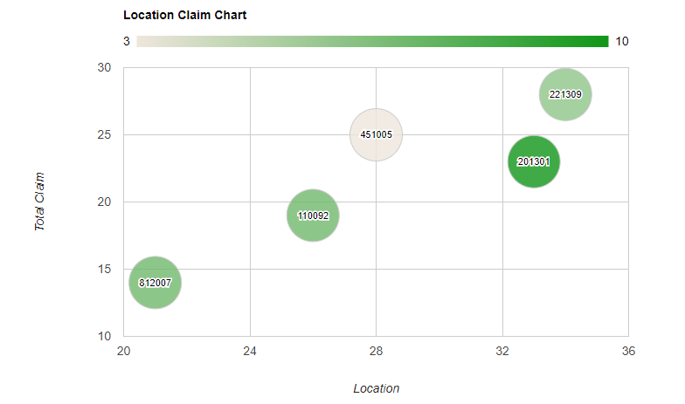
Chart Representation:

Slide 7
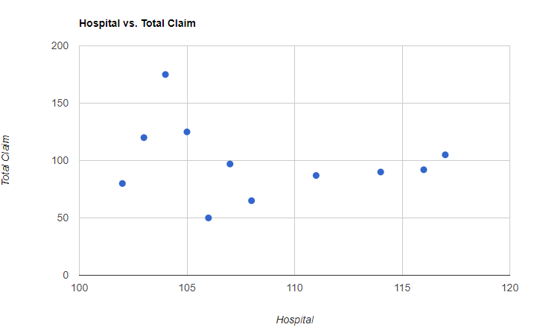
Conti…

