Slide 1
Employee Data Analysis using Excel
STUDENT NAME:VIGNESHWARAN.SP
REGISTER NO:2213211042134/umn13212213211042134
DEPARTMENT:B.COMCORPORATE SECTARYSHIP
COLLEGE:PRESIDENCY COLLEGE (AUTONOMOUS)

Slide 2
PROJECT TITLE
Employee Salary Analysis using Excel

Slide 3


AGENDA
Problem Statement
Project Overview
End Users
Our Solution and Proposition
Dataset Description
Modelling Approach
Results and Discussion
Conclusion
3/21/2024 Annual Review

Slide 4

PROBLEM STATEMENT
-To review and optimize employee salaries for fairness and competitiveness
-Identify salary disparities and inequalities
- Determine market competitiveness of current salaries
-Develop a plan to adjust salaries for fairness and
retention

Slide 5

PROJECT OVERVIEW
Methodology:
- Collected and cleaned employee salary data in Excel
- Conducted market research to determine industry standards
- Analyzed salary disparities, inequalities, and trends.- Developed recommendations for salary adjustments
Conclusion:
This analysis provides a comprehensive review of employee salaries, enabling data-driven decisions to optimize compensation and improve employee satisfaction and retention.

Slide 6

WHO ARE THE END USERS?
HR Department
Management
Employees
Finance Department
Business Owners/Leaders
Recruitment Team
Compensation and Benefits Team
Diversity, Equity, and Inclusion (DEI) Team
Union Representatives
External Auditors/Consultants

Slide 7

OUR SOLUTION AND ITS VALUE PROPOSITION
Data analysis about employee salary
-Filtering
-Pivot chart
-Pivot table

Slide 8
Dataset Description
-Employee data set – Kaggle
-26 Features
-I took 4 features
-Emp ID
-Name
-Salary
-Department
-Work location

Slide 9

THE "WOW" IN OUR SOLUTION
-Your Pivot chart feature is the most
useful solution for this data
analysis in addition pivot table also
3/21/2024 Annual Review
9

Slide 10
MODELLING
Data Collecting:
Data collecting involves gathering information from various sources and storing it in a format that can be used for analysis
Data Cleaning:
Data cleaning involves reviewing and correcting data for errors, inconsistencies, and inaccuracies
Techniques:
Techniques refer to the methods used to analyze and manipulate data in Excel
Results:
Results refer to the output or findings of data analysis. In Excel, results can be presented in various formats
Pivot Table:
A PivotTable is a powerful tool in Excel that allows you to summarize and analyze large datasets
Pivot Chart:
A PivotChart is a visual representation of PivotTable data
10

Slide 11
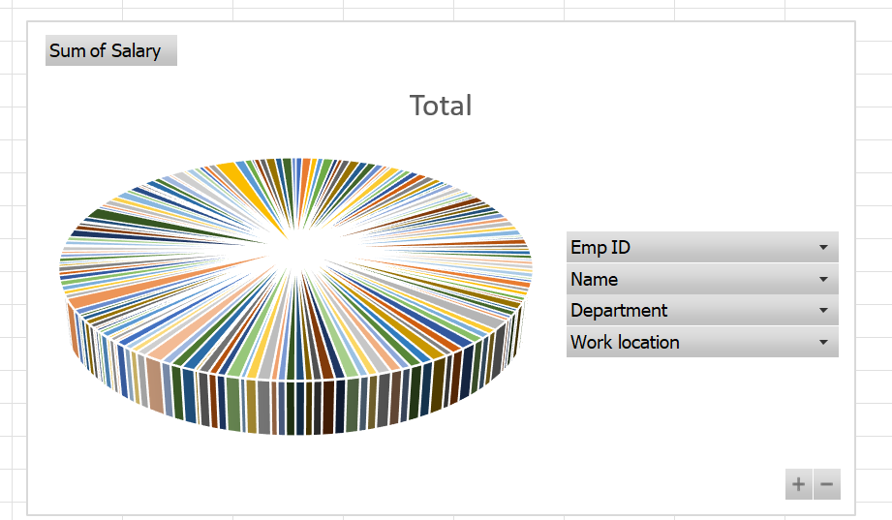
RESULTS
11

Slide 12
conclusion
This employee salary analysis project aimed to provide a comprehensive review of our
organization's compensation structure, identifying areas of strength and opportunities
for improvement
Through the use of Excel, we successfully:
-Collected and cleaned employee salary data
-Conducted market research to determine industry standards
-Analyzed salary disparities, inequalities, and trends
-Developed recommendations for salary adjustments

