Slide 1
TIMES SERIES PREDICTION
Scientific Computing

Slide 2
Table of contents
01
02
03
Introduction
Model and algorithm
Conclusion

Slide 3
01
Introduction

Slide 4
Team members
Nguyen Van Lam
Nguyen The Minh Quan
Pham Trung Hieu
20215219
20215237
20215205
Nguyen Thanh Dat
Nguyen Tien Thanh
20215194
20215243

Slide 5
History of time-series prediction
In the 1980s and 1990s, artificial neural networks (ANNs) were developed and used for time series prediction
In the early 2000s, support vector machines (SVMs) were introduced for time series prediction
In recent years, deep learning techniques have been applied to time series prediction

Slide 6
Problem description
The aim of this research is to develop a model with the ability to indicate future direction of stocks price with the given information, including:
Time
Volume of stock
Price

Slide 7
02
Model and algorithm

Slide 8
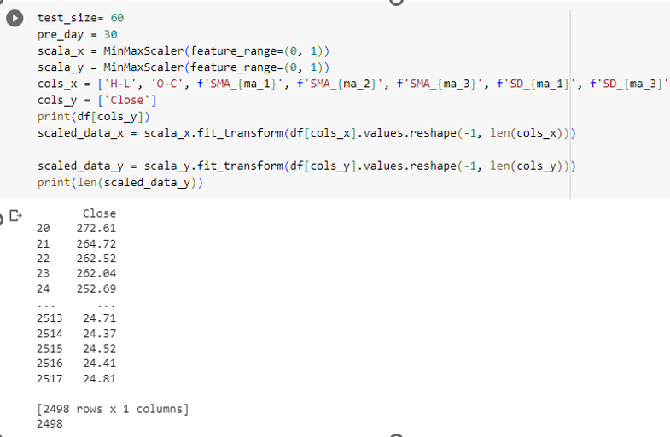
Data handling
After gathering data from different sources, we will handle the data in the correct form and standardize the data
Standardize the data

Slide 9
Sequential Model
A sequential model is a type of neural network in deep learning that is composed of a linear stack of layers, including:
Dense layers
Convolutional layers
Recurrent layers
Pooling layers

Slide 10
Long Short-Term Memory
Long Short-Term Memory (LSTM) is a type of Recurrent Neural Network (RNNs) that is specifically designed to handle sequential data, such as time series, speech, and text.
LSTM has a chain structure that contains four neural networks and different memory blocks called cells.

Slide 11
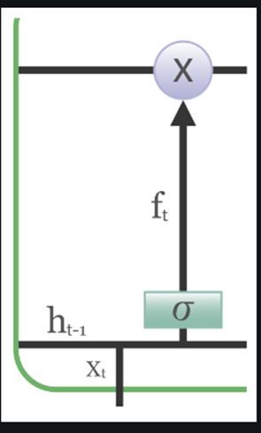
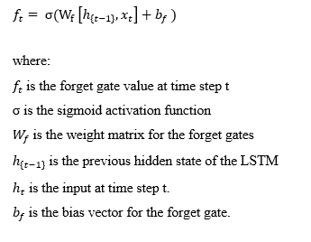
Forget Gate
The information that is no longer useful in the cell state is removed with the forget gate. The equation for the forget gate is:

Slide 12
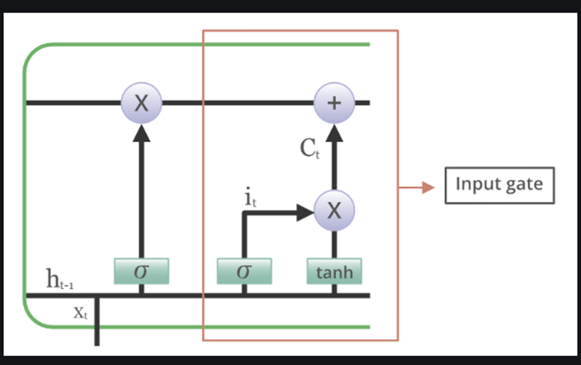
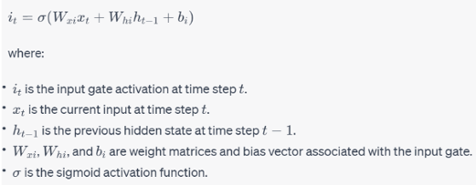
Input Gate
The input gate in an LSTM is responsible for deciding how much of the new input information should be stored in the cell state. The equation for the input gate is:

Slide 13


Output Gate
The output gate in an LSTM controls how much of the current cell state is exposed as the output of the LSTM cell. The output for the output gate is:
The state of current cell
The hidden output of cell

Slide 14
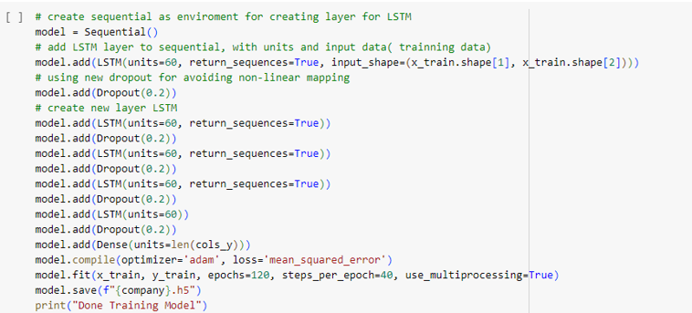
Building and training model
Building and training model

Slide 15
03
Conclusion

Slide 16
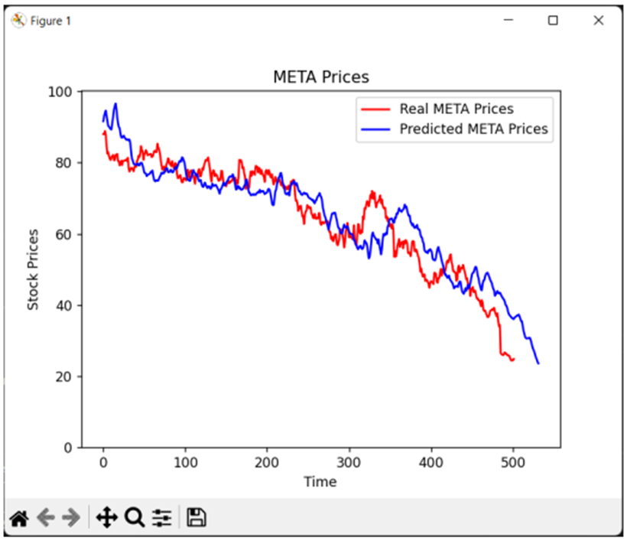
Evaluation and testing
Test result

Slide 17
Thanks
for your listening

