Slide 1
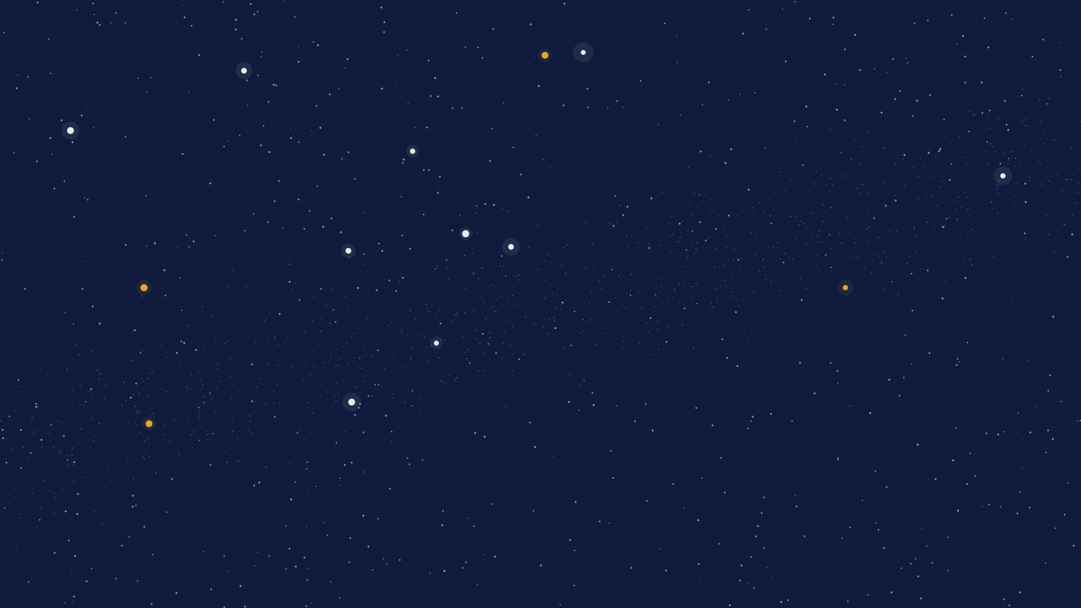
UTSSRP 2026 · COLLABORATIVE RESEARCH PROJECT
Predicting Stellar Properties
from Gaia Spectra
An applied project in machine learning and uncertainty quantification
Josh Speagle · Statistical Sciences and Astronomy & Astrophysics · University of Toronto

Slide 2



THE PROGRAM
About UTSSRP
The Statistical Sciences Research Program brings together top undergraduates from across Canada for a two-week research experience: June 8–19, 2026, in Toronto, with accommodation at Knox College. It has three parts.
Research project
Short courses
Seminars
Teams work on a real project with a faculty supervisor and a doctoral mentor. This is what we do each afternoon.
Graduate-level short courses on statistical methods, taught by faculty (mornings).
Research talks and career-path discussions from faculty (mornings).
Your project ends with a lightning talk and a poster at the final-day reception.
2

Slide 3
OVERVIEW
This project at a glance
Goal: build machine-learning models that predict a star's physical properties — temperature, gravity, composition — from its Gaia spectrum, and attach a calibrated uncertainty to every prediction.
→
→
Inputs
Model
Prediction
110 numbers describing each star's spectrum
learns the mapping from labeled examples
a stellar label, with an uncertainty
You'll work as a team of three across nine research afternoons, building toward conformal prediction — a method for trustworthy uncertainty.
3

Slide 4


DELIVERABLES
What you'll produce
Lightning talk
Poster
A short talk that states your question and headline result, and points people to your poster.
The full story: question, data, methods, results, and — importantly — limitations.
WE'LL LOOK FOR
clear framing · correct understanding of the methods · honest, well-labeled figures · an honest account of uncertainty and limitations · clear delivery
4

Slide 5
ROADMAP
The five phases
→
→
→
→
1
2
3
4
5
Explore
Build
Quantify
Guarantee
Communicate
Understand the data through plots
A prediction pipeline
Uncertainty + calibration
Conformal prediction
Talk + poster
Each phase builds on the one before it.
5

Slide 6
TIMELINE
The two weeks
Week 1
Week 2
Mon Data & exploratory analysis ★
Tue Debrief + first regression
Wed Build the ML pipeline ★
Thu Models + tuning
Fri Uncertainty quantification ★
Mon Conformal prediction ★
Tue Your model + comparison
Wed Shore up + build poster/talk
Thu Feedback & polish ★
Fri Lightning talks + posters
★ a new topic is introduced, with Josh in the room. Daily research block: 2:30–5:30 PM.
6

Slide 7
THE PROJECT ACROSS TWO WEEKS
The phases, mapped to the days
WEEK 1
WEEK 2
★
★
★
★
★
Mon Jun 8
Tue Jun 9
Wed Jun 10
Thu Jun 11
Fri Jun 12
Mon Jun 15
Tue Jun 16
Wed Jun 17
Thu Jun 18
Fri Jun 19
1 Explore
data & EDA
2 Build
pipeline + model
3 Quantify
4 Guarantee
conformal
5 Communicate
talk + poster
Present
★ a phase introduced with Josh in the room. Daily research block 2:30–5:30; evenings are yours.
7

Slide 8
01
BACKGROUND
The science
Stars, spectra, and the properties we want to measure.

Slide 9
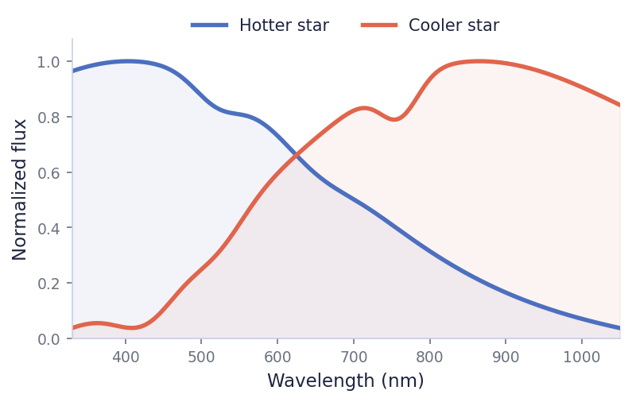
BACKGROUND
What is a stellar spectrum?
Split a star's light by wavelength and you get a spectrum.
Its overall shape and its dips (absorption features) are set by the star's temperature, gravity, and chemical makeup.
Different stars leave different fingerprints — which is exactly what lets us read properties from light.
Reconstructed spectra for a hotter and a cooler star.
9

Slide 10
TARGETS
The properties we predict (“labels”)
Effective temperature (Tₑff)
— how hot the star's surface is
Surface gravity (log g)
— compact dwarf vs. puffed-up giant
Metallicity ([Fe/H])
— abundance of heavy elements — a record of the star's origin
Also: α-abundance, age, distance
— further labels available in the catalog
These come from careful spectroscopic analysis. They are our prediction targets — we start with metallicity, then temperature and gravity.
10

Slide 11
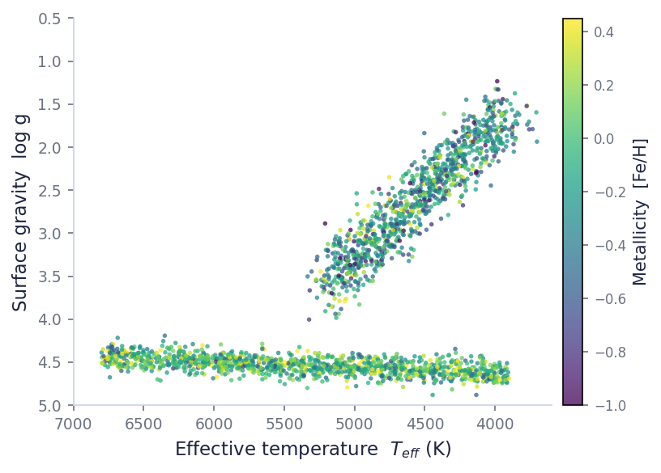
A KEY DIAGRAM
The Hertzsprung–Russell / Kiel diagram
Plot temperature against gravity and the structure of stellar populations appears:
the dense main sequence of hydrogen-burning stars, and the giant branch of evolved stars.
It's a diagnostic you'll recreate from the data.
Temperature vs. gravity, colored by metallicity (illustrative).
11

Slide 12
OUR INPUTS
Gaia and its XP spectra
Gaia (ESA) has surveyed about two billion stars.
For 220+ million it released low-resolution “BP/RP” (XP) spectra. These aren't stored as pixels — each spectrum is compressed into 110 coefficients (55 blue + 55 red).
Those 110 numbers are our model inputs: low-resolution, but cheap and all-sky.
110
55+55
coefficients per star
blue + red bands
220M+
stars with XP spectra, all-sky
12

Slide 13
THE DATASET
APOGEE and our training data
APOGEE is a high-resolution spectroscopic survey that yields precise stellar labels. Laroche & Speagle cross-matched its labels with Gaia XP spectra — and that cross-match is our training data (the high signal-to-noise filtering is already done).
~502k
~203k
110
3
stars, full catalog
high-SNR “good” set
input coefficients
labels to start
So: 110 spectral coefficients in, stellar labels out — a supervised learning problem.
13

Slide 14
MOTIVATION
Why this matters: label transfer
High-resolution labels are precise but scarce. Gaia XP spectra are everywhere.
If a model learns the mapping from XP spectra to labels on the stars where we have both, we can estimate labels for the vastly larger set that has only XP — helping map the Milky Way at scale. This is an active research problem.
220M+ stars with XP only
~200k stars with labels
→
learn here, predict there
14

Slide 15
02
FUNDAMENTALS
Machine learning
Learning a mapping from labeled examples to predictions.

Slide 16
FUNDAMENTALS
Supervised regression
Supervised learning: from examples with known answers (inputs X, targets y), learn a function f so that f(X) ≈ y — then predict y for new inputs. Regression means the targets are continuous numbers (here, stellar labels).
→
→
Inputs X
Model f
Prediction ŷ
110 spectral coefficients
fit to the labeled examples
estimated stellar label
The model never sees the true answer for new stars — it has to generalize.
16

Slide 17
PIPELINE
The machine-learning pipeline
→
→
→
→
Raw input
Preprocess
Model
Predict
Evaluate
110 coefficients
normalize by G-band, then standardize
fit & tune
stellar label
accuracy + plots
Why preprocess? Normalizing by overall brightness keeps the spectral shape (not distance); standardizing puts all 110 coefficients on comparable scales so the model can learn from each.
17

Slide 18
DATA SPLITTING
Train, calibrate, test
Train
Calibration
Test
Train — fit the model
Calibration — held out — used to check and guarantee uncertainty
Test — untouched until the end, for an honest score
Why hold data out? A model that simply memorizes its training data looks perfect there but fails on new stars — that's overfitting.
18

Slide 19




MODELS
The models you'll use
Linear regression
K-nearest neighbors
a simple, interpretable baseline
predict from the most similar stars
Random forest
Neural network
an ensemble of decision trees
a flexible function fit by gradient descent
Each of you takes one method; all are compared against the linear baseline.
19

Slide 20
EVALUATION
How we judge predictions
Accuracy
Precision
Is the prediction close to the truth on average? (low bias)
How scattered are the predictions? (low spread / RMSE)
And we look, not just summarize: predicted-vs-true plots and residuals across the parameter space show where a model does well or poorly — a single number can hide that.
20

Slide 21
03
FUNDAMENTALS
Uncertainty quantification
How much should we trust each prediction?

Slide 22
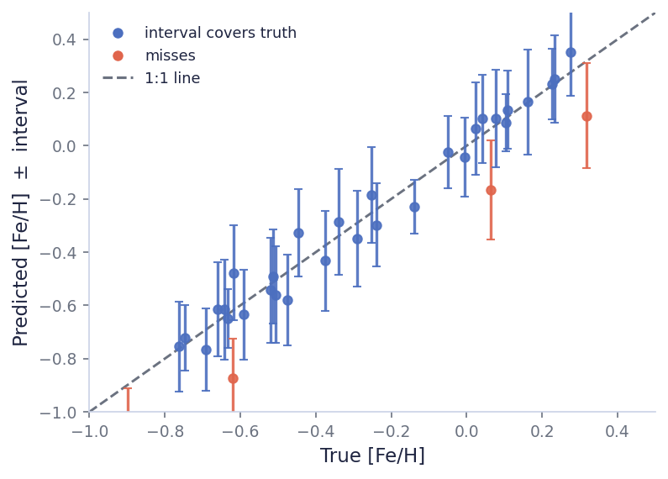
MOTIVATION
Why a point estimate isn't enough
A single predicted number tells you nothing about confidence.
Is the true metallicity within 0.02 of our guess, or 0.3? For science, we need a range the true value plausibly lies in — an interval, not just a point.
Goal: every prediction comes with a reliable interval.
Each prediction shown with an interval; blue intervals contain the truth.
22

Slide 23


CONCEPTS
Two kinds of uncertainty
Aleatoric
Epistemic
Irreducible noise in the data itself — measurement scatter, photon noise. More data won't make it go away.
Uncertainty in the model and what it hasn't learned yet. It shrinks with more or better data.
Different uncertainty methods capture different pieces — worth knowing which is which.
23

Slide 24
METHODS
Getting uncertainties from a model
Ensembles — train several models; the spread of their predictions is uncertainty
Dropout — randomly switch off neural-net units at prediction time, many times
Residual scatter — model the typical error as a function of the inputs
Input Monte Carlo — perturb the inputs within their noise and watch the output vary
You'll build a simple shared method, plus one matched to your own model.
24

Slide 25
CALIBRATION
Are the error bars honest?
An interval is only useful if it's calibrated: a “90% interval” should contain the true value about 90% of the time.
If it only covers 70%, the model is overconfident; if 99%, it's too timid. We check coverage on held-out data before trusting it.
Count how often the interval covers the truth — that's the coverage.
25

Slide 26
THE HEADLINE METHOD
Conformal prediction
A way to turn any model's outputs into intervals with a guaranteed coverage level — distribution-free (no assumption about the error shape) and model-agnostic.
→
→
Calibration errors
Take a quantile
Sized interval
see how wrong the model usually is, on held-out data
find the cutoff for the coverage you want
intervals that hit the target coverage
A subtlety you'll probe: marginal coverage (right on average) vs. conditional coverage (right everywhere) — they're not the same.
26

Slide 27
04
PRACTICALITIES
Your project & today
How you'll work — and what to do this afternoon.

Slide 28
TEAM
How you'll work together
Explore the data individually.
Diverge — each of you owns one method.
Converge — cross-check results, then build one shared set of figures.
Everything lives in one shared GitHub repository.
Student A
K-Nearest Neighbors
Student B
Random Forest
Student C
Neural Network
28

Slide 29






GOALS
What you'll take away
Reason about uncertainty
Explore & diagnose
what an error bar and “coverage” really mean
read data and models through plots
Build a pipeline
Conformal prediction
frame, train, tune, and evaluate a model
trustworthy intervals — and where they break
Collaborate
Communicate
split the work, then combine results
a clear talk and poster, limitations included
29

Slide 30




LOGISTICS
How the days run
Daily research block
2:30–5:30 PM. Mornings are the program's short courses and seminars.
Who's in the room
Josh introduces each new topic (Mon/Wed/Fri, then Mon/Thu); a TA and doctoral mentor support you every day.
One shared repo
the whole team works in a single GitHub repository.
The showcase
lightning talks and a poster session at the Friday, June 19 reception.
30

Slide 31
DAY 1
Today: explore the data
No modeling today.
Load the data, reconstruct a few example spectra, and plot the inputs and the labels. Get a real feel for what's there before building anything.
“Become one with the data” — understand it thoroughly first.
PLOTS TO MAKE
Example spectra
Signal-to-noise
Coefficient scales
Label distributions
Kiel diagram
Correlations
Aim to be able to explain each plot — every claim should be something you can show.
31

Slide 32
DAY 1
Who does what today
A
B
C
Student A
Student B
Student C
Example spectra + signal-to-noise
Coefficient scales + correlation heatmap
Label corner plot + Kiel diagram
First: set up the shared repo and agree who does what. Today's minimum: each of you brings 2–3 annotated plots to share.
32

Slide 33
LOOKING AHEAD
Where we're headed
Today — explore the data.
This week — build prediction pipelines and quantify uncertainty.
Next week — conformal prediction, then your talk and poster.
Questions?

