Slide 1

June
2009
UNO + Gameloft Live

Slide 2
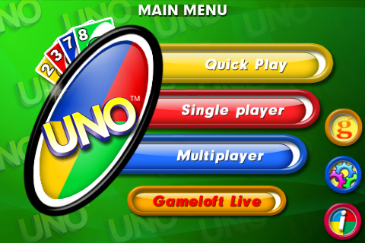
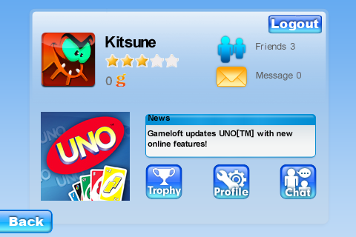
Getting Started
From Uno’s main menu, you get access to your free Gameloft Live account

Slide 3
Features
From there you can
  Make friends
  Invite them to join you in the game
  Send them messages
  Chat with them
  Compare your trophies with theirs
  And evaluate them

Slide 4
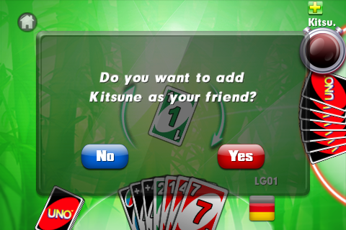
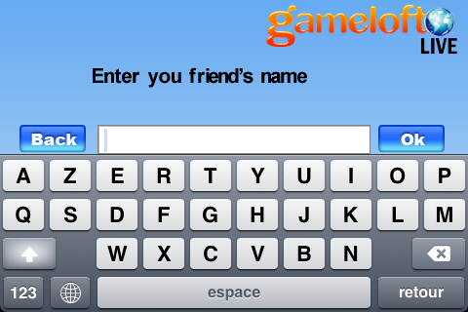
How to make friends
Invite cool players you meet ingame…
… or just type their username if you know them in real life

Slide 5
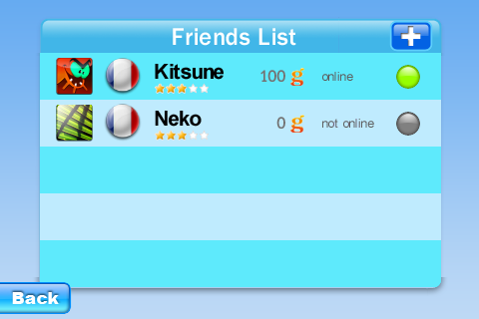
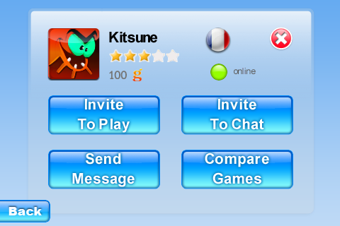
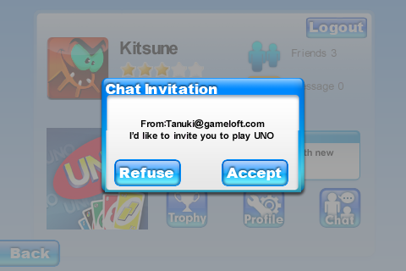
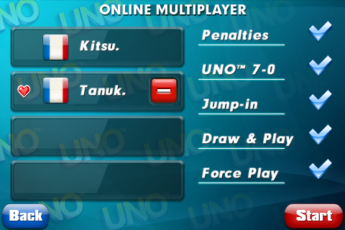
Invite an online friend to play
Touch a friend in your list
Touch invite to play
Your friend will get this prompt
That will lead him in the game with you

Slide 6
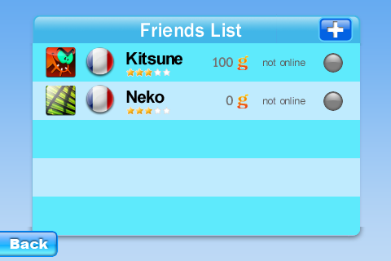
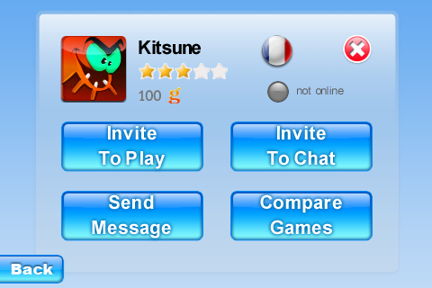
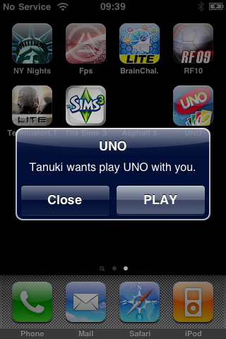
Invite an offline friend to play
Touch a friend in your list
Touch invite to play
This notification is pushed to your friend
That will lead him in the game with you

Slide 7
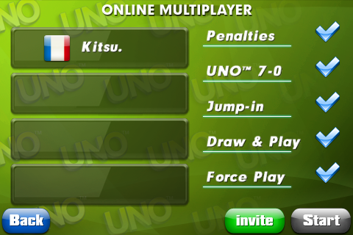
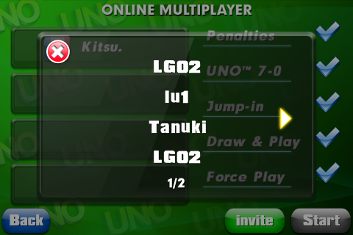
Invite your friends to play from the game lobby
Touch invite
Add friends from your list
and they can join the fun!

Slide 8
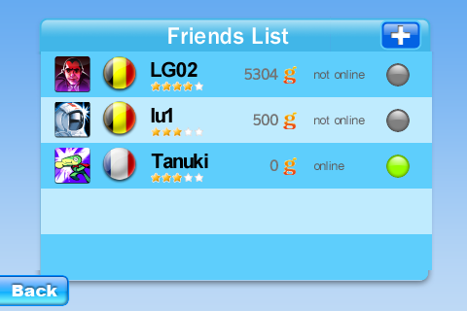
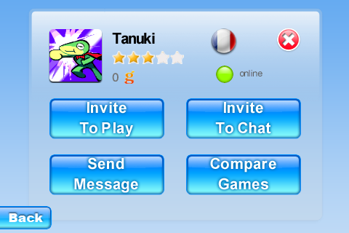
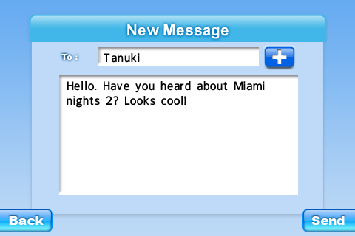
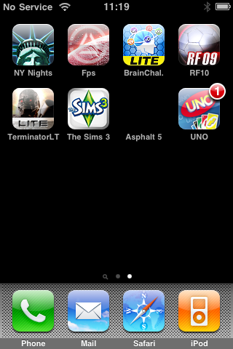
Send messages to your Friends
Touch a friend in your list
Touch Send Message
Type & send
Your friend will get a badge notification for each unread message

Slide 9
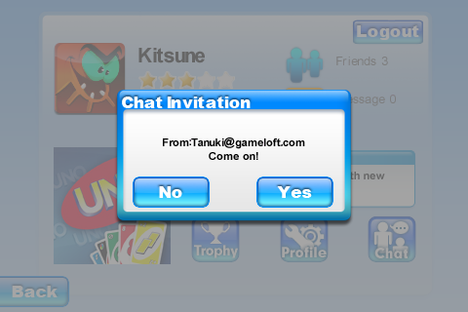
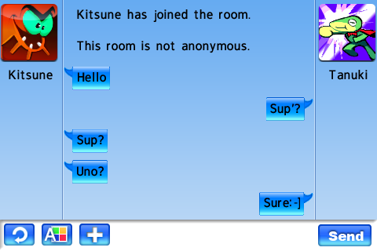
Chat with your friends
Touch Invite to Chat
Your friend will get this prompt
And can join you in the chat room

Slide 10

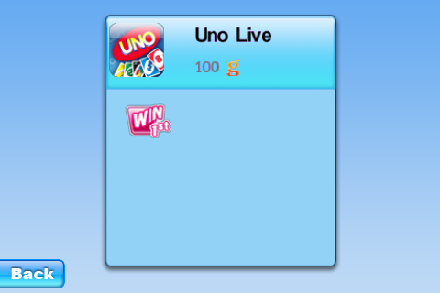
Trophies
Collect Gameloft points thanks to ingame achievements
Hit the Trophy button…
… and check out your achievements

Slide 11
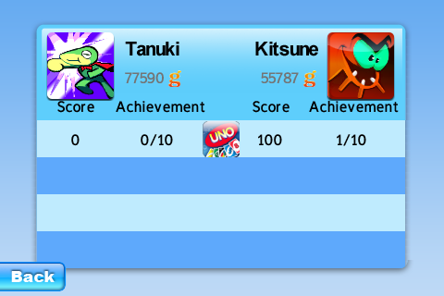
Trophies
And compare your score on each game with your friends
Hit Compare Games…
… and check out who’s the best achiever

Slide 12
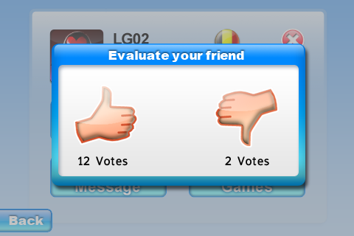
Evaluation system
Get more stars…
…with positive feedback from other users

