Slide 1

Gaussian Distribution of PID Cloud Fragments
Kamyar Modjtahedzadeh
Boeing Intelligence & Analytics
May 2, 2025

Slide 2
Motivation
Long term interest in the concept of debris clouds
More stars in the observable universe than grains of sand on Earth
concept of packing density
Goal: Find the probability of impact given an interceptor is flying through a cloud of debris.

Slide 3
Presentation Outline
Packing Density Model
Fragment Size and Spatial Distribution Considerations
Normal Distribution of Fragments ★
Fragment Size Dependency
Evolution of PID Cloud with Time
Orbital Mechanics

Slide 4
I. Packing Density Model

Slide 5
PID Cloud Formation
A uniform solid sphere exists in space.
It either explodes or collides with another body such as an interceptor and causes the sphere to fragment into equivalent pieces of post-impact debris (PID) with all the PID fragments being evenly spaced.
The fragments forms a cloud resembling a sphere.

Slide 6


Solid Sphere vs. PID Cloud

Slide 7

Packing Density & Mass Conservation
Packing density is a number that captures how much space is filled by stuff, like grains of sand in a spherical shell.
The packing density of the cloud is always less than one, because the PID fragments don't fit together perfectly—there are always gaps or voids between them, so they can't fill the entire space like the original solid sphere did.
$$\left\{\begin{aligned}η_{c}<1 \\ η_{s}=1\end{aligned}\right.$$
The mass of the solid sphere is the same as the mass of the debris cloud (mass conservation).

Slide 8
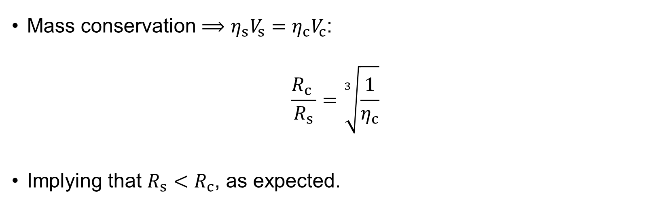
Packing Density & Mass Conservation
Mass conservation $⟹{η_{s}V_{s}=η}_{c}V_{c}$:
$$\frac{R_{c} }{R_{s}}=\sqrt[3]{\frac{1}{η_{c}}}$$
Implying that $R_{s}<R_{c}$, as expected.

Slide 9
II. Spatial Distribution Considerations and Fragment Size

Slide 10
Caveats of Packing Density Model
Assumes all debris fragments are identical.
Assumes all fragments are evenly spaced.

Slide 11

II.2 Gaussian Distribution

Slide 12


Postulates
The fragments will be distributed at a peak relative to the cloud’s radius.
The fragment dispersion post-impact is symmetric about the peak of the distribution

Slide 13

Normal Distribution Function
$$ρ=ρ_{0}exp\left[−\frac{{\left(r −μR_{c}\right)}^{2}}{2σ^{2}R_{c}^{2}}\right]$$
$ρ_{0}$ is a normalization constant
$r$ is the radial distance from the center
$μR_{c}$ is the peak of the distribution
$σ$ is the standard deviation

Slide 14
II.2 Size Dependency

Slide 15

Characteristic Length
Fragments have different sizes!
The size is defined by each fragment’s respective characteristic length ($L_{c}$)
The parameters in the formula for $ρ$ are now size dependent;
$ρ_{0}→ρ_{0}\left(L_{c}\right)$
$μ→μ(L_{c})$
$σ→σ(L_{c})$

Slide 16

Size Dependency of Parameters
$ρ_{0}\left(L_{c}\right)$ can be found by integrating the mass integral itself over the range of characteristic lengths.
$μ(L_{c})$ is now defined for each specific $L_{c}$.
$σ(L_{c})$:
$v∝A/m;$ smaller $L_{c}$ implies higher $A/m$and hence higher $v$.
$σ∝v$ and velocity is inversely related to $L_{c}$:
$$σ\left(L_{c}\right)≃σ_{0}⋅L_{c}^{−α}$$
where $σ_{0}$ and $α$ are observable constants.

Slide 17
III. Time Evolution of Debris Cloud

Slide 18

Transition from Sphere
$$Spherical⟶Ellipsoidal⟶Toroidal⟶Shell$$
The cloud radius evolves with time.
For short time periods ($t≤120 s$), this expansion is linear:
$$R_{c}\left(t\right)=R_{c}\left(0\right)+v_{expansion}⋅t$$

Slide 19


Temporal Evolution of $ρ_{0}$
The mass density’s normalization constant must evolve to preserve the total mass of the cloud as it expands.
The increase in volume is proportional to the cube of the increase of $R_{c}$:
$$ρ_{0}\left(L_{c},t\right)=ρ_{0}\left(L_{c},0\right)⋅{\left[\frac{R_{c}\left(0\right)}{R_{c}\left(t\right)}\right]}^{3}$$

Slide 20
IV. Orbital Mechanics

Slide 21

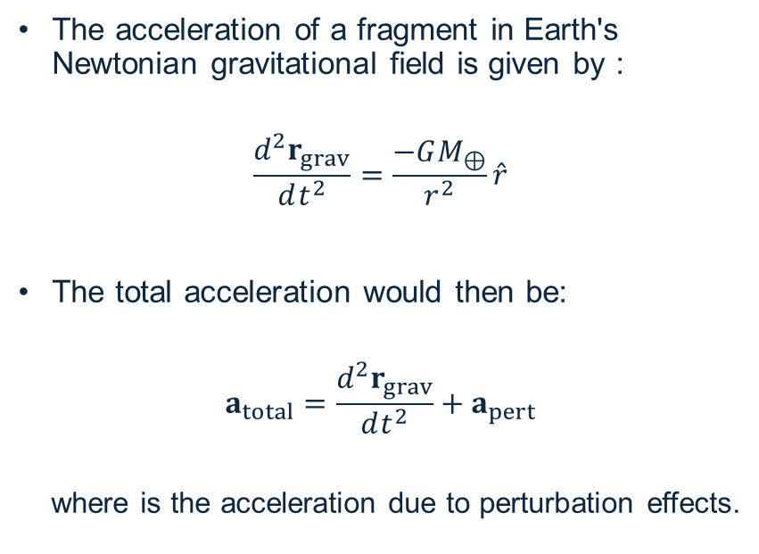
Gravitational Acceleration
The acceleration of a fragment in Earth's Newtonian gravitational field is given by :
$$\frac{d^{2}r_{grav}}{dt^{2}}=\frac{−GM_{⊕}}{r^{2}}\hat{r}$$
The total acceleration would then be:
$$a_{total}=\frac{d^{2}r_{grav}}{dt^{2}}+a_{pert}$$
where is the acceleration due to perturbation effects.

Slide 22


Perturbation Forces
The expression for the non-gravitational perturbation acceleration is:
$$a_{pert}=a_{SRP}+a_{d}+a_{EM}$$
SRP: solar radiation pressure
d: drag
EM: electromagnetic (neglected)

Slide 23
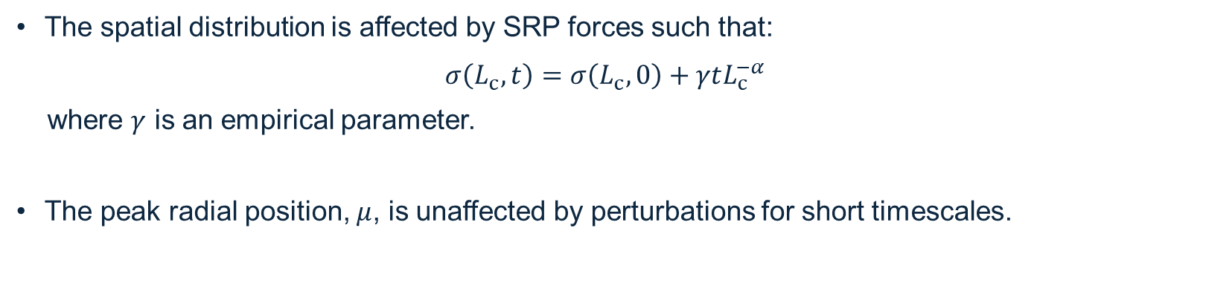
Perturbation Impact on Dispersion
The spatial distribution is affected by SRP forces such that:
$$σ\left(L_{c},t\right)=σ\left(L_{c},0\right)+γtL_{c}^{−α}$$
where $γ$ is an empirical parameter.
The peak radial position, $μ$, is unaffected by perturbations for short timescales.

Slide 24

Final Mass Density
The Gaussian distribution function with all its mapping is:
$$ρ\left(r, L_{c}, t\right)=ρ_{0}\left(L_{c},t\right)⋅exp\left[−\frac{1}{2}{\left(\frac{r −μ{\left(L_{c}\right)R}_{c}(t)}{σ\left(L_{c},t\right)R_{c}(t)}\right)}^{2}\right]$$

Slide 25
The End

