Slide 1

FeedApp
Design Document
Gruppe 9
Andre Frøseth Jønland, Jan-Erik Erstad, Kenneth Fossen, Rune Almåsbakk

Slide 2
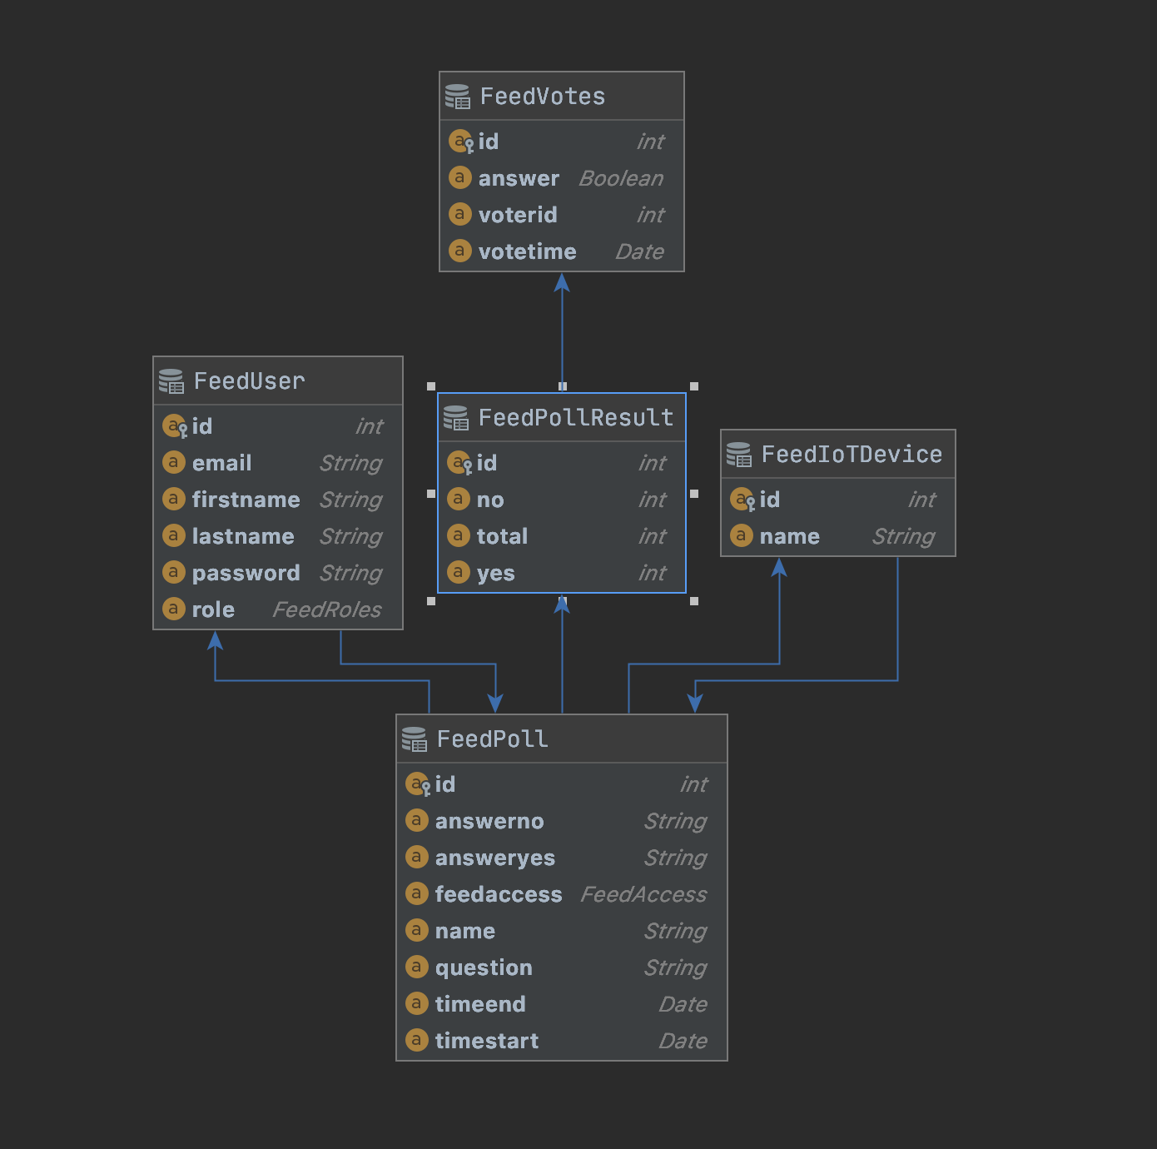
Domain Model

Slide 3
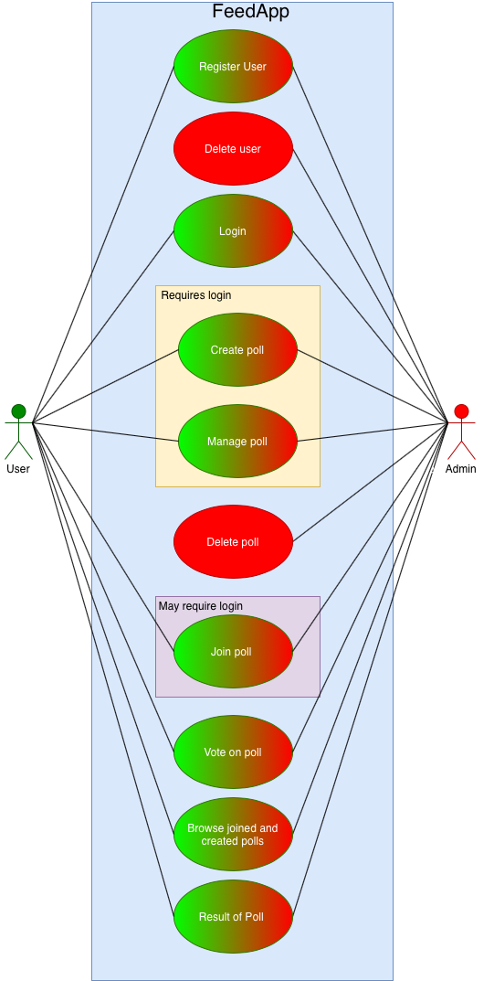
Use case diagrams

Slide 4
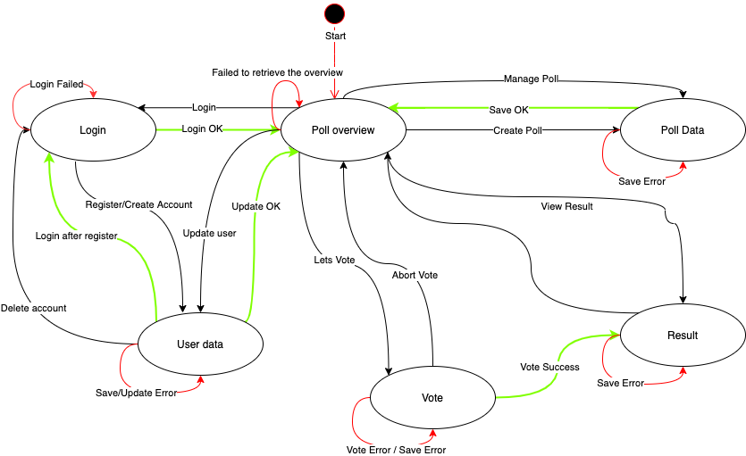
Application flow diagrams (Front End)

Slide 5
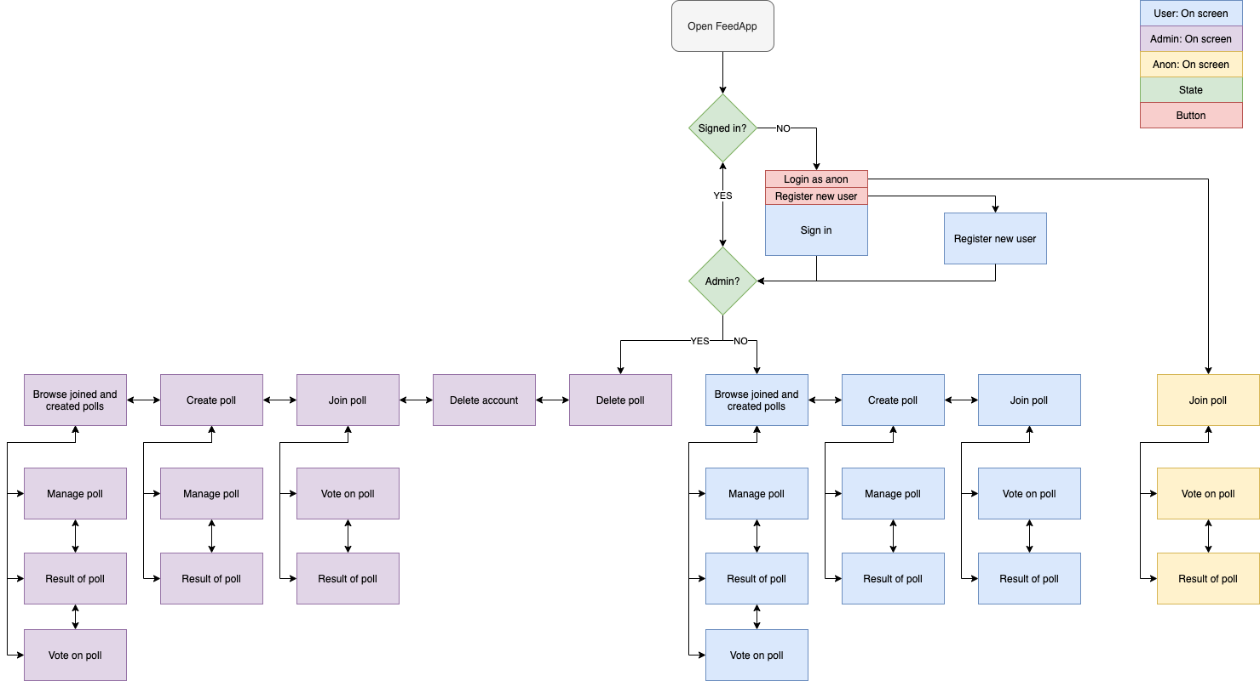
Application flow diagrams (Front End)

Slide 6
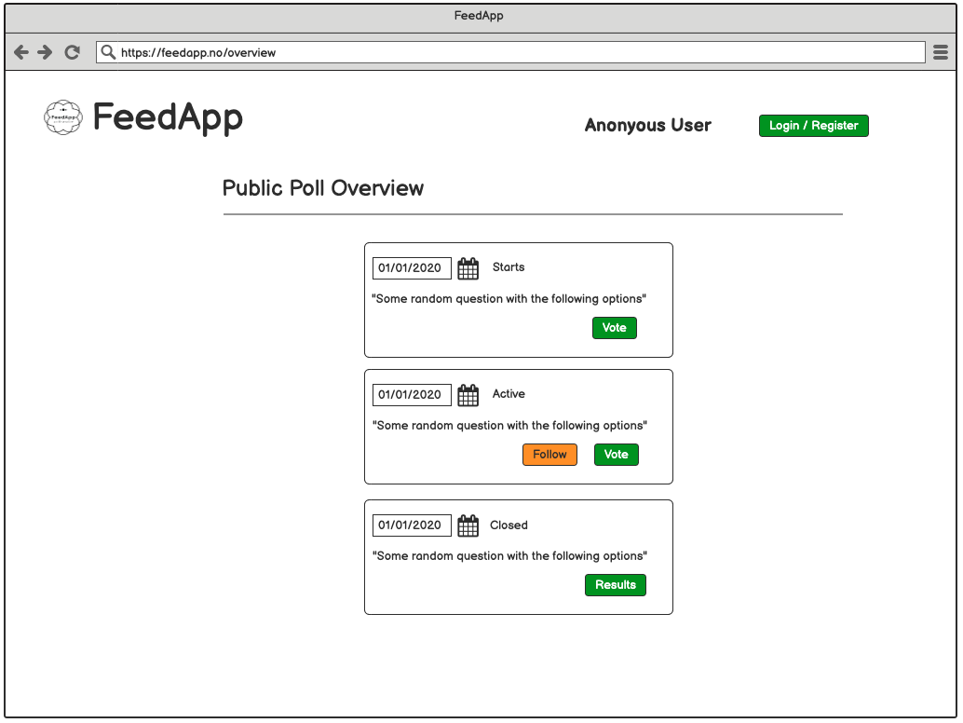
Mock-up user screens

Slide 7
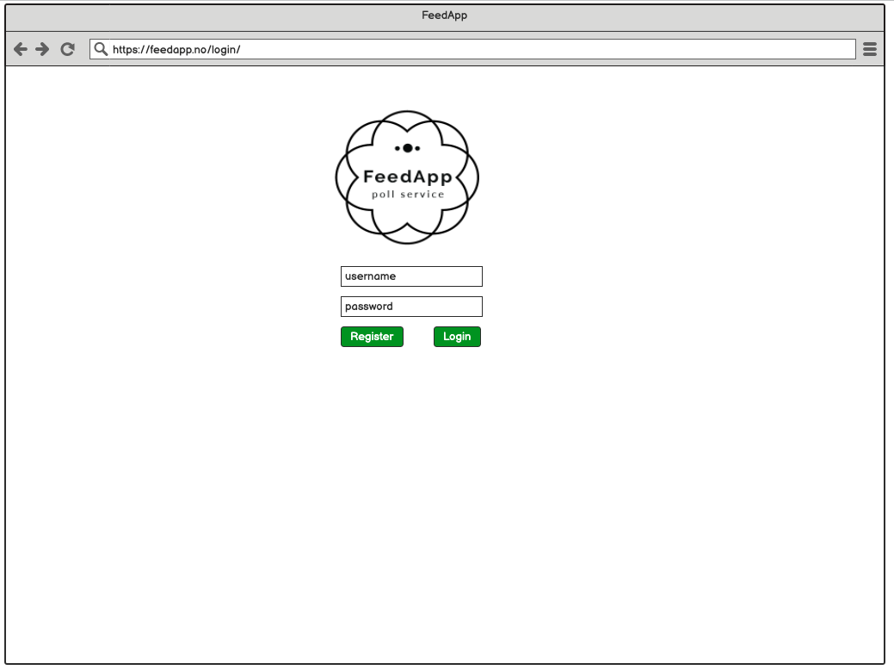
Mock-up user screens

Slide 8
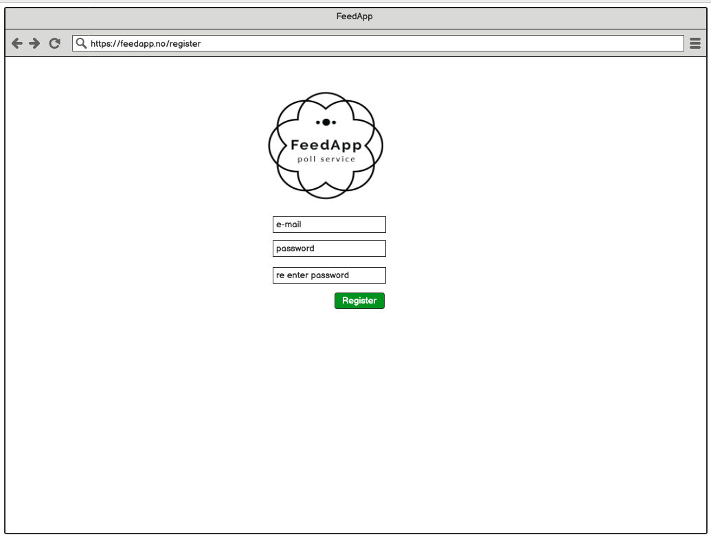

Slide 9
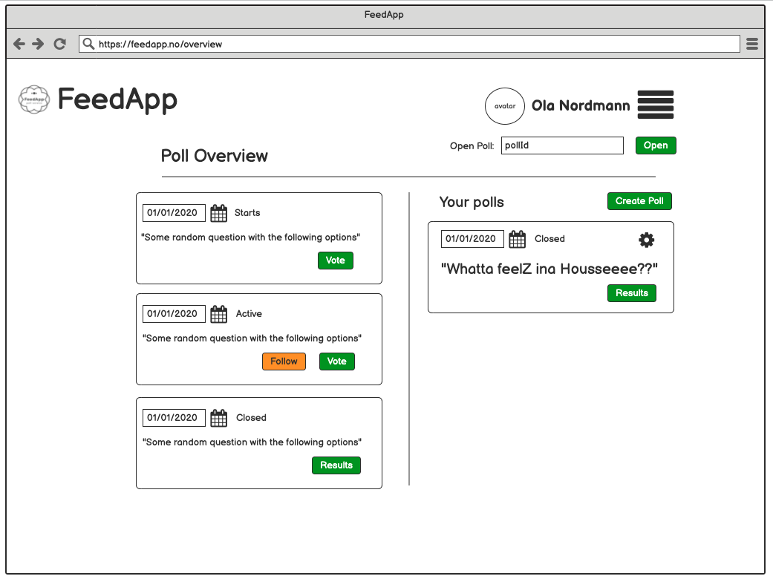

Slide 10
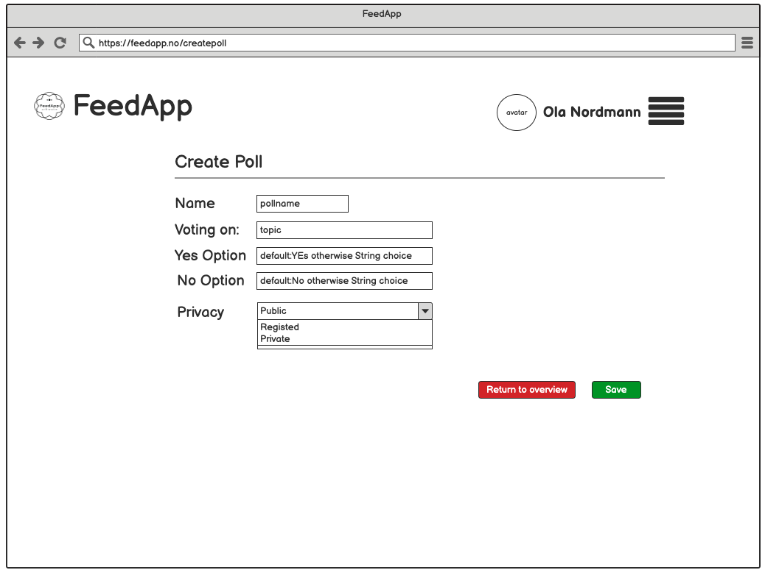

Slide 11
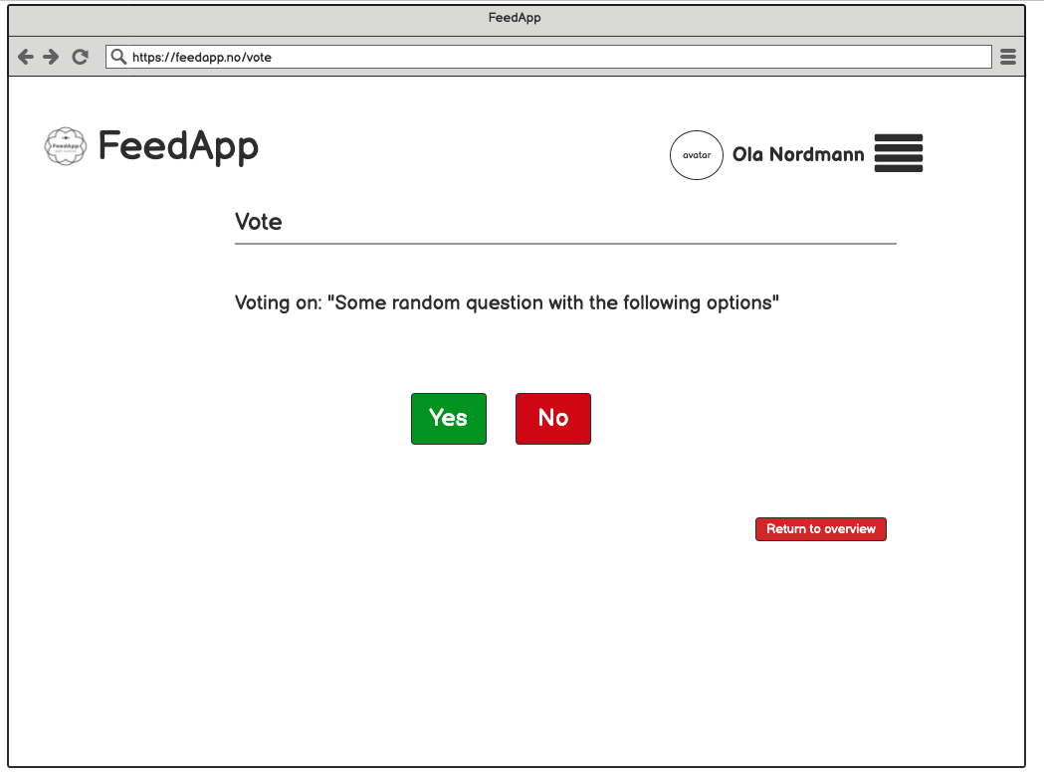

Slide 12
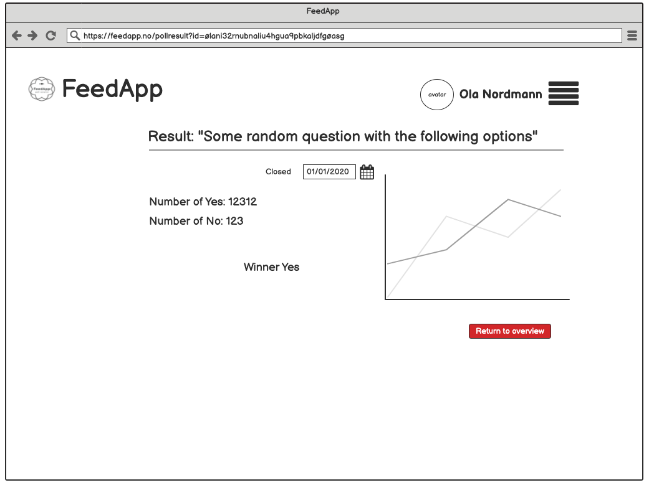

Slide 13
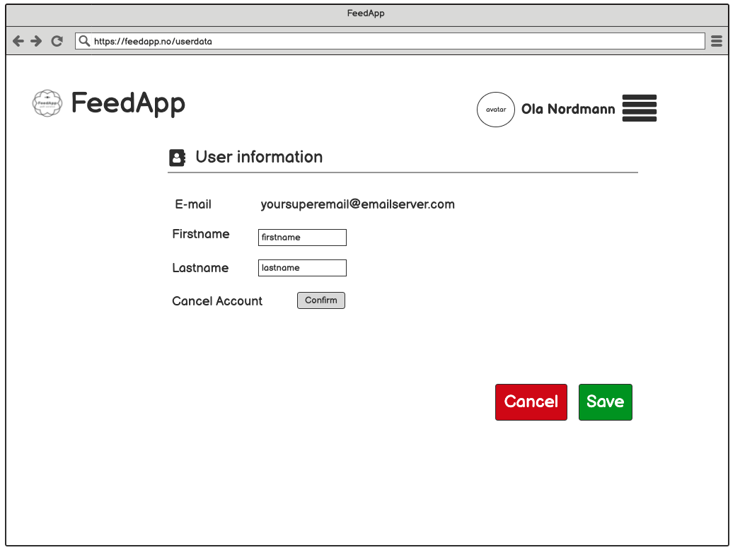

Slide 14
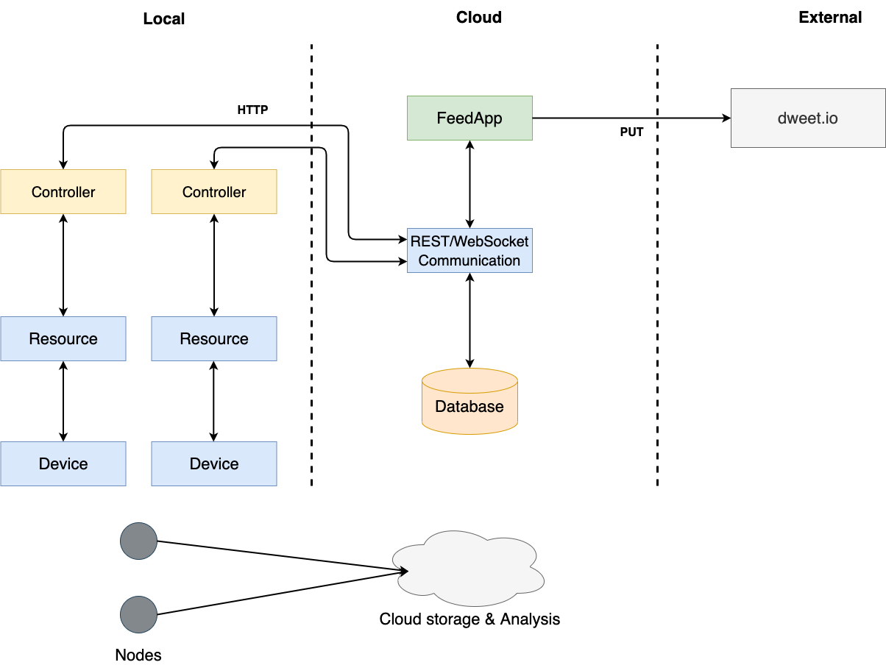
An architectural diagram

