Slide 1
Fruit Quality Classifier using Machine Learning
Ηλίας Αλεξανδρόπουλος mtn2302
Σπυρίδων Γεωργούλας mtn2309
Βασιλική Ρέντουλα mtn2317

Slide 2
Introduction
Apply advanced machine learning algorithms for fruit quality assessment.
Utilize the FruitNet: Indian Fruits Dataset [1] with Quality for model training.
Develop classification models to categorize fruits by quality indicators.
Optimize model performance for accurate quality categorization.
[1]
https://www.kaggle.com/datasets/shashwatwork/fruitnet-indian-fruits-dataset-with-quality?resource=download

Slide 3
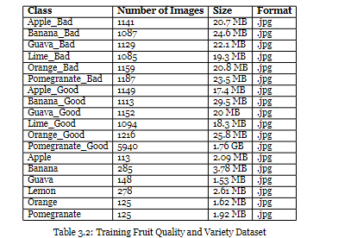
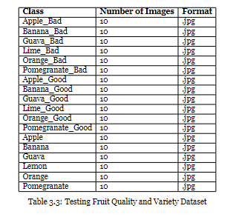
Data description

Slide 4
Data preprocessing
Background reduction:
exclude unnecessary information
GrabCut algorithm
Feature Extraction:
Color Features (HSV Color Space)
Texture Features (Local Binary Pattern - LBP)
Shape Features (Contours)

Slide 5
Model Training and Validation
1. 90°rotation 2. 180°rotation 3. 270°rotation 4. Gamma 0.2 5. Gamma 1.2
Hyperparameter tuning SVM

Slide 6
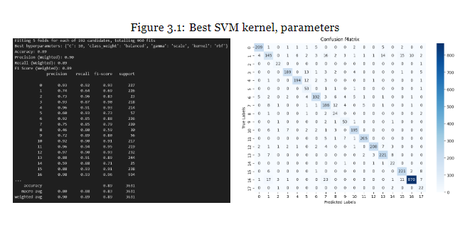
Evaluation (Sigmoid, Polyonimal, RBF )

Slide 7
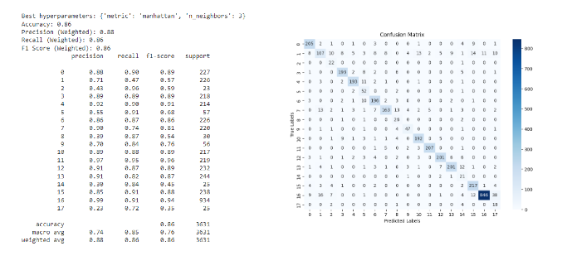
Evaluation – Comparison model (KNN)

Slide 8
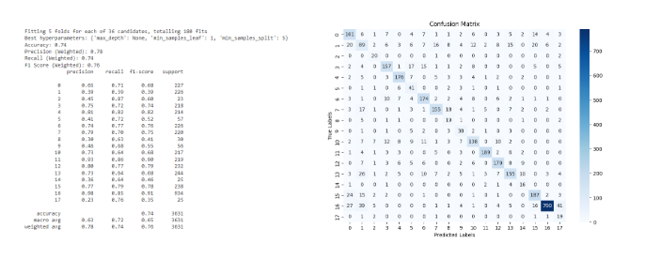
Evaluation – Comparison model (Decision tree)

Slide 9
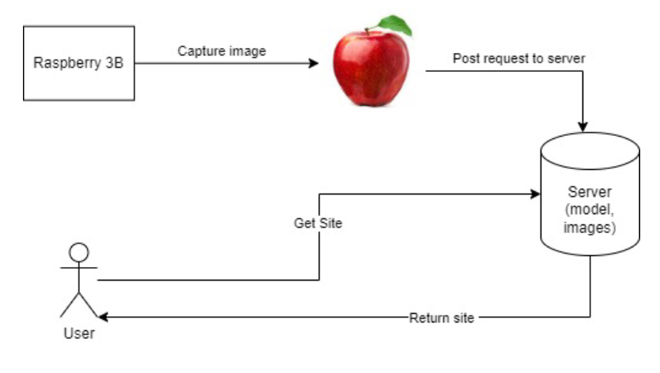
System Integration

Slide 10
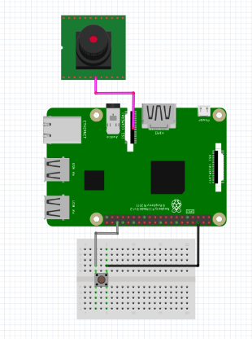
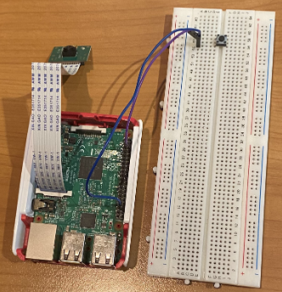
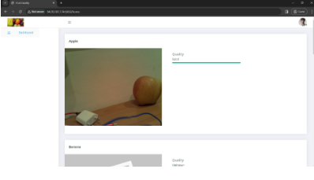
System Integration
Raspberry Pi Model: Raspberry Pi 3 Model B Camera Module: Raspberry Pi Camera Board v1.3 (5MP, 1080p)
Button

Slide 11

Thanks!

