Slide 1
Fruit Quality Classifier using Machine Learning
Ηλίας Αλεξανδρόπουλος mtn2302
Σπυρίδων Γεωργούλας mtn2309
Βασιλική Ρέντουλα mtn2317

Slide 2
Introduction
Apply advanced machine learning algorithms for fruit quality assessment.
Utilize the FruitNet: Indian Fruits Dataset [1] with Quality for model training.
Develop classification models to categorize fruits by quality indicators.
Optimize model performance for accurate quality categorization.
[1]
https://www.kaggle.com/datasets/shashwatwork/fruitnet-indian-fruits-dataset-with-quality?resource=download

Slide 3
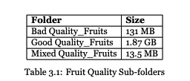
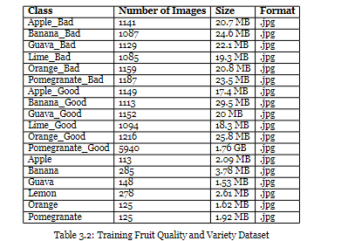
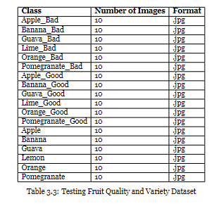
Data description
3 Sub-folders:
[1]
[1]
[1]
https://www.kaggle.com/datasets/shashwatwork/fruitnet-indian-fruits-dataset-with-quality?resource=download

Slide 4
Data pre-processing
Background reduction:
exclude unnecessary information
GrabCut algorithm
Feature Extraction:
Color Features (HSV Color Space)
Texture Features (Local Binary Pattern - LBP)
Shape Features (Contours)

Slide 5
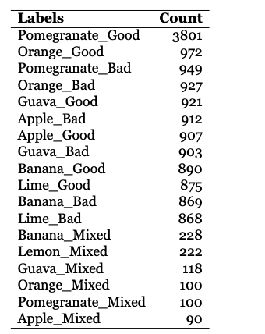
Model Training and Validation
Data: training (80%) and testing (20%)
Randomize order to prevent bias
Solve: Trimming and Augmentation
1. 90°rotation 2. 180°rotation 3. 270°rotation 4. Gamma 0.2 5. Gamma 1.2
Hyperparameter tuning SVM
C: [0.1, 0.5, 1, 10] to find optimal balance
gamma: [scale, auto, 0.1, 0.01, 0.001, 0.0001] to fine-tune the models' sensitivity
Unbalanced dataset

Slide 6
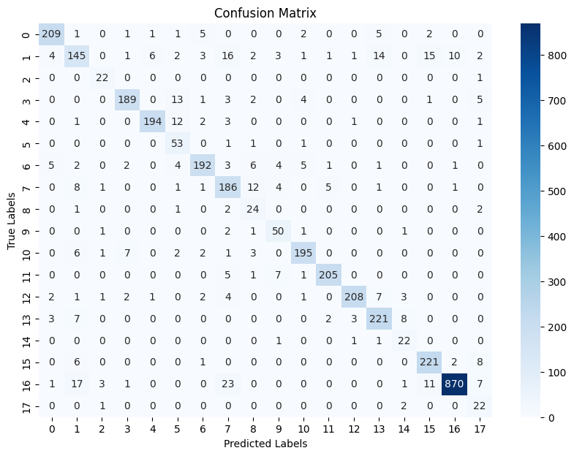
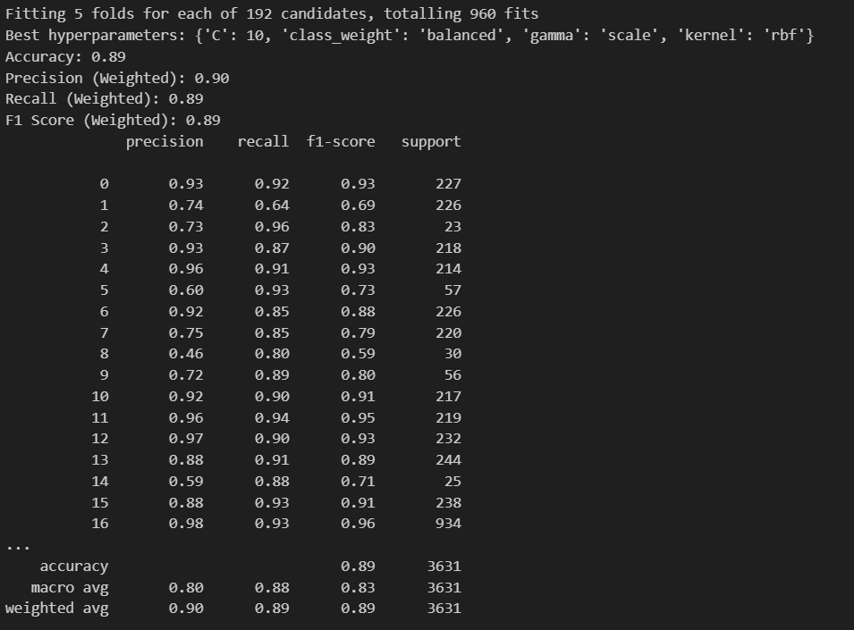
SVM Models Evaluation
(Linear, Radial Basis Function (RBF), Polynomial, Sigmoid)
Kernel: rbf
C: 10
Class_weight: balanced
Gamma: scale
Accuracy: 0.89
F1 : 0.89

Slide 7
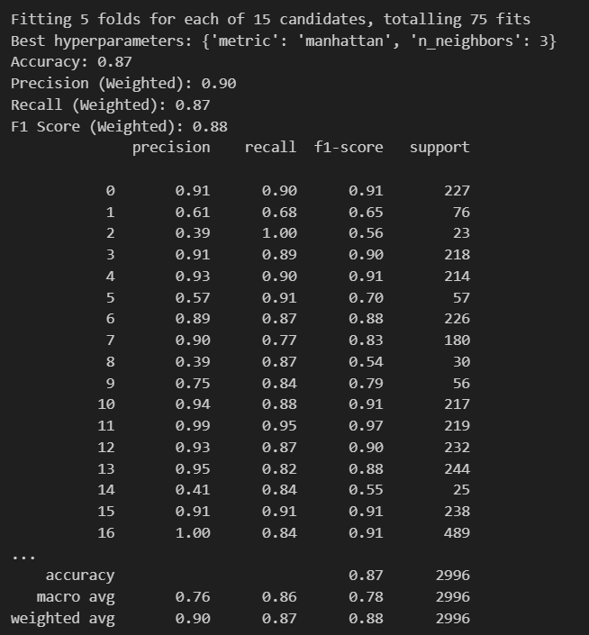
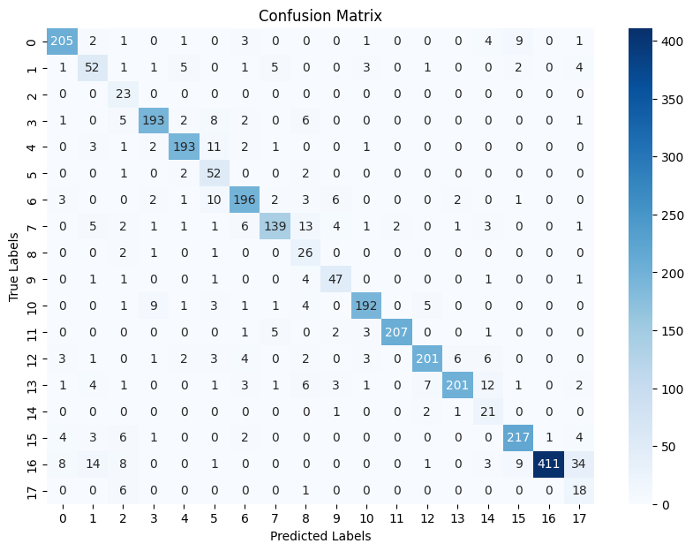
Evaluation – Comparison model (KNN)

Slide 8
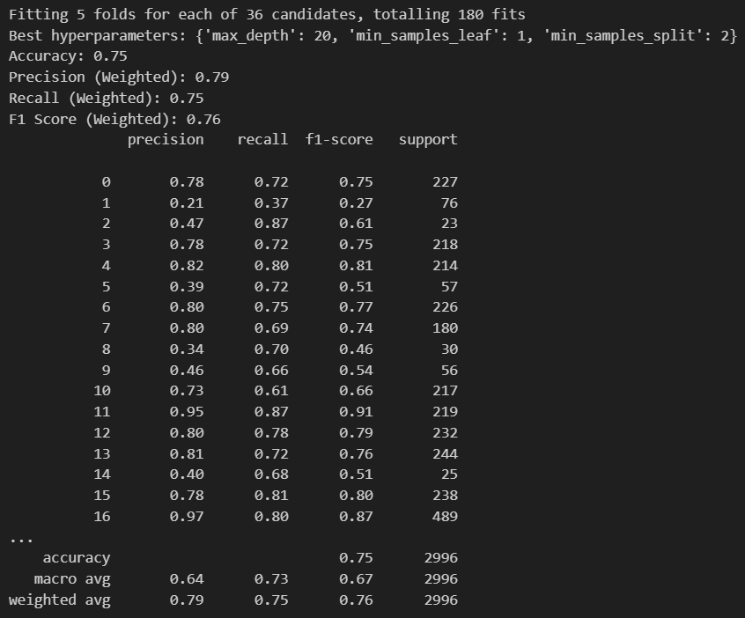
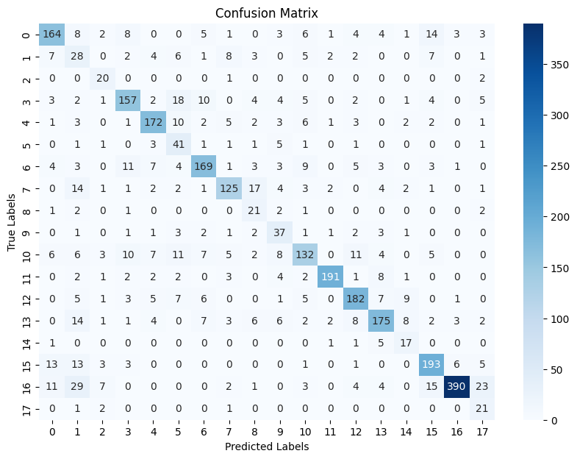
Evaluation – Comparison model (Decision tree)

Slide 9
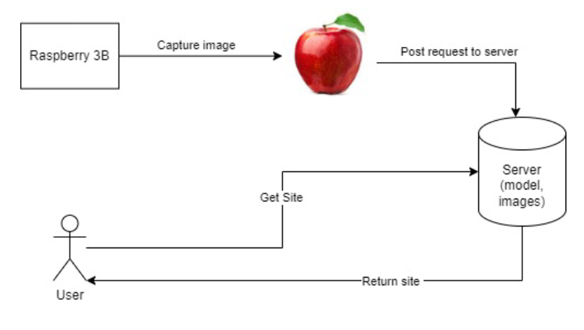
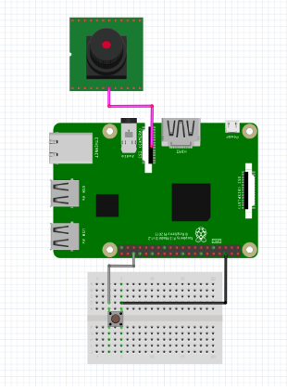
System Integration pipeline

Slide 10
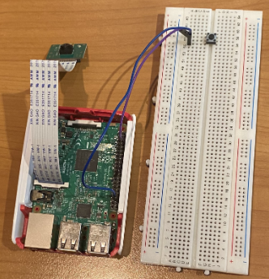
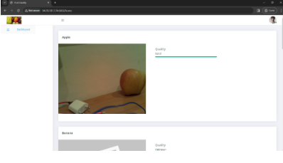
System Integration
Raspberry Pi Model: Raspberry Pi 3 Model B Camera Module: Raspberry Pi Camera Board v1.3 (5MP, 1080p)
Button

Slide 11

Thanks!

