Slide 1

#SQL: Document-Oriented Database
Shubham Gupta Research Scholar Department of Computer Science and Engineering Indian Institute of Technology Jodhpur, Rajasthan, India 342030
CSL4030 Data Engineering Lab - 6
August 13th 2023

Slide 2
What is document DB?
A document-oriented database stores and retrieves documents (XML, JSON, BSON and so on).
Documents are self-describing.
Hierarchical tree data structures (maps, collection, and scalar values).
Document databases store documents in the value part of the key-value.
Documents are indexed using a BTree.
Queried using a JavaScript query engine.
Documents have differences in their attributes but belongs to the same collection.

Slide 3
Features
Document Type Model
Flexible Schema
Distributed and Resilient
Manageable Query Language

Slide 4
Differences [1]
RDBMS | Document-Oriented
Database instance | DocumentDB instance
schema | database
table | collection
row | document
Rowid | _id
Join | DBRef

Slide 5



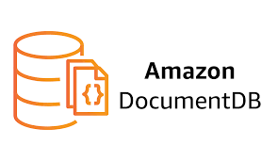
Document DBs

Slide 6
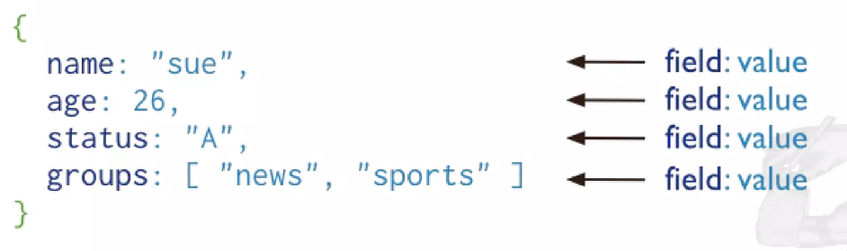
MongoDB
MongoDB is a document databsse designed for ease of development scaling.
Intuitive and easy to use NoSQL database.
Easy readability
High performance and availability
Community and Enterprise edition.
https://www.mongodb.com/try/download/community
https://www.mongodb.com/try/download/shell

Slide 7
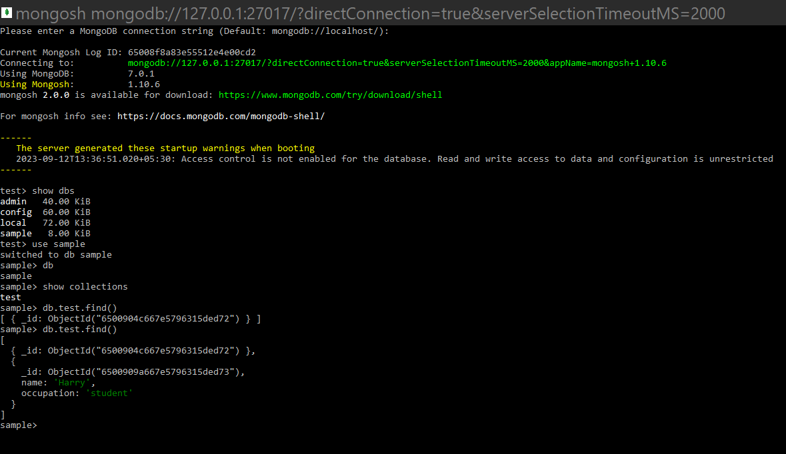
How to use?

Slide 8
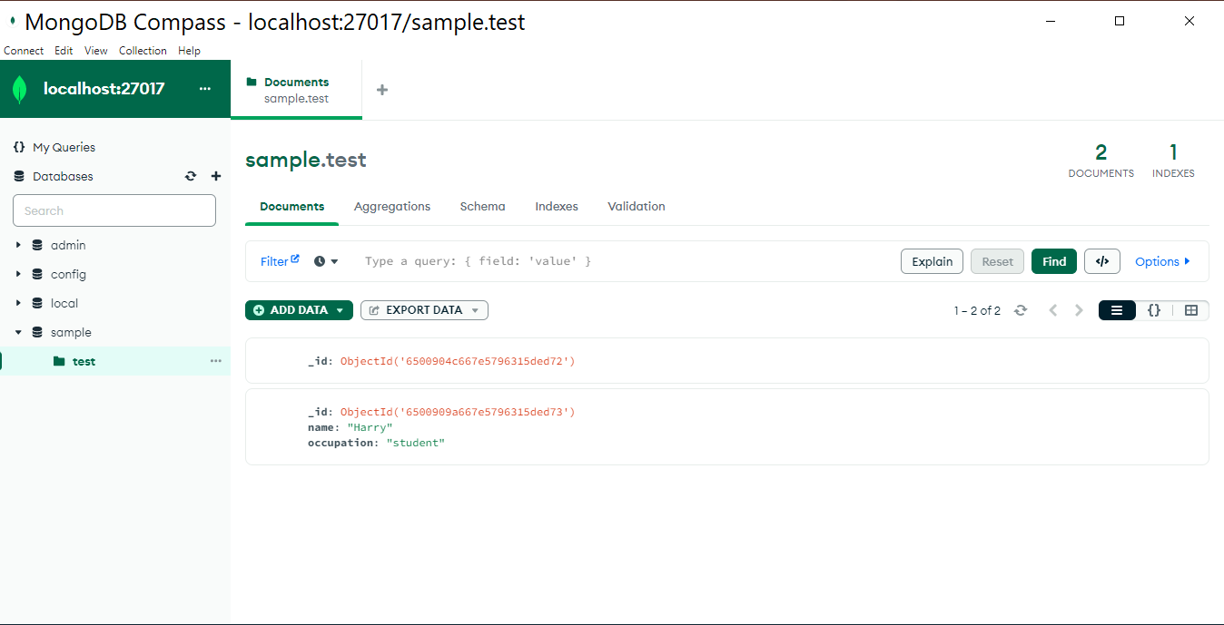
How to use?

Slide 9
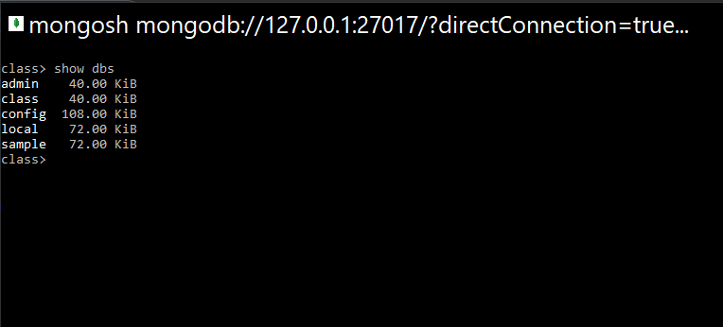
Commands
Commands
View all databases
show dbs

Slide 10
Commands
Create a new or switch databases
View current Database
Delete Database
Show Collections
use dbName
db
db.dropDatabase()
show collections

Slide 11
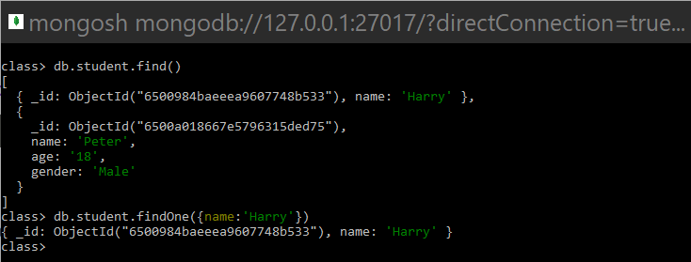
Commands
Show all Rows in a Collection
Find the first row matching the object
Db.<collection name>.find()
Db.<collection name>.findOne({name:’Harry’})

Slide 12
Commands
Insert One Row
Insert many rows
db.<collection name>.insert({
'name': 'Harry',
'lang': 'JavaScript',
'member_since': 5
})
db.<collection name>.insertMany([{
'name': 'Harry',
'lang': 'JavaScript',
'member_since': 5
},
{'name': 'Rohan’,
'lang': 'Python',
'member_since': 3
},
{'name': 'Lovish',
'lang': 'Java',
'member_since': 4
}])

Slide 13
Commands
Update One Row
Update All rows
Delete Row
db.<collection name>.updateOne({name: ‘Peter'},
{$set: {'name': 'Harry',
'lang': 'JavaScript',
'member_since': 51
}}, {upsert: true})
db.<collection name>.update({name: ‘Peter'},
{$set: {'name': 'Harry',
'lang': 'JavaScript',
'member_since': 51
}}, {upsert: true})
db.<collection name>.remove({name: ‘Peter’})

Slide 14
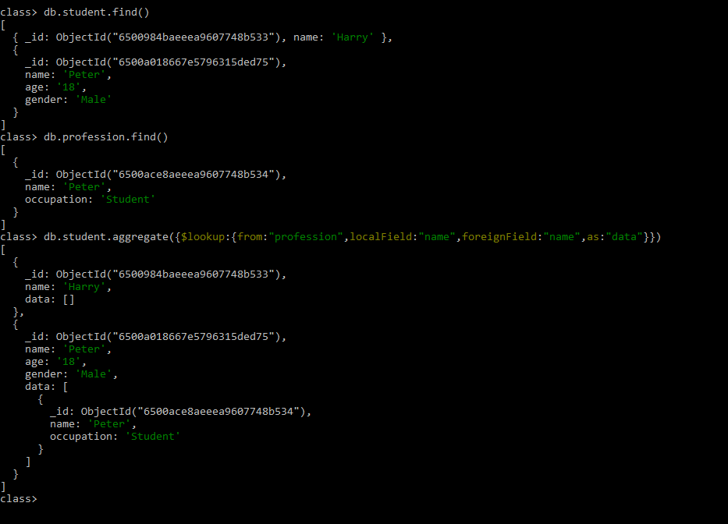
Commands
Aggregation between two collections
db.<collection name1>.aggregate({
$lookup:{
from:“<collection name2>",
localField:"uid",
foreignField:"uid",
as:"users_comments" } })
https://www.mongodb.com/docs/manual/reference/operator/

Slide 15
References
https://www.slideshare.net/fabiofumarola1/9-document-oriented-databases
https://www.mongodb.com/docs/manual/reference/operator/

Slide 16
Thank You!

