Slide 1

JSON
Aarju Dixit Research Scholar Department of Computer Science and Engineering Indian Institute of Technology Jodhpur, Rajasthan, India 342030
CSL4030 Data Engineering Lab 7
October 4th 2023

Slide 2
Document-based databases
MongoDB: A top NoSQL database engine that uses something similar to JSON. MongoDB has its own query language.
Cosmos DB: Saves documents in JSON.
CouchDB: An open source database management system that uses JSON natively.
Oracle: Provides SQL querying and reporting over JSON documents. Oracle Autonomous JSON Database is MongoDB compatible.
Elasticsearch: A search engine based on the document-store data model.

Slide 3
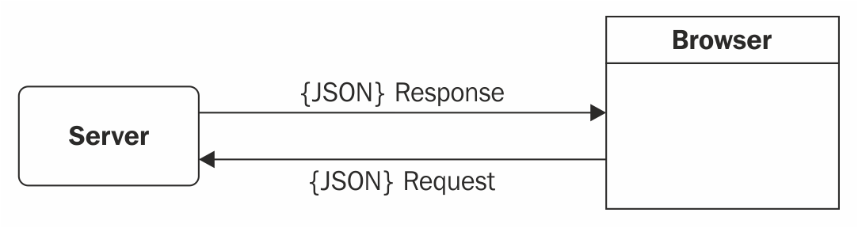
Data Interchange Formats in JSON [4]
JSON can be used in web applications for data transfer. Consider the following block diagram of the simple client-server architecture. Assume that the client is a browser that sends an HTTP request to the server, and the server serves the request and responses as expected.
In the preceding two-way communication, the data format used is a serialized string, with the combination of key-value pairs enveloped in parentheses; that is JSON!
Prior to JSON, XML was considered to be the chosen data interchange format.
XML parsing required an XML DOM implementation on the client side that would ingest the XML response, and then XPath was used to query the response in order to access and retrieve the data. This made life tedious, as querying for data had to be performed at two levels: first on the server side where the data was being queried from a database, and a second time on the client side using XPath.
JSON does not need any specific implementations; the JavaScript engine in the browser handles JSON parsing.

Slide 4
Introducing JSON [1]
JSON (JavaScript Object Notation) is a lightweight data-interchange format.
It is based on a subset of the JavaScript Programming Language Standard ECMA-262 3rd Edition - December 1999.
JSON is a text format that is completely language independent but uses conventions that are familiar to programmers of the C-family of languages, including C, C++, C#, Java, JavaScript, Perl, Python, and many others.
These properties make JSON an ideal data-interchange language.
JSON is built on two structures:
A collection of name/value pairs. In various languages, this is realized as an object, record, struct, dictionary, hash table, keyed list, or associative array.
An ordered list of values. In most languages, this is realized as an array, vector, list, or sequence.

Slide 5
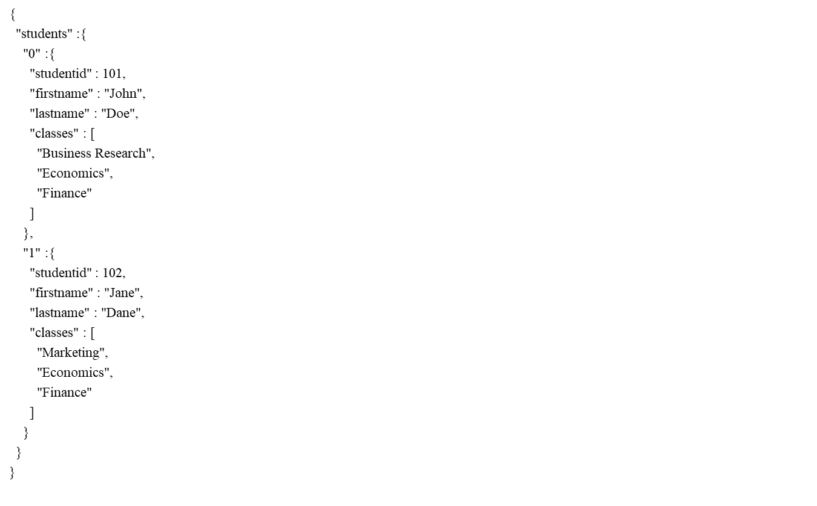
Example of XML and JSON [4]
<?xml version="1.0" encoding="UTF-8" ?>
<!-- This is an example of student feed in XML -->
<students>
<student>
<studentid>101</studentid>
<firstname>John</firstname>
<lastname>Doe</lastname>
<classes>
<class>Business Research</class>
<class>Economics</class>
<class>Finance</class>
</classes>
</student>
<student>
<studentid>102</studentid>
<firstname>Jane</firstname>
<lastname>Dane</lastname>
<classes>
<class>Marketing</class>
<class>Economics</class>
<class>Finance</class>
</classes>
</student>
</students>

Slide 6
JSON Data Types
In JSON, values must be one of the following data types: [2]
a string
a number
an object (JSON object)
an array
a Boolean
Null
JSON values cannot be one of the following data types: [2]
a function
a date
undefined

Slide 7
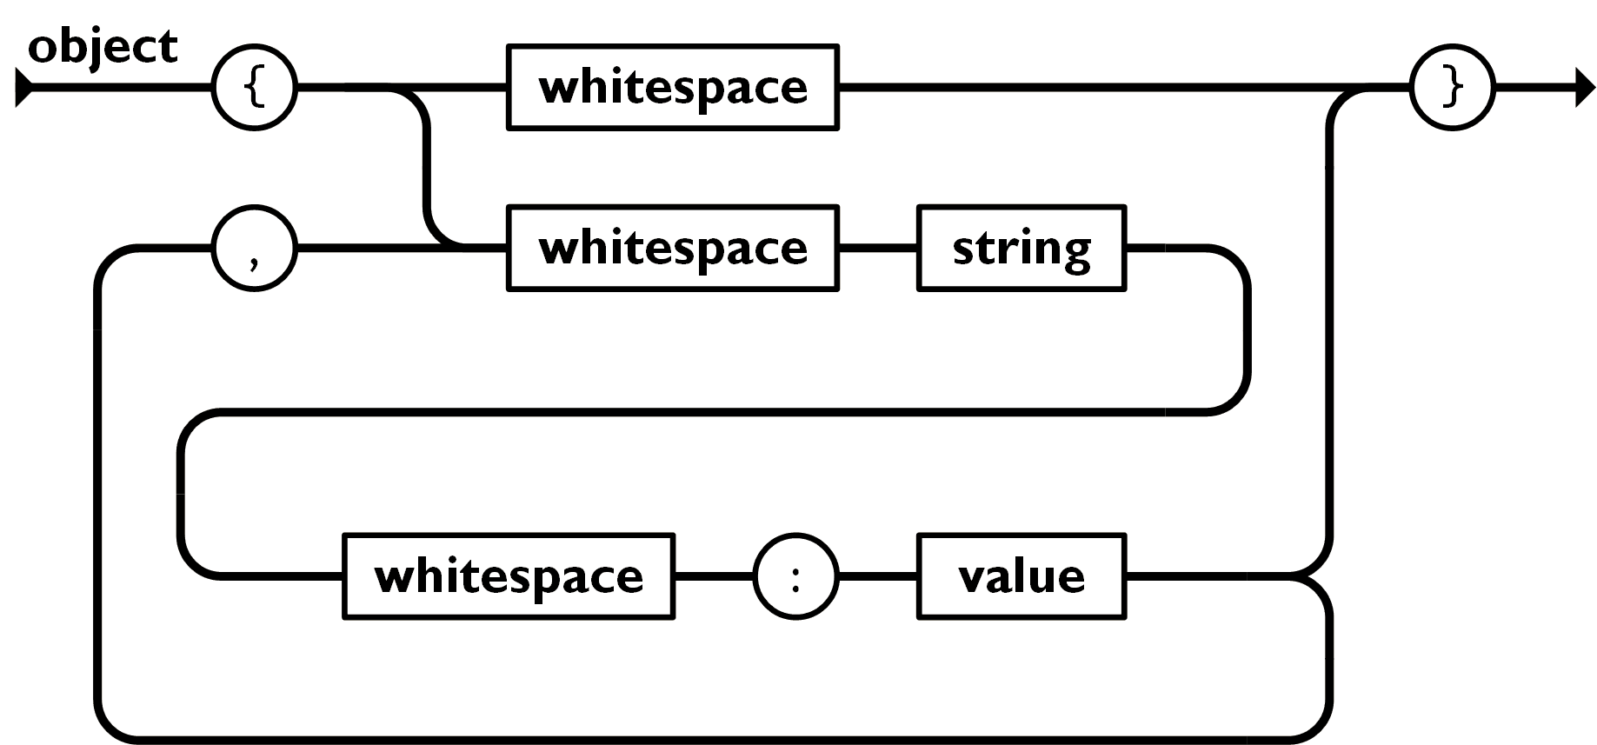
Object in JSON
An object is an unordered set of name/value pairs. An object begins with {left brace and ends with }right brace. Each name is followed by :colon and the name/value pairs are separated by ,comma.
Ex: { "employee":{"name":"John", "age":30, "city":"New York"} } [2]
Introducing JSON

Slide 8
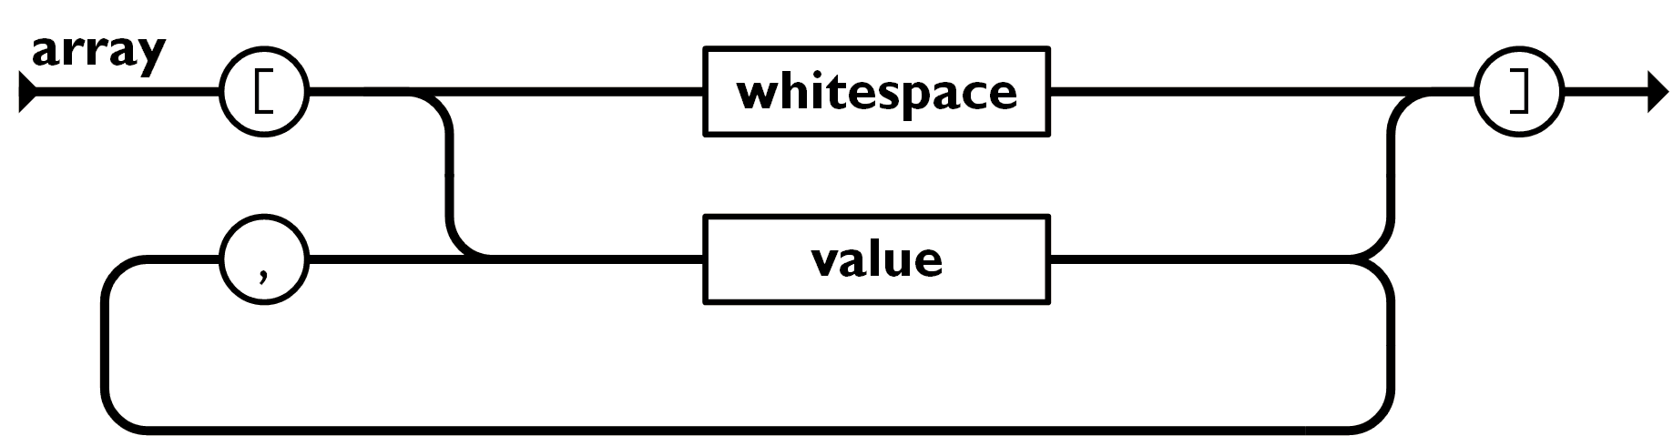
Array in JSON
An array is an ordered collection of values. An array begins with [left bracket and ends with ]right bracket. Values are separated by ,comma.
Ex: { "employees":["John", "Anna", "Peter"] } [2]

Slide 9
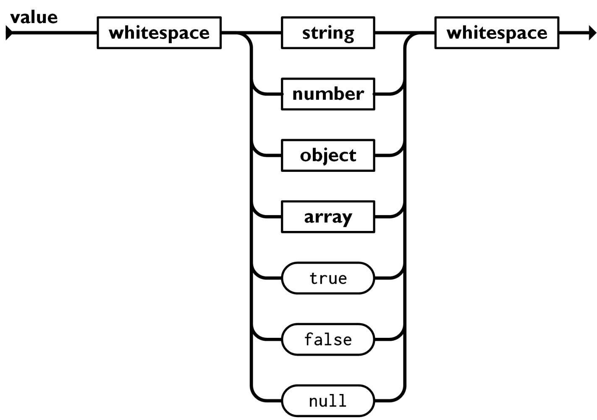
Value in JSON
A value can be a string in double quotes, or a number, or true or false or null, or an object or an array. These structures can be nested.

Slide 10
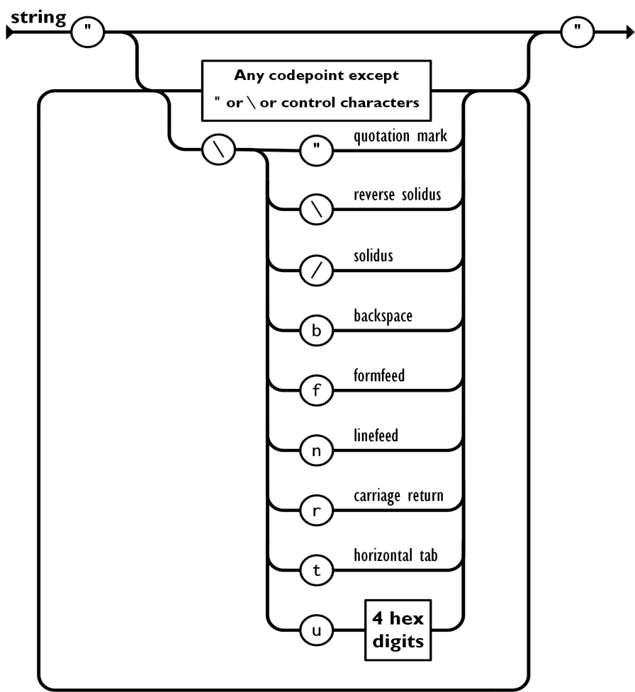
String in JSON
A string is a sequence of zero or more Unicode characters, wrapped in double quotes, using backslash escapes. A character is represented as a single character string. A string is very much like a C or Java string.
Ex: {"name":"John"} [2]

Slide 11
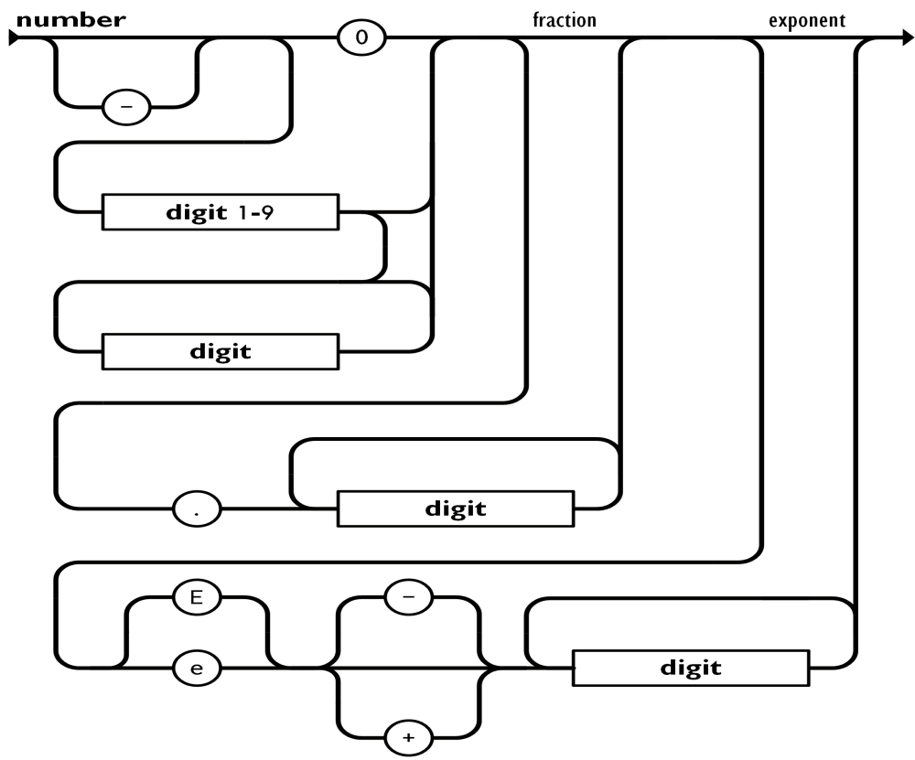
Number in JSON
A number is very much like a C or Java number, except that the octal and hexadecimal formats are not used.
Ex: {"age":30} [2]

Slide 12
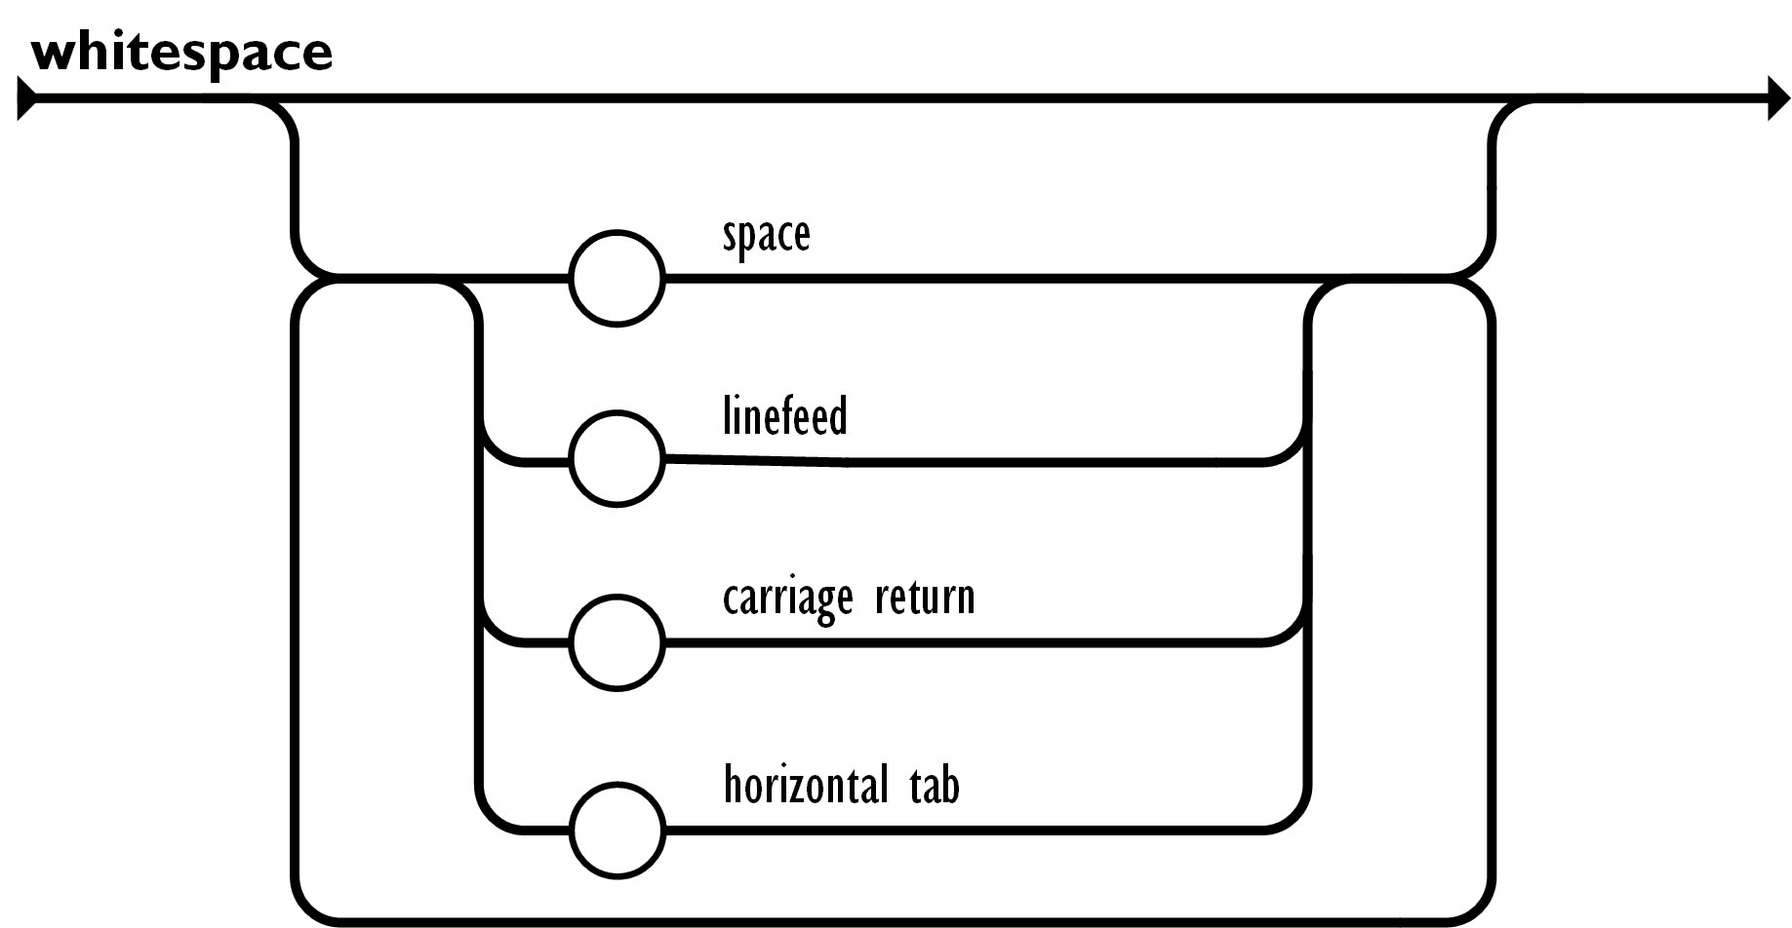
Whitespace in JSON
Whitespace can be inserted between any pair of tokens. Excepting a few encoding details, that completely describes the language.

Slide 13
Simple Encoder in JSON
class json.JSONEncoder(*, skipkeys=False, ensure_ascii=True, check_circular=True, allow_nan=True, sort_keys=False, indent=None, separators=None, default=None) [3]
Extensible JSON encoder for Python data structures.
Supports the following objects and types by default:
Python | JSON
dict | object
list, tuple | array
str | string
int, float, int- & float-derived Enums | number
True | true
False | false
None | null

Slide 14
Encoding in JSON
JSON exposes an API familiar to users of the standard library marshal and pickle modules.
Encoding basic Python object hierarchies: [3]
import json json.dumps(['foo', {'bar': ('baz', None, 1.0, 2)}])
print(json.dumps("\"foo\bar"))
print(json.dumps('\u1234'))
print(json.dumps('\\'))
print(json.dumps({"c": 0, "b": 0, "a": 0}, sort_keys=True))
from io import StringIO io = StringIO() json.dump(['streaming API'], io) io.getvalue()
Compact encoding: [3]
import json json.dumps([1, 2, 3, {'4': 5, '6': 7}], separators=(',', ':'))
Pretty printing: [3]
import json print(json.dumps({'4': 5, '6': 7}, sort_keys=True, indent=4))

Slide 15
Simple JSON decoder
class json.JSONDecoder(*, object_hook=None, parse_float=None, parse_int=None, parse_constant=None, strict=True, object_pairs_hook=None) [3]
Translations in decoding by default:
JSON | Python
object | dict
array | list
string | str
number (int) | int
number (real) | float
true | True
false | False
null | None

Slide 16
Decoding in JSON
Decoding JSON: [3]
import json
json.loads('["foo", {"bar":["baz", null, 1.0, 2]}]')
json.loads('"\\"foo\\bar"')
from io import
StringIO io = StringIO('["streaming API"]')
json.load(io)
Specializing JSON object decoding: [3]
import json
def as_complex(dct):
if '__complex__' in dct:
return complex(dct['real'], dct['imag'])
return dct
json.loads('{"__complex__": true, "real": 1, "imag": 2}',
object_hook=as_complex)
import decimal
json.loads('1.1', parse_float=decimal.Decimal)

Slide 17
Python - convert image to JSON [5]
As the base64.encodebytes() has been deprecated in base64 and base64.b64decode(data['img']) to convert back
import json
import base64
data = {}
with open('some.gif', mode='rb') as file:
img = file.read()
data['img'] =base64.encodebytes(img).decode('utf-8')
print(json.dumps(data))

Slide 18
Working With JSON Data in Python
JSON is supposed to be readable by anyone who’s used a C-style language, and Python is a C-style language.
JSON supports primitive types, like strings and numbers, as well as nested lists and objects.
{
"firstName": "Jane",
"lastName": "Doe",
"hobbies": ["running", "sky diving", "singing"],
"age": 35,
"children": [
{
"firstName": "Alice",
"age": 6
},
{
"firstName": "Bob",
"age": 8
}
]
}

Slide 19
Python Supports JSON Natively!
Python comes with a built-in package called json for encoding and decoding JSON data.
Ex: import json

Slide 20
References
[1]. https://www.json.org/json-en.html
[2]. https://www.w3schools.com/js/js_json_datatypes.asp
[3]. https://docs.python.org/3/library/json.html
[4].https://subscription.packtpub.com/book/webdevelopment/9781788624701/1/ch01lvl1sec10/json-a-dataexchangeformat#:~:text=To%20define%20JSON%2C%20we%20can,is%20not%20dependent%20on%20JavaScript
[5] https://stackoverflow.com/questions/54660800/python-convert-image-to-json/54661844#54661844

