Slide 1

#SQL: Joins
Aarju Dixit Research Scholar Department of Computer Science and Engineering Indian Institute of Technology Jodhpur, Rajasthan, India 342030
CSL4030 Data Engineering Lab - 4
August 23st, 2023

Slide 2
What is SQL?
SQL stands for Structured Query Language.
SQL lets you access and manipulate databases.
There are major commands (such as SELECT, UPDATE, DELETE, INSERT, WHERE) in a similar manner.

Slide 3
Join Types
SQL Join statement is used to combine data or rows from two or more tables based on a common field between them. Different types of Joins are as follows:
INNER JOIN
LEFT JOIN
RIGHT JOIN
FULL JOIN
NATURAL JOIN
SELF JOIN

Slide 4
Inner Join
The INNER JOIN keyword selects all rows from both the tables as long as the condition is satisfied.
This keyword will create the result-set by combining all rows from both the tables where the condition satisfies i.e. value of the common field will be the same.

Slide 5
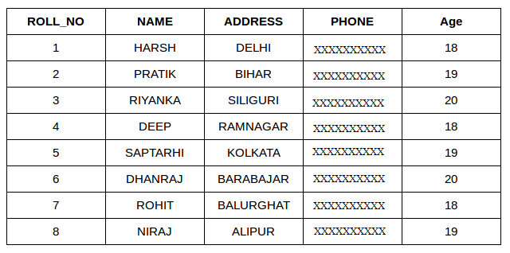
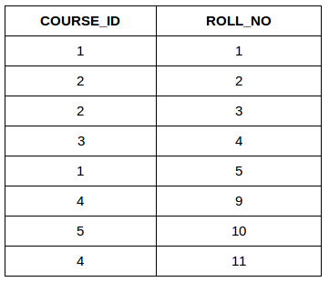
Consider the two tables below as follows:
Student Course [1] Student [1]

Slide 6
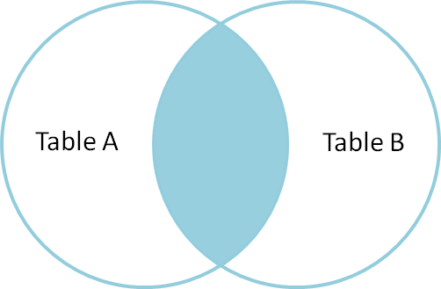
Inner Join
SELECT table1.column1,table1.column2,table2.column1,....
FROM table1
INNER JOIN table2
ON table1.matching_column = table2.matching_column;
table1: First table.
table2: Second table
matching_column: (Column common to both the tables.)

Slide 7
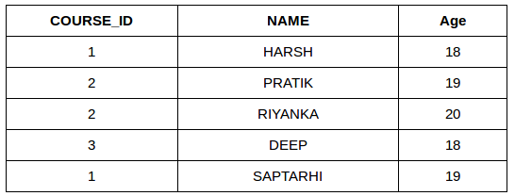
Example Queries(INNER JOIN)
This query will show the names and age of students enrolled in different courses.
SELECT StudentCourse.COURSE_ID, Student.NAME, Student.AGE FROM Student
INNER JOIN StudentCourse
ON Student.ROLL_NO = StudentCourse.ROLL_NO;
Output:

Slide 8
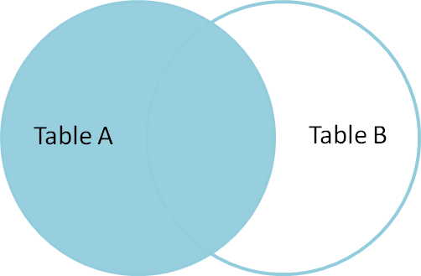
LEFT JOIN
This join returns all the rows of the table on the left side of the join and matches rows for the table on the right side of the join. For the rows for which there is no matching row on the right side, the result-set will contain null. LEFT JOIN is also known as LEFT OUTER JOIN.
SELECT table1.column1,table1.column2,table2.column1,....
FROM table1
LEFT JOIN table2
ON table1.matching_column = table2.matching_column;
table1: First table
table2: Second table
matching_column: Column common to both the tables.

Slide 9
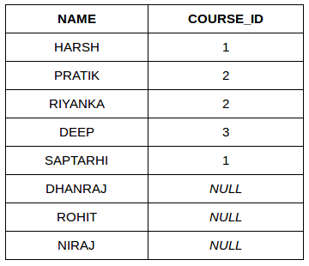
Example Queries(LEFT JOIN)
SELECT Student.NAME,StudentCourse.COURSE_ID
FROM Student
LEFT JOIN StudentCourse
ON StudentCourse.ROLL_NO = Student.ROLL_NO;
Output:

Slide 10
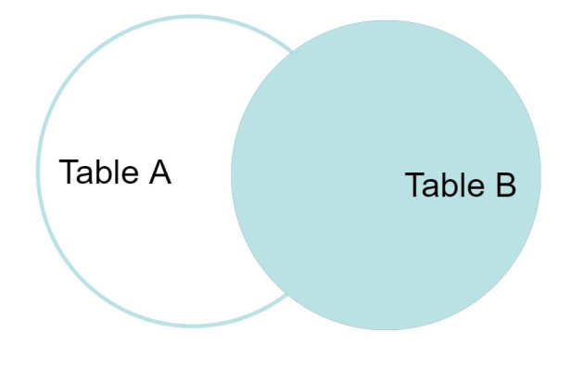
RIGHT JOIN
RIGHT JOIN is similar to LEFT JOIN.
This join returns all the rows of the table on the right side of the join and matching rows for the table on the left side of the join.
For the rows for which there is no matching row on the left side, the result-set will contain null.
RIGHT JOIN is also known as RIGHT OUTER JOIN.
Syntax:
SELECT table1.column1,table1.column2,table2.column1,....
FROM table1
RIGHT JOIN table2
ON table1.matching_column = table2.matching_column;
table1: First table
table2: Second table
matching_column: Column common to both the tables.

Slide 11
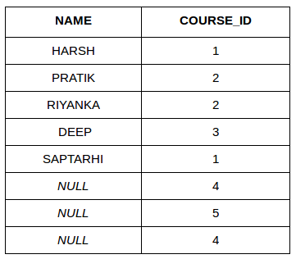
Example Queries (RIGHT JOIN):
SELECT Student.NAME,StudentCourse.COURSE_ID
FROM Student
RIGHT JOIN StudentCourse
ON StudentCourse.ROLL_NO = Student.ROLL_NO;
Output:

Slide 12
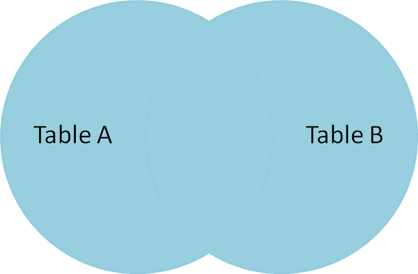
Full Join
FULL JOIN creates the result-set by combining results of both LEFT JOIN and RIGHT JOIN.
The result-set will contain all the rows from both tables. For the rows for which there is no matching, the result-set will contain NULL values.
Syntax:
SELECT table1.column1,table1.column2,table2.column1,....
FROM table1
FULL JOIN table2
ON table1.matching_column = table2.matching_column;
table1: First table.
table2: Second table
matching_column: Column common to both the tables.

Slide 13
Example Queries(FULL JOIN)
SELECT Student.NAME,StudentCourse.COURSE_ID
FROM Student
FULL JOIN StudentCourse
ON StudentCourse.ROLL_NO = Student.ROLL_NO;
Output:
NAME | COURSE_ID
HARSH | 1
PRATIK | 2
RIYANKA | 2
DEEP | 3
SAPTARHI | 1
DHANRAJ | NULL
ROHIT | NULL
NIRAJ | NULL
NULL | 4
NULL | 5
NULL | 4

Slide 14
Natural join (⋈)
Natural Join joins two tables based on same attribute name and data types. The resulting table will contain all the attributes of both the table but keep only one copy of each common column.
Example:
Consider the two tables given below [1] Student Table Marks Table [1]
Employee
Emp_id | Emp_name | Dept_id
1 | Ram | 10
2 | Jon | 30
3 | Bob | 50
Department
Dept_id | Dept_name
10 | IT
30 | HR
40 | TIS

Slide 15
Query: Find all Employees and their respective departments. Solution: (Employee) ⋈ (Department)
Emp_id | Emp_name | Dept_id | Dept_id | Dept_name
1 | Ram | 10 | 10 | IT
2 | Jon | 30 | 30 | HR
Employee data |  |  | Department data

Slide 16
Self Join
A self join is a regular join, but the table is joined with itself.
Syntax:
SELECT column_name(s) FROM table1 T1, table1 T2 WHERE condition;
T1 and T2 are different table aliases for the same table.

Slide 17
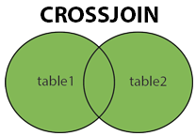
CROSS JOIN
The CROSS JOIN keyword returns all records from both tables (table1 and table2).
Syntax:
SELECT column_name(s) FROM table1 CROSS JOIN table2; [2]
Note: CROSS JOIN can potentially return very large result-sets

Slide 18
References
https://www.geeksforgeeks.org/sql-join-set-1-inner-left-right-and-full-joins/ [1]
https://www.w3schools.com/mysql/mysql_join_cross.asp [2]

Slide 19
Thank You!

