Slide 1

#SQL: Transactions
Aarju Dixit Research Scholar Department of Computer Science and Engineering Indian Institute of Technology Jodhpur, Rajasthan, India 342030
CSL4030 Data Engineering Lab - 5
August 30th 2023

Slide 2
What are transactions?
Transactions group a set of tasks into a single execution unit.
Each transaction begins with a specific task and ends when all the tasks in the group successfully complete.
If any of the tasks fail, the transaction fails. Therefore, a transaction has only two results: success or failure. [2]
It is a set of operations used to perform a logical unit of work.
A transaction generally represent change in database.
In database there are two type of transaction: read and write.

Slide 3
Properties of Transactions
Transactions have the following four standard properties, usually referred to by the acronym ACID.
Atomicity: ensures that all operations within the work unit are completed successfully. Otherwise, the transaction is aborted at the point of failure and all the previous operations are rolled back to their former state.
Consistency: ensures that the database properly changes states upon a successfully committed transaction.
Isolation: enables transactions to operate independently of and transparent to each other.
Durability: ensures that the result or effect of a committed transaction persists in case of a system failure. [2]

Slide 4
Example on transaction
Example: A Transaction to transfer $150 from account A to account B:
1. read(A) 2. A := A – 150 3. write(A) 4. read(B) 5. B := B + 150 6. write(B)
Incomplete steps result in the failure of the transaction.
A database transaction, by definition, must be atomic, consistent, isolated and durable.
These are popularly known as ACID properties.
These properties can ensure the concurrent execution of multiple transactions without conflict. [1]

Slide 5
How to implement Transactions using SQL?
Following commands are used to control transactions.
It is important to note that these statements cannot be used while creating tables and are only used with the DML Commands such as:
INSERT, UPDATE and DELETE. [2]

Slide 6
Transaction Control
1. BEGIN TRANSACTION: It indicates the start point of an explicit or local transaction.
Syntax:
BEGIN TRANSACTION transaction_name ;
2. SET TRANSACTION: Places a name on a transaction.
Syntax:
SET TRANSACTION [ READ WRITE | READ ONLY ];
3. COMMIT: If everything is in order with all statements within a single transaction, all changes are recorded together in the database is called committed.
The COMMIT command saves all the transactions to the database since the last COMMIT or ROLLBACK command.
Syntax:
COMMIT;

Slide 7
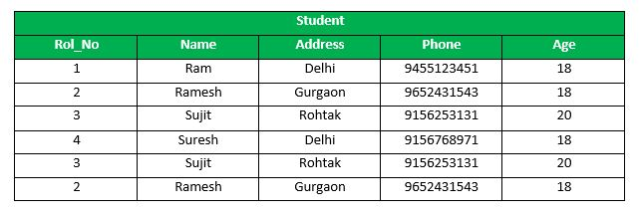
Example
Following is an example which would delete those records from the table which have age = 20 and then COMMIT the changes in the database.
Queries:
DELETE FROM Student WHERE AGE = 20; COMMIT; [2]

Slide 8
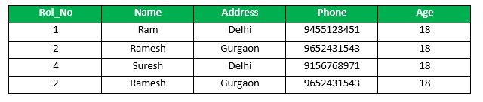
Example Contd.
Output: Thus, two rows from the table would be deleted and the SELECT statement would look like: [2]

Slide 9
Roll Back
If any error occurs with any of the SQL grouped statements, all changes need to be aborted.
The process of reversing changes is called rollback.
This command can only be used to undo transactions since the last COMMIT or ROLLBACK command was issued.
Syntax: ROLLBACK;

Slide 10
SAVEPOINT
It creates points within the groups of transactions in which to ROLLBACK.
A SAVEPOINT is a point in a transaction in which you can roll the transaction back to a certain point without rolling back the entire transaction.
Syntax
SAVEPOINT SAVEPOINT_NAME;
This command is used only in the creation of SAVEPOINT among all the transactions.
In general ROLLBACK is used to undo a group of transactions.
Syntax for rolling back to Savepoint command:
ROLLBACK TO SAVEPOINT_NAME;
you can ROLLBACK to any SAVEPOINT at any time to return the appropriate data to its original state.

Slide 11
RELEASE SAVEPOINT
RELEASE SAVEPOINT:- This command is used to remove a SAVEPOINT that you have created.
Syntax:
RELEASE SAVEPOINT SAVEPOINT_NAME
Once a SAVEPOINT has been released, you can no longer use the ROLLBACK command to undo transactions performed since the last SAVEPOINT.
It is used to initiate a database transaction and used to specify characteristics of the transaction that follows.

Slide 12
References
https://www.tutorialspoint.com/sql/sql-transactions.htm [1]
https://www.geeksforgeeks.org/sql-transactions/ [2]

Slide 13
Thank You!

