Slide 1

Data encoding with XML
Aarju Dixit Research Scholar Department of Computer Science and Engineering Indian Institute of Technology Jodhpur, Rajasthan, India 342030
CSL4030 Data Engineering Lab 7
September 27th 2023

Slide 2
Data Encoding
Encoding is the process of converting data into a specified format for the transmission of data. For example, when one app is communicating with other apps, they share data in a pre-decided format.
Decoding is the reverse process of encoding i.e. to extract the data from the encoded format.
Many data formats are programming/scripting language specific. For example, data can be encoded into and decoded from the ‘pickle’ format using only Python.
Some data formats are widely supported by almost all languages. Two such formats are XML and JSON.

Slide 3
Introduction of XML (Extensible Markup Language)
Derived from SGML (Standard Generalized Markup Language). SGML was designed to encode any large files. Based on that, W3C introduced the XML 1.0 language specification in 1998 to specifically encode data files.
Side note: HTML is also a markup language designed specifically for encoding webpages.
Documents have tags giving extra information about sections of the document
E.g., <title> XML </title> <slide> Introduction …</slide>
Extensible (unlike HTML). Users can define new tags.

Slide 4
XML Introduction (Cont.)
The ability to create user defined tags, and to create nested tag structures make XML a great way to exchange data, not just documents.
Much of the use of XML has been in data exchange applications, not as a replacement for HTML.
Tags make data (relatively) self-documenting.
E.g., <university> <department> <dept_name> Comp. Sci. </dept_name> <building> Taylor </building> <budget> 100000 </budget> </department> <course> <course_id> CS-101 </course_id> <title> Intro. to Computer Science </title> <dept_name> Comp. Sci </dept_name> <credits> 4 </credits> </course>
</university>

Slide 5
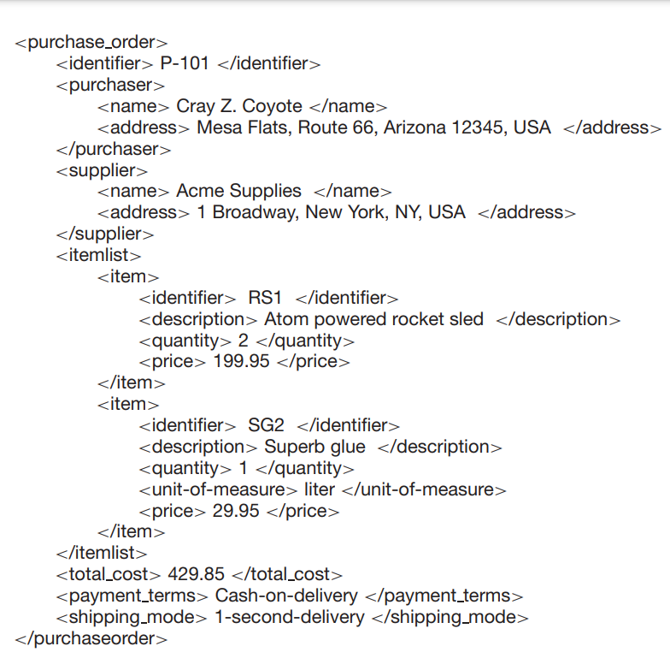
Example related to XML Motivation

Slide 6
Motivation of XML Example Explanation
The previous example shows how information about a purchase order can be represented in XML, illustrates a more realistic use of XML.
Purchase orders are typically generated by one organization and sent to another. Traditionally they were printed on paper by the purchaser and sent to the supplier; the data would be manually re-entered into a computer system by the supplier.
This slow process can be greatly sped up by sending the information electronically between the purchaser and supplier.
The nested representation allows all information in a purchase order to be represented naturally in a single document.
XML provides a standard way of tagging the data; the two organizations must of course agree on what tags appear in the purchase order, and what they mean.
The previous example compared to storage of data in a relational database, the XML representation may be inefficient, since tag names are repeated throughout the document.
The presence of the tags makes the message self-documenting; that is, a schema need not be consulted to understand the meaning of the text.

Slide 7
Structure of XML Data
An element = start-tag + text ‘in the context of the element’ + end-tag
Tag: label for a section of data
Element: section of data beginning with <tagname> and ending with matching </tagname>
Elements must be properly nested.
Proper nesting
<course> … <title> …. </title> </course>
Improper nesting
<course> … <title> …. </course> </title>
Formally: every start tag must have a unique matching end tag, that is in the context of the same parent element.
Every document must have a single root element.

Slide 8
Attributes
Elements can have attributes
<course course_id= “CS-101”> <title> Intro. to Computer Science</title> <dept name> Comp. Sci. </dept name> <credits> 4 </credits> </course>
Attributes are specified by name=value pairs inside the starting tag of an element
An element may have several attributes, but each attribute name can only occur once
<course course_id = “CS-101” credits=“4”>

Slide 9
Attributes vs Subelements
Distinction between sub element and attribute
In the context of documents, attributes are part of markup, while subelement contents are part of the basic document contents
In the context of data representation, the difference is unclear and may be confusing
Same information can be represented in two ways
<course course_id= “CS-101”> … </course>
<course> <course_id>CS-101</course_id> … </course>
Suggestion: use attributes for identifiers of elements, and use subelements for contents.

Slide 10
NameSpaces
XML data has to be exchanged between organizations.
Same tag name may have different meaning in different organizations, causing confusion on exchanged documents.
Specifying a unique string as an element name avoids confusion.
Better solution: use unique-name:element-name.
Avoid using long unique names all over document by using XML Namespaces.
<university xmlns:yale=“http://www.yale.edu”> …
<yale:course>
<yale:course_id> CS-101 </yale:course_id>
<yale:title> Intro. to Computer Science</yale:title>
<yale:dept_name> Comp. Sci. </yale:dept_name>
<yale:credits> 4 </yale:credits>
</yale:course> …
</university>

Slide 11
More on XML Syntax
Elements without subelements or text content can be abbreviated by ending the start tag with a /> and deleting the end tag
<course course_id=“CS-101” Title=“Intro. To Computer Science” dept_name = “Comp. Sci.” credits=“4” />
To store string data that may contain tags, without the tags being interpreted as subelements, use CDATA as below
<![CDATA[<course> … </course>]]>
Here, <course> and </course> are treated as just strings
CDATA stands for “character data”

Slide 12
XML Document Schema
Database schemas constrain what information can be stored, and the data types of stored values.
XML documents are not required to have an associated schema.
However, schemas are very important for XML data exchange.
Otherwise, a site cannot automatically interpret data received from another site
Two mechanisms for specifying XML schema:
Document Type Definition (DTD)
Widely used
XML Schema
Newer, increasing use

Slide 13
Document Type Definition
The type of an XML document can be specified using a DTD.
DTD constraints structure of XML data
What elements can occur?
What attributes can/must an element have?
What subelements can/must occur inside each element, and how many times?
DTD does not constrain data types
All values represented as strings in XML
DTD syntax
<!ELEMENT element (subelements-specification) >
<!ATTLIST element (attributes) >

Slide 14
Elements specified in DTD
Subelements can be specified as
names of elements, or
#PCDATA (parsed character data), i.e., character strings
EMPTY (no subelements) or ANY (anything can be a subelement)
Example
<! ELEMENT department (dept_name building, budget)>
<! ELEMENT dept_name (#PCDATA)>
<! ELEMENT budget (#PCDATA)>
Subelement specification may have regular expressions
<!ELEMENT university ( ( department | course | instructor | teaches )+)>
Notation:
“|” - alternatives
“+” - 1 or more occurrences
“*” - 0 or more occurrences

Slide 15
University DTD
<!DOCTYPE university [ <!ELEMENT university ( (department|course|instructor|teaches)+)> <!ELEMENT department ( dept name, building, budget)> <!ELEMENT course ( course id, title, dept name, credits)> <!ELEMENT instructor (IID, name, dept name, salary)> <!ELEMENT teaches (IID, course id)> <!ELEMENT dept name( #PCDATA )> <!ELEMENT building( #PCDATA )> <!ELEMENT budget( #PCDATA )> <!ELEMENT course id ( #PCDATA )> <!ELEMENT title ( #PCDATA )> <!ELEMENT credits( #PCDATA )> <!ELEMENT IID( #PCDATA )> <!ELEMENT name( #PCDATA )> <!ELEMENT salary( #PCDATA )>
]>

Slide 16
Limitations of DTDs
No typing of text elements and attributes.
All values are strings, no integers, reals, etc.
Difficult to specify unordered sets of subelements
Order is usually irrelevant in databases (unlike in the document-layout environment from which XML evolved)
(A | B)* allows specification of an unordered set, but
Cannot ensure that each of A and B occurs only once
IDs and IDREFs are untyped
The instructors attribute of an course may contain a reference to another course, which is meaningless
instructors attribute should ideally be constrained to refer to instructor elements

Slide 17
XML Schema
XML Schema is a more sophisticated schema language which addresses the drawbacks of DTDs. it supports:
Typing of values
E.g., integer, string, etc.
Also, constraints on min/max values.
User-defined, complex types.
Many more features, including:
uniqueness and foreign key constraints, inheritance.
XML Schema is itself specified in XML syntax, unlike DTDs.
More-standard representation, but verbose.
XML Scheme is integrated with namespaces.
BUT: XML Schema is significantly more complicated than DTDs.

Slide 18
XML Schema Version of Univ. DTD
<xs:schema xmlns:xs=“http://www.w3.org/2001/XMLSchema”>
<xs:element name=“university” type=“universityType” />
<xs:element name=“department”>
<xs:complexType>
<xs:sequence>
<xs:element name=“dept name” type=“xs:string”/>
<xs:element name=“building” type=“xs:string”/>
<xs:element name=“budget” type=“xs:decimal”/>
</xs:sequence>
</xs:complexType>
</xs:element>
….
<xs:element name=“instructor”>
<xs:complexType>
<xs:sequence>
<xs:element name=“IID” type=“xs:string”/>
<xs:element name=“name” type=“xs:string”/>
<xs:element name=“dept name” type=“xs:string”/>
<xs:element name=“salary” type=“xs:decimal”/>
</xs:sequence>
</xs:complexType>
</xs:element>
… Contd.

Slide 19
XML Schema Version of Univ. DTD (Cont.)
….
<xs:complexType name=“UniversityType”>
<xs:sequence>
<xs:element ref=“department” minOccurs=“0” maxOccurs=“unbounded”/>
<xs:element ref=“course” minOccurs=“0” maxOccurs=“unbounded”/>
<xs:element ref=“instructor” minOccurs=“0” maxOccurs=“unbounded”/>
<xs:element ref=“teaches” minOccurs=“0” maxOccurs=“unbounded”/>
</xs:sequence>
</xs:complexType>
</xs:schema>
Choice of “xs:” was an example -- any other namespace prefix could be chosen
Element “university” has type “universityType”, which is defined separately
xs:complexType is used later to create the named complex type “UniversityType”

Slide 20
Querying and Transforming XML Data
Translation of information from one XML schema to another
Querying on XML data
Above two are closely related, and handled by the same tools
Standard XML querying/translation languages
XPath
Simple language consisting of path expressions
XSLT
Simple language designed for translation from XML to XML and XML to HTML
XQuery
An XML query language with a rich set of features

Slide 21
Tree Representation
Tree representation: model XML data as tree and store using relations nodes(id, parent_id, type, label, value)
Each element/attribute is given a unique identifier.
Type indicates element/attribute.
Label specifies the tag name of the element/name of attribute.
Value is the text value of the element/attribute.
Can add an extra attribute position to record ordering of children.
university (id:1)
course (id:2)
department (id: 5)
course_id (id: 3)
dept_name (id: 7)

Slide 22
Tree Model of XML Data
Query and transformation languages are based on a tree model of XML data.
An XML document is modeled as a tree, with nodes corresponding to elements and attributes.
Element nodes have child nodes, which can be attributes or subelements
Text in an element is modeled as a text node child of the element
Children of a node are ordered according to their order in the XML document
Element and attribute nodes (except for the root node) have a single parent, which is an element node
The root node has a single child, which is the root element of the document.

Slide 23
Tree Representation (Cont.)
Benefit: Can store any XML data, even without DTD.
Drawbacks:
Data is divided into too many pieces, increasing space overheads.
Even simple queries require a large number of joins, which can slow the process.

Slide 24
XPath
XPath is used to address (select) parts of documents using.
path expressions
A path expression is a sequence of steps separated by “/”
Think of file names in a directory hierarchy
Result of path expression: set of values that along with their containing elements/attributes match the specified path .
E.g., /university-3/instructor/name evaluated on the university-3 data we saw earlier returns
<name>Srinivasan</name> <name>Brandt</name>
E.g., /university-3/instructor/name/text( )
Returns the same names, but without the enclosing tags.

Slide 25
XPath (Cont.)
The initial “/” denotes root of the document (above the top-level tag)
Path expressions are evaluated left to right
Each step operates on the set of instances produced by the previous step
Selection predicates may follow any step in a path, in [ ]
E.g., /university-3/course[credits >= 4]
returns account elements with a balance value greater than 400
/university-3/course[credits] returns account elements containing a credits subelement
Attributes are accessed using “@”
E.g., /university-3/course[credits >= 4]/@course_id
returns the course identifiers of courses with credits >= 4
IDREF attributes are not dereferenced automatically (more on this later)

Slide 26
XQuery
XQuery is a general purpose query language for XML data.
The textbook description is based on a January 2005 draft of the standard. The final version may differ, but major features likely to stay unchanged.
XQuery is derived from the Quilt query language, which itself borrows from SQL, XQL and XML-QL.
XQuery uses a for … let … where … order by …result … syntax for ⬄ SQL from where ⬄ SQL where order by ⬄ SQL order by
result ⬄ SQL select let allows temporary variables, and has no equivalent in SQL

Slide 27
Different tools to run XQuery
Tools to run XQuery:
BaseX
Stylus Studio
Eclipse
Oxygen XML Editor

Slide 28
Doc() and Collection() Function
The built-in function doc(name) returns the root of a named document; the name could be a file name or a URL.
The root returned by the function can then be used in a path expression to access the contents of the document.
Thus, a path expression can be applied on a specified document, instead of being applied on the current default document.
For example, if the university data in our university example is contained in a file “university.xml”, the following path expression would return all departments at the
university: doc(“university.xml”)/university/department
The function collection(name) is similar to doc, but returns a collection of documents identified by name.
The function collection can be used, for example, to open an XML database, which can be viewed as a collection of documents; the following element in the XPath expression would select the appropriate document(s) from the collection.

Slide 29
FLWOR (For, Let, Where, Order by, Return) Syntax in XQuery
For clause uses XPath expressions, and variable in for clause ranges over values in the set returned by XPath
Simple FLWOR expression in XQuery
find all courses with credits > 3, with each result enclosed in an <course_id> .. </course_id> tag for $x in /university-3/course let $courseId := $x/@course_id where $x/credits > 3 return <course_id> { $courseId } </course id>
Items in the return clause are XML text unless enclosed in {}, in which case they are evaluated
Let clause not really needed in this query, and selection can be done In XPath. Query can be written as:
for $x in /university-3/course[credits > 3] return <course_id> { $x/@course_id } </course_id>
Alternative notation for constructing elements:
return element course_id { element $x/@course_id }

Slide 30
Sorting in XQuery
The order by clause can be used at the end of any expression.
E.g., to return instructors sorted by name
for $i in /university/instructor order by $i/name return <instructor> { $i/* } </instructor>
Use order by $i/name descending to sort in descending order
Can sort at multiple levels of nesting (sort departments by dept_name, and by courses sorted to course_id within each department)
<university-1> { for $d in /university/department order by $d/dept name return <department> { $d/* } { for $c in /university/course[dept name = $d/dept name] order by $c/course id return <course> { $c/* } </course> } </department> } </university-1>

Slide 31

Sorting Example with Result
<?xml version="1.0" encoding="UTF-8"?>
<xsl:stylesheet version="1.0"
xmlns:xsl="http://www.w3.org/1999/XSL/Transform">
<xsl:template match="/">
<html>
<body>
<table border="1">
<tr bgcolor="#9acd32">
<th>Title</th>
<th>Artist</th>
</tr>
<xsl:for-each select="catalog/cd[artist='Bob Dylan']">
<tr>
<td><xsl:value-of select="title"/></td>
<td><xsl:value-of select="artist"/></td>
</tr>
</xsl:for-each>
</table>
</body>
</html>
</xsl:template>
</xsl:stylesheet>
Courtesy: from w3cSchools [2]

Slide 32
Joins in XML
Joins in XML can be used to add tags from one stream into a leading XML structure from a second stream.
The target stream must have only one row, since it represents a XML document.
The other stream can consist of many rows and the tags from all rows will be added to the target document.

Slide 33
Example of Joins
Joins are specified in a manner very similar to SQL
for $c in /university/course, $i in /university/instructor, $t in /university/teaches where $c/course_id= $t/course id and $t/IID = $i/IID return <course_instructor> { $c $i } </course_instructor>
The same query can be expressed with the selections specified as XPath selections:
for $c in /university/course, $i in /university/instructor, $t in /university/teaches[ $c/course_id= $t/course_id and $t/IID = $i/IID] return <course_instructor> { $c $i } </course_instructor>

Slide 34
References
Chapter 23, A. SILBERSCHATZ, H.F. KORTH, S. SUDARSHAN (2011), Database System Concepts, McGraw Hill. Publications, 6th Edition.
https://www.w3schools.com/xml/tryxslt.asp?xmlfile=cdcatalog&xsltfile=cdcatalog_filter [2]

Slide 35
Thank You!

