Slide 1
Fatal Police Shootings in the USA
Andrei Martins
Daniel Dedoukh
Hidayat Rzayev
Ivaylo Gatev
Spyridon Ntokos

Slide 2

INTRODUCTION
Data provided by Washington Post
Cases filed between 2000 and 2017
Deaths tracked:
shootings in which a police officer, in the line of duty, shot and killed a civilian
Deaths not tracked:
people in police custody
fatal shootings by off-duty officers
non-shooting deaths

Slide 3
Business Understanding
What affects the fatal outcome of police shootings?
Race
Gender
Age
Mental illness

Slide 4


Data Source
Fatal Police Shootings in the US
https://www.kaggle.com/kwullum/fatal-police-shootings-in-the-us
US Police Involved Fatalities
https://data.world/awram/us-police-involved-fatalities
Datasets are in CSV format

Slide 5
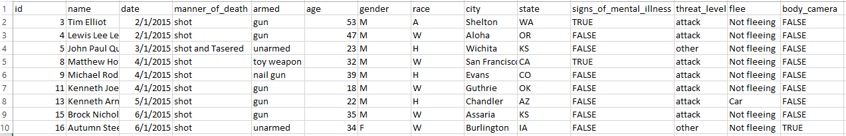
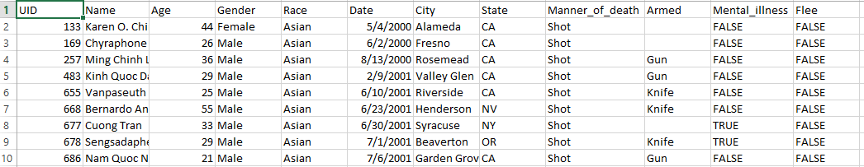
Data Understanding
12.306 rows of data
Unnecessary columns
manner_of_death
threat_level
flee
body_camera

Slide 6
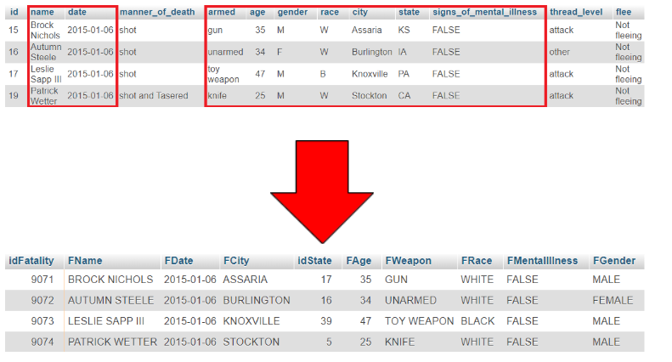
Data Preparation
Harmonization
Data cleansing
Data quality

Slide 7
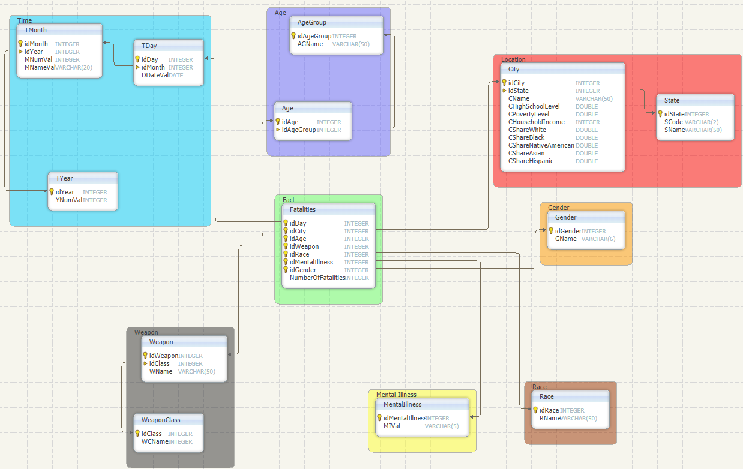
Modeling of CDWH
Fact table:
Fatalities
Dimension tables:
Time
Location
Race
Gender
Weapon
Age
Mentalillnes

Slide 8
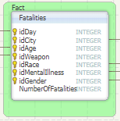
Fact Table
Foreign keys to 7 dimensions
Number of fatalities happened on a particular:
Day
City
etc.

Slide 9
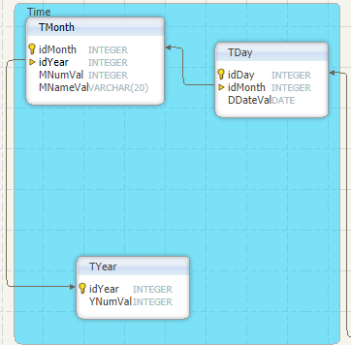
Time Dimension
When did an accident take place?
Day
Month
Year

Slide 10
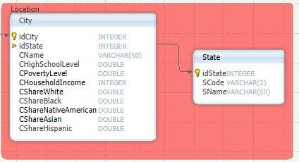
Location Dimension
City
State
Each city belongs to a single state

Slide 11
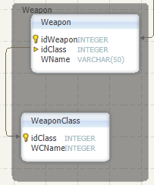
Weapon Dimension
Weapon
67 distinct weapons
Grouped by WeaponClass
10 distinct weapon categories, such as
Ranged
Melee
Explosives
Vehicle
etc.

Slide 12
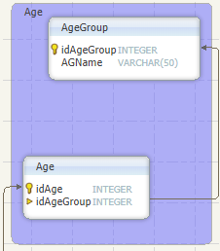
Age Dimension
Age
Age value as primary key
Grouped by AgeGroup
Children
Teenagers
Adults
Elderly
Unknown

Slide 13
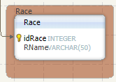
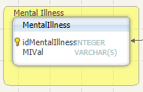
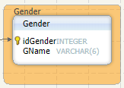
Further Dimensions
Race
White
Black
Hispanic
Native American
Asian
Other
Unknown
Gender
Male
Female
Unknown
Mental Illness
True
False

Slide 14
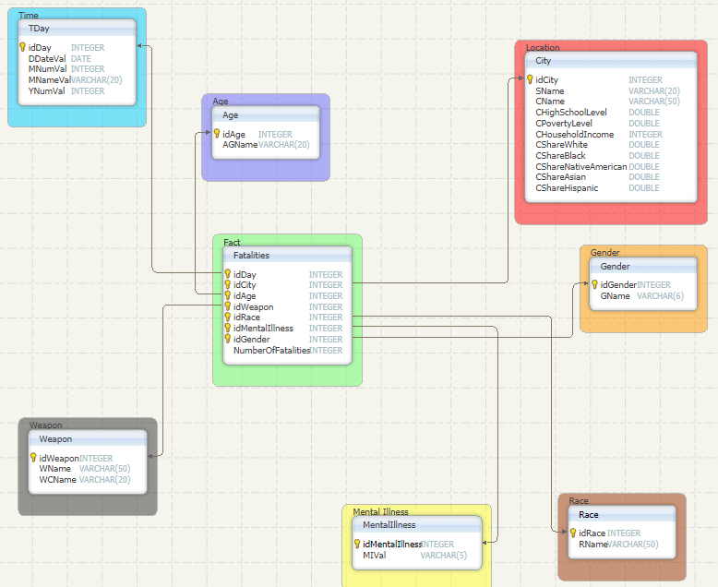
Modeling of DM
Fact table:
Fatalities
Dimension tables:
Time Dimension: TDay, TMonth, TYear ⇒ TDay
Location Dimension: City, State ⇒ City
Weapon Dimension: Weapon, WeaponClass ⇒ Weapon
Age Dimension: Age, AgeGroup ⇒ Age
Gender, Race and MentalIllnes ⇒ kept the same

Slide 15
Analytics

Slide 16
Basic summary statistics
Dataset shape: 12.306 entries 21 different columns
City Share:
White: min = 0%, max = 100%, average = 63,54%
Black: min = 0%, max = 98,6%, average = 16,4%
Native American: min = 0%, max = 99,7%, average = 1,39%
Asian: min = 0%, max = 67,1%, average = 5,25%
Hispanic: min = 0%, max = 98,2%, average = 24,07%
Age: min = 1, max = 107, average = 34
City Household income: min = 12.083$. max = 194.336$, average = 49.746$
City High-School grads: min =25.5%, max = 100%, average = 83,4%
Below Poverty level cities: min = 0,6%, max = 76,4%, average = 19,68%

Slide 17
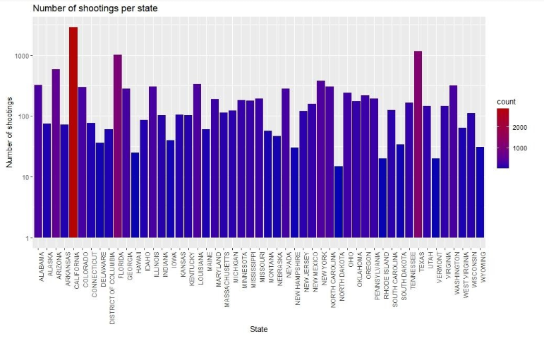
Number of shootings per state
Highest rated states:
California
Texas
Florida
Lowest rated states:
North Dakota
Vermont
Rhode Island

Slide 18
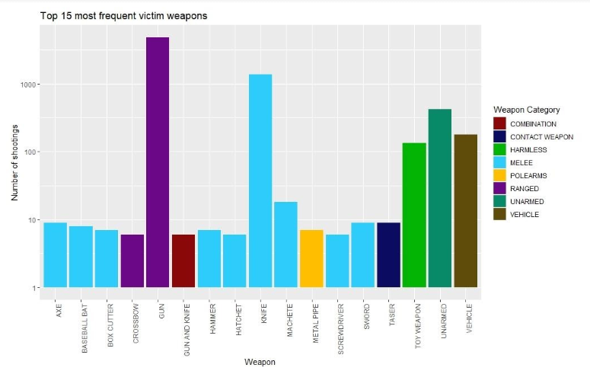
Top 15 most frequent victim weapons
Most used weapons
Gun
Knife
Unarmed

Slide 19
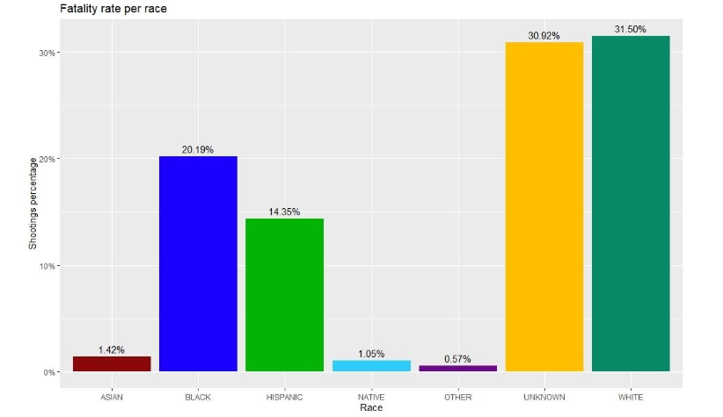
Fatality rate per race
Most involved races
White
Black
Hispanic
High unknown rate
No final conclusion

Slide 20
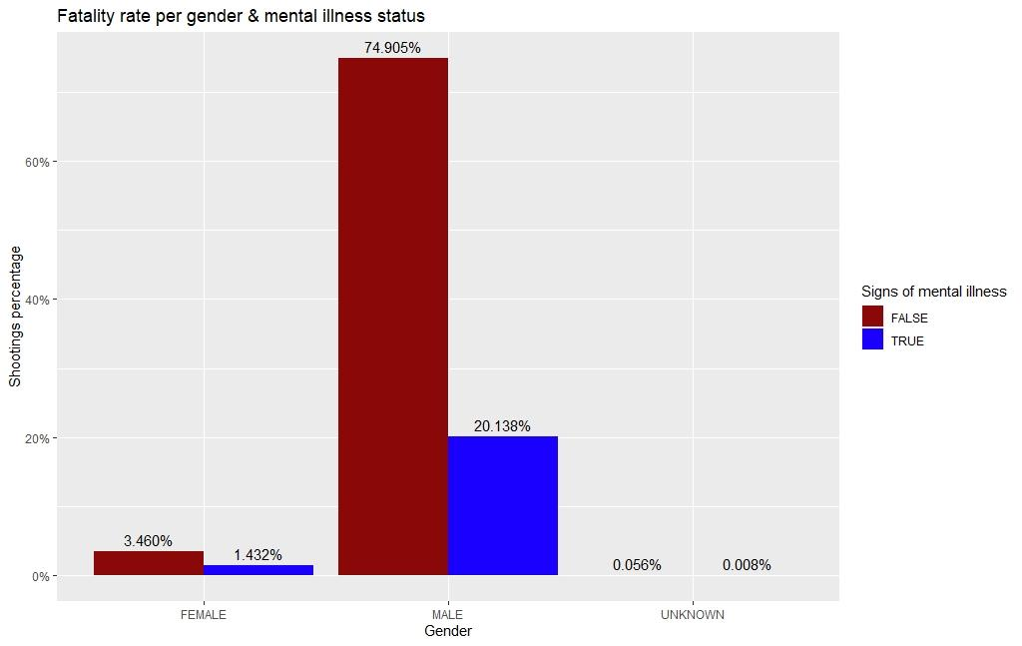
Fatality rate per gender & mental illness state
Males
Most involved gender
Relatively low mental illness rate
Females
Least involved gender
Relatively high mental illness rate

Slide 21
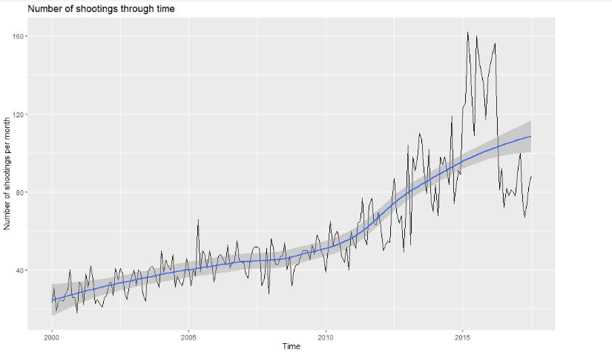
Number of shootings through time
Gradual growth over time.
Significant growth in 2015/16.
4x growth rate in 2017 compared to 2000.

Slide 22
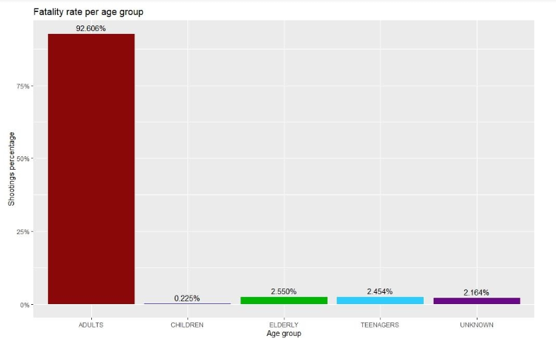
Fatality rate per age group
Most involved age group
Adults
Least involved age group
Children
1-year old children involved
107-year old elderly involved

Slide 23
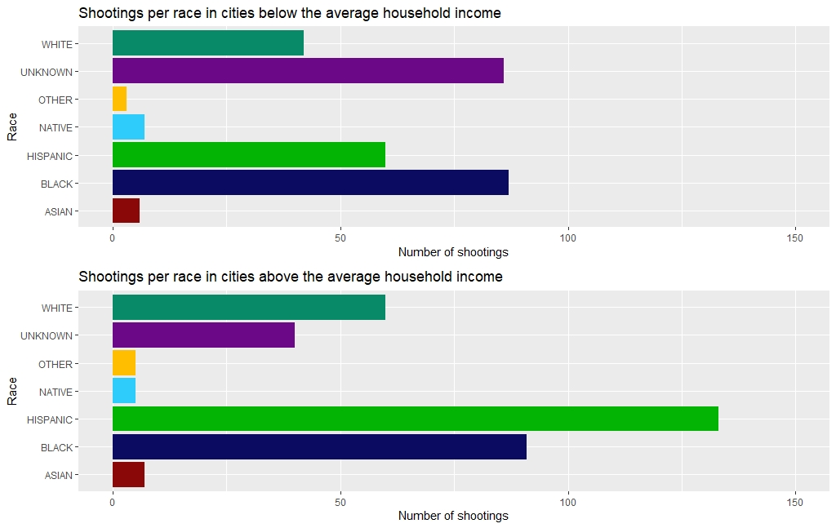
Shootings based on city’s average household income
Most involved races in low household income cities:
Black
Hispanic (excluding “Unknown”)
White
Most involved races in high household income cities:
Hispanic
Black
White

Slide 24
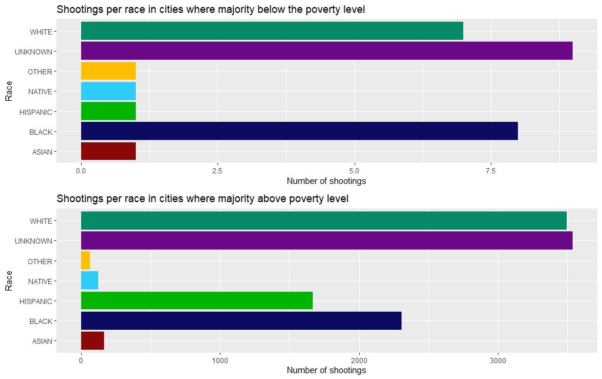
Shootings based on city’s poverty level
Only 28 cities with majority below poverty level
Most involved races below poverty level:
Black (excluding “Unknown”)
White
Most involved races above poverty level:
White (excluding “Unknown”)
Black
Hispanic

Slide 25
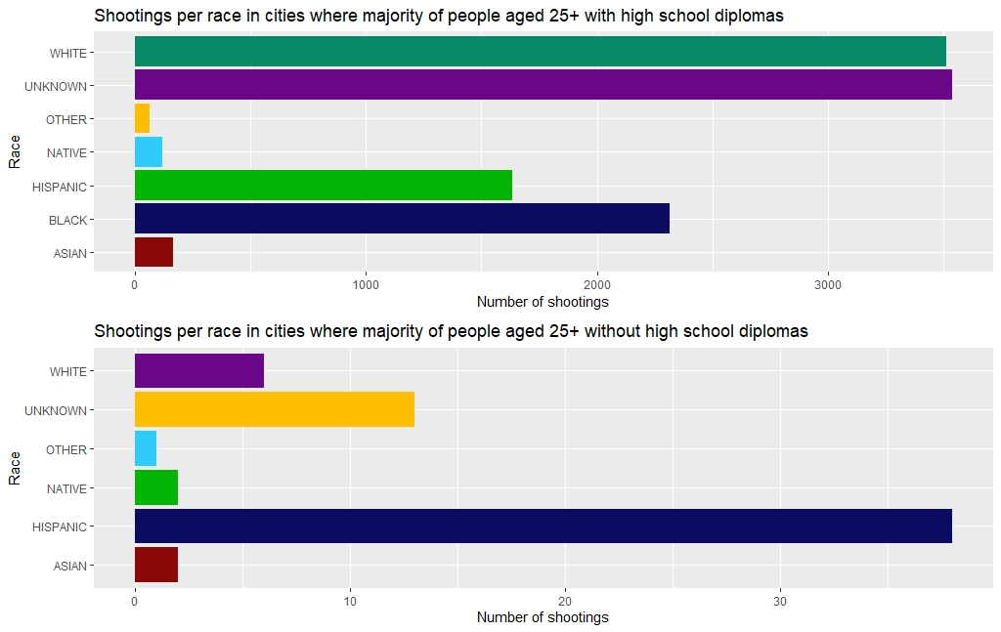
Shootings based on city’s high school level
Only 46 cities with low graduation rate and no shooting involved Black people reported
Most involved races in high graduation rate cities:
White (excluding “Unknown”)
Black
Hispanic
Most involved races in low graduation race cities:
Hispanic
White (excluding “Unknown”)

Slide 26
Thank you for the attention!
Any questions?

