Slide 1
Hangman:
Rescue Mission
PORTFOLIO CASE STUDY · 2023 TO 2026
A bootcamp word game rebuilt as a production app on Cloudflare's free tier, at a running cost of $0.
R
E
S
C
U
Spyros Trimis
hangman.spyrostrimis.com
Notes:
Opening. Hangman: Rescue Mission is a vocabulary game I built as a bootcamp project in 2023 and rebuilt in 2026 under one hard rule: it must cost nothing to run. This deck is the story of that rebuild and, more than the features, the decisions behind it. The word tiles spell RESCUE with one letter still missing, because the project is still in progress.

Slide 2
A bootcamp game with one flaw I could not keep
01 · ORIGIN
2023 · MERN bootcamp
A game for learners
What was wrong
Built at Social Hackers Academy with React, an Express server, MongoDB and OpenAI.
Guess the word to learn English vocabulary and pronunciation. Win a round and a painting rescues the robot.
Example sentences were LLM-written quotations attributed to real authors and works. That was wrong.
Hangman: Rescue Mission
2 / 15
Notes:
The 2023 version was a bootcamp project: MERN stack, OpenAI for content. It worked, but it generated example sentences with an LLM and attributed them to real authors, works and dates. Fabricated quotations are not acceptable in a learning tool, and that single flaw is what made me treat the rebuild as a redesign rather than a clean-up. 116 of the 2023 DALL-E 2 paintings survive and are still used.

Slide 3
Rebuilt,
not migrated.
02 · THE DECISION
Real content only
A modern stack
A $0 running cost
Examples come from Merriam-Webster, with attribution.
Vite, Hono and D1 replace Create React App, Express and MongoDB.
Free-tier allowances are ceilings, never a reason to upgrade.
Hangman: Rescue Mission
3 / 15
Notes:
The key decision: I did not try to migrate the old code. I kept the idea, the 105 words and the rescued paintings, and rebuilt everything else around three rules: only real, attributed content, a modern stack, and a running cost that stays at zero. Any proposal that needs a paid plan is flagged for a decision and never implemented silently.

Slide 4
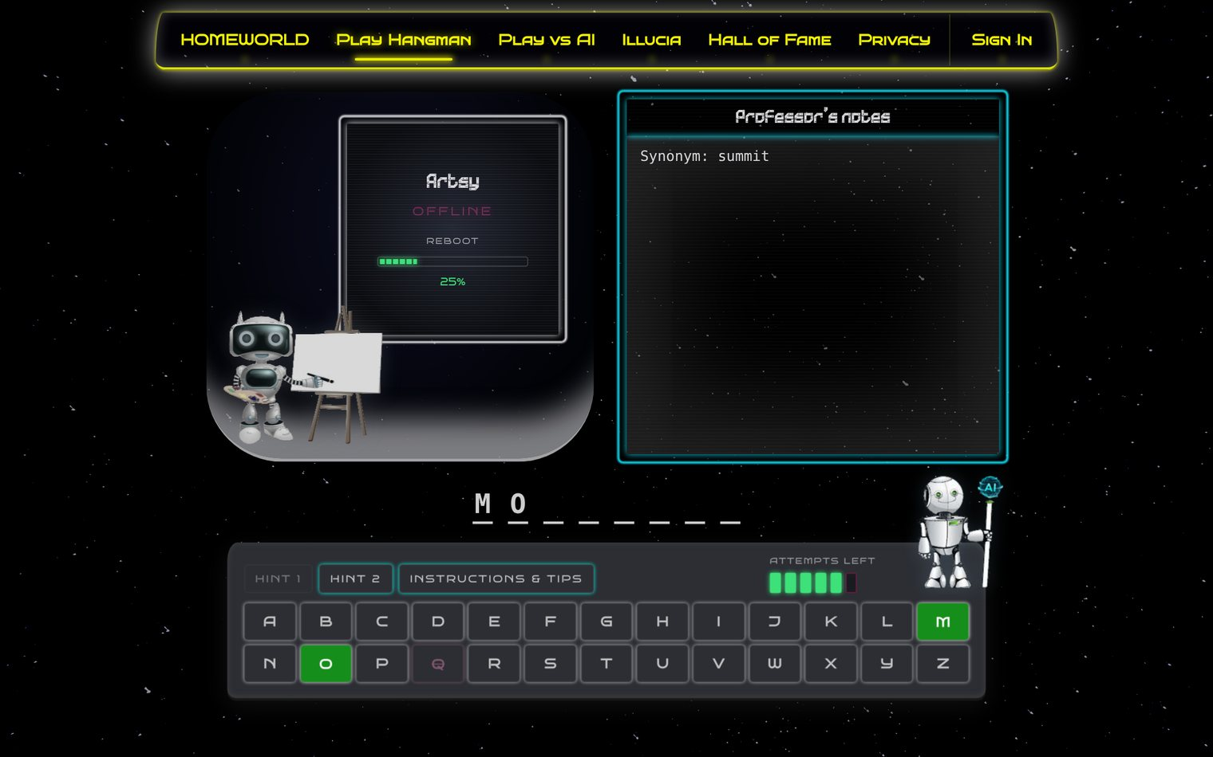
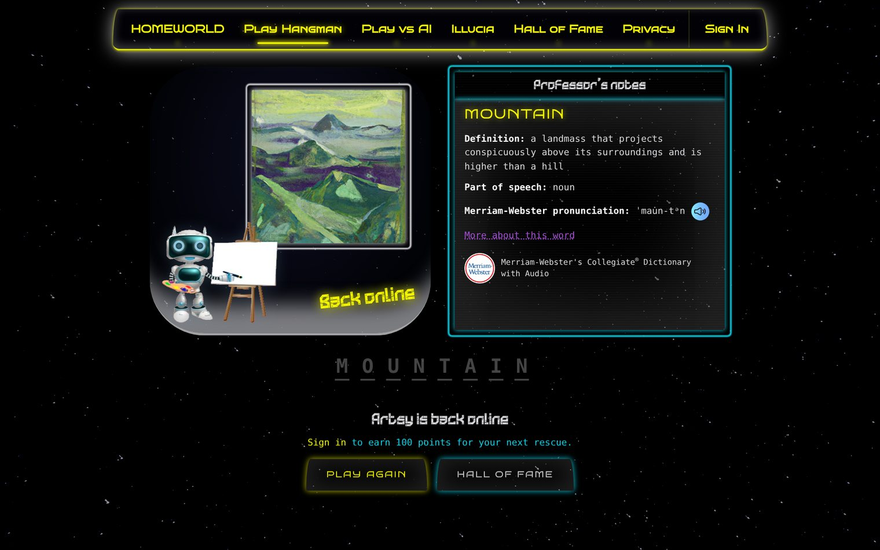
Save a robot by guessing the word
03 · THE PRODUCT
The game. Each right letter reboots Artsy. Each wrong one costs an attempt.
The reward. A win shows a rescued painting and the dictionary entry, with attribution.
Screenshots of hangman.spyrostrimis.com, taken as a signed-out guest.
4 / 15
Notes:
This is the live site. The story is a rescue mission: the painter robot Artsy has shut down, and each correct letter reboots him. The first screenshot is a round in progress with the first hint open. The second is the win screen: one of the rescued paintings, the definition, pronunciation and audio from Merriam-Webster, and the required dictionary attribution. A signed-out guest can play but earns no points.

Slide 5
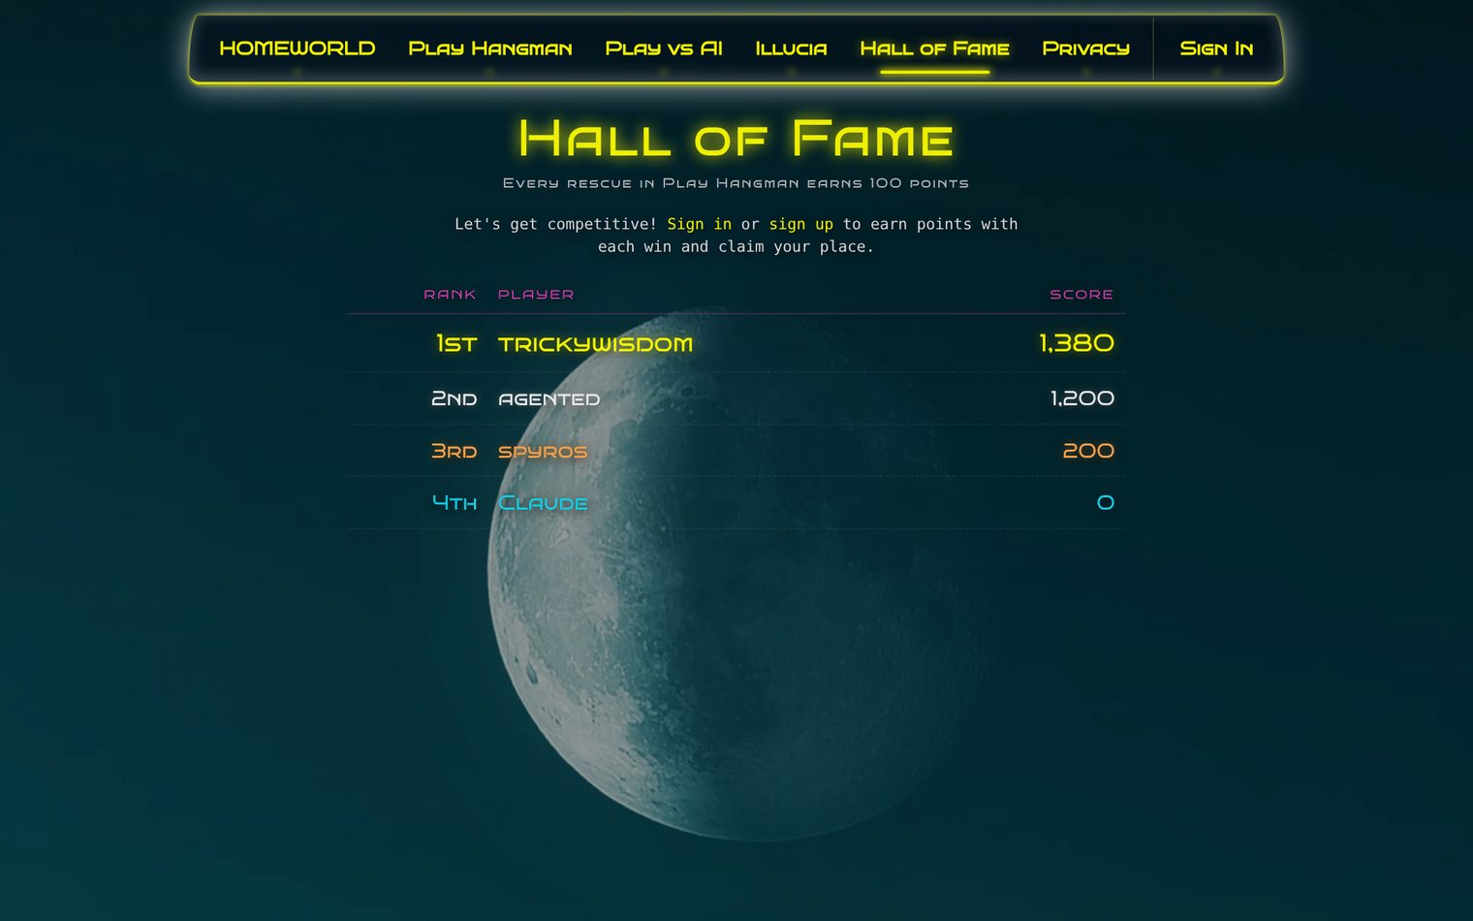
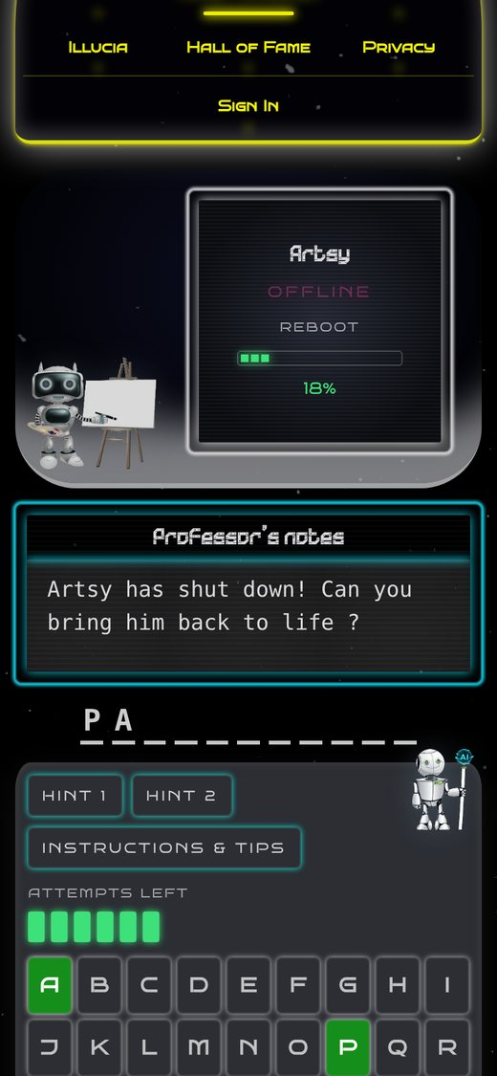
A public leaderboard, on any screen
04 · IN USE
Worth knowing
Guests play for free. Signed-in players earn 100 points per rescue.
The phone layout got its own pass, confirmed on a real device.
Hall of Fame. Real accounts, real scores.
On a phone.
Screenshots of hangman.spyrostrimis.com, October 2026.
5 / 15
Notes:
The Hall of Fame is public and reads live from the API. The score table is real data from accounts on the site. The phone screenshot is the same Hangman page at phone width: the layout was reworked in its own slice and I confirmed it on a real phone on 28 September. Remember the scoring slide: this leaderboard is honest about being a friendly board, not a trusted ranking.

Slide 6







All on Cloudflare's free tier
05 · ARCHITECTURE
Pages
Workers
D1
React client
Hono API
Accounts and scores
React 18 and Vite. A push to main deploys it.
Routed under /user/*, deployed with wrangler.
Users, rounds and scores, with migrations.
Static JSON
R2
Release
105-word manifest
105 paintings
Every deploy is live
No runtime word API at all.
Served from a custom asset domain.
There is no staging environment.
Hangman: Rescue Mission
6 / 15
Notes:
The shape of the system. The client is a React and Vite app on Cloudflare Pages. A small Hono Worker handles accounts and scores against D1. The word data is a static JSON manifest and the paintings live in R2, so gameplay needs no word API. The last card matters: there is no staging, every push to main and every wrangler deploy is production, so each change is kept small and checked before it ships.

Slide 7
What the $0 constraint looks like
06 · THE NUMBERS
$0
105
Monthly running cost. Free allowances are ceilings, never targets.
Words in the game, each with a rescued painting served from R2.
135,897
1.96 ms
Words in the Illucia vocabulary, 4 to 15 letters, profanity-filtered.
Median Worker CPU at launch on the Free plan (3.56 ms at P99, small sample).
Hangman: Rescue Mission
7 / 15
Notes:
Four numbers. The cost is zero and stays zero. 105 words each have a painting. The Illucia vocabulary is 135,897 words after profanity filtering. And the CPU figure is from the first deployed measurements on the Free plan: a median of 1.96 milliseconds and 3.56 at the 99th percentile. I flag it as a small sample on purpose; it is evidence the design fits the free tier, not a benchmark.

Slide 8




Assembled offline, never generated at runtime
07 · WORD DATA
Step 1
Step 2
Merriam-Webster
Human overrides
Collegiate Dictionary only: definition, pronunciation, audio and a real, attributed example.
76 explicit entry choices settle ambiguity. No hidden ranking decides.
Step 3
Step 4
Reviewed enrichment
Assemble and validate
Hints and explanations drafted with an LLM, human-reviewed, committed as static data.
A deterministic assembler builds the manifest. A validator rejects hints that leak the answer.
Hangman: Rescue Mission
8 / 15
Notes:
This is where the 2023 flaw is fixed. Definitions, pronunciation, audio and examples come from Merriam-Webster's Collegiate Dictionary, with attribution on screen. Where the dictionary is ambiguous, 76 explicit human choices decide, never a hidden ranking. Hints and explanations were drafted with an LLM during planning conversations, then reviewed by me and committed as static data, so the provenance field honestly says llm-generated. A small deterministic assembler and a schema validator produce the manifest the game ships with. The pipeline never runs in production.

Slide 9



The raw password never leaves the browser
08 · SECURITY DECISION
In the browser
The reasoning
PBKDF2-HMAC-SHA-256, 600,000 iterations, a random salt per account.
Bcrypt hit the Worker's CPU limit, so the work moved to the browser.
In the Worker
Only an HMAC verifier under a secret pepper. The derived credential is never stored or logged.
Session
The work factor only ever rises, through a new kdf_version. It is never lowered to fit a limit.
A jose JWT in an HttpOnly cookie, expiring after 24 hours.
Hangman: Rescue Mission
9 / 15
Notes:
The most important engineering decision. I tested bcryptjs on a Worker and confirmed it blows the free CPU budget. The easy fix would have been a weaker hash. Instead the stretching moved into the browser using Web Crypto: PBKDF2 at 600,000 iterations with a random per-account salt. The Worker only ever sees the derived value and stores an HMAC verifier under a secret pepper. The rule I wrote down: the work factor can only rise, through a new kdf_version, and is never lowered to fit a CPU limit.

Slide 10



A leaderboard that states its limits
09 · HONEST SCORING
Ticket
Claim
Floor
Server picks the word
Replay, then award
Five-second minimum
The Worker issues an account-bound round ticket. Play itself stays local.
A win sends the guesses. The Worker replays them and awards 100 points once.
No earlier claim is accepted, so each account tops out at 12 awards a minute.
Answers are public by design, so valid scores do not prove honest play. The Hall of Fame is not a trusted ranking.
Hangman: Rescue Mission
10 / 15
Notes:
Scoring is where I chose honesty over theatre. The server issues a ticket and chooses the word, a winning claim is replayed through the same shared rules the client uses, and 100 points are awarded at most once per round. A five-second floor limits each account to twelve awards a minute. But the answer is public by design, so a script can manufacture valid histories. I say that plainly in the docs and in the UI rather than pretending the leaderboard is a trusted competition.

Slide 11
Measuring her broke an assumption
10 · ILLUCIA, THE REVERSE GAME
Win rate against common words | Apprentice | Scholar | Master
Before: 4 letters, unweighted | 56% | 46% | 42%
After: 4 to 6 letters, weighted | 72.9% | 72.3% | 72.5%
What I found
What I changed
A bigger vocabulary holds more short look-alikes, so the cleverer tiers played worse on common words.
Candidates are weighted by how common they are. A gate now checks tier order: 0 of 171 comparisons fail.
Two different word sets, so compare rows by their trend only. Cost: rare words are guessed less often.
11 / 15
Notes:
Illucia reverses the game: the player sets a secret word and a local solver guesses it letter by letter. Difficulty is vocabulary size, so Master should beat Apprentice. I measured it, and on common short words the tiers were inverted: Apprentice 56 percent, Scholar 46, Master 42, because a larger vocabulary contains more look-alike short words. Weighting candidates by commonness fixed it: on common four-to-six-letter words the tiers are level at about 72 to 73 percent, and a benchmark gate now checks the order. The honest cost is on rare words that Master knows, where its win rate fell from 92.1 to 87.2 percent. The two rows use different word sets, so read them as a trend, not a like-for-like comparison. Her letter choice is plain code; no model is involved.

Slide 12
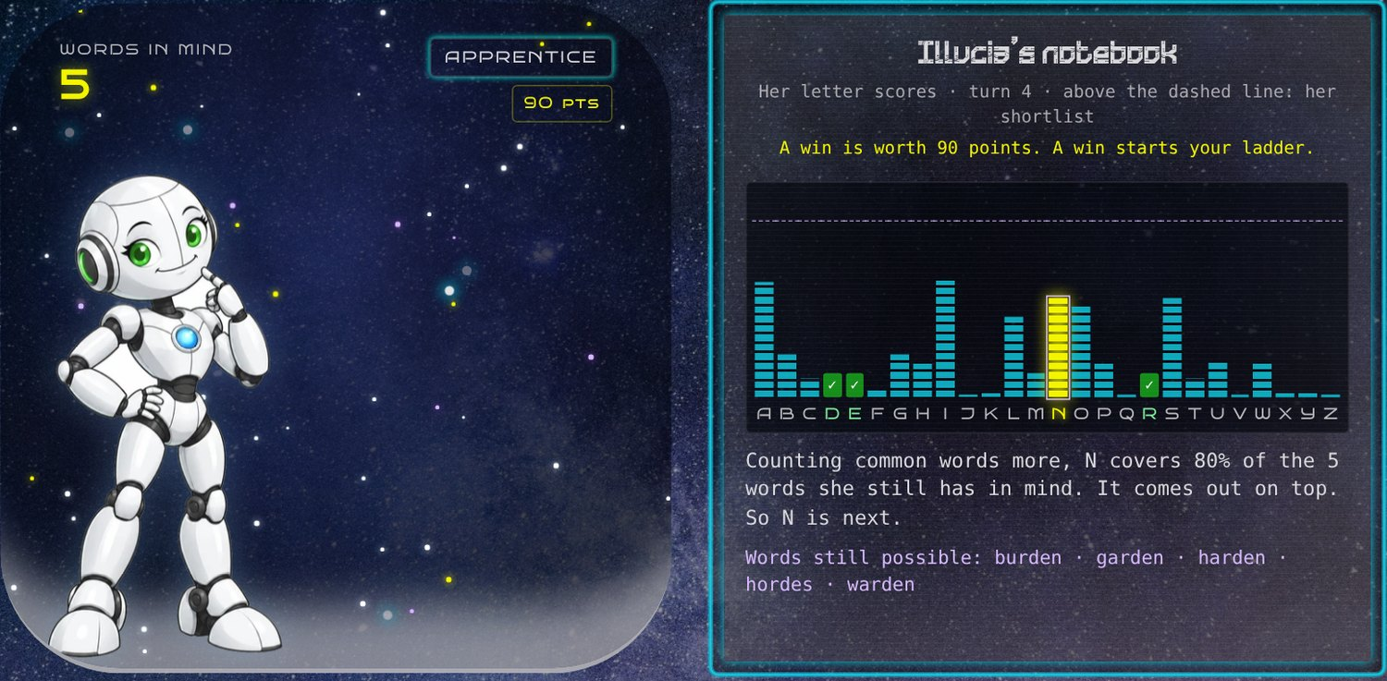
She explains each guess, and it is true
11 · HER REASONING
The chart
One bar per letter. Her shortlist sits above the dashed line.
The line
Written from her real decision record, not from a template.
Why
A line that describes something she did not do is a bug.
The Observatory. A live duel, Apprentice level, turn 4.
Screenshot of hangman.spyrostrimis.com/illucia-observatory, October 2026.
12 / 15
Notes:
A real duel on the live site. I chose the word GARDEN at Apprentice level and she played it herself. At turn 4 she has narrowed her vocabulary to five words, listed at the bottom of the notebook, and the chart shows why N is next: it covers 80 percent of them. The line under the chart is generated from her actual decision record. Early on, her reasoning text said things that stopped being true once she started exploring, so I made honesty of those lines a rule. She won this round in seven guesses.

Slide 13



Chat plans, Code executes, tests decide
12 · HOW I WORK
Plan
Execute
Verify
In Claude chat
In Claude Code
Before trusting
A Project holds the instructions, a living state.md and a build diary. Decisions are made here.
One scoped task per session. CLAUDE.md carries the constraints, and the opening prompt is the handoff.
Real diffs and real test output before each commit. A test counts only once I have seen it fail.
One concern per change. One commit per change. Flag every adjacent fix, never bundle it silently.
Hangman: Rescue Mission
13 / 15
Notes:
The process matters as much as the product. Planning happens in a Claude chat Project, which holds my instructions, a state file and a diary. Implementation happens in Claude Code, which cannot see that Project, so each session starts from a tightly scoped prompt and the constraints in CLAUDE.md. The discipline that makes it work: small slices, one concern per commit, real diffs and test output before anything is called done, and tests that must be proven non-vacuous by breaking the fix and watching them fail. The same rules apply to AI-written code and my own.

Slide 14
Built, tested and live are three different claims
13 · WHERE IT STANDS
Area | State
Accounts and Hall of Fame | Live. Signup, login and a saved win were verified in a browser.
Round-ticket scoring | Live. Production API checks passed; a production browser check was blocked.
Illucia duel and Observatory | Live for signed-in players. No authenticated production check of a points claim is recorded.
Account deletion, round expiry | Deployed. No production check of deletion or a retention run is recorded.
Experimental AI mode | Page tested against a mocked route only. The Worker route is deployed.
Status from the project notes, early October 2026.
14 / 15
Notes:
I keep three states apart in every status note: implemented and committed, tested locally, and verified live. This table is that discipline applied honestly. The core game, accounts and scoring are live. Several things are deployed but not yet checked in production, and I list them as unchecked rather than rounding them up to done. For a recruiter or a senior reviewer, that is the more useful signal than a wall of green ticks.

Slide 15
Still redesigning, still inventing
14 · WHAT'S NEXT
Illucia v2: player memory, WordNet questions and an experimental AI mode, still to be checked live
Close the open production checks: scoring in a browser, account deletion, Illucia claims
Self-host the Merriam-Webster audio, if the licence allows it
Clear the open dependency advisories
Play it
hangman.spyrostrimis.com
Read the code
github.com/spyrostrimis/hangman
Dictionary content: Merriam-Webster's Collegiate® Dictionary with Audio.
15 / 15
Notes:
The project is not finished and I would rather say so. Illucia v2 is built in slices and still needs checking on the live site. The open production checks are on my list in plain sight. Beyond that: self-hosting the dictionary audio if the licence permits and clearing dependency advisories. The site and the repository are both public, so everything in this deck can be checked against the code. Thank you.

