Slide 1


Cancer genes
Clustering and Classification
Spyros Travlos

Slide 2
01
• Introduction •
Myself and the company
1

Slide 3
• Introduction Myself
Spyros Travlos
From Civil Engineering to Data Science
Project Manager for 3 years in real estate development
Civil Engineering Graduate with Bachelors from Cardiff University and Masters from Imperial College London
Looking to make a career change and excel in the field of Data science where I can apply my work and educational experiences to turn data into insights.
2

Slide 4
• Introduction The company
Helps bring novel therapies to patients faster and more efficiently by applying Data Science to drug development.
3

Slide 5
02
• Project Description and Objectives •
Outline of the project and the goals
4

Slide 6
• Background
TCGA
GTEX
The Cancer Genome Atlas
Genotype-Tissue Expression
Cancer genomics program
An ongoing study on tissue-specific gene expression and regulation
Molecularly characterized cancer samples spanning over 33 types of cancer
Samples were collected from 54 non-diseased tissue sites across nearly 1000 individuals
5

Slide 7
• Dataset
Source
Size
University of California Santa - Cruz
20,000 rows (samples) x 60,000 columns (gene expressions)
Retrieval
Tools for analysis
xenaPython – API for accessing xena hubs
AWS remote server
6

Slide 8
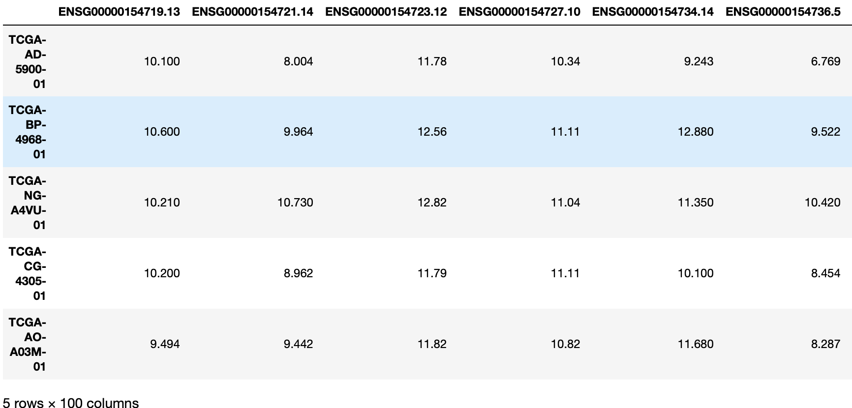


• Dataset
Gene
Sample
Normalized expression of the RNA sequence of the gene found in the sample
7

Slide 9

• Preprocessing Dropped genes:
Keep only protein-coding genes
Small variation between samples (standard deviation < 0.5
Were 0 everywhere
60,000
20,000
8

Slide 10
• Goals
Clustering TCGA samples
Classification Healthy vs Unhealthy
Classification Cancer Categories
Creating groups of similar cancers
Predicting whether a sample is healthy or cancerous
Predicting under which cancer category a sample falls
9

Slide 11
03
• Analyses and Results•
Presentation of the analyses and the results
10

Slide 12
• Clustering Methodology
02
04
01
03
Unseen data
Kmeans algorithm
Kept test set for evaluating the algorithm
Choose k and apply algorithm
Remove values outside the normal range (outliers)
Reduce dimensions
Use PCA
Interquartile Range Method
11

Slide 13
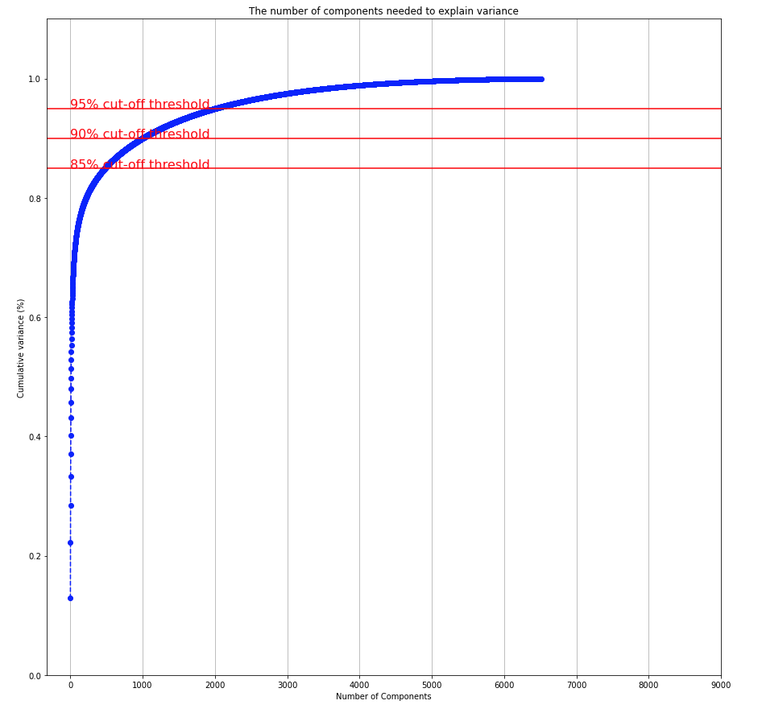
• PCA
Chose number of components to keep 85% variance
481 features
12

Slide 14
• Choosing k (number of clusters)
Domain knowledge
Elbow method
Silhouette Score
13

Slide 15
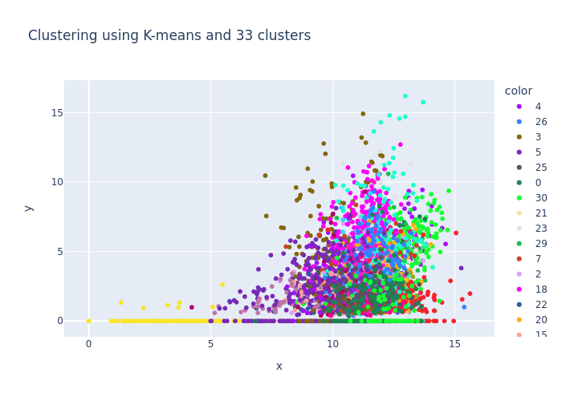
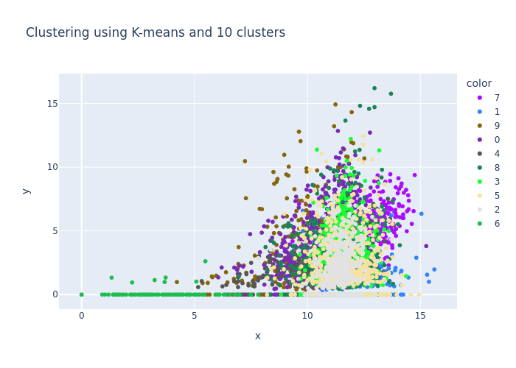
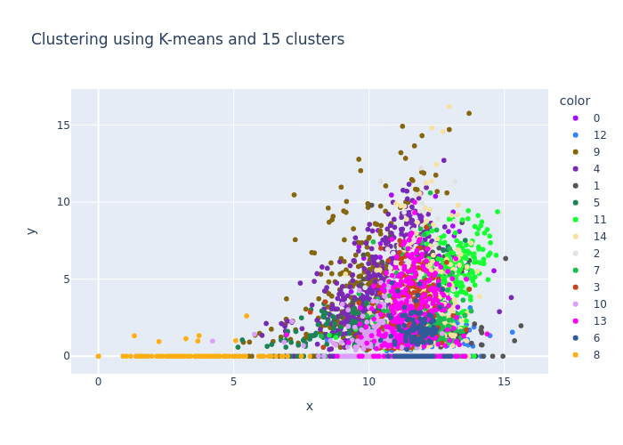
14

Slide 16
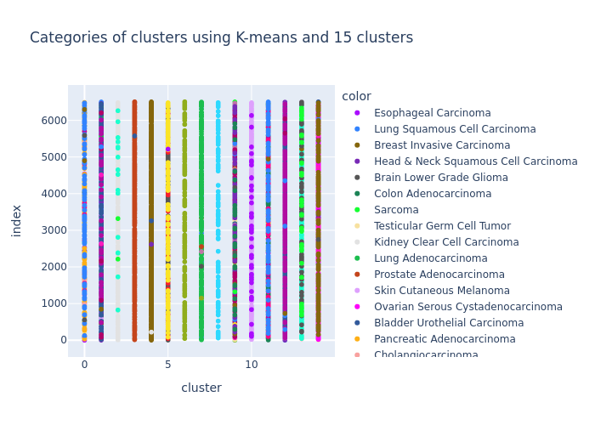
• Compare with original categories
15

Slide 17
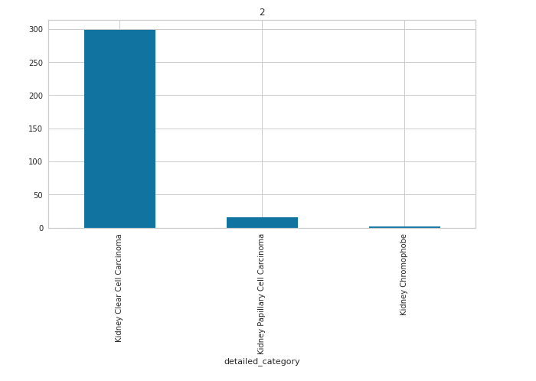
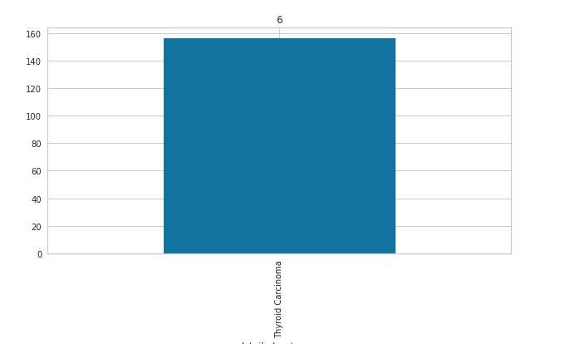
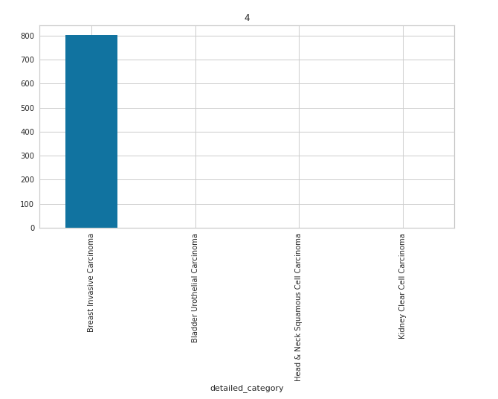
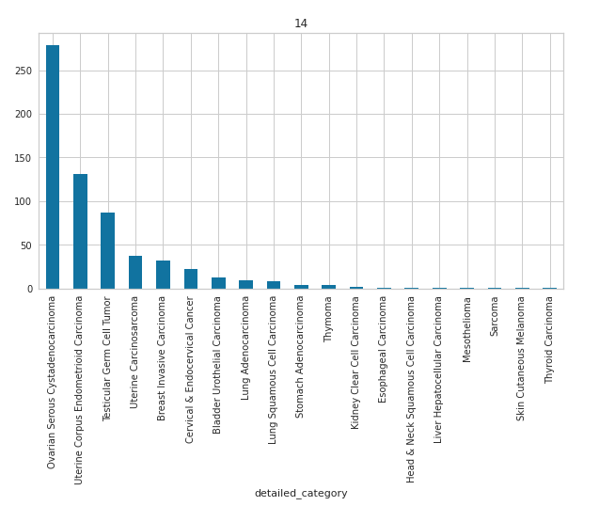
• Dig deeper into the clusters
16

Slide 18
• Labeling of clusters where possible
2 | Kidney Clear Cell Carcinoma | 300/360 | Kidney Clear Cell Carcinomas
 | Kidney Papillary Cell Carcinoma | 20/187
6 | Thyroid Carcinoma | 159/159 | Thyroid Carcinoma
14 | Ovarian Cerous Cystadenocarcinoma | 281/281 | Associated with the reproductive system
 | Uterine Corpus endometrioid carcinoma | 140/145
 | Testicular Germ Cell Tumor | 85/108
 | Uterine Adenocarcinoma | 45/45
4 | Breast Invasive Carcinoma | 810/922 | Breast Invasive Carcinoma
17

Slide 19
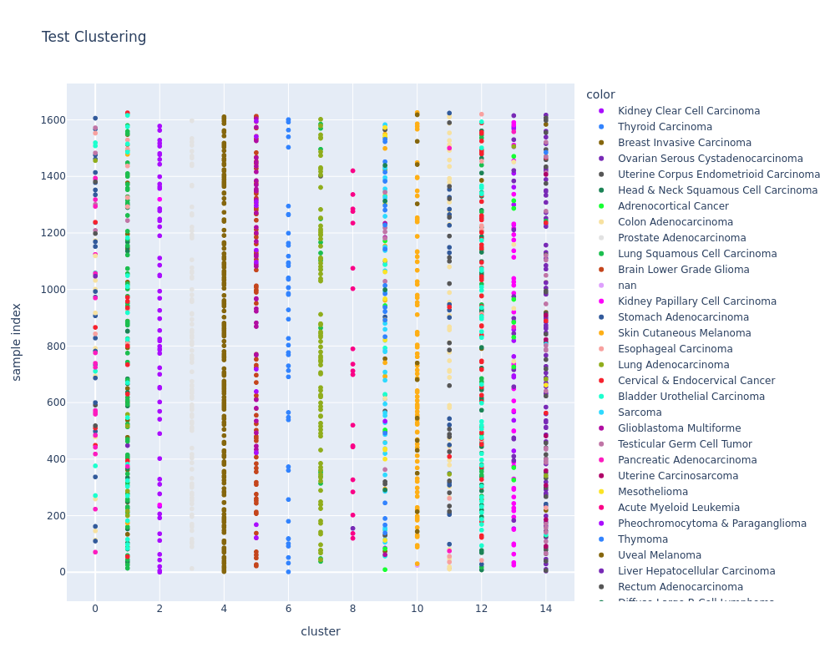
• Clustering on unseen data
18

Slide 20
• Classification: Healthy vs Unhealthy methodology
02
04
01
03
Apply multiple algorithms and evaluate on common metrics
Remove genes that exist in one dataframe and not the other. Remove outliers
Retrieve TCGA and GTEx dataframes using xenaPython
Keep a set as unseen data
Use PCA
19

Slide 21
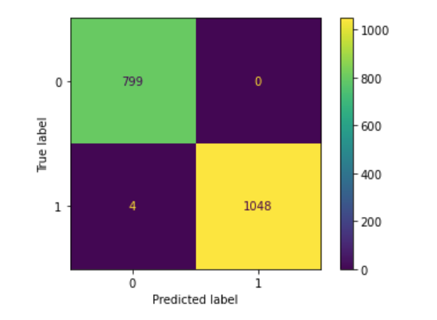
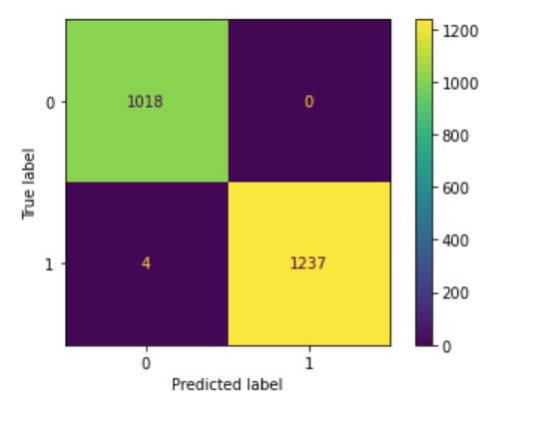
Model | Accuracy | Recall
Logistic Regression | 100% | 100%
KNeighbors | 100% | 99.6%
Random Forest | 100% | 100%
Gradient Boosting | 100% | 99.7%
Test set
Unseen Data
20

Slide 22
• Batch Effects
Batch Effects
Technical variation between different measurement methods
TCGA vs GTEx: Different studies
Vastly Different Batches
Ease of prediction
Incredibly Easy for our algorithms to distinguish between samples
Solution
Normalization across batches of specific samples by domain experts
21

Slide 23
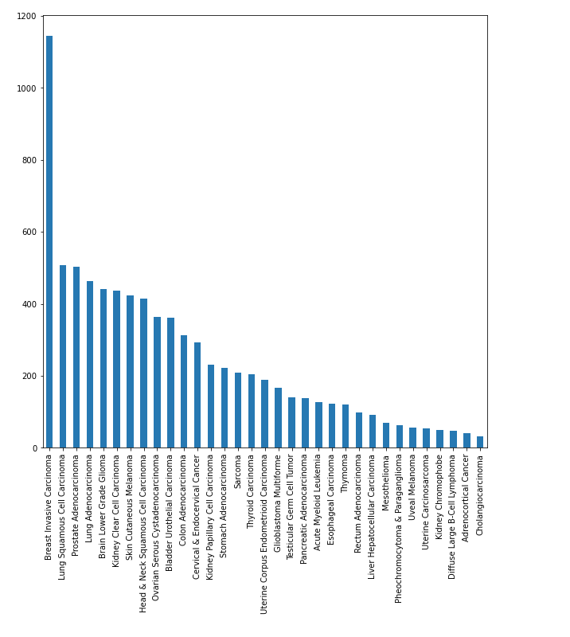
• Classification: Cancer Categories
Class Imbalance
Corrected using class_weight module
22

Slide 24
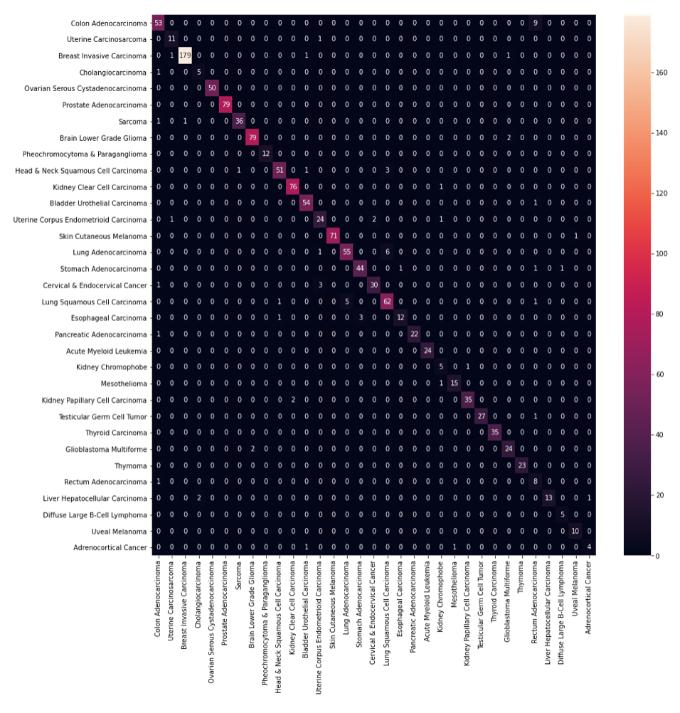

• Results on test and unseen data
23

Slide 25
92 %
Accuracy
24

Slide 26
04
• Conclusions•
Summary and Suggestions for future work
25

Slide 27
• Conclusions
01
02
Algorithm for classifying healthy vs unhealthy samples needs technical biases removal to be useful
Useful algorithm for Clustering TCGA samples
Accurate algorithm for predicting cancer categories
26

Slide 28
• Suggestions for future work
Adopt a method for removing batch effects
Include more information about the samples (gender, primary site or sample type).
Focus the analysis on a particular type of cancer
27

Slide 29

Thanks!
Do you have any questions?
travlos.spyridon@gmail.com
https://www.linkedin.com/in/spyros-travlos/
https://github.com/spytravlos/
28

Slide 30
05
• Appendix•

Slide 31
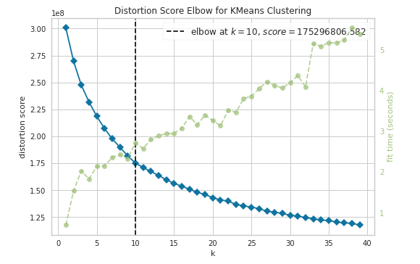
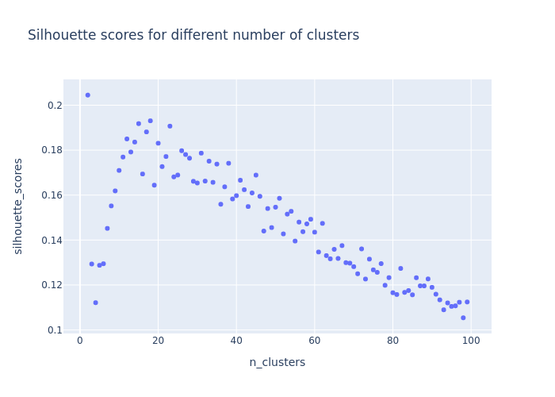
• Choosing k (number of clusters)
Elbow method
Silhouette Score

Slide 32
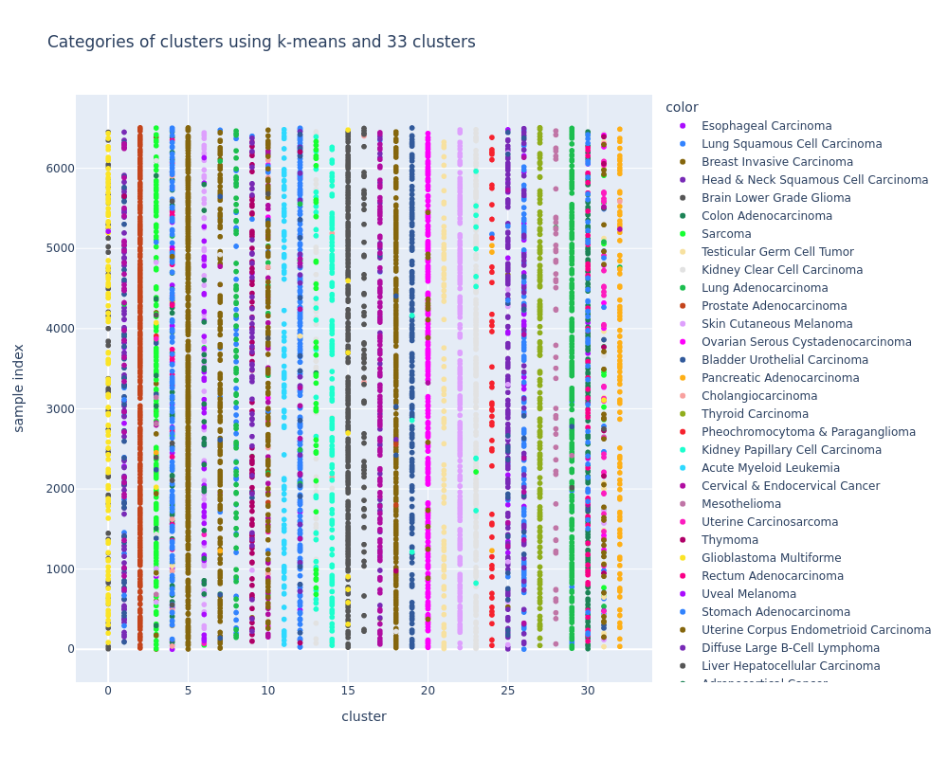
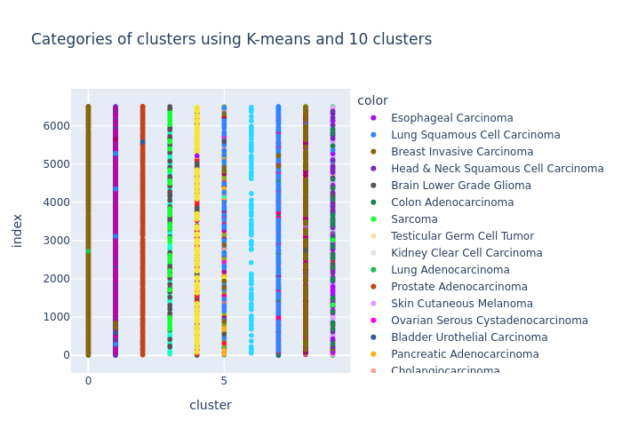
• Choosing k (number of clusters)

