Slide 1
Stroke Prediction Analysis
Spyros Travlos

Slide 2
Contents
Overview
Dataset
Analysis
Modelling
Conclusions

Slide 3
Overview
By analyzing a dataset containing information about patients we will try to predict the likelihood of a patient suffering a stroke.

Slide 4
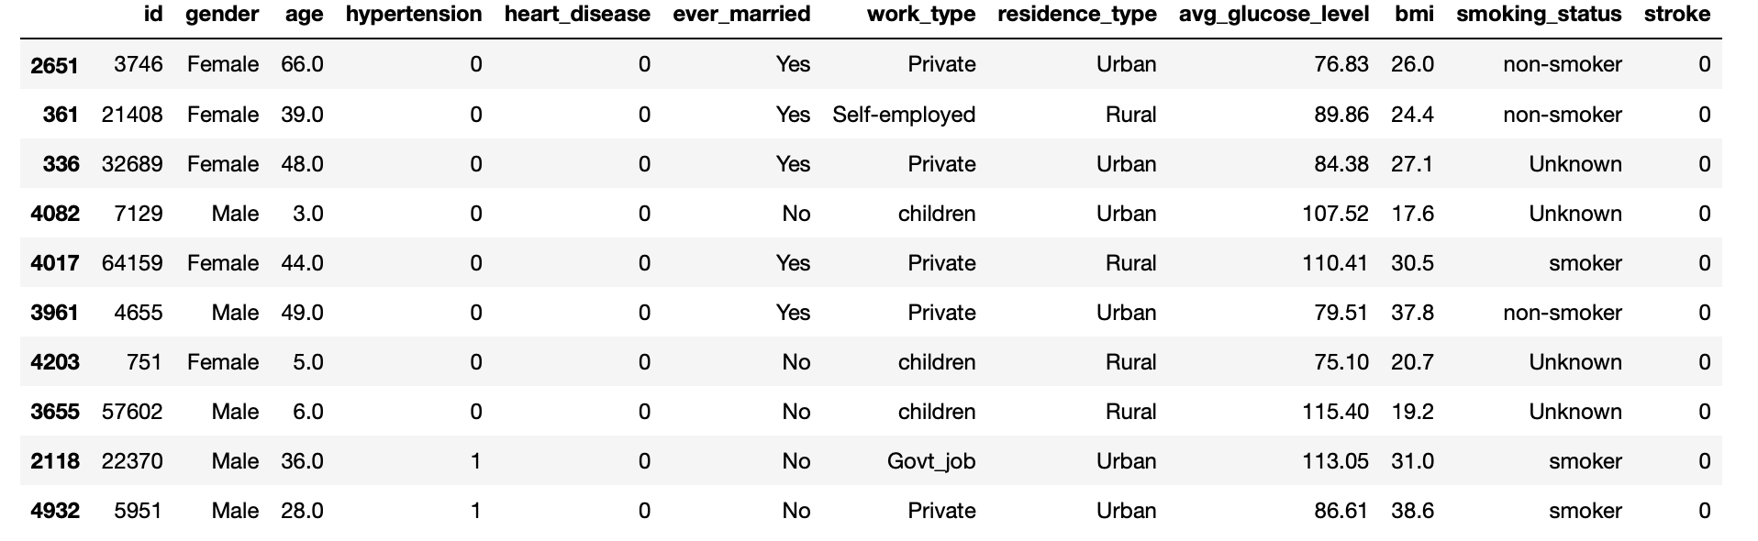
Dataset

Slide 5
Dataset
1) id: unique identifier 2) gender: "Male", "Female" or "Other" 3) age: age of the patient 4) hypertension: 0 if the patient doesn't have hypertension, 1 if the patient has hypertension 5) heart_disease: 0 if the patient doesn't have any heart diseases, 1 if the patient has a heart disease 6) ever_married: "No" or "Yes" 7) work_type: "children", "Govt_jov", "Never_worked", "Private" or "Self-employed" 8) Residence_type: "Rural" or "Urban" 9) avg_glucose_level: average glucose level in blood 10) bmi: body mass index 11) smoking_status: "formerly smoked", "never smoked", "smokes" or "Unknown"* 12) stroke: 1 if the patient had a stroke or 0 if not

Slide 6
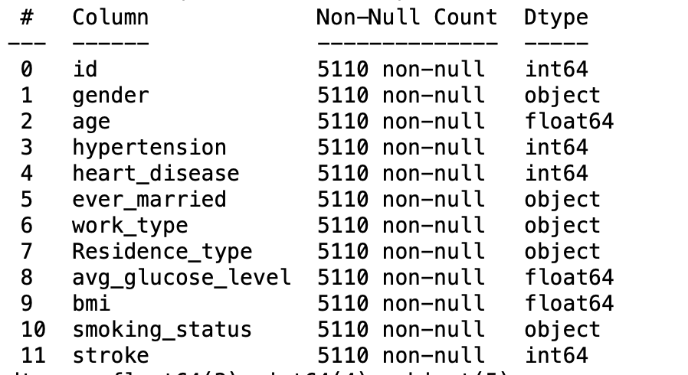
Dataset
Only 5110 samples. Quite a small dataset

Slide 7
Analysis
Let’s run EDA in order to gain valuable information regarding stroke sufferers. We will explore the relation of each feature with stroke occurence

Slide 8
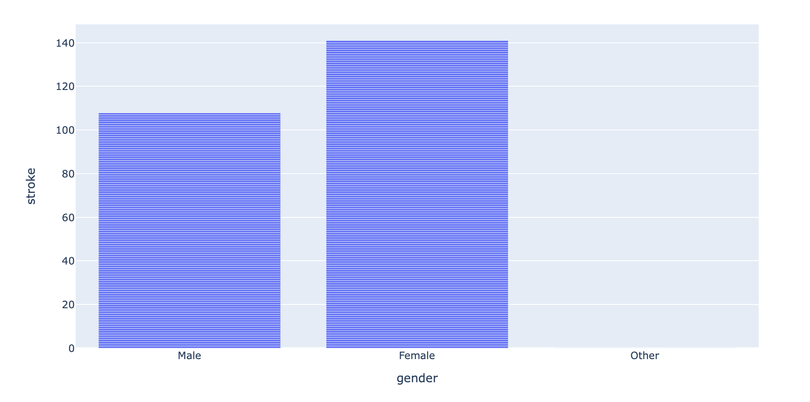
Gender
Stroke is more common in women

Slide 9
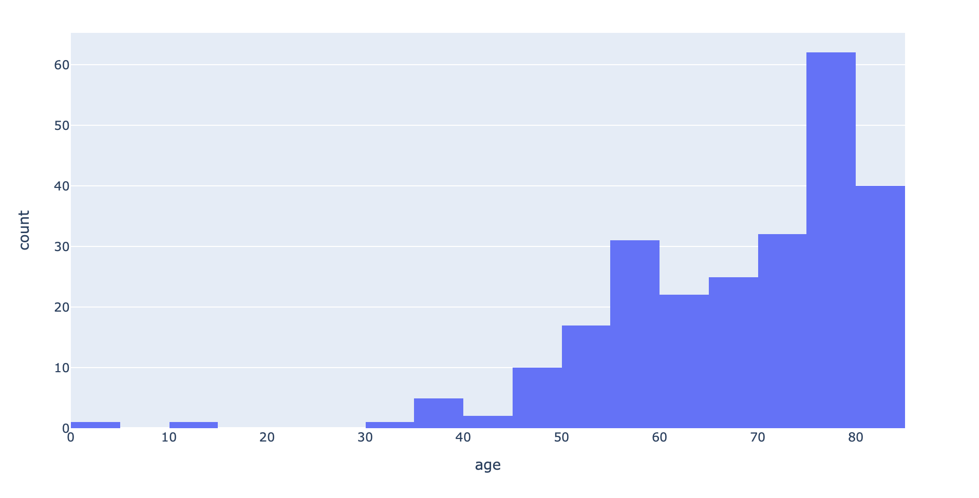
Most stroke sufferers are aged 75 to 79 years old

Slide 10
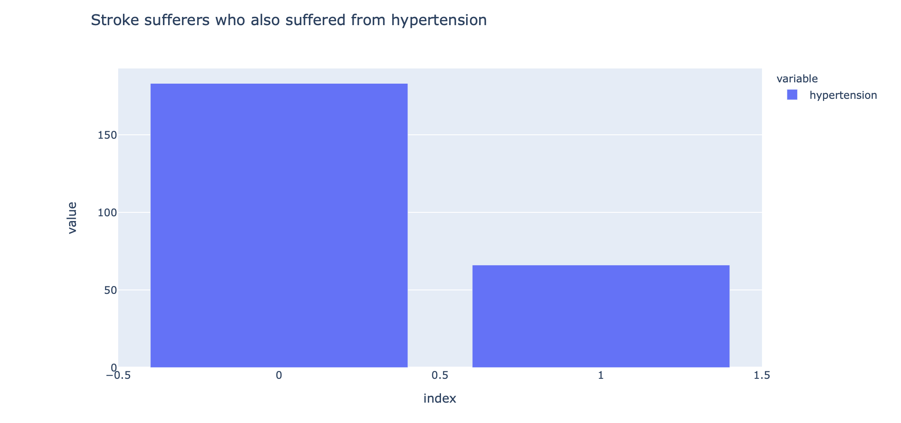

Slide 11
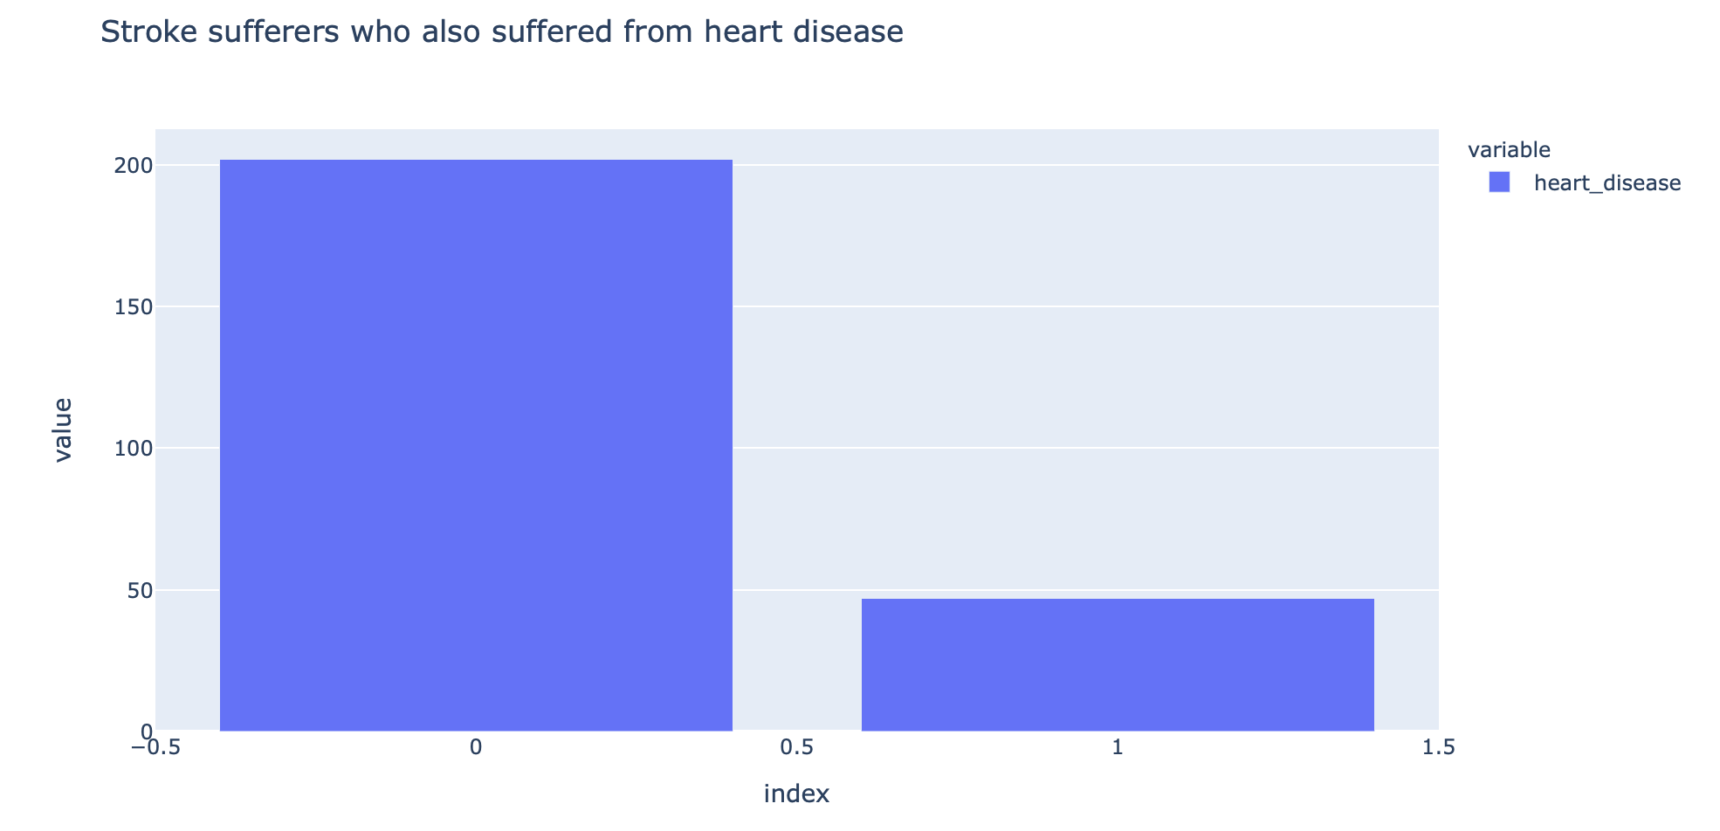

Slide 12
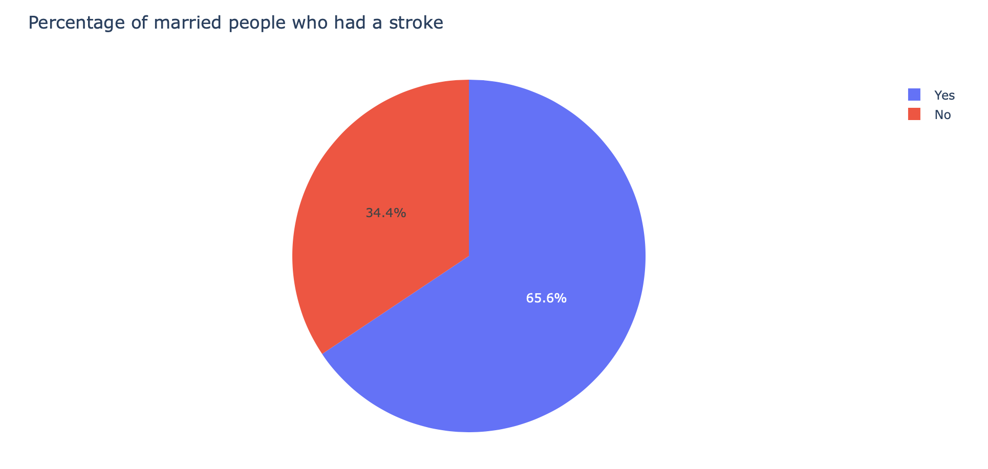

Slide 13
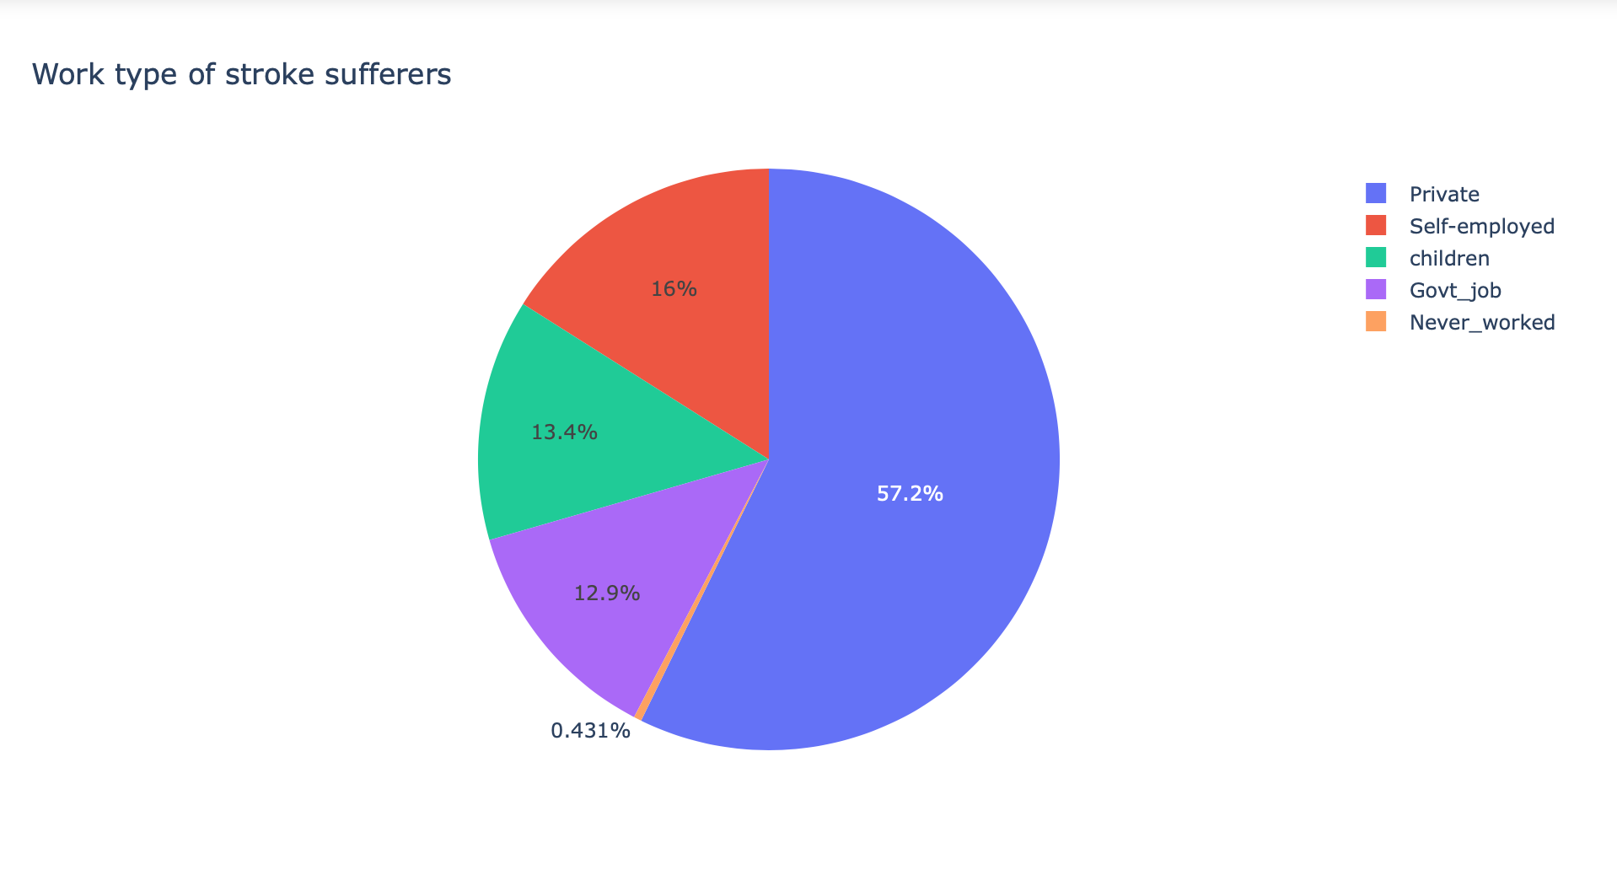

Slide 14
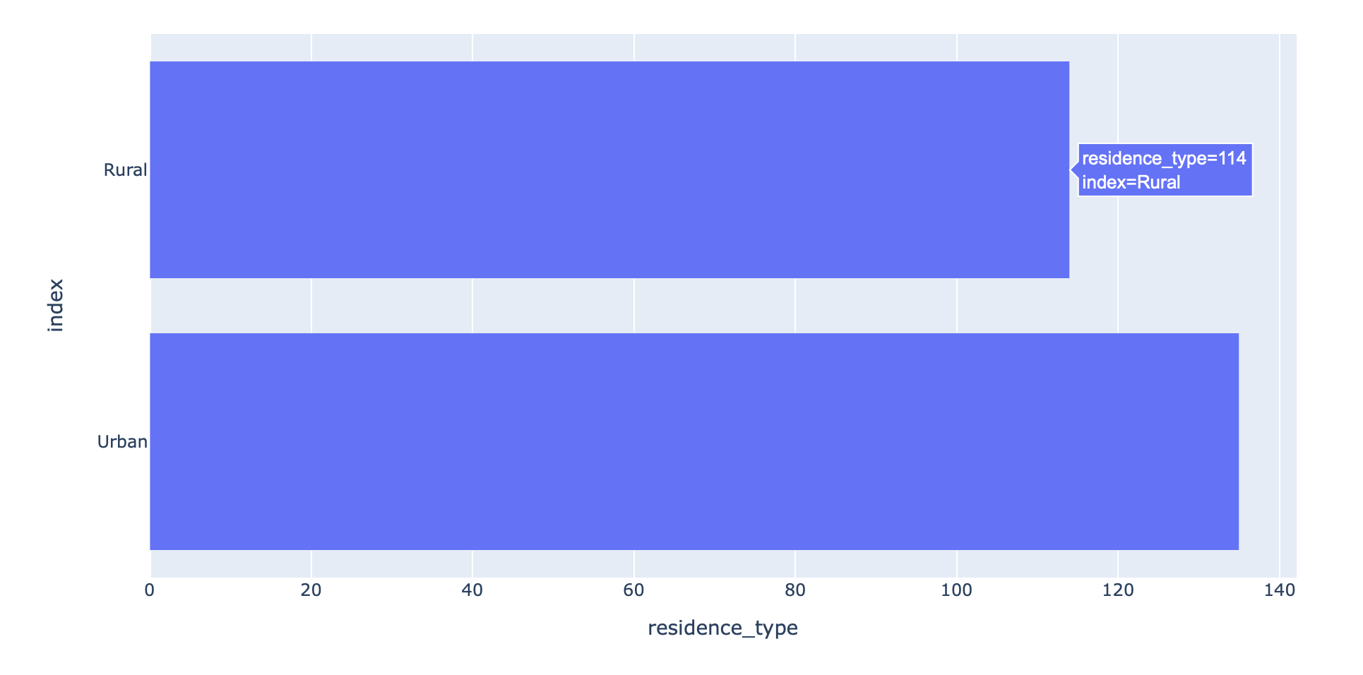

Slide 15
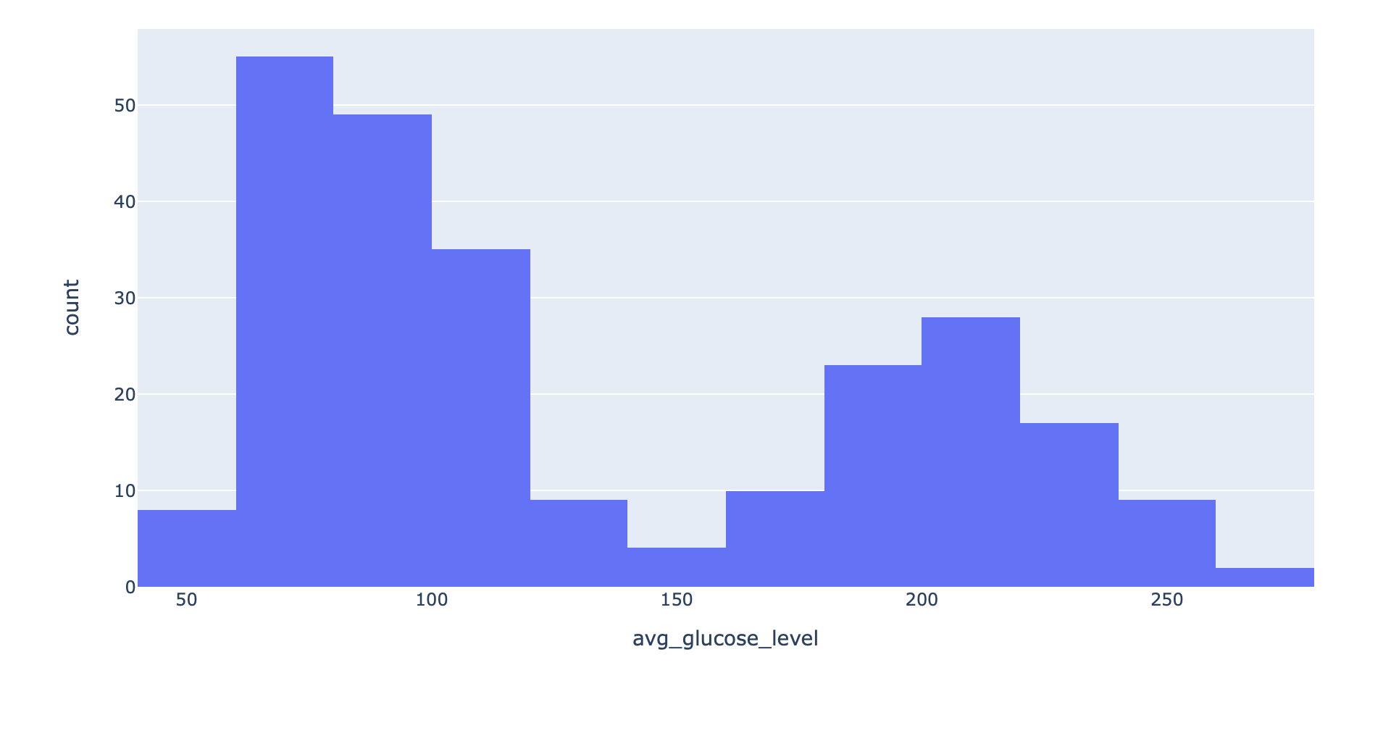
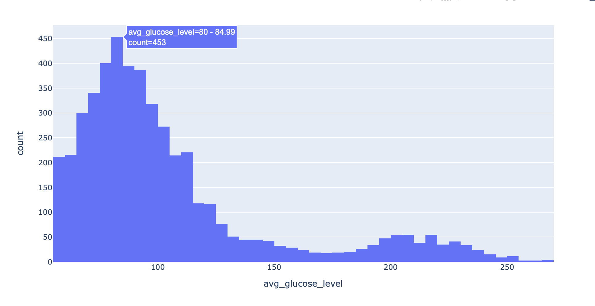
Stroke Sufferers
Non - Stroke Sufferers

Slide 16
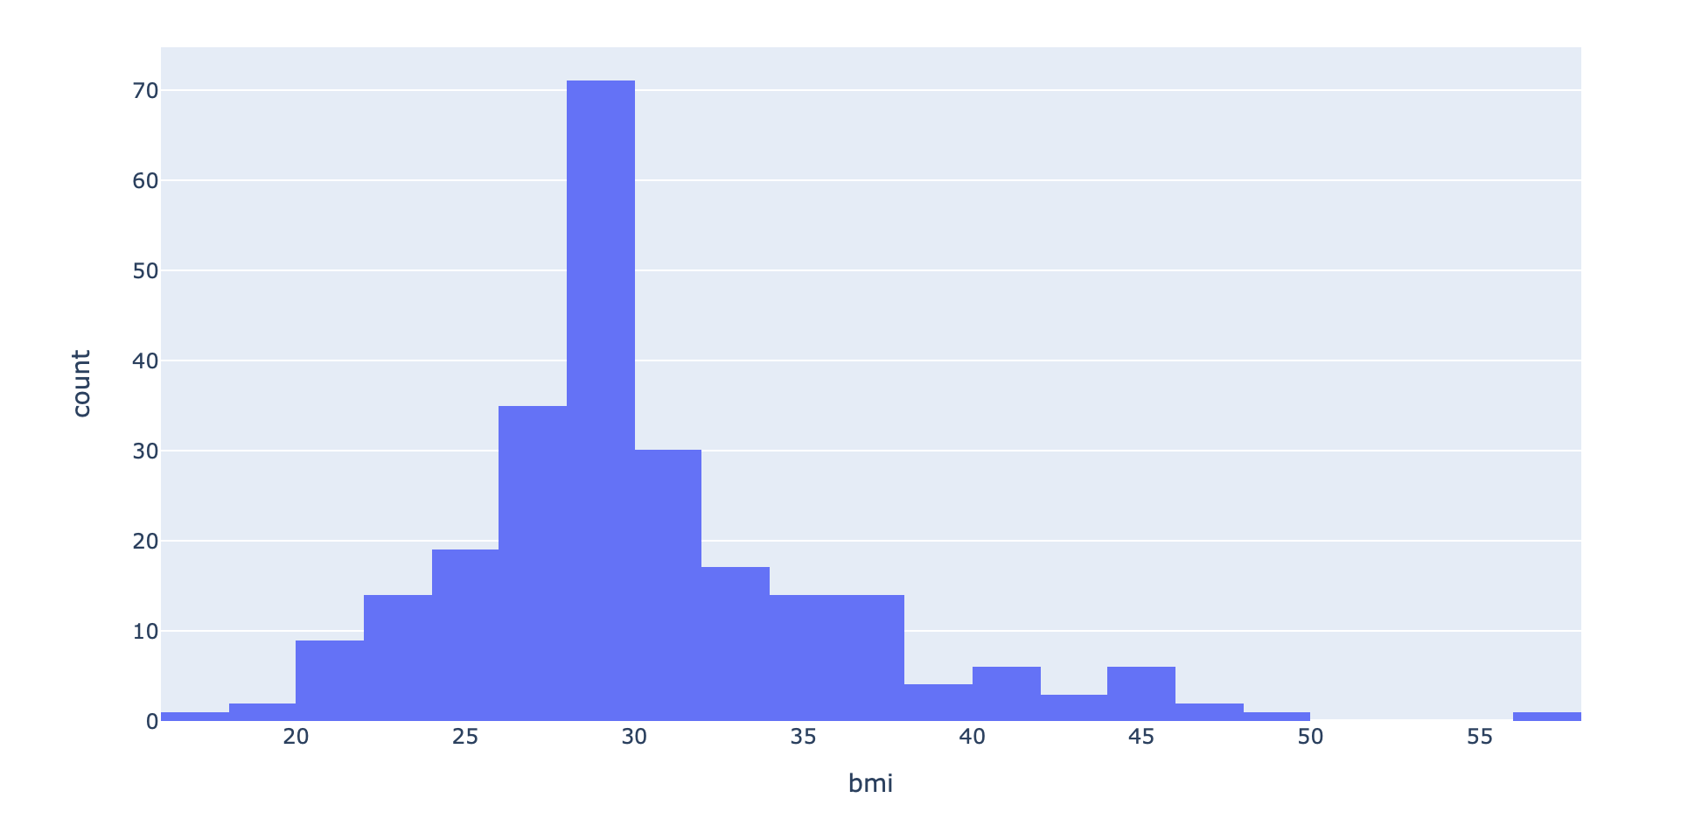
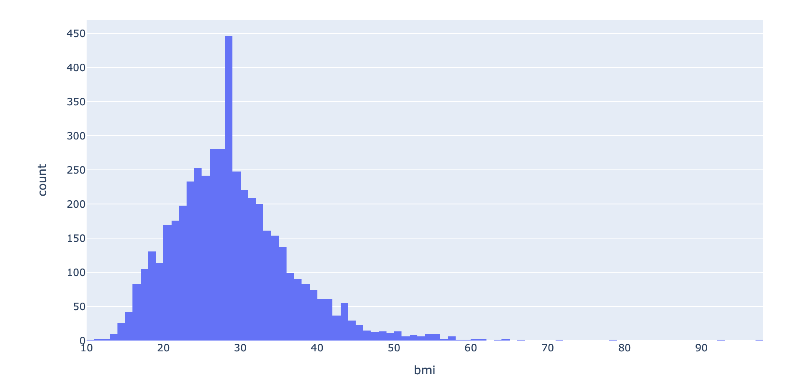
Stroke Sufferers
Non - Stroke Sufferers

Slide 17
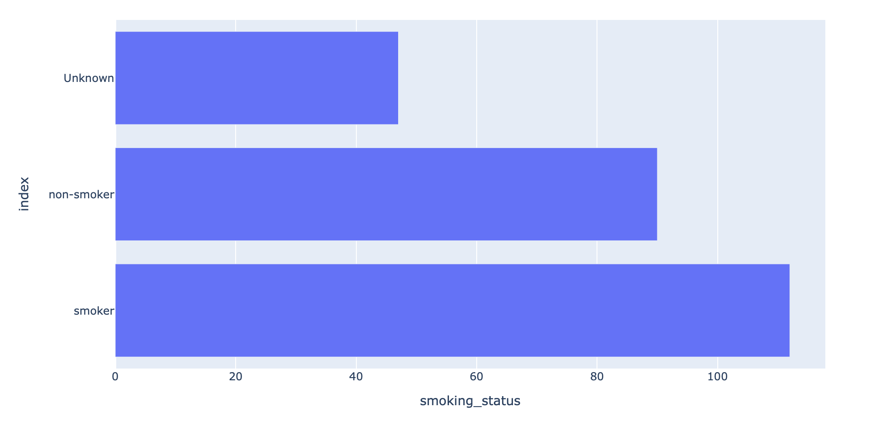

Slide 18
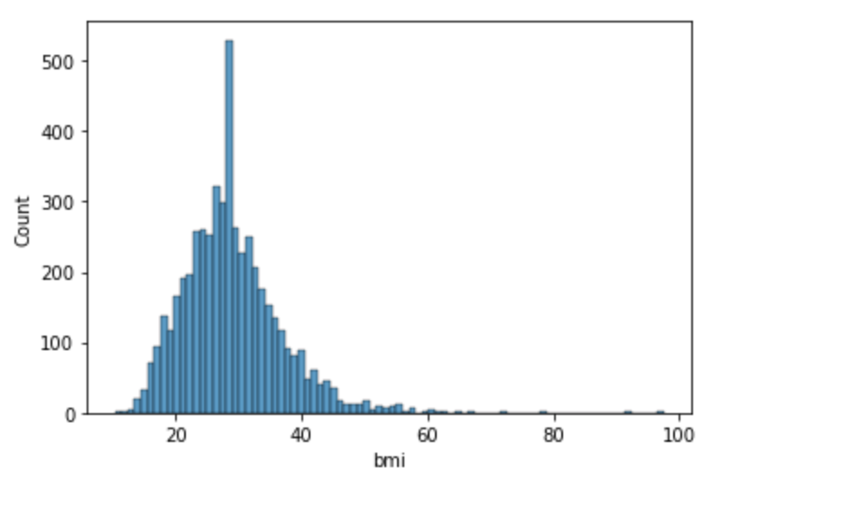
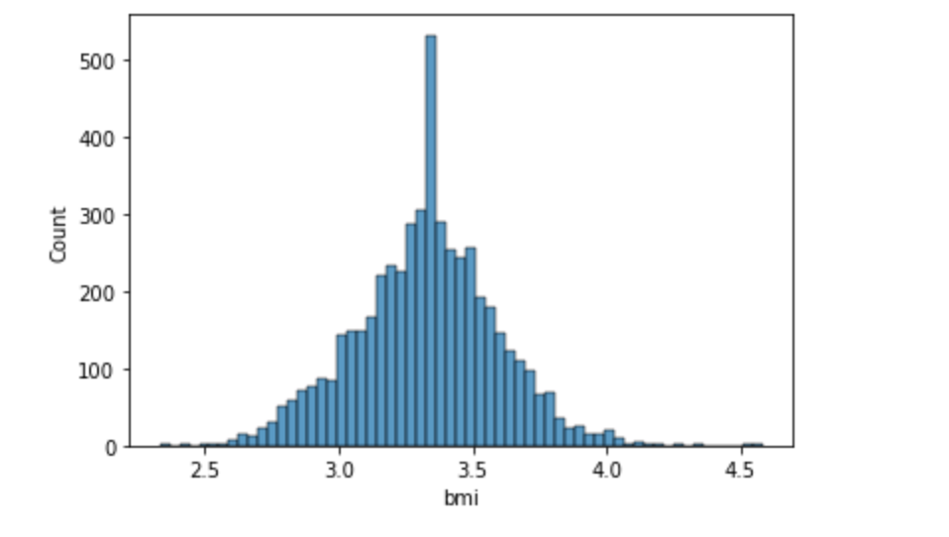
Modelling
Feature Engineering
Before log transforming
After log transforming

Slide 19
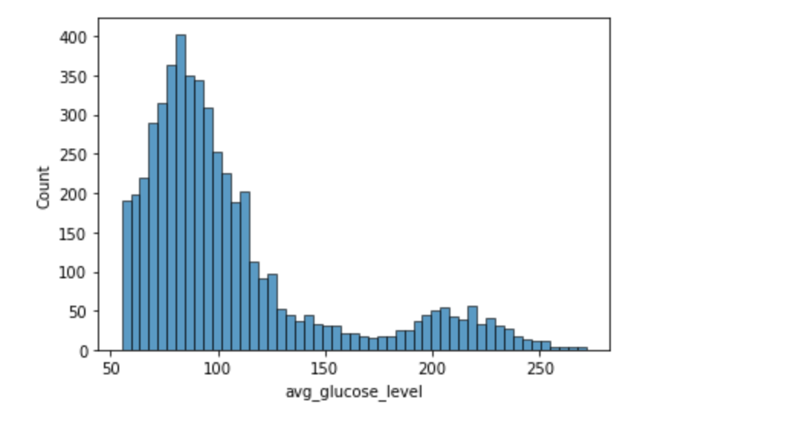
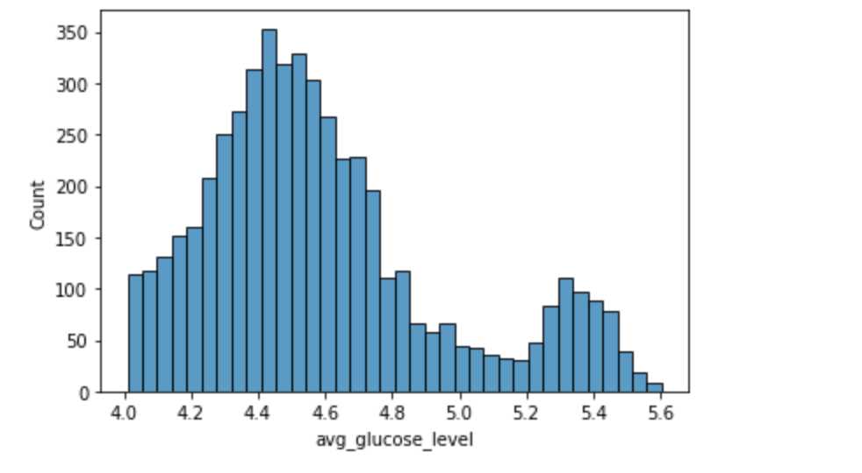
Modelling
Feature Engineering
Before log transforming
After log transforming

Slide 20
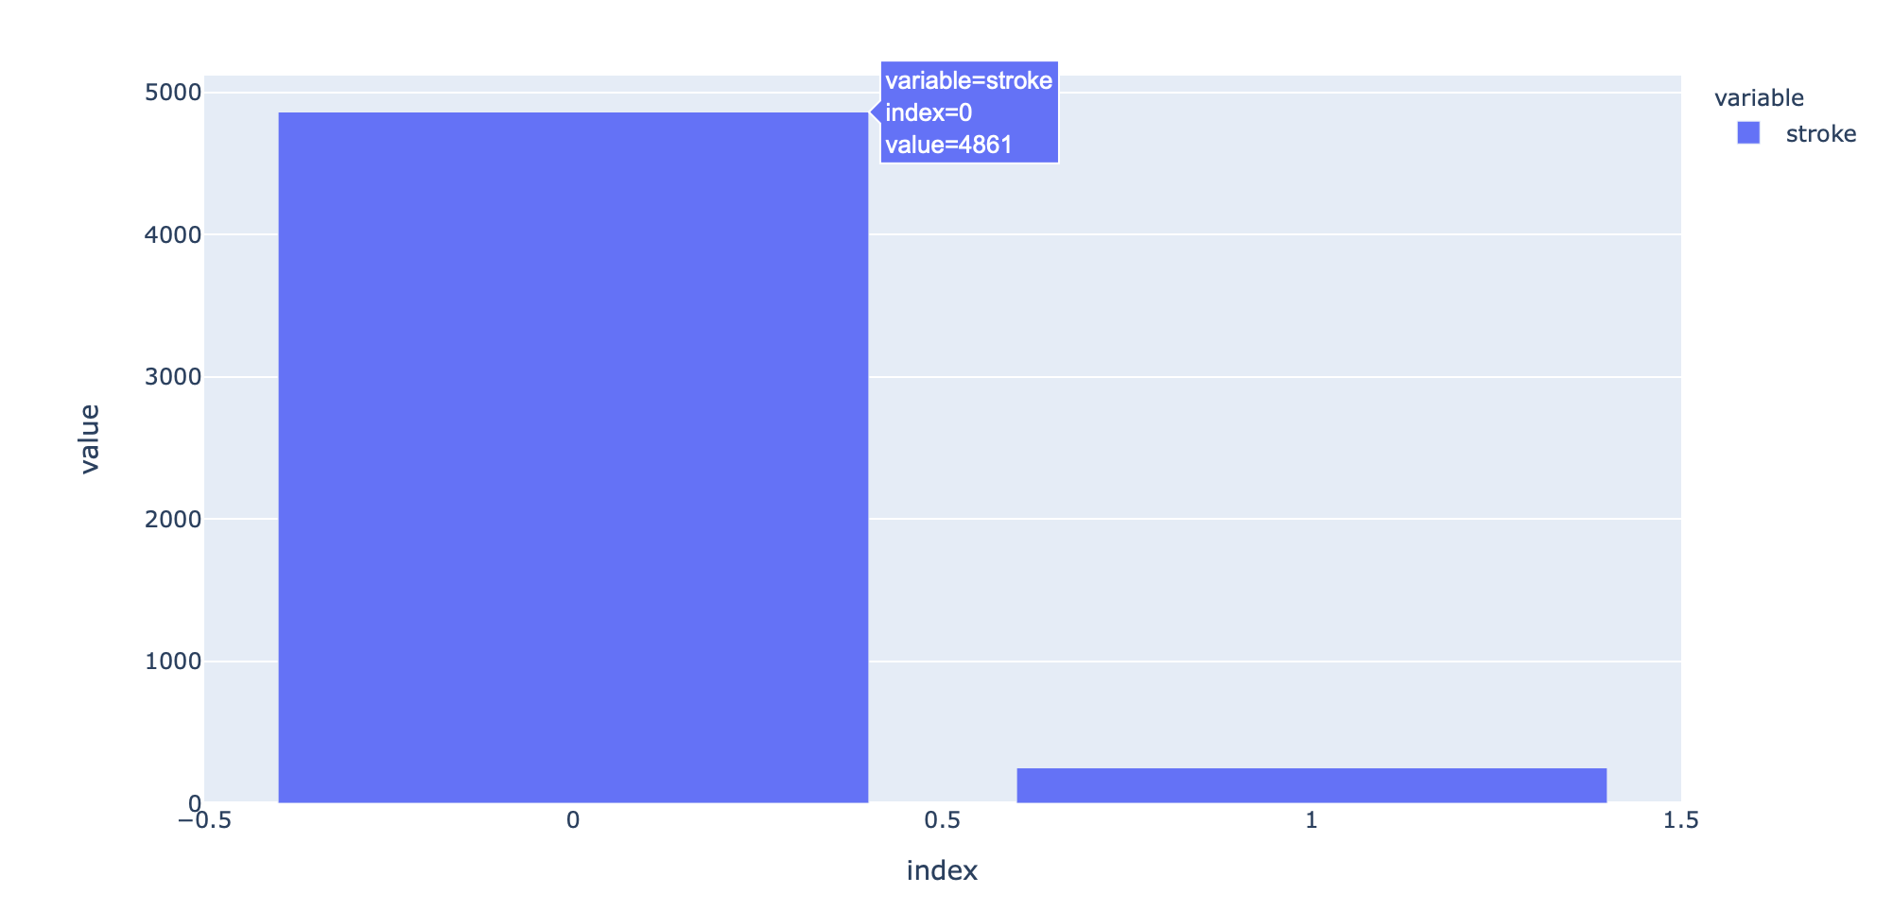
Modelling
Unbalanced Dataset
Used Oversampling (SMOTE)

Slide 21
Modelling
Models to test:
KNN
Random Forest
SVC
Gradient Boosting

Slide 22
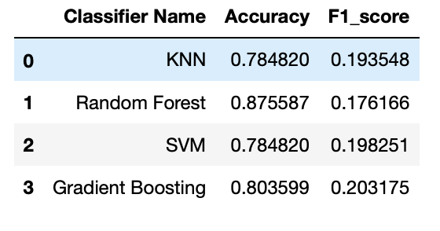
Modelling

Slide 23
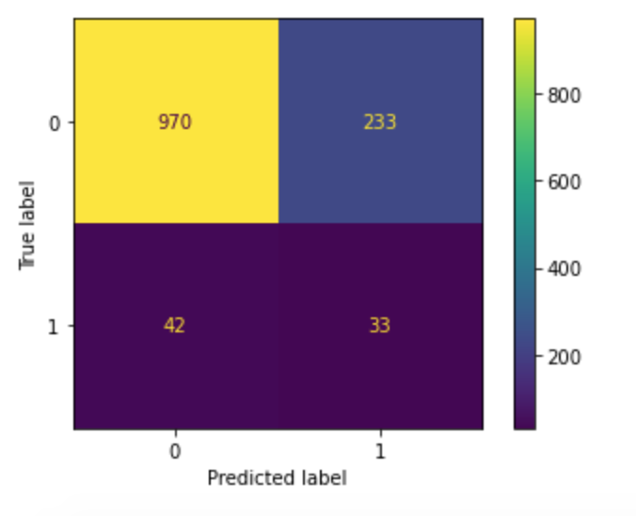
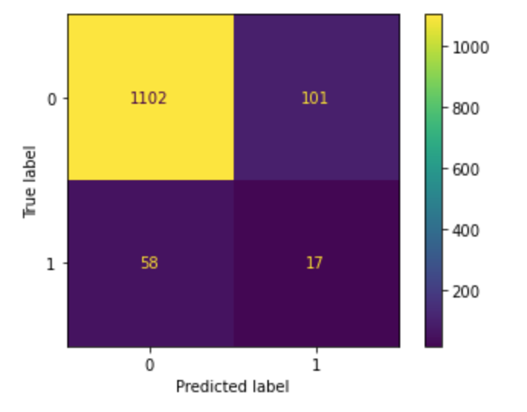
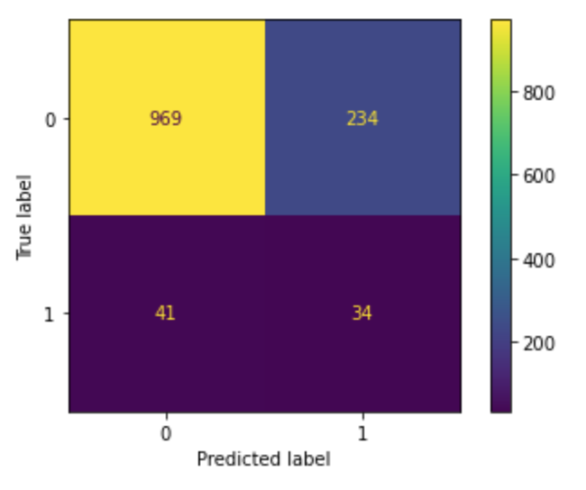
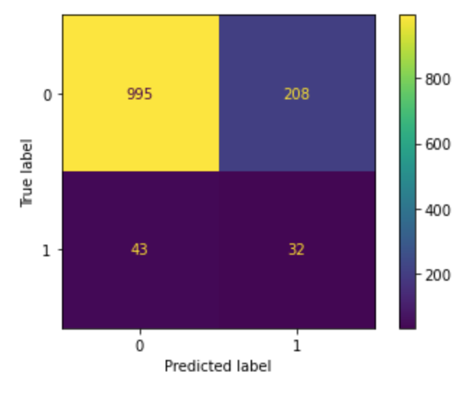
KNN
Random
Forest
Gradient
Boosting
SVM

Slide 24
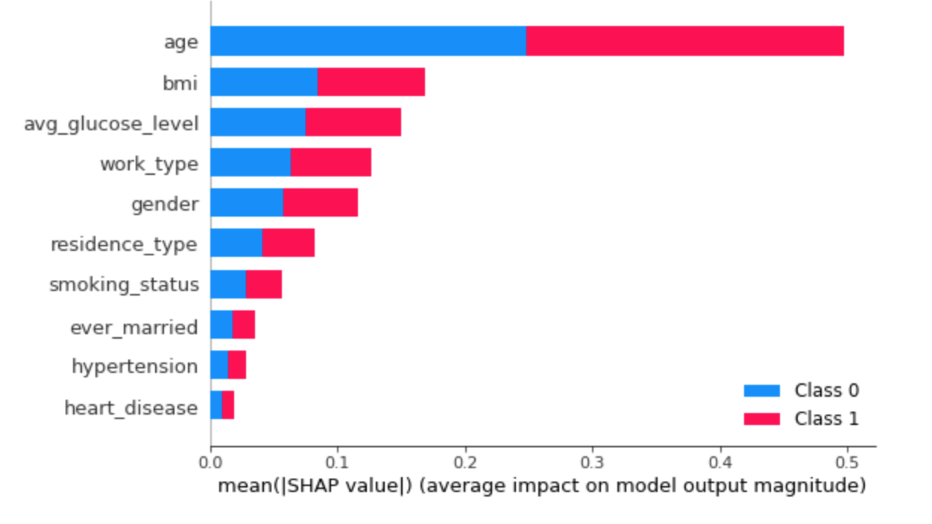
Feature importance using SHAP values

Slide 25
QUESTIONS

