Slide 1

Web Scraping NBA Players
Analysis of NBA Players 2020-2021 Regular Season Performance
Spyros Travlos

Slide 2
Contents
Data
Analysis
Clustering
Suggestions for further work

Slide 3
Data
Data Source: ESPN website
Web Scraping using BeautifulSoup library

Slide 4
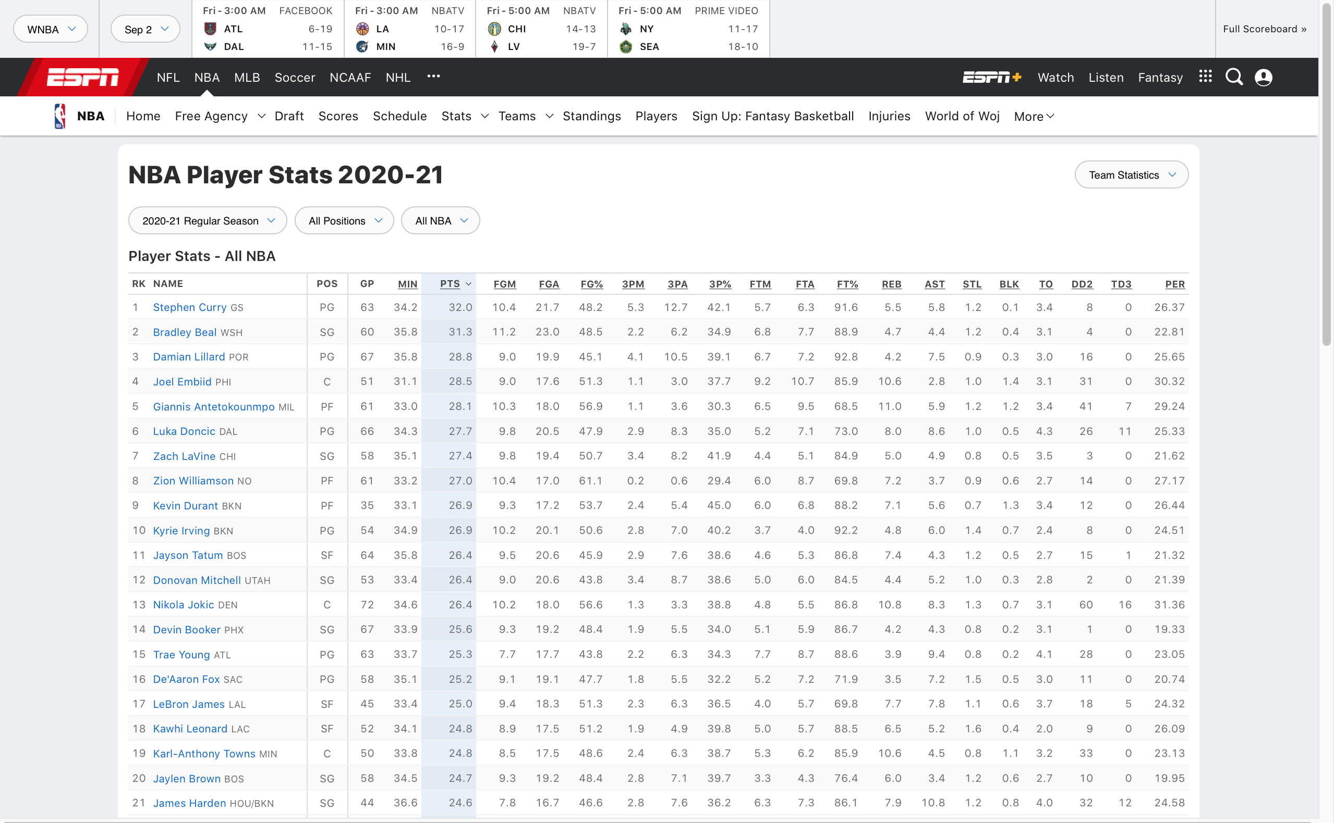

Slide 5
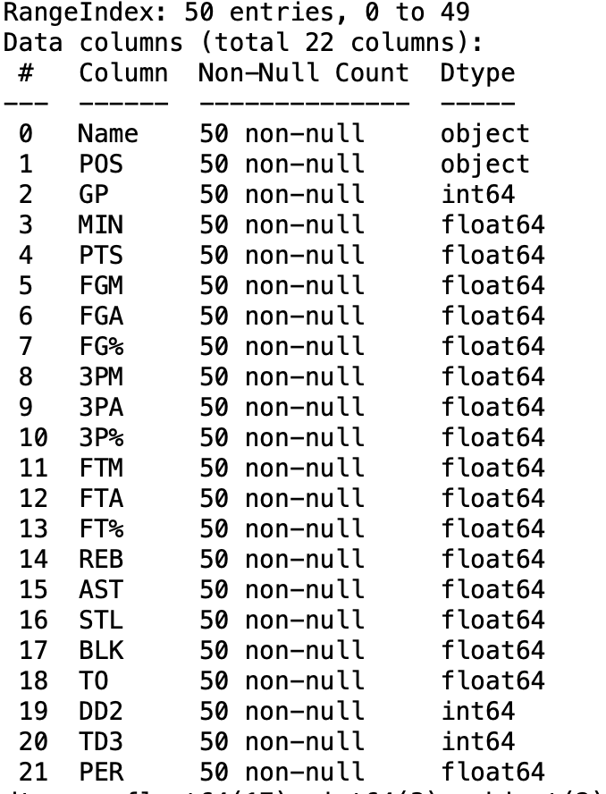
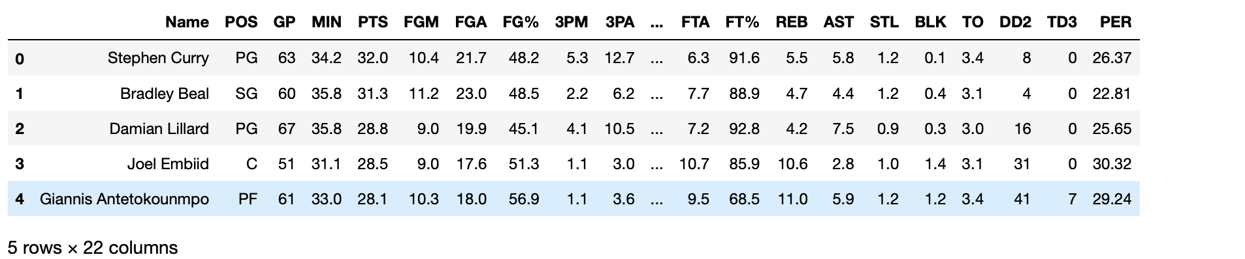
Data

Slide 6
Analysis
We focused our analysis on the best offensive players of the season
Top 50 scorers

Slide 7
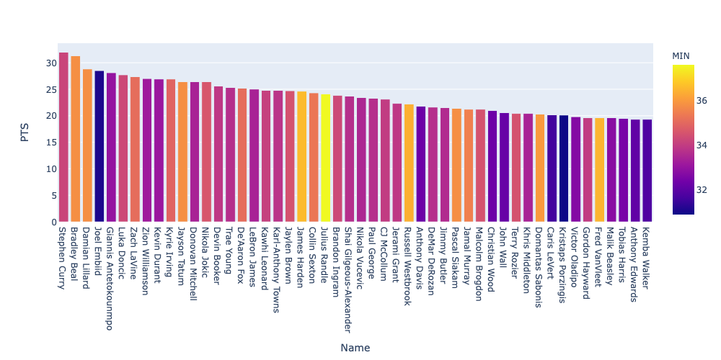
Points Scored

Slide 8
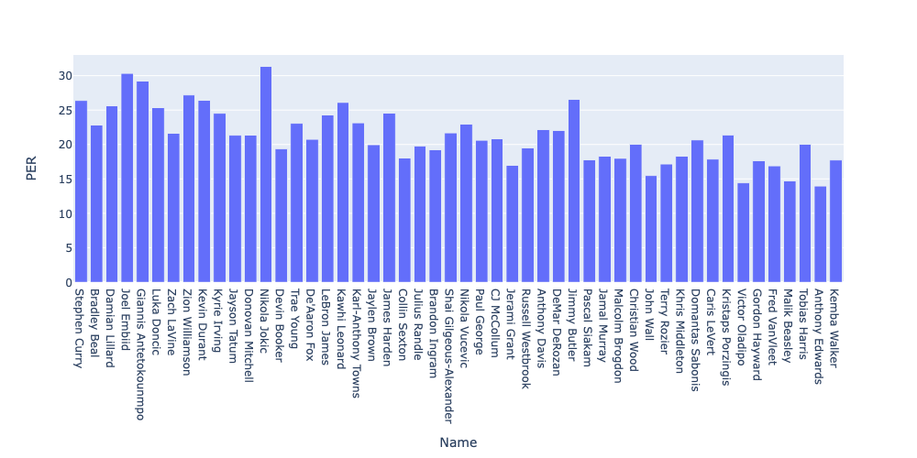
Most Efficient Players

Slide 9
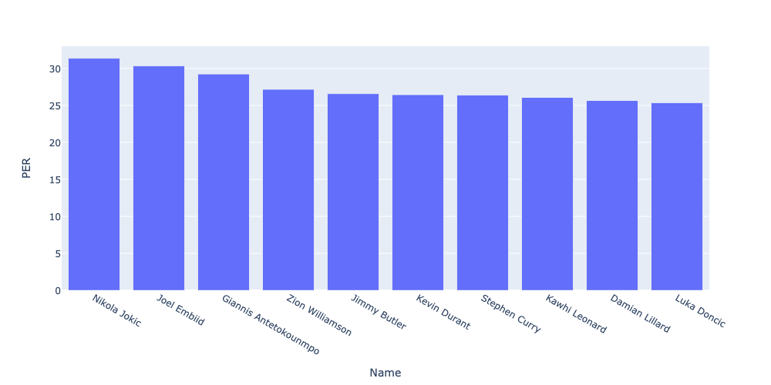
Most Efficient Players
Nikola Jokic well deserved the MVP title of the regular season

Slide 10
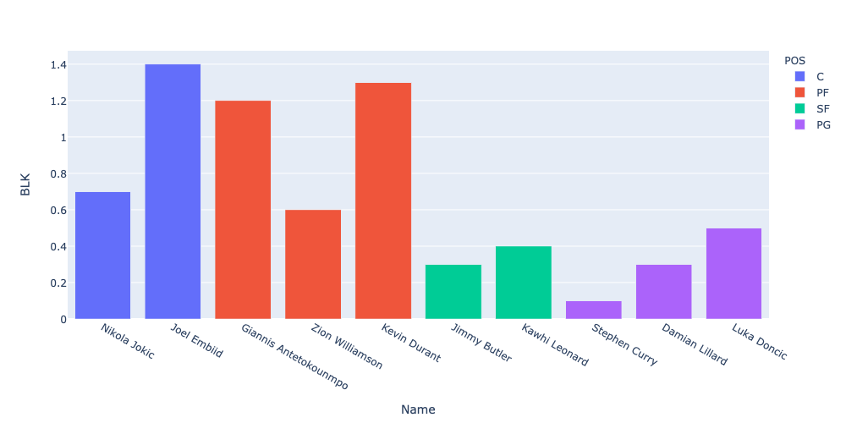
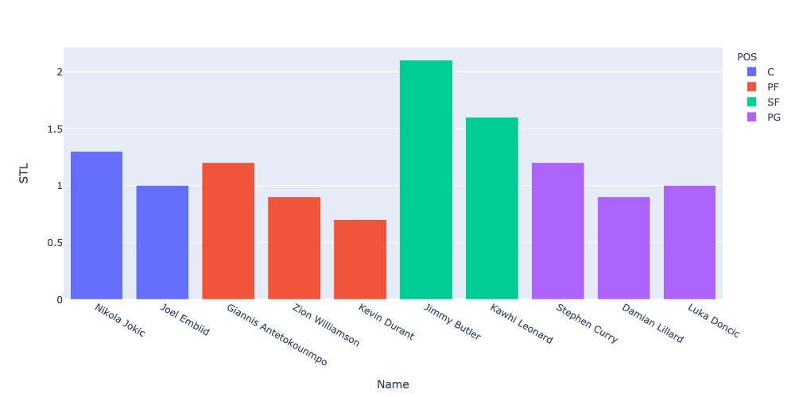
Defensive Performance

Slide 11
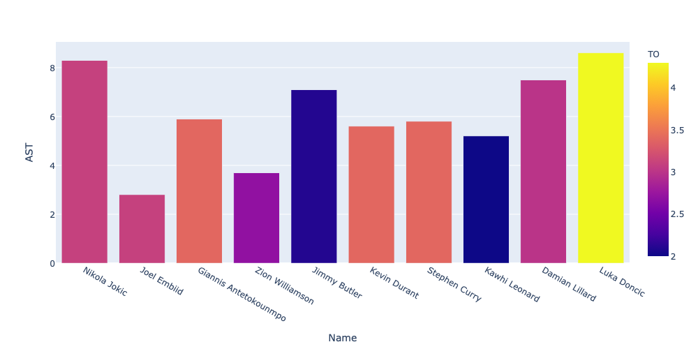
Playmaking Ability

Slide 12
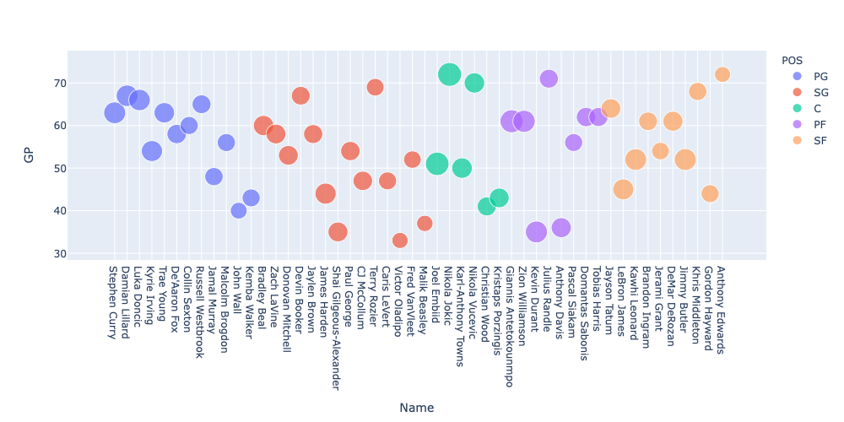
Most Reliable Players

Slide 13
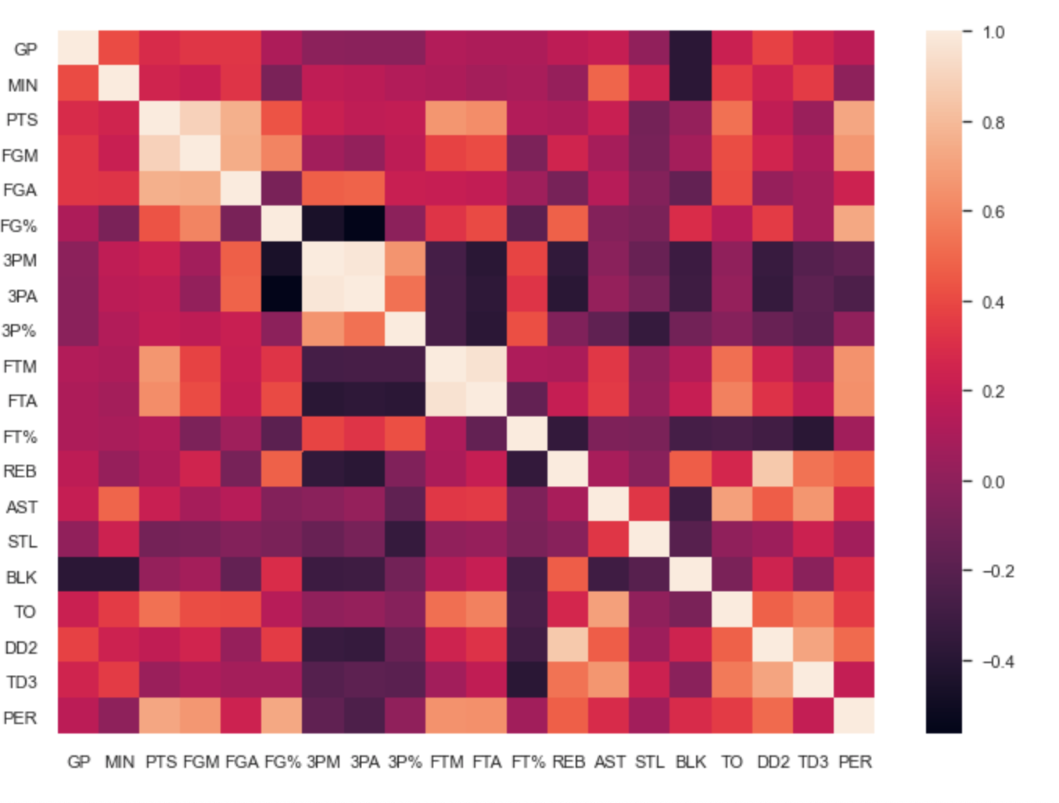
Clustering
Remove highly correlated features :
FGM , 3PM, FTM

Slide 14
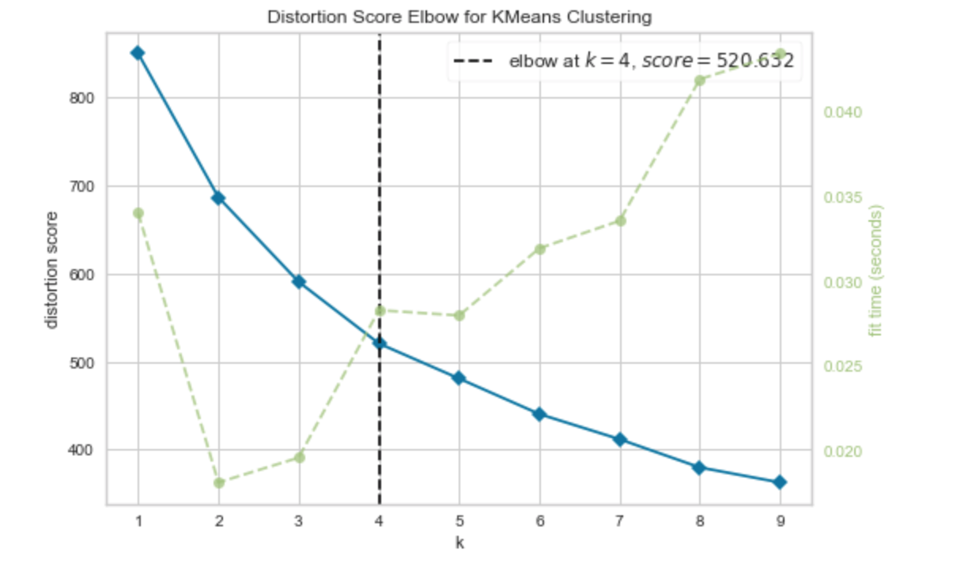
Clustering

Slide 15
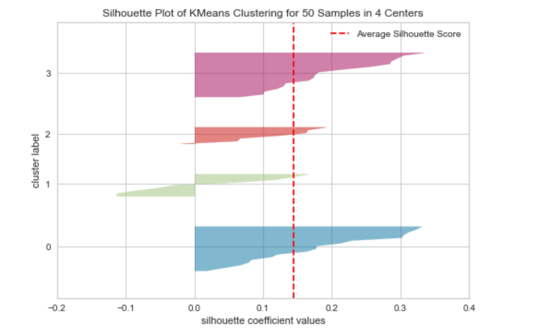
Clustering
Negative silhouette scores means incorrectly clustered points

Slide 16
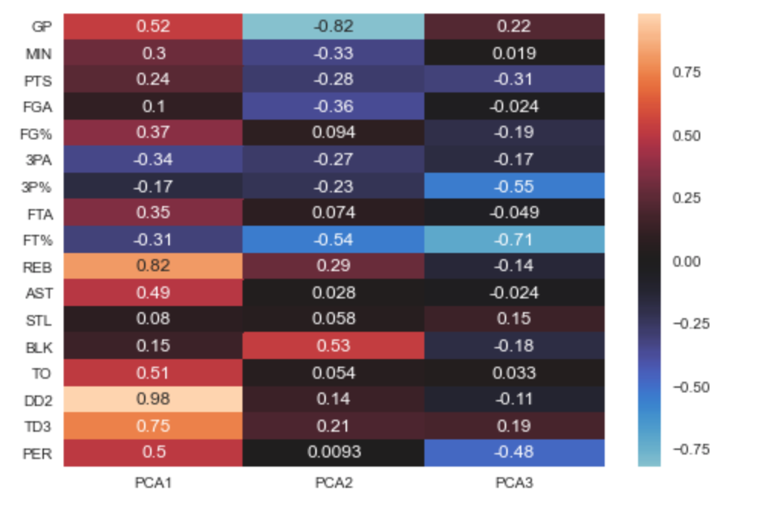
PCA
Reducing the number of features

Slide 17
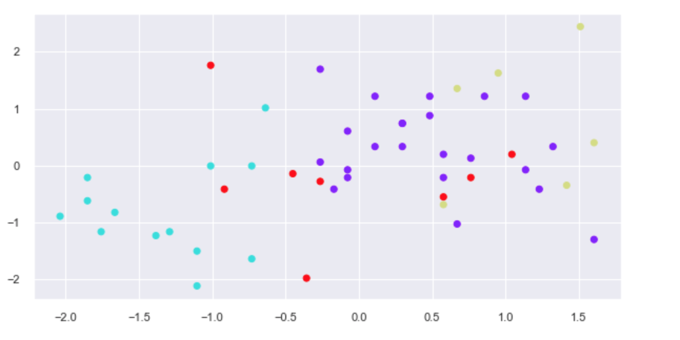
Clustering

Slide 18
Suggestions for further work
1) Include more data (use selenium to get more than 50 players
2) Include more features (i.e. market value of players, age etc)
3) Use the clustering model on new players coming to the league next season
4) Make recommendations to teams, on which player to pursue

Slide 19
QUESTIONS?

