Slide 1
Report
Xishuo Li
School of Computer Science and Engineering
Beihang University, Beijing, China

Slide 2
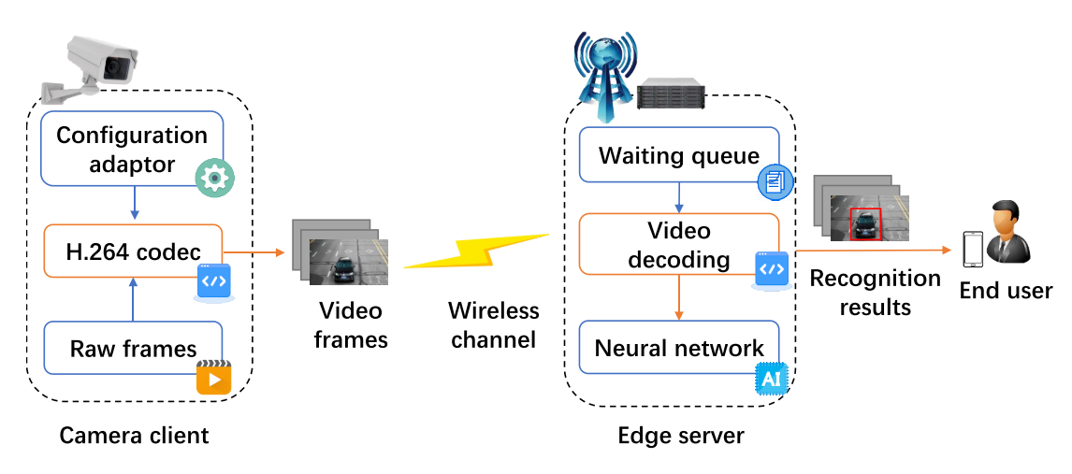
Background
Video analytics system
Key component in smart city, intelligent transportation
Edge-assisted deployment
Lightweight cameras cannot satisfy the computation requirements
Uploading video to edge/cloud servers for analysis is a popular approach

Slide 3
Background
Video analytics system
Transmission- and computation-intensive task
Constrained and unstable bandwidth and computation resources
How to enhance the system performance, e.g., delay and accuracy?
Video configurations impact performance
Low resolution, frame rate, light NN: low delay
High resolution, frame rate, heavy NN: high accuracy
Previous studies
How to adjust video configurations to balance delay and accuracy?
Weighted sum, Pareto optimal, hard/soft constraint …

Slide 4
Background
Encountered problem
The instantaneous delay and accuracy fluctuate with dynamic network conditions and variable video contents
Optimizing mean delay and accuracy
Poor performance may last for a long time
User experience can hardly be guaranteed
Previous studies
Adjust video configurations frequently/periodically
Use other optimization objectives
Lag, uploading lag
Tail accuracy

Slide 5
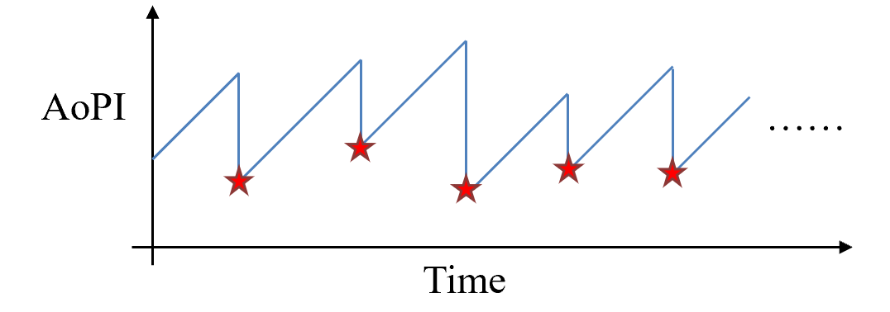
Background
Encountered problem
Key issue in previous studies
Delay and accuracy are conflicting metrics
Making decisions to achieve the balance is extremely hard
We adopt a more comprehensive objective
Age of processed information, AoPI
Time elapsed since the generation of the last received and successfully recognized frame at the user side
Low AoPI: deliver accurate results to user timely

Slide 6
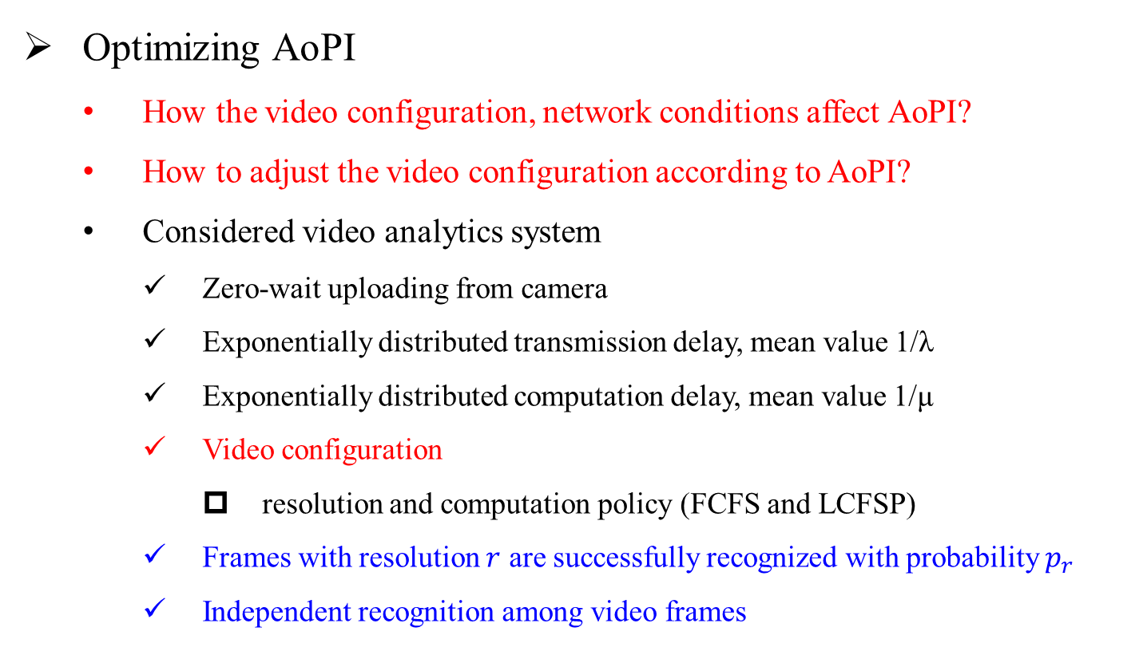
Problem
Optimizing AoPI
How the video configuration, network conditions affect AoPI?
How to adjust the video configuration according to AoPI?
Considered video analytics system
Zero-wait uploading from camera
Exponentially distributed transmission delay, mean value 1/λ
Exponentially distributed computation delay, mean value 1/μ
Video configuration
resolution and computation policy (FCFS and LCFSP)
Frames with resolution $r$ are successfully recognized with probability $p_{r}$
Independent recognition among video frames

Slide 7
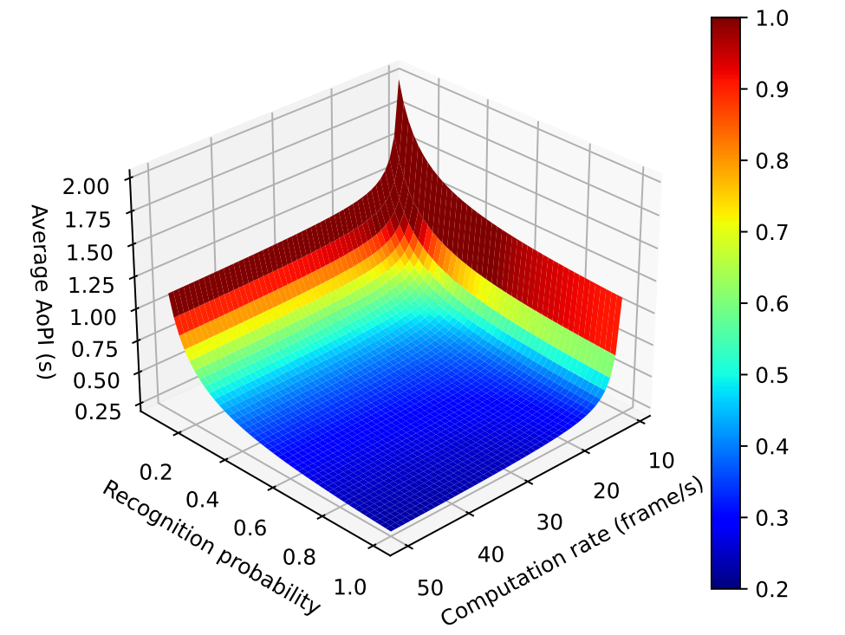
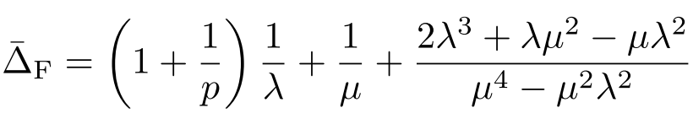
Problem
Analyze AoPI with FCFS
Average AoPI
AoPI is inversely proportional to recognition probability p
AoPI is a convex and monotone decreasing function with respect to the mean computation rate µ
The large the recognition probability and computation rate, the lower the average AoPI

Slide 8
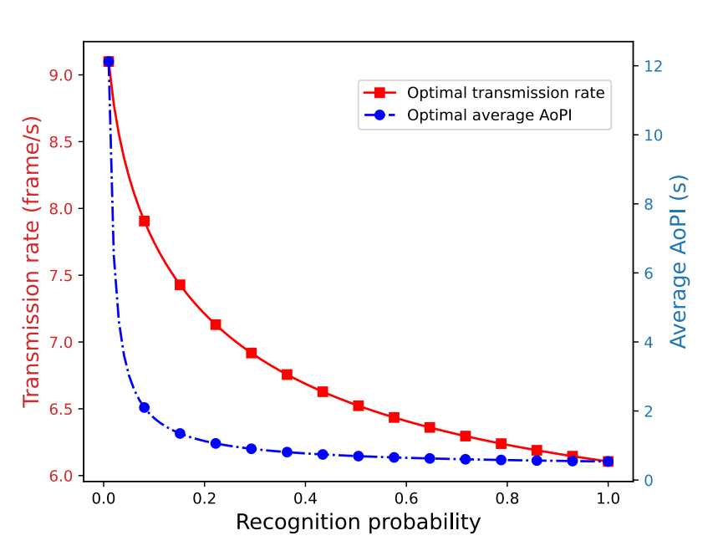
Problem
Analyze AoPI with FCFS
AoPI is a convex function with respect to the mean transmission rate λ, which first decreases and then increases with λ
The optimal transmission rate decreases with the recognition probability p

Slide 9

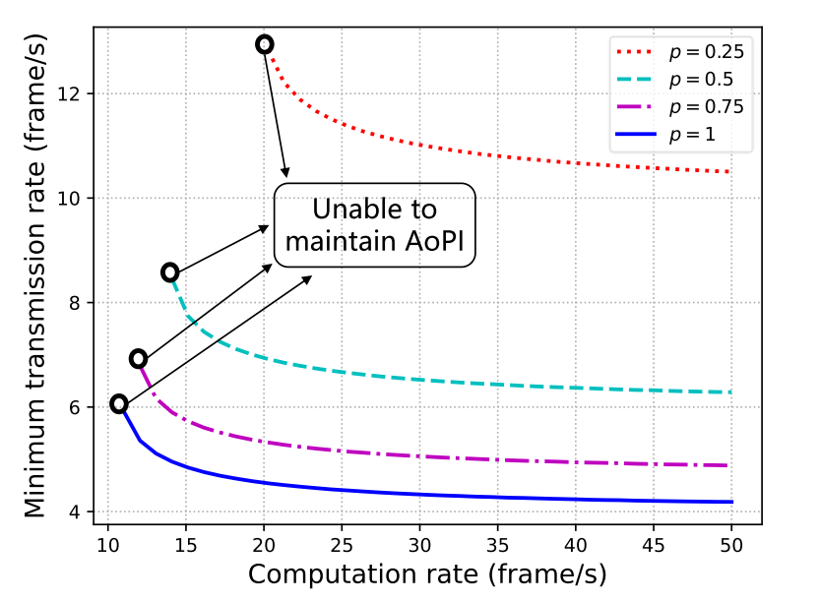

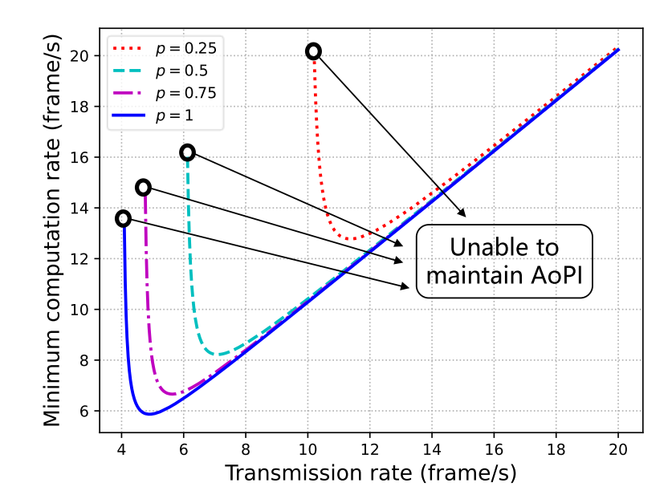
Problem
Maintaining AoPI level
Transmission-computation resource trading
The minimum required transmission rate decreases with the allocated computation rate ①
The minimum required computation rate first decreases and then increases with the allocated transmission rate ②

Slide 10
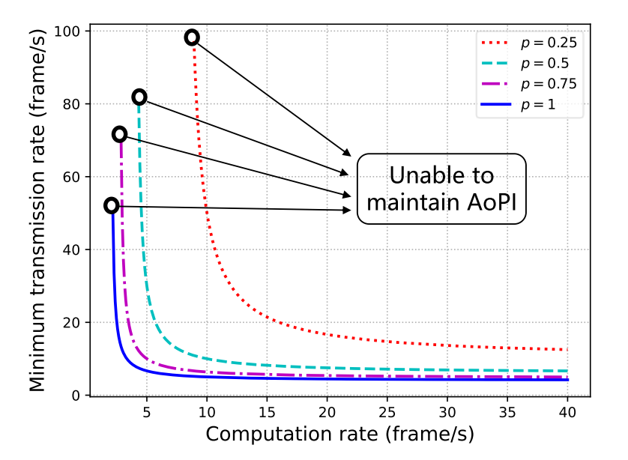
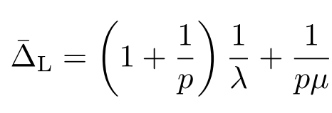

Problem
Analyze AoPI with LCFSP
Average AoPI
Impact of $p,λ,μ$
The large, the better
Maintaining AoPI level
The minimum required transmission rate decreases with the allocated computation rate, and vice versa

Slide 11
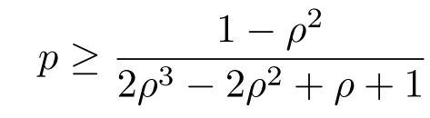
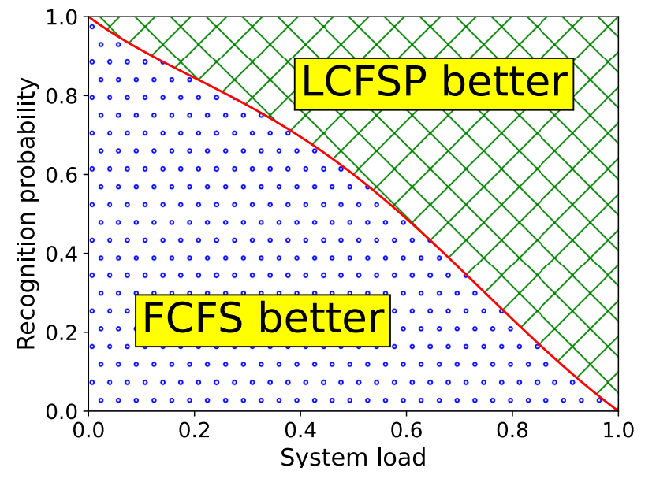
Problem
Computation policy comparison
Adopt the LCFSP strategy if
The LCFSP policy should be adopted in cases of abundant bandwidth, constrained computation resources, and high recognition probability

Slide 12
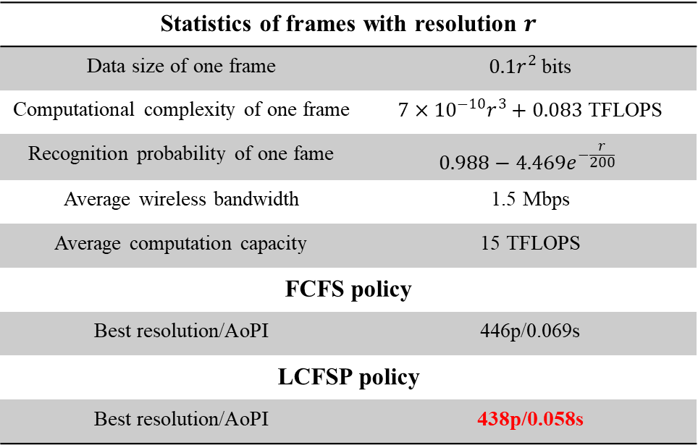
Problem
How to adjust video configuration: An example
Statistics of frames with resolution $r$
Data size of one frame | $0.1r^{2}$ bits
Computational complexity of one frame | $7×{10}^{−10}r^{3}+0.083$ TFLOPS
Recognition probability of one fame | $$0.988−4.469e^{−\frac{r}{200}}$$
Average wireless bandwidth | 1.5 Mbps
Average computation capacity | 15 TFLOPS
FCFS policy
Best resolution/AoPI | 446p/0.069s
LCFSP policy
Best resolution/AoPI | 438p/0.058s
Choose 438p resolution and LCFSP policy

Slide 13
Problem
Adjust video configuration
Calculating AoPI
How the configuration impacts delay and accuracy?
Profiling in advance
Without profiling
Reinforcement learning
Adjust configuration via trail-and-error

Slide 14
Problem
Insights from analysis
Video resolution selection
Uploading frames with too low or high resolution usually leads to higher AoPI
Computation policy selection
The LCFSP policy is better when the system load exceeds a certain threshold that decreases with the recognition probability.
Performance difference between two policies
The advantage of LCFSP policy increases with abundant bandwidth, constrained computation resources, and high recognition probability

Slide 15
Problem
Insights from analysis
Impact of allocating more resources
Increasing the computation resources always reduces the average AoPI
Allocating more bandwidth does not necessarily improve the system timeliness under the FCFS policy
There always exists an optimal value of bandwidth which increases with a low recognition probability under the FCFS policy

Slide 16
Problem
Insights from analysis
Minimum resources to maintain AoPI
The minimum required transmission and computation resources increase significantly with a lower recognition probability
Transmission-computation resources trading
Under the LCFSP policy, allocating more transmission or computation resources helps save the other required resources
Under the FCFS policy, reserving more computation resources helps save the wireless bandwidth, but NOT vice versa

Slide 17
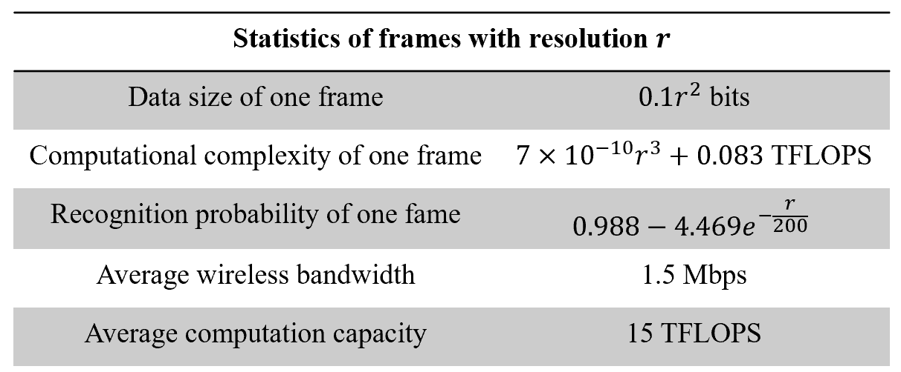
Simulations
Settings
Alternative resolution: {360p, 540p, 720p, 900p, 1080p}
Proposed analytical approach: ANA
Baselines
Profiling-based adaptation (PFA)
Feedback-based adaptation (FBA)

Slide 18
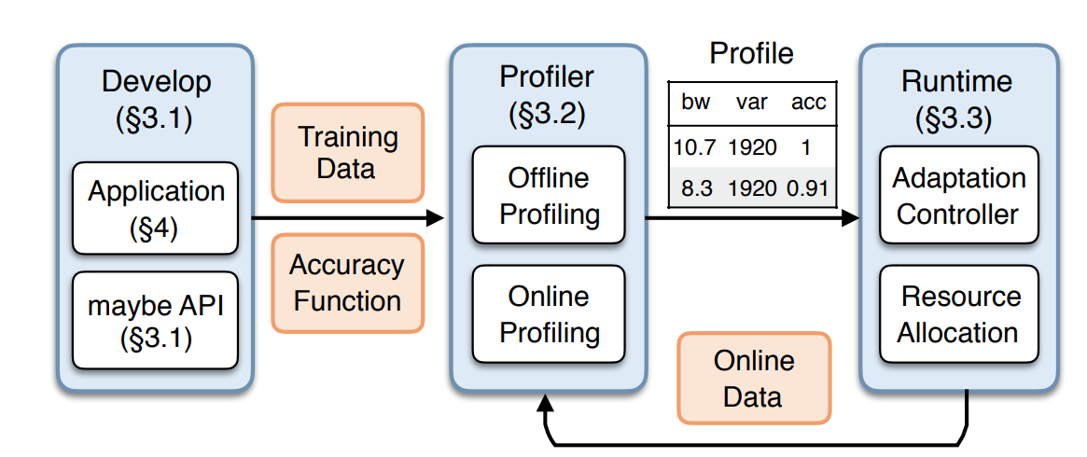
Simulations
Profiling-based adaptation (PFA)
Record the delay and accuracy of each resolution in advance
Adjust resolution according to the weighted sum of delay and accuracy
PFA_FCFS and PFA_LCFSP

Slide 19
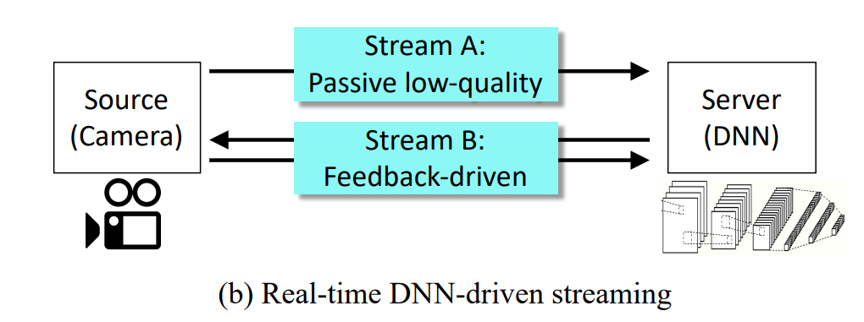
Simulations
Feedback-based adaptation (FBA)
Upload low-resolution frames by default
Retransmit high-resolution frames if previous frames are unsuccessfully recognized
FBA_FCFS and FBA_LCFSP

Slide 20
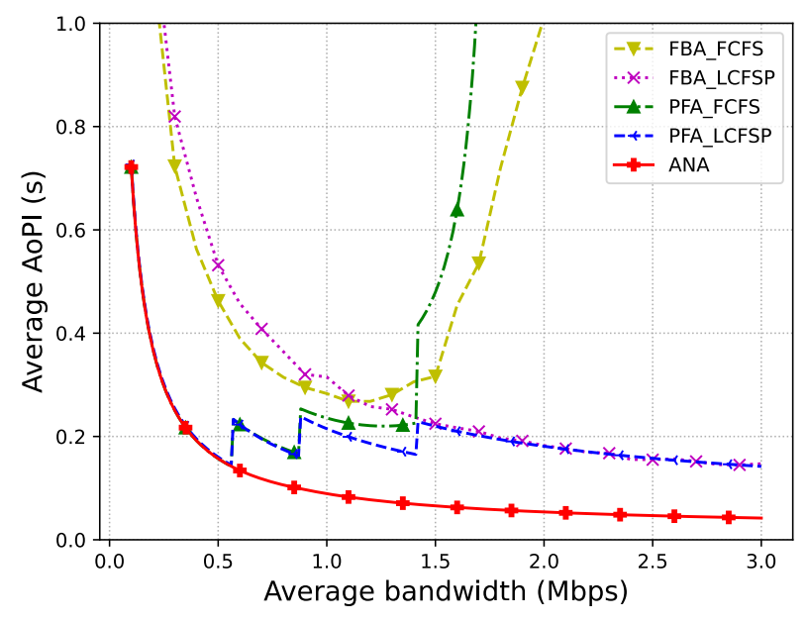
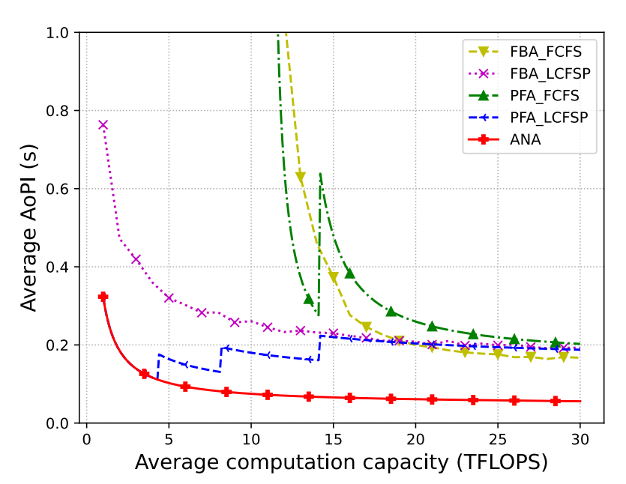
Simulations
Change of average bandwidth and computation capacity
The average AoPI is reduced by up to 3.38X by using ANA

Slide 21
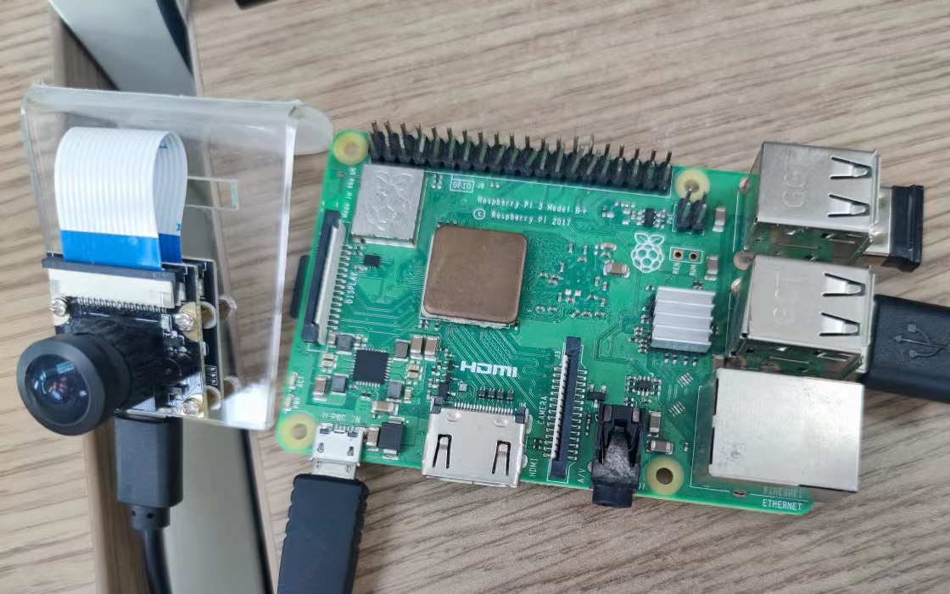
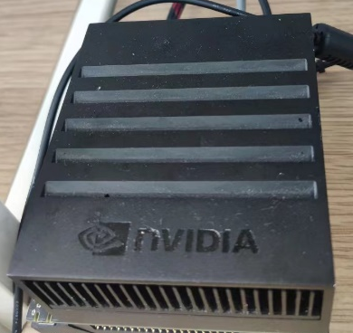

Prototype
Validating the analysis results
Prototype deployment
OpenCV image preprocessing
Image to base64 string
Tornado server listening
YOLOv5m for object recognition
Campus
Wi-Fi
HTTP post
Raspberry 3b+
with a USB camera
Nvidia Jetson
AGX Xavier

Slide 22
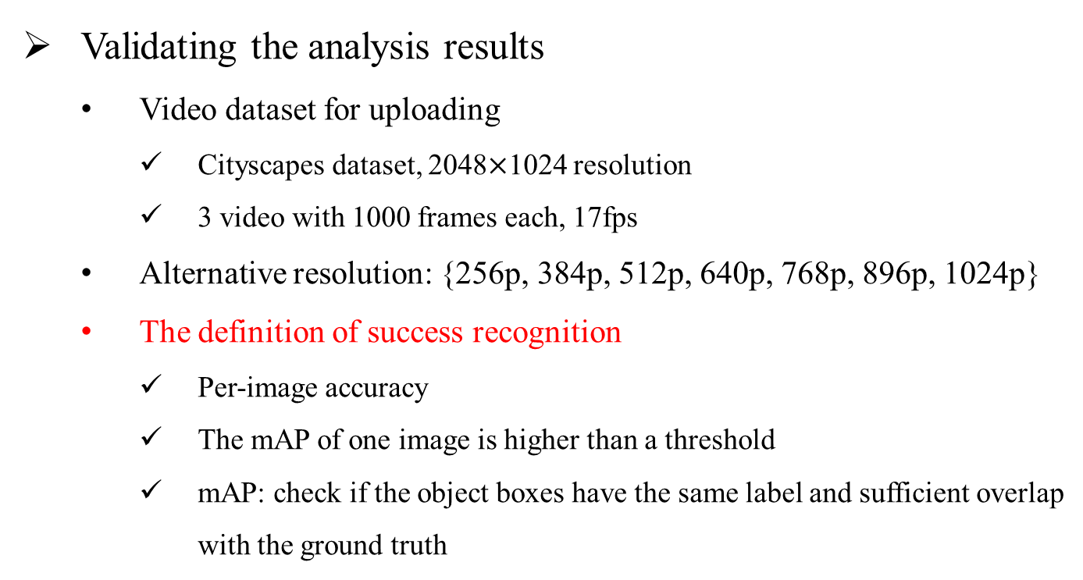
Prototype
Validating the analysis results
Video dataset for uploading
Cityscapes dataset, 2048$×$1024 resolution
3 video with 1000 frames each, 17fps
Alternative resolution: {256p, 384p, 512p, 640p, 768p, 896p, 1024p}
The definition of success recognition
Per-image accuracy
The mAP of one image is higher than a threshold
mAP: check if the object boxes have the same label and sufficient overlap with the ground truth

Slide 23
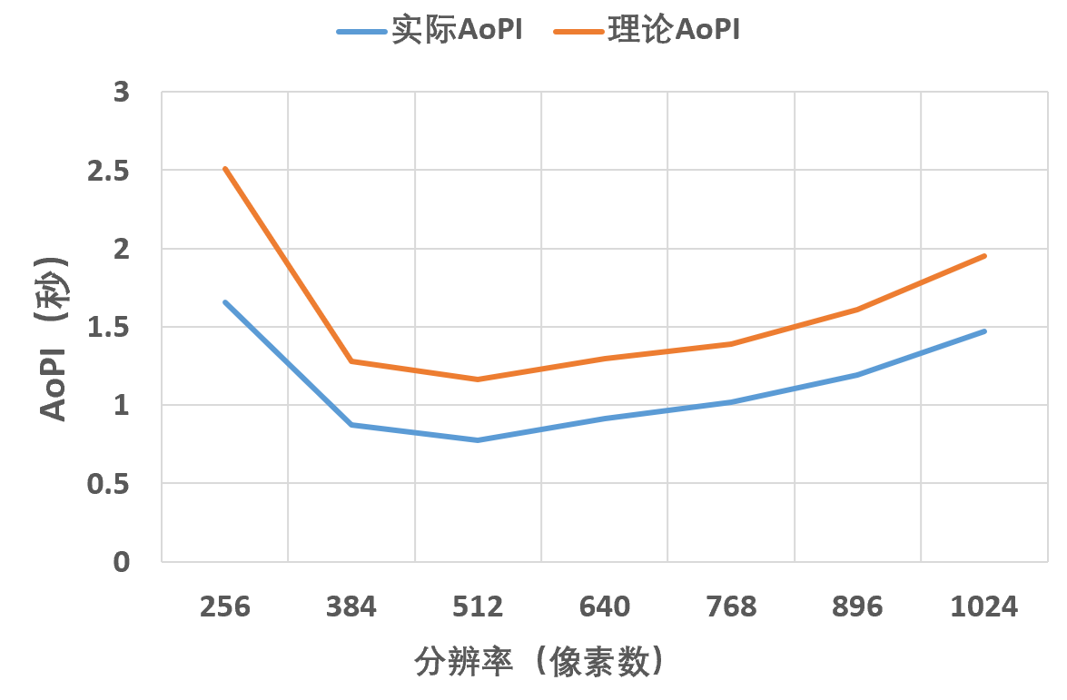
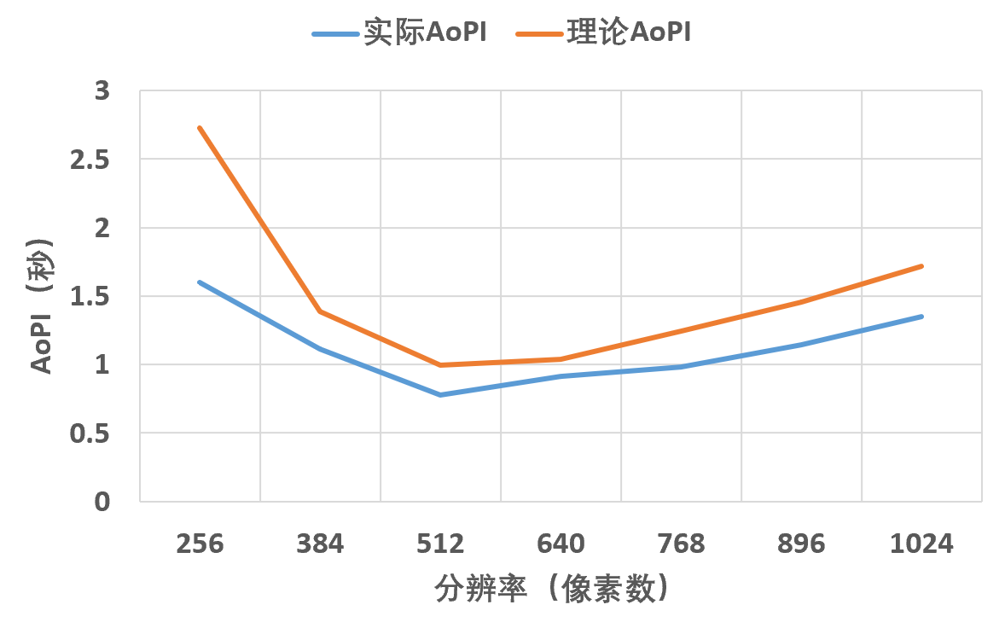
Prototype
Validating the analysis results
The analytical AoPI shares the same trend with the experimental AoPI
Theoretical best video configuration: 512p, LCFSP policy
FCFS policy
LCFSP policy

Slide 24
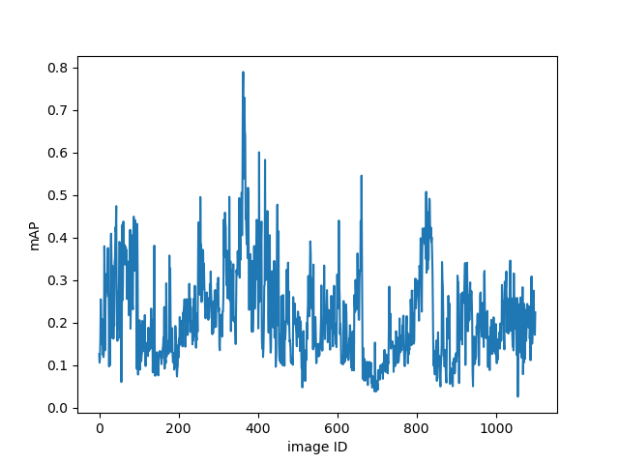
Prototype
Reasons for the deviation
Assumptions in analysis
Exponentially distributed transmission delay
Exponentially distributed computation delay
Frames are successfully recognized with probability 𝑝
Independent recognition among video frames
Experiments
Random transmission delay
Almost fixed computation delay
Fluctuating recognition probability
Temporal correlations between frames

Slide 25
Conclusion
Analyze the age of video analytics system
Adopt AoPI metric to reflect user experience
Analyze AoPI under different computation policies
Provide insights to adjust video configuration and allocate network resources according to AoPI
Show the optimization space of AoPI
Validate the analysis via prototype

Slide 26
Conclusion
Future work
Modify the simulations and experiments
Discuss how to model the temporal correlations among frames
Explore the possibility of online video configuration adaptation approach for practical systems

