Slide 1
Congestion & Flow Control of
Transmission in Space Segment
单乾

Slide 2
Outline
Background
REFWA: Fair Congestion Control by Adjusting TCP Window Size
Congestion Control by Informing Neighbor Satellite to Reroute
ELB: Routing-table-based Rerouting
PAR & DRNL: Latitude-and-longitude-based Rerouting

Slide 3
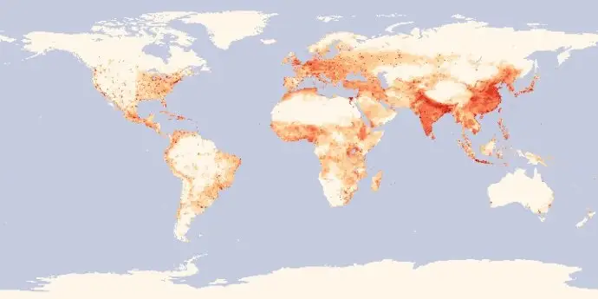
Background (1/1)
variance user density over the globe
differentiated services
delay-sensitive vs. not sensitive
urban areas vs. rural areas vs. ocean
unbalanced traffic load
some satellites heavy loaded, while others idle

Slide 4



REFWA (1/4)
Recursive, Explicit, and Fair Window Adjustment
key concept
adaptively adjust TCP flow rate to available bandwidth
intermediate satellites send feedback message to TCP source to adjust window size
if feedback < RWND, then let RWND = feedback
calculate feedback
(rewrite RWND in TCP)
source
destination

Slide 5
REFWA (2/4)
estimation of RTT and grouping
a satellite estimate each flow’s RTT:
H_{b}, H_{f}: backward & forward hop number when passing through this satellite
ISL_{delay}: delay of inter-satellite link, assumed as a constant
fairness: flows with the same RTT are grouped together
the same RTT, the same feedback, then the same throughput
vs. standard TCP: “undesirable bias against long RTT flows”
$$RTT=2⋅(H_{b}+H_{f}+2)⋅ISL_{delay}$$
Notes:
Hb Hf: TCP包的往返跳数 Hb+Hf+2即为链路总跳数
认为ISLdelay 是常数，且忽略了队列延迟
模拟显示这种估计方法的误差在30%~40%

Slide 6
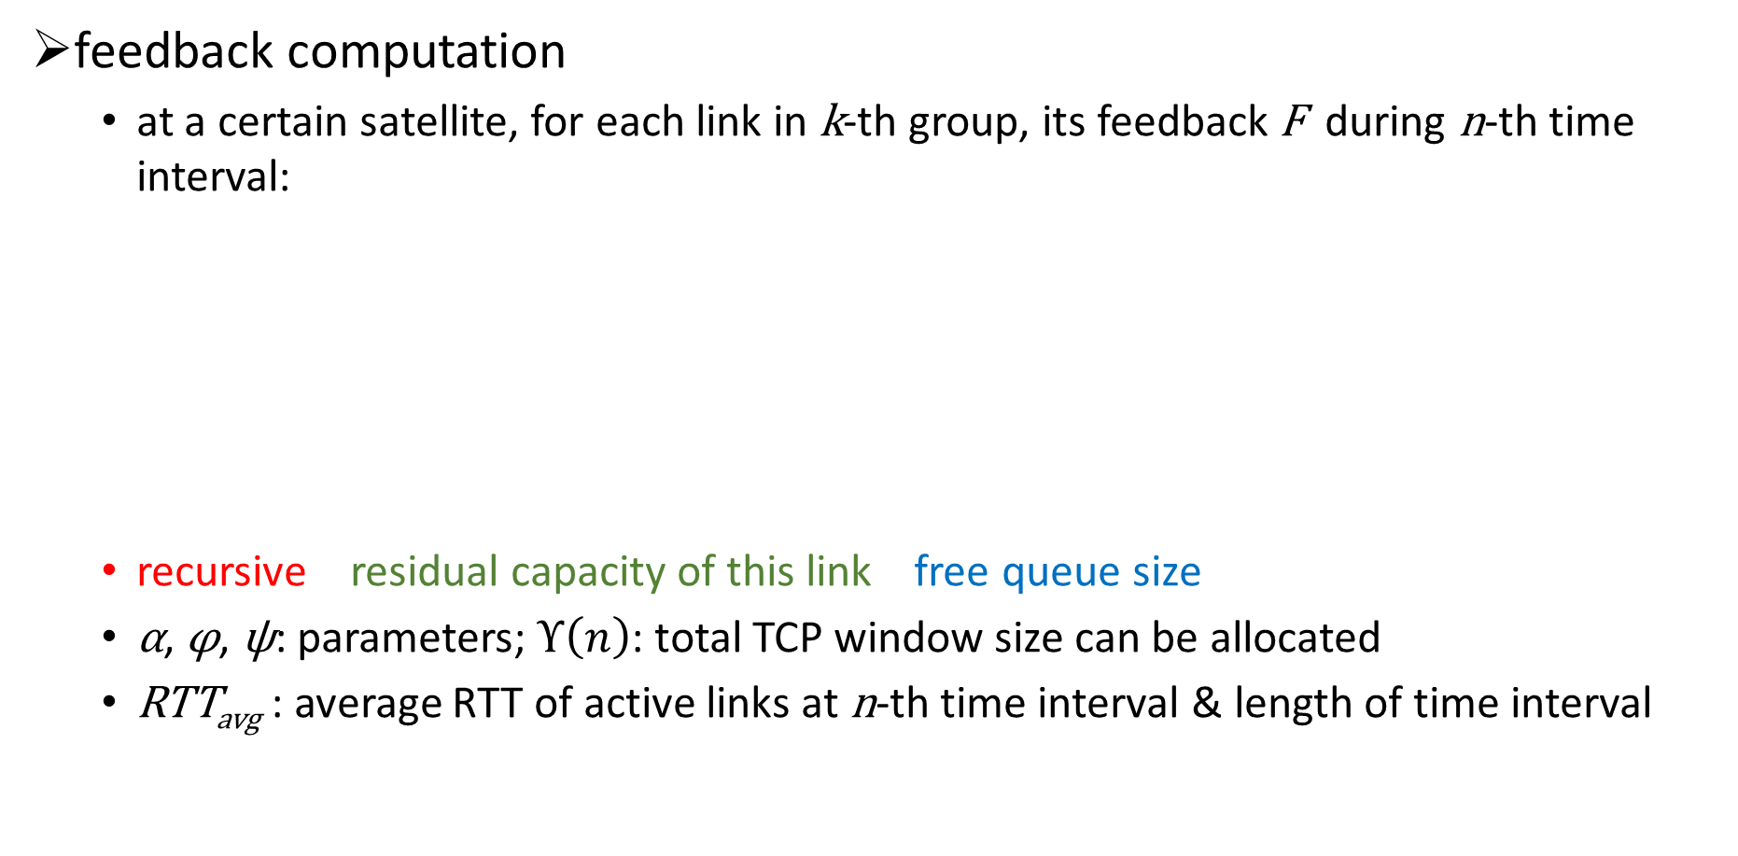
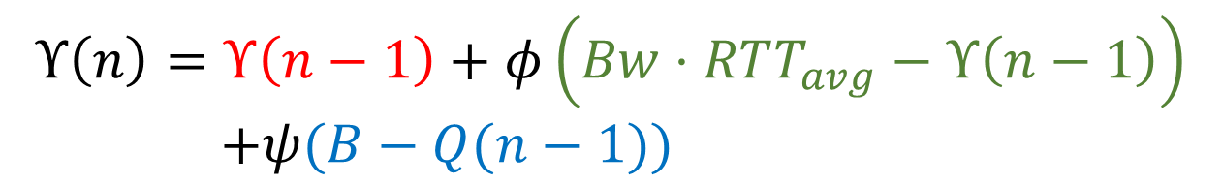
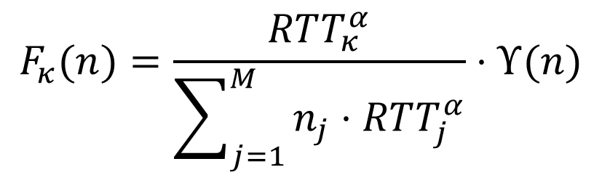
REFWA (3/4)
feedback computation
at a certain satellite, for each link in k-th group, its feedback F during n-th time interval:
recursive residual capacity of this link free queue size
α, φ, ψ: parameters; $Υ\left(n\right)$: total TCP window size can be allocated
RTT_{avg} : average RTT of active links at n-th time interval & length of time interval
$$F_{κ}(n)=\frac{RTT_{κ}^{α}}{\sum_{j=1}^{M}{n_{j}}⋅RTT_{j}^{α}}⋅Υ(n)$$
$$Υ\left(n\right)=Υ\left(n−1\right)+φ\left(Bw⋅RTT_{avg}−Υ\left(n−1\right)\right)$$
$+ψ(B−Q(n−1))$

Slide 7
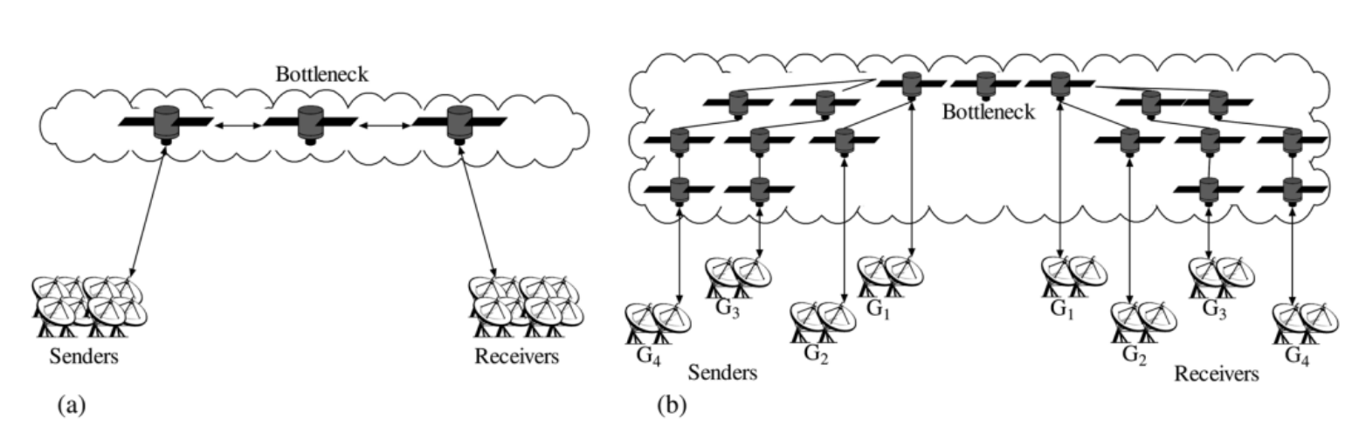
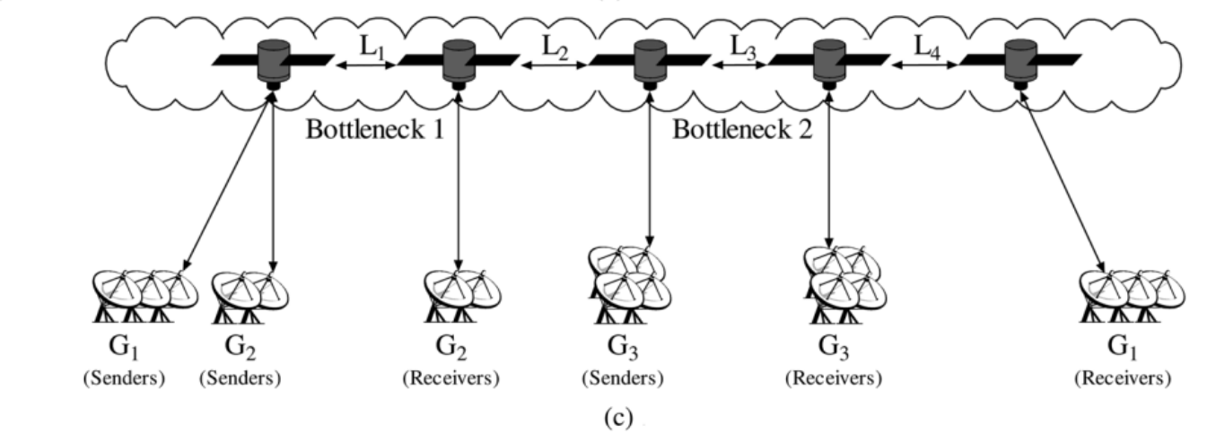

REFWA (4/4)
experiments & conclusion (vs. TCP NewReno)
measures: bottleneck link utilization, loss rate, queue size, fairness index
for lower packet losses & smaller queue size, $φ=1.5$, $ψ=0.5$; for fairness, α=1
more robust when abrupt change of traffic load happens
fairness: operates correctly when there are links with variant RTTs (Fig b)
multiple bottlenecks: doesn’t matter (Fig c)
tolerant to errors in RTT estimate
Notes:
robust: 使模拟中的连接数突然增加/减少，链路利用率、队列长度不会突然变化
fairness: 不同连接在考虑RTT的情况下，基本平分带宽

Slide 8
ELB (1/3)
Explicit Load Balancing
key concept
when a satellite is congested, it informs its neighbors to reroute
packets should have passed this satellite are sent through alternative paths
may cause out-of-order reception & packets have to traverse more hops
original path
congestion information
new path

Slide 9
ELB (2/3)
three states of a certain satellite A
α, β, χ are parameters
β = 1 – p(packet dropping possibility); α = β / 2
χ is relative to:
traffic coming from the ground
the satellite’s ability to output
time we want the satellite to stay in normal state
name | total queue size | operation
free state | (0, α) | none
fairly busy state | [α, β] | send a warning message to neighbors, ordering them to start searching alternative paths
busy state | (β, +inf) | send a busy message to neighbors, ordering them to send only χ portion packets via A (e.g. flow control)
Notes:
关于χ：
首先计算当busy signal到达邻居时的队列长度
为了使之后的队列长度在时间θ内回到α以下，需要更新输入流量（输入流量既有来自邻居卫星的也有来自地面的，来自地面的流量是为不可调，只能调整邻居卫星传来的流量）
χ就是新输入流量与原有输入流量的比值

Slide 10
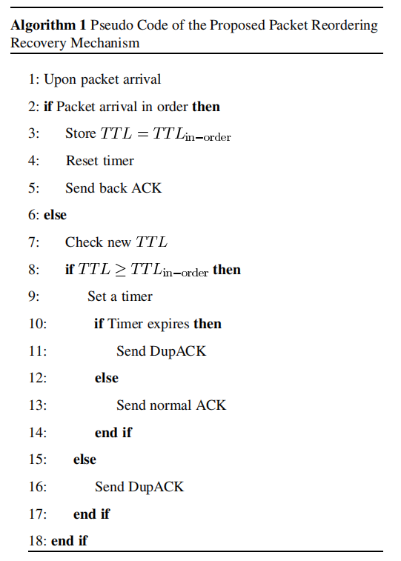
ELB (3/3)
packet reordering recovery
some packets traverse through shortest path,
while others detour
may cause TCP recovery
solution: modify TCP code at receiver
QUESTION1: what if topology changes
and shortest link becomes longer?
QUESTION2: what if alternative paths also congests?

Slide 11
PAR & DRNL (1/4)
Priority-based Adaptive Routing & 基于邻居卫星负载状态的分布式路由算法
key concept:
latitude-and-longitude-based
the satellite has no routing table
but a database recording satellites’ geographical location
distributed
a satellite decides the packet’s next hop merely
according to link congestion conditions between two satellites

Slide 12
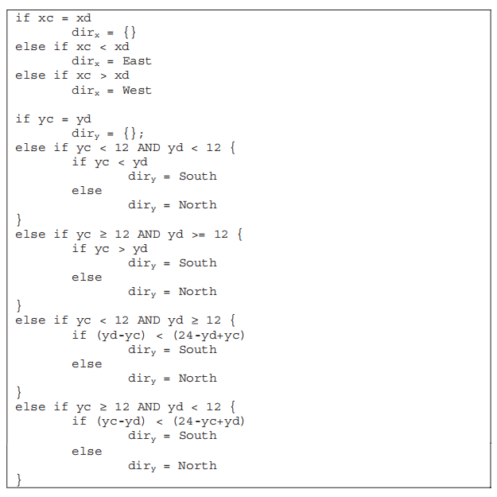
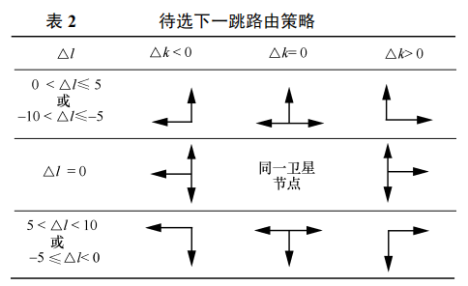
PAR & DRNL (2/4)
routing strategy
consider current satellite’s position & destination satellite’s position

Slide 13
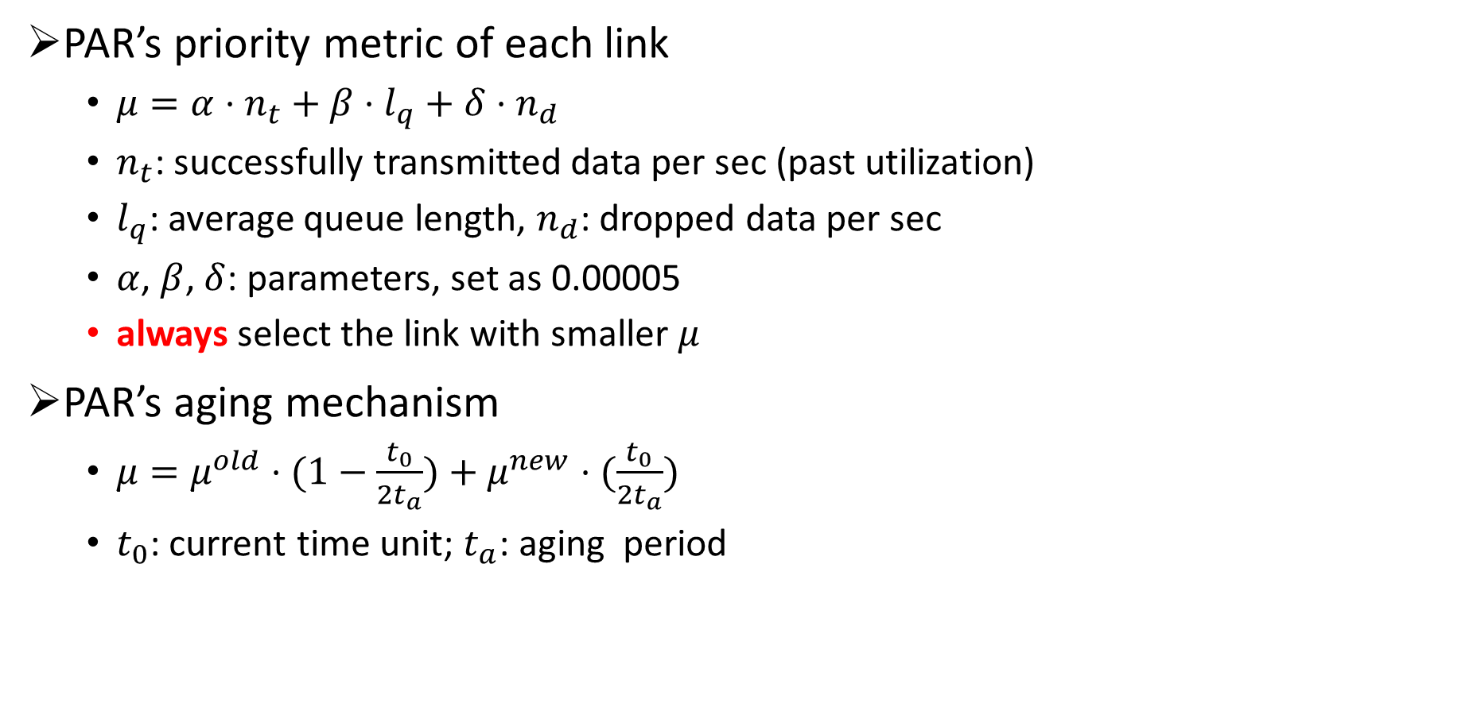
PAR & DRNL (3/4)
PAR’s priority metric of each link
$μ=α⋅n_{t}+β⋅l_{q}+δ⋅n_{d}$
$n_{t}$: successfully transmitted data per sec (past utilization)
$l_{q}$: average queue length, $n_{d}$: dropped data per sec
$α$, $β$, $δ$: parameters, set as 0.00005
always select the link with smaller $μ$
PAR’s aging mechanism
$μ=μ^{old}⋅(1−\frac{t_{0}}{2t_{a}})+μ^{new}⋅(\frac{t_{0}}{2t_{a}})$
$t_{0}$: current time unit; $t_{a}$: aging period

Slide 14
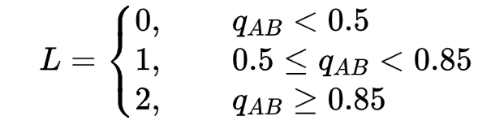

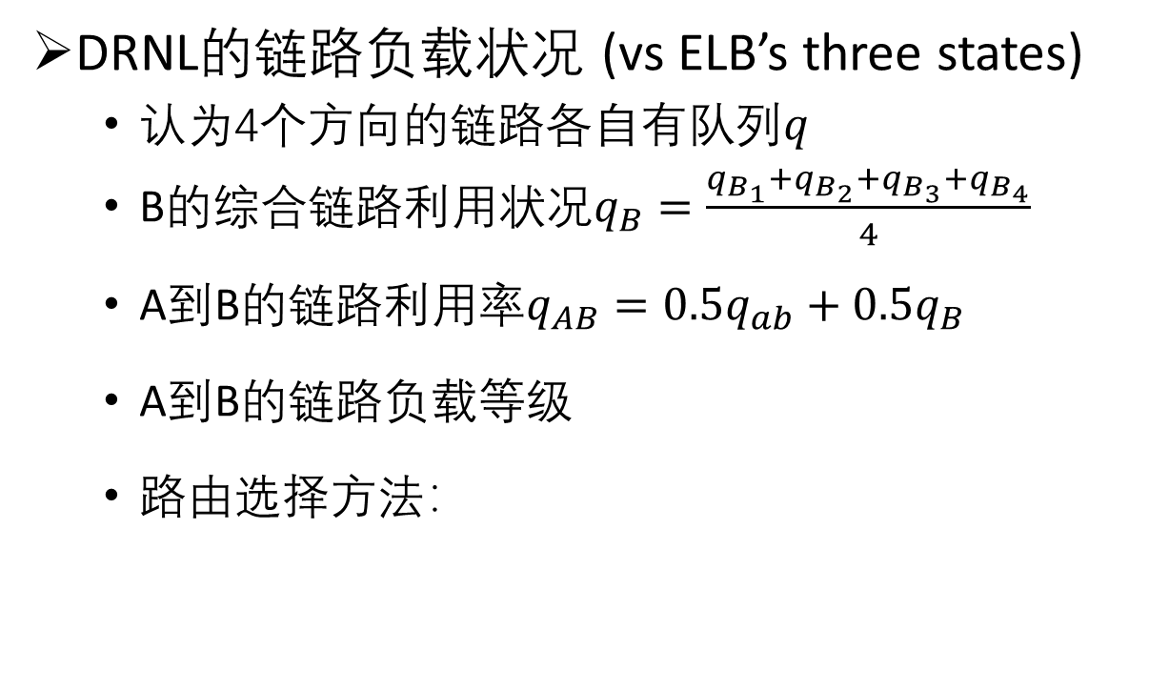




PAR & DRNL (4/4)
DRNL的链路负载状况 (vs ELB’s three states)
认为4个方向的链路各自有队列$q$
B的综合链路利用状况$q_{B}=\frac{q_{B_{1}}+q_{B_{2}}+q_{B_{3}}+q_{B_{4}}}{4}$
A到B的链路利用率$q_{AB}=0.5q_{ab}+0.5q_{B}$
A到B的链路负载等级
路由选择方法：
$$q_{B_{2}}$$
A
$$q_{B_{1}}$$
B
$$q_{B_{3}}$$
$$q_{ab}$$
$$q_{B_{4}}$$
C
根据位置得出
的可选方向
if L(B) == L(C):
0.5概率选择B
0.5概率选择C
else if abs(L(B) - L(C)) == 1:
0.7概率选择负载等级低的卫星
0.3概率选择负载等级高的卫星
else:
0.85概率选择负载等级低的卫星
0.15概率选择负载等级高的卫星

Slide 15
Thanks!

