Slide 1
引用了ELB的2篇文献:
ALBR & TLR
单乾

Slide 2
Outline
Background
ALBR: Agent-based load balancing routing for LEO satellite networks
TLR: A Traffic-Light-Based Intelligent Routing Strategy for NGEO Satellite IP Networks
an improvement of ELB

Slide 3
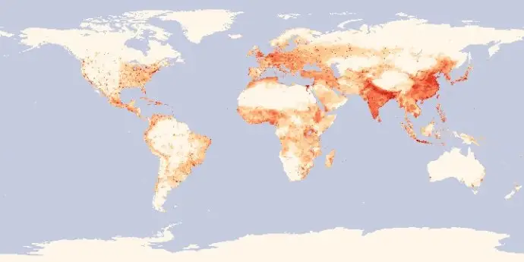
Background (1/2)
variance user density over the globe
differentiated services
delay-sensitive vs. not sensitive
urban areas vs. rural areas vs. ocean
unbalanced traffic load
some satellites heavy loaded, while others idle

Slide 4
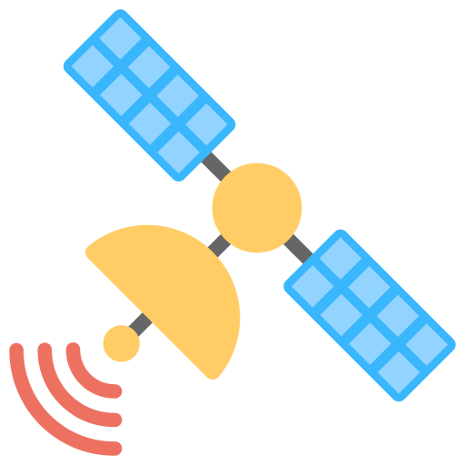
Background (2/2)
ELB
when a satellite is congested, it informs its neighbors to reroute
three states of a certain satellite A:
name | total queue size | operation
free state | (0, α) | none
fairly busy state | [α, β] | send a warning message to neighbors, ordering them to start searching alternative paths
busy state | (β, +inf) | send a busy message to neighbors, ordering them to send only χ portion packets via A
original path
congestion information
new path
Notes:
α β χ是参数，其具体值是计算得出

Slide 5
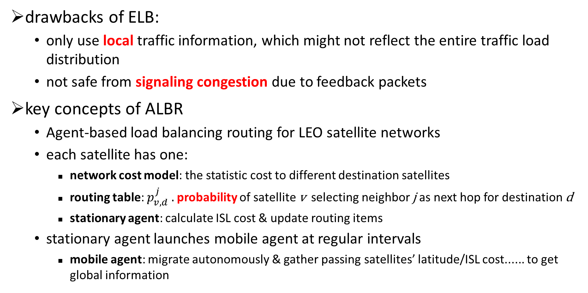
ALBR (1/5)
drawbacks of ELB:
only use local traffic information, which might not reflect the entire traffic load distribution
not safe from signaling congestion due to feedback packets
key concepts of ALBR
Agent-based load balancing routing for LEO satellite networks
each satellite has one:
network cost model: the statistic cost to different destination satellites
routing table: $p_{v,d}^{j} .$probability of satellite v selecting neighbor j as next hop for destination d
stationary agent: calculate ISL cost & update routing items
stationary agent launches mobile agent at regular intervals
mobile agent: migrate autonomously & gather passing satellites’ latitude/ISL cost...... to get global information

Slide 6
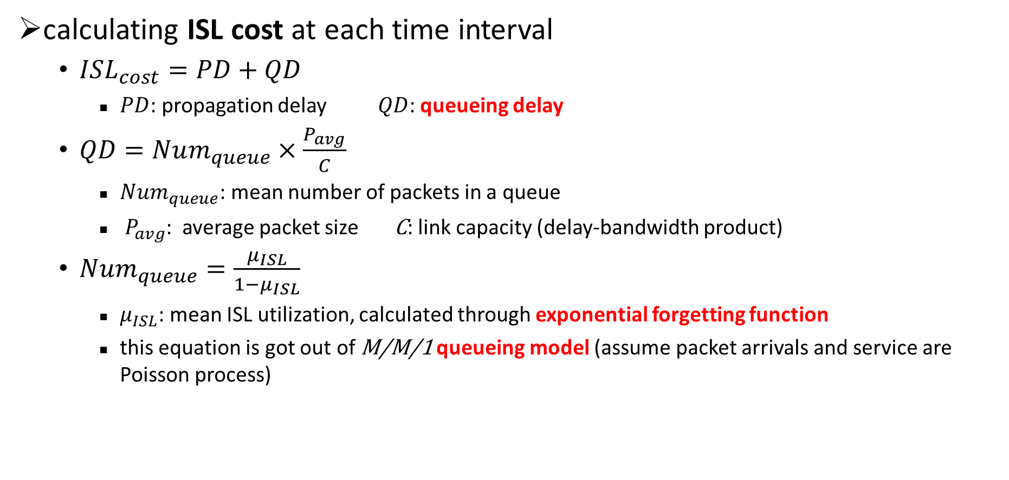
ALBR (2/5)
calculating ISL cost at each time interval
$ISL_{cost}=PD+QD$
$PD$: propagation delay $QD$: queueing delay
$QD=Num_{queue}×\frac{P_{avg}}{C}$
$Num_{queue}$: mean number of packets in a queue
$P_{avg}$: average packet size C: link capacity (delay-bandwidth product)
$Num_{queue}=\frac{μ_{ISL}}{1−μ_{ISL}}$
$μ_{ISL}$: mean ISL utilization, calculated through exponential forgetting function
this equation is got out of M/M/1 queueing model (assume packet arrivals and service are Poisson process)

Slide 7
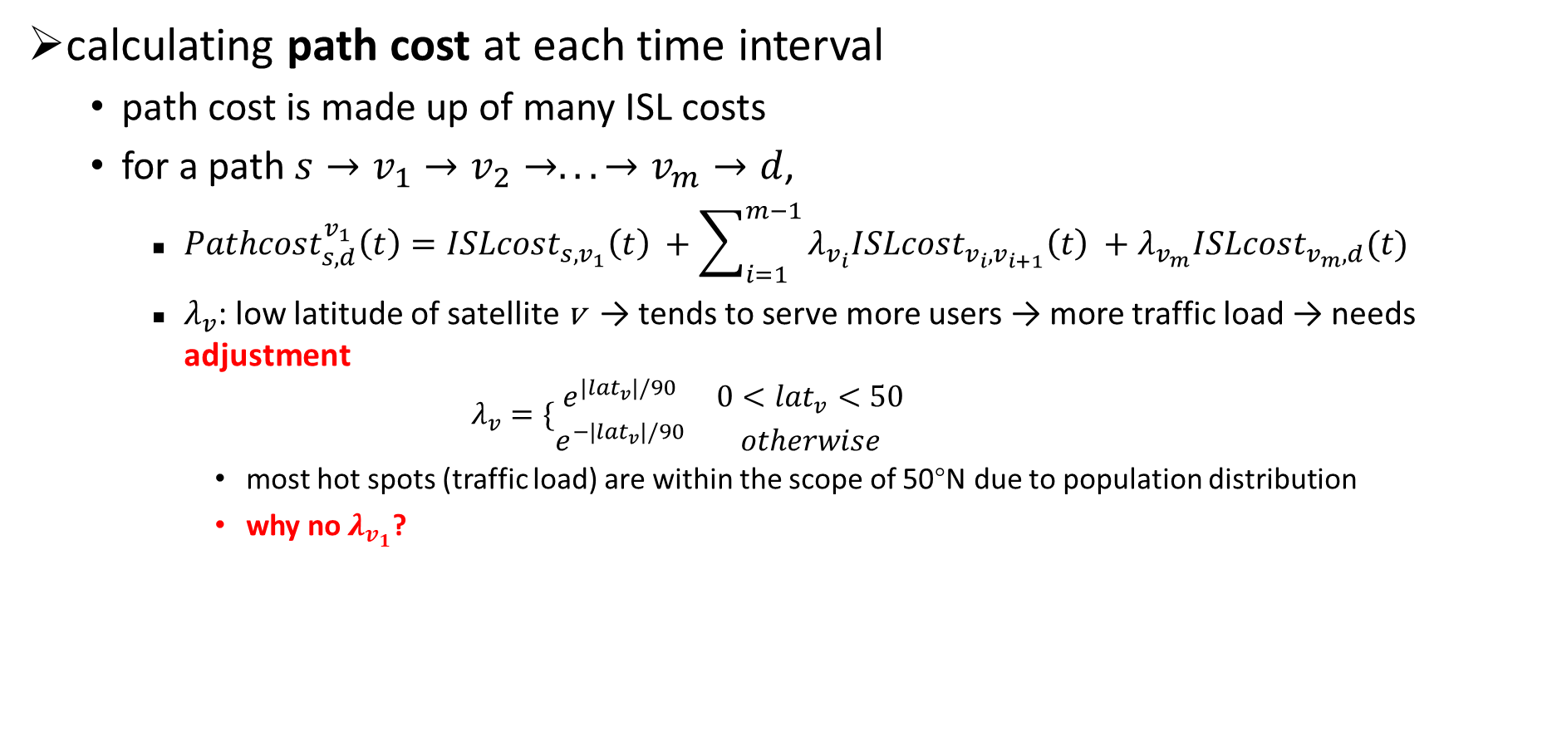
ALBR (3/5)
calculating path cost at each time interval
path cost is made up of many ISL costs
for a path $s→v_{1}→v_{2}→...→v_{m}→d$,
$Pathcost_{s,d}^{v_{1}}\left(t\right)=ISLcost_{s,v_{1}}\left(t\right) +\sum_{i=1}^{m−1}{λ_{v_{i}}ISLcost_{v_{i},v_{i+1}}\left(t\right)} +λ_{v_{m}}ISLcost_{v_{m},d}(t)$
$λ_{v}$: low latitude of satellite v → tends to serve more users → more traffic load → needs adjustment
$$λ_{v}=\{\begin{matrix}e^{|lat_{v}|/90} & 0<lat_{v}<50 \\ e^{−|lat_{v}|/90} & otherwise\end{matrix}$$
most hot spots (traffic load) are within the scope of 50°N due to population distribution
why no $λ_{v_{1}}$?

Slide 8
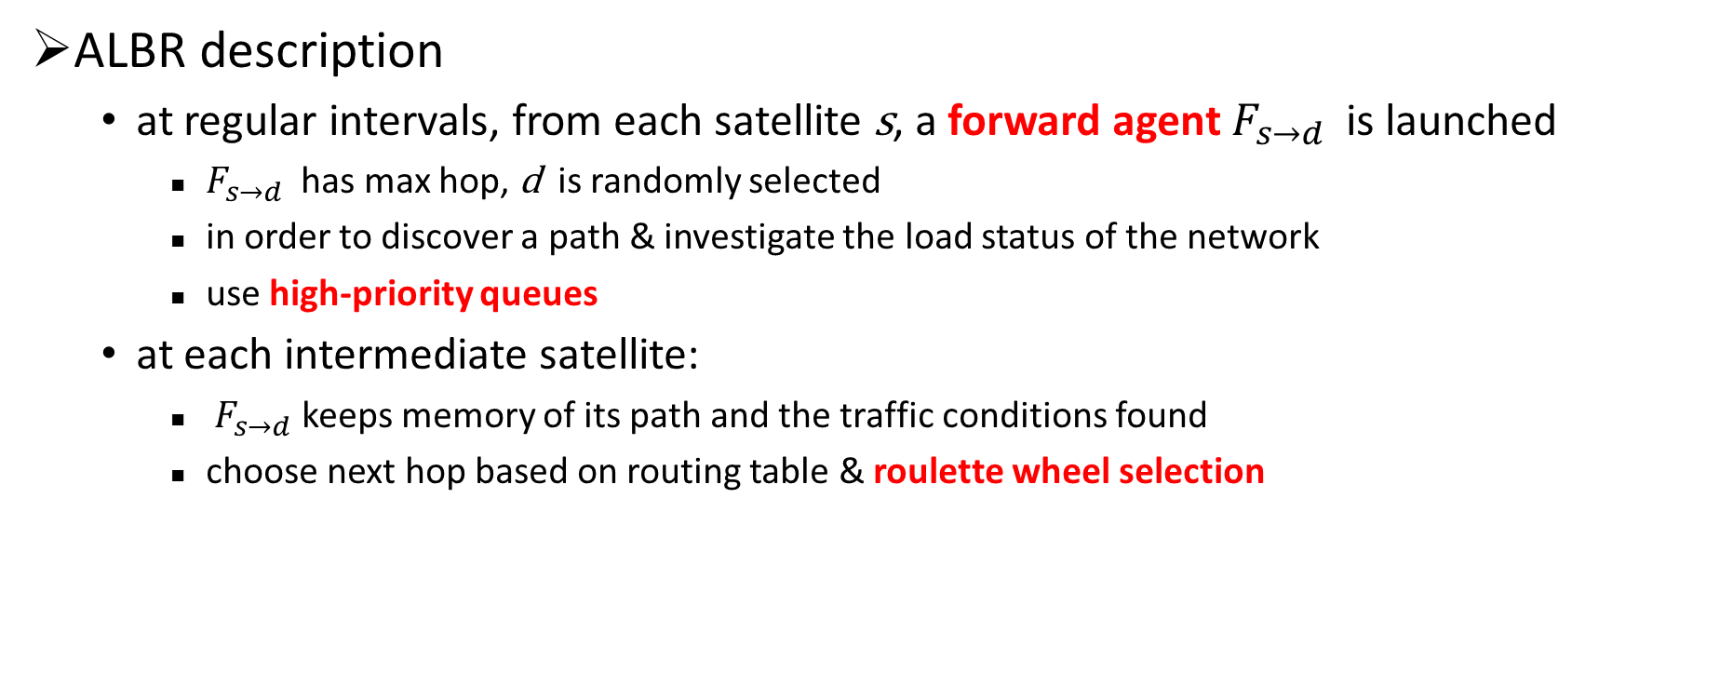
ALBR (4/5)
ALBR description
at regular intervals, from each satellite s, a forward agent $F_{s→d}$ is launched
$F_{s→d}$ has max hop, d is randomly selected
in order to discover a path & investigate the load status of the network
use high-priority queues
at each intermediate satellite:
$F_{s→d}$ keeps memory of its path and the traffic conditions found
choose next hop based on routing table & roulette wheel selection
forward agent
s
d
backward

Slide 9
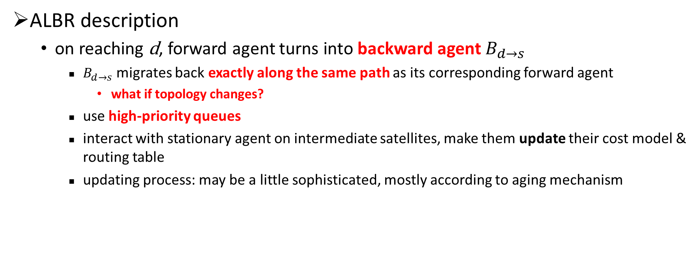
ALBR (5/5)
ALBR description
on reaching d, forward agent turns into backward agent $B_{d→s}$
$B_{d→s}$ migrates back exactly along the same path as its corresponding forward agent
what if topology changes?
use high-priority queues
interact with stationary agent on intermediate satellites, make them update their cost model & routing table
updating process: may be a little sophisticated, mostly according to aging mechanism
s
d
backward
backward agent

Slide 10

TLR (1/4)
drawbacks of ELB & key concepts of TLR:
even if the state of the next hop is “FREE”, some packets may be dropped before they are sent out if the current hop is overloaded
a satellite needs to know:
the state of its neighbor (solved by ELB)
the congestion state of the link between them (i.e. its own buffer queue size heading towards a certain neighbor)
TLR: traffic light signals of link & neighbor
concerns both current & next hop congestion

Slide 11
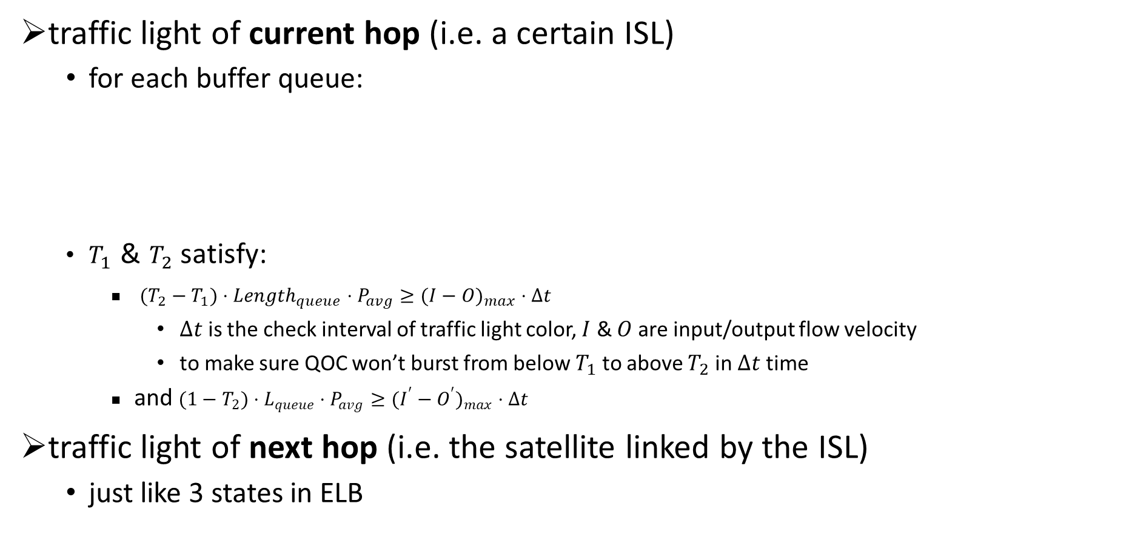
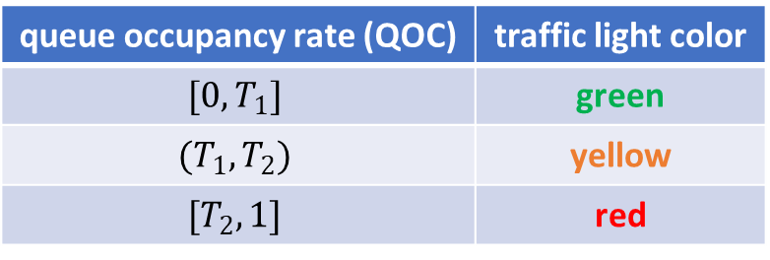
TLR (2/4)
traffic light of current hop (i.e. a certain ISL)
for each buffer queue:
$T_{1}$ & $T_{2}$ satisfy:
$(T_{2}−T_{1})⋅{Length}_{queue}⋅P_{avg}≥(I−O)_{max}⋅Δt$
$Δt$ is the check interval of traffic light color, $I$ & $O$ are input/output flow velocity
to make sure QOC won’t burst from below $T_{1}$ to above $T_{2}$ in $Δt$ time
and $(1−T_{2})⋅L_{queue}⋅P_{avg}≥(I^{′}−O^{′})_{max}⋅Δt$
traffic light of next hop (i.e. the satellite linked by the ISL)
just like 3 states in ELB
queue occupancy rate (QOC) | traffic light color
$$[0,T_{1}]$$ | green
$$(T_{1},T_{2})$$ | yellow
$$[T_{2},1]$$ | red

Slide 12
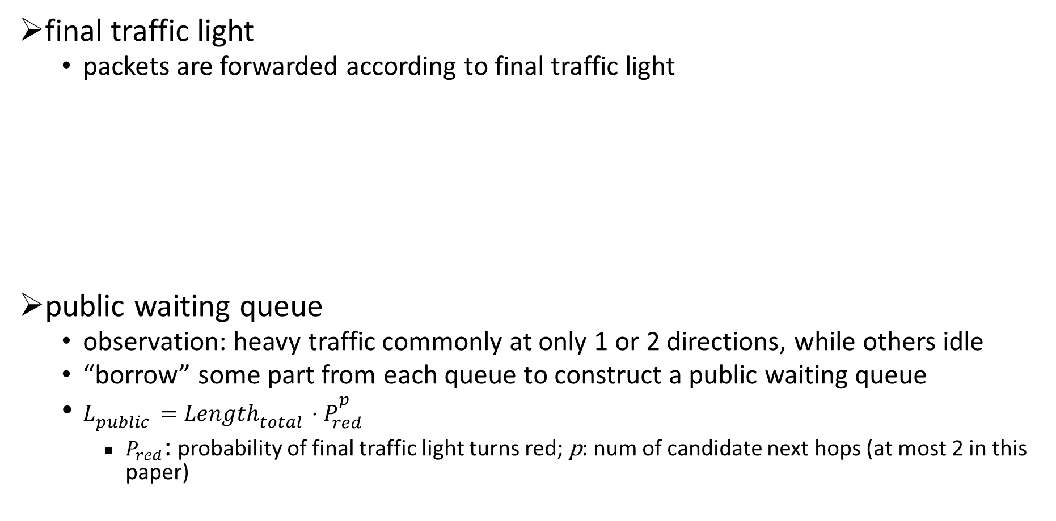
TLR (3/4)
final traffic light
packets are forwarded according to final traffic light
public waiting queue
observation: heavy traffic commonly at only 1 or 2 directions, while others idle
“borrow” some part from each queue to construct a public waiting queue
$L_{public}=Length_{total}⋅P_{red}^{p}$
$P_{red}$: probability of final traffic light turns red; p: num of candidate next hops (at most 2 in this paper)
traffic light of current hop | traffic light of next hop | final traffic light color
green | green | green
 | yellow | yellow
 | red | red
yellow | green | yellow
 | yellow | yellow
 | red | red
red | any | red

Slide 13
TLR (4/4)
routing algorithm
build the routing table: each orbit has an orbit speaker
collect the state information of intra orbit satellites
exchange information with orbit speakers at other orbits and broadcast it intra-orbit
request orbit speakers at adjacent orbits had better to have a direct link, or role shift will happen
source routing + real-time adjustment
actual path different from calculated path! how to recover?
endless-loop avoidance: remember id of passed satellites in packet header
more overhead!
best-next-hop color | second-best-next-hop color | where to go
green | any | best next hop
yellow | green/yellow | half and half
 | red | best next hop
red | green/yellow | second best next hop
 | red | public waiting queue

Slide 14
Thanks!

