Slide 1
引用了ELB的又2篇文献
单乾

Slide 2
Outline
Background
DCCR: A Distributed Congestion Control Routing Protocol Based on Traffic Classification in LEO Satellite Networks
IADR: Dynamic Routing for Software-Defined LEO Satellite Networks based on ISL Attributes

Slide 3
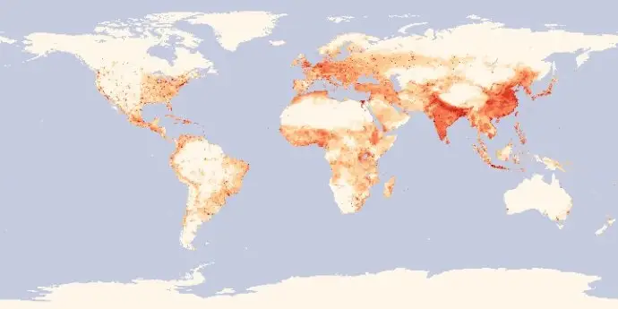
Background (1/2)
variance user density over the globe
differentiated services
delay-sensitive vs. not sensitive
urban areas vs. rural areas vs. ocean
unbalanced traffic load
some satellites heavy loaded, while others idle

Slide 4

Background (2/2)
ELB
when a satellite is congested, it informs its neighbors to reroute
three states of a certain satellite A:
name | total queue size | operation
free state | (0, α) | none
fairly busy state | [α, β] | send a warning message to neighbors, ordering them to start searching alternative paths
busy state | (β, +inf) | send a busy message to neighbors, ordering them to send only χ portion packets via A
original path
congestion information
new path
Notes:
α β χ是参数，其具体值是计算得出

Slide 5
DCCR (0/4)
A Distributed Congestion Control Routing Protocol Based on Traffic Classification in LEO Satellite Networks
2021 IFIP/IEEE International Symposium on Integrated Network Management (IM)
Laboratory of Networking and Switching Technology, Beijing University of Posts and Telecommunications

Slide 6
DCCR (1/4)
key concepts
distributed routing scheme: 9 different cases based on source & destination satellites’ location
divide traffic into 3 types: according to the service’s sensitivity of latency & throughput
improvement of ELB
each satellite has 2 states: FREE & BUSY
if queue length exceeds a threshold, the states turns from FREE to BUSY
just like ELB

Slide 7
DCCR (2/4)
routing scheme
position between source S & destination D |  | routing methods
different (latitude) positions, the same plane | - | along orbital plane
relative position, different planes | outside polar region | horizontally along intra-plane(?) ISL
 | in polar region | choose the node with higher latitude as next hop
different positions, different planes | in the same polar region | case 1
 | in different polar regions | case 2
 | S: outside polar region D: in polar region | case 3
 | S: in polar region D: outside polar region | case 4
 | … | case 5
 | … | case 6

Slide 8
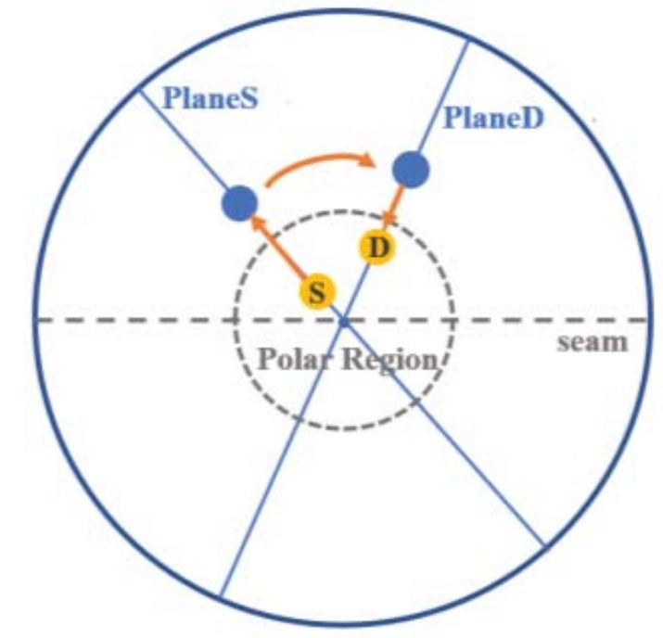
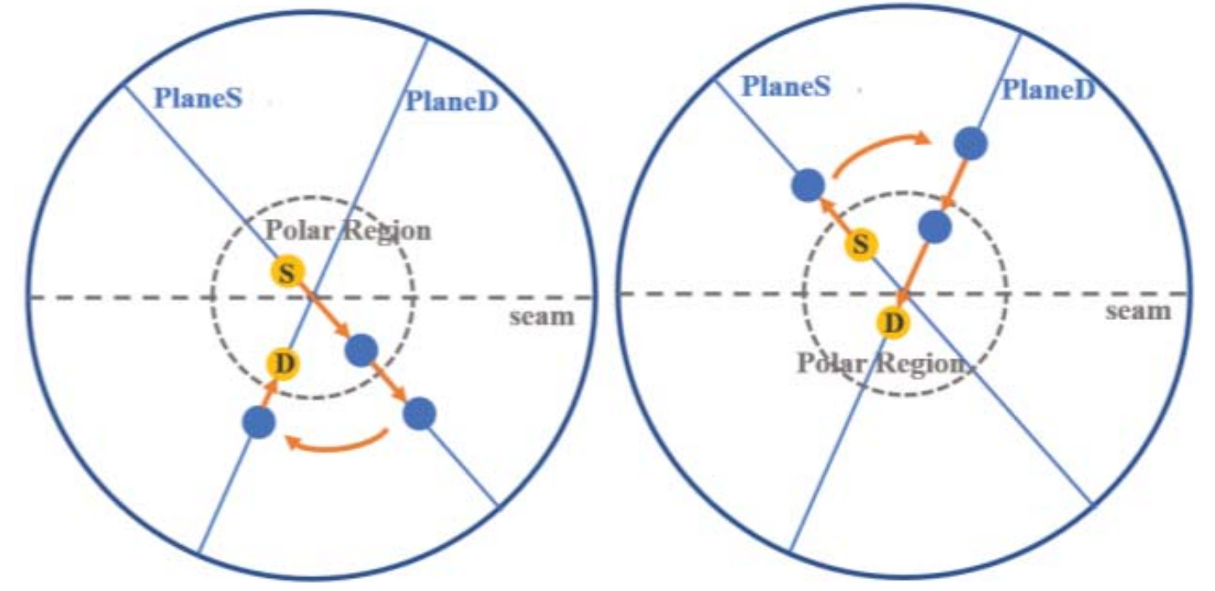
DCCR (3/4)
case 1
S and D are in different positions & different planes
S and D are in the same polar region
on the same side of the seam
on different sides of the seam

Slide 9
DCCR (4/4)
traffic classification strategy
traffic allocation
the routing scheme before increases the traffic on high-latitude satellites
traffic B: select a low-latitude path with the same hop count as the shortest one
traffic C: when the satellite is BUSY, some part of traffic C is allocated to detour
just like ELB
traffic type | character | example service
traffic A | latency-sensitive, has the highest priority, shortest path should be guaranteed | voice over IP, interactive video application
traffic B | throughput-sensitive, should be transmitted with abundant bandwidth | video on demand, large file distribution
traffic C | ordinary traffic, do best to transmit | voice message, file transfer
Notes:
因为高纬度的轨间链路更短

Slide 10
IADR (0/4)
Dynamic Routing for Software-Defined LEO Satellite Networks based on ISL Attributes
2021 IEEE Global Communications Conference (GLOBECOM)
Chongqing University of Posts and Telecommunications & University of Technology Sydney

Slide 11
IADR (1/4)
key concepts
software-defined satellite networks
consider 3 ISL attributes to construct the link utility function
use maximum deviation algorithm to adaptively calculate the weight of attribute parameters in link utility function
use ISL utility to build path utility & choose the path with highest path utility

Slide 12
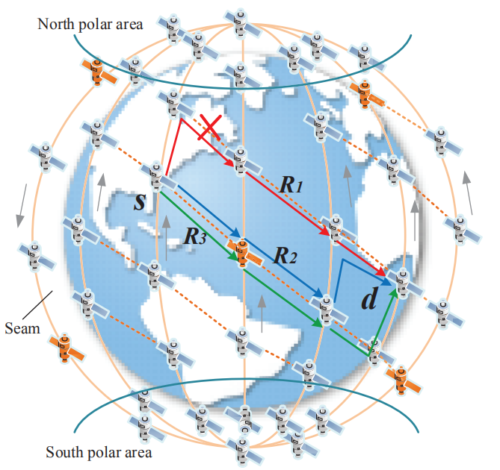
IADR (2/4)
software-defined satellite networks
control plane & data plane
control plane:
generates network topology snapshots
calculates optimal routing paths
needs to gather global information
my understanding: a centralized routing algorithm
how are satellite controllers distributed?

Slide 13
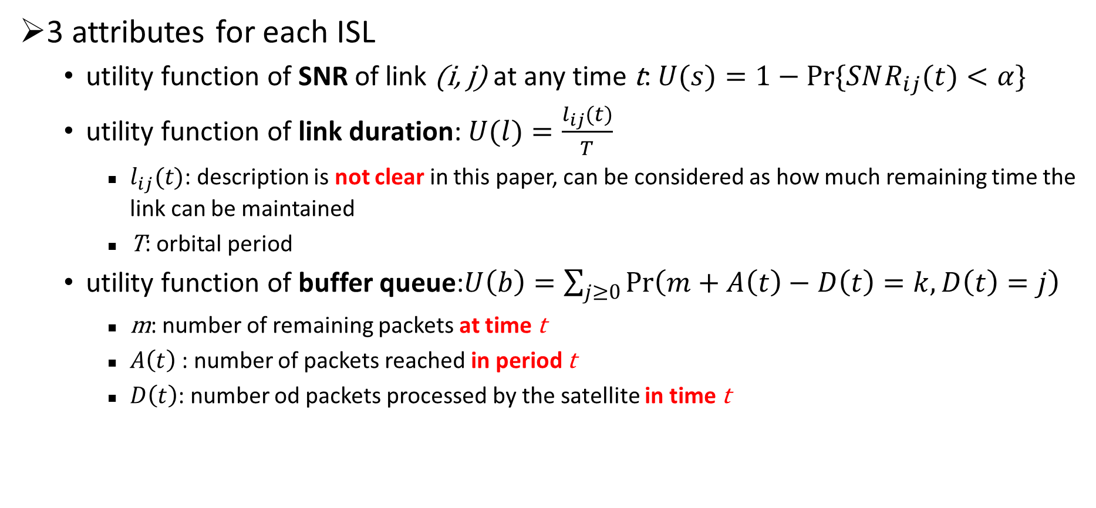
IADR (3/4)
3 attributes for each ISL
utility function of SNR of link (i, j) at any time t:$U(s)=1−Pr\{SNR_{ij}(t)<α\}$
utility function of link duration: $U(l)=\frac{l_{ij}(t)}{T}$
$l_{ij}(t)$: description is not clear in this paper, can be considered as how much remaining time the link can be maintained
T: orbital period
utility function of buffer queue:$U\left(b\right)=\sum_{j≥0}{\operatorname{Pr}\left(m+A\left(t\right)−D\left(t\right)=k,D\left(t\right)=j\right)}$
m: number of remaining packets at time t
$A\left(t\right)$: number of packets reached in period t
$D\left(t\right)$: number od packets processed by the satellite in time t
Notes:
SNR: 换句话说就是链路通断信息

Slide 14
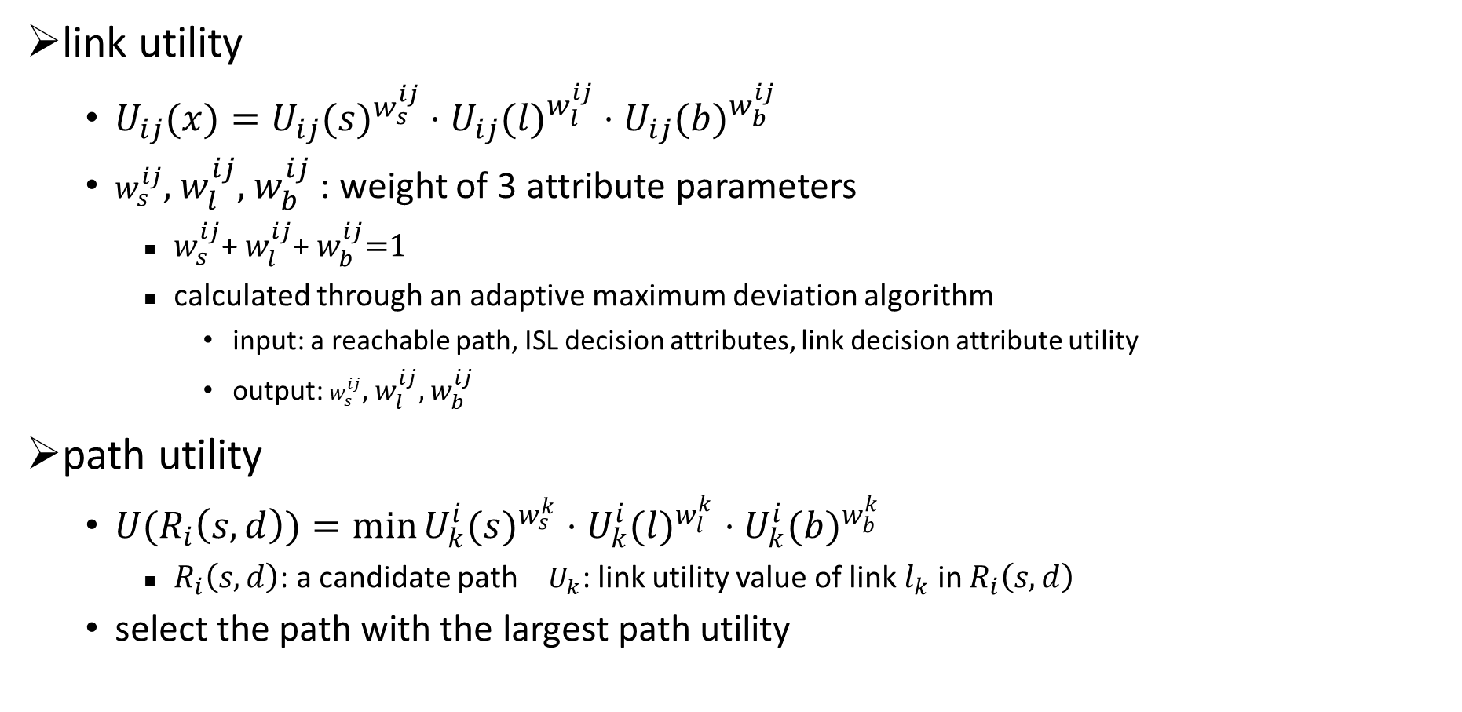
IADR (4/4)
link utility
$U_{ij}(x)=U_{ij}(s)^{w_{s}^{ij}}⋅U_{ij}(l)^{w_{l}^{ij}}⋅U_{ij}(b)^{w_{b}^{ij}}$
$w_{s}^{ij}$, $w_{l}^{ij},$ $w_{b}^{ij}$: weight of 3 attribute parameters
$w_{s}^{ij}$+ $w_{l}^{ij}$+ $w_{b}^{ij}$=1
calculated through an adaptive maximum deviation algorithm
input: a reachable path, ISL decision attributes, link decision attribute utility
output: $w_{s}^{ij}$, $w_{l}^{ij},$ $w_{b}^{ij}$
path utility
$U(R_{i}\left(s,d\right))=\min{U_{k}^{i}(s)^{w_{s}^{k}}⋅U_{k}^{i}(l)^{w_{l}^{k}}⋅U_{k}^{i}(b)^{w_{b}^{k}}}$
$R_{i}\left(s,d\right)$: a candidate path $U_{k}$: link utility value of link $l_{k}$ in $R_{i}\left(s,d\right)$
select the path with the largest path utility

Slide 15
Thanks!

