Slide 1
Congestion & Flow Control of
Transmission in Space Segment
单乾

Slide 2
Outline
Background
REFWA: Fair Congestion Control by Adjusting TCP Window Size
Congestion Control by Informing Neighbor Satellite to Reroute
ELB: Routing-table-based Rerouting
PAR & DRNL: Latitude-and-longitude-based Rerouting

Slide 3
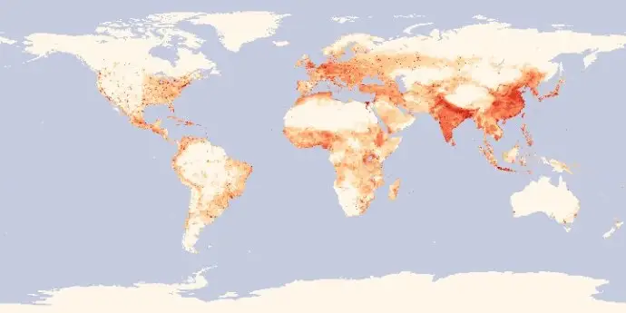
Background (1/1)
variance user density over the globe
differentiated services
delay-sensitive vs. not sensitive
urban areas vs. rural areas vs. ocean
unbalanced traffic load
some satellites heavy loaded, while others idle

Slide 4
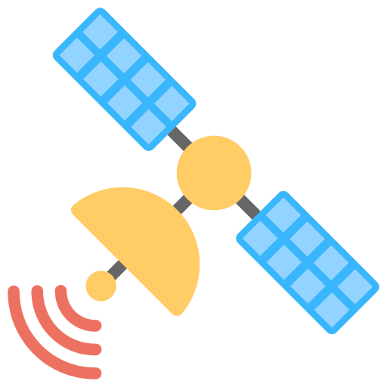


REFWA (1/4)
Recursive, Explicit, and Fair Window Adjustment
key concept
adaptively adjust TCP flow rate to available bandwidth
intermediate satellites send feedback message to TCP source to adjust window size
if feedback < RWND, then let RWND = feedback
calculate feedback
(rewrite RWND in TCP)
source
destination

Slide 5
REFWA (2/4)
estimation of RTT and grouping
a satellite estimate each flow’s RTT:
H_{b}, H_{f}: backward & forward hop number when passing through this satellite
ISL_{delay}: delay of inter-satellite link, assumed as a constant
fairness: flows with the same RTT are grouped together
the same RTT, the same feedback, then the same throughput
vs. standard TCP: “undesirable bias against long RTT flows”
$$RTT=2⋅(H_{b}+H_{f}+2)⋅ISL_{delay}$$
Notes:
Hb Hf: TCP包的往返跳数 Hb+Hf+2即为链路总跳数
认为ISLdelay 是常数，且忽略了队列延迟
模拟显示这种估计方法的误差在30%~40%

Slide 6
REFWA (3/4)
feedback computation
at a certain satellite, for each link in k-th group, its feedback F during n-th time interval:
recursive residual capacity of this link free queue size
α, φ, ψ: parameters; $Υ\left(n\right)$: total TCP window size can be allocated
RTT_{avg} : average RTT of active links at n-th time interval & length of time interval
$$F_{κ}(n)=\frac{RTT_{κ}^{α}}{\sum_{j=1}^{M}{n_{j}}⋅RTT_{j}^{α}}⋅Υ(n)$$
$$Υ\left(n\right)=Υ\left(n−1\right)+φ\left(Bw⋅RTT_{avg}−Υ\left(n−1\right)\right)$$
$+ψ(B−Q(n−1))$

Slide 7
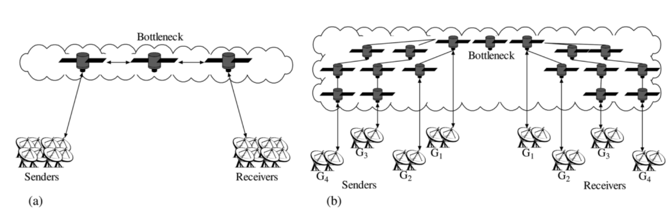
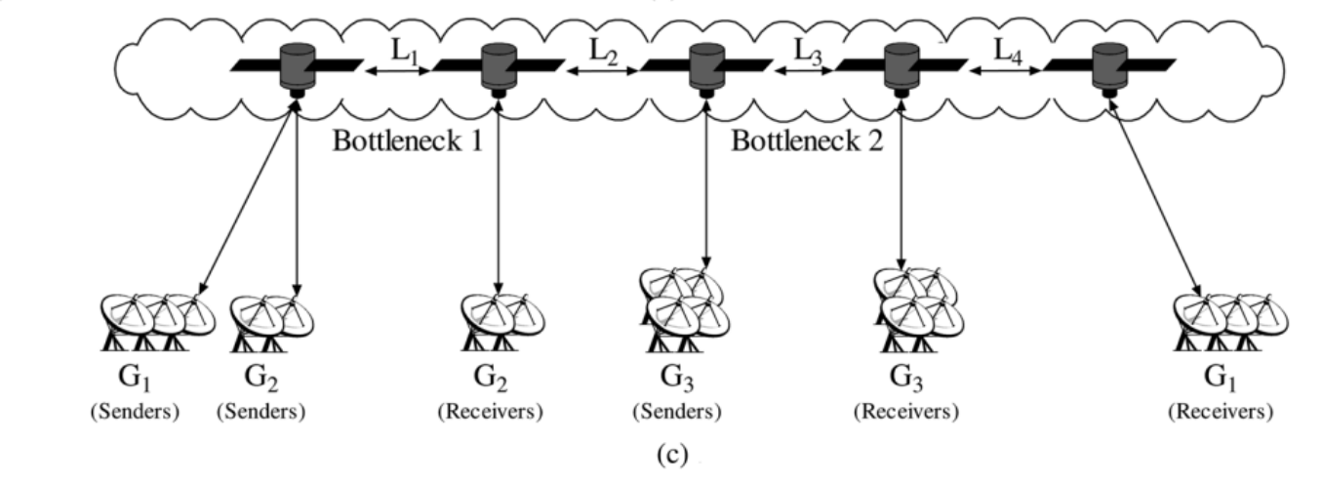
REFWA (4/4)
experiments & conclusion (vs. TCP NewReno)
measures: bottleneck link utilization, loss rate, queue size, fairness index
for lower packet losses & smaller queue size, $φ=1.5$, $ψ=0.5$; for fairness, α=1
more robust when abrupt change of traffic load happens
fairness: operates correctly when there are links with variant RTTs (Fig b)
multiple bottlenecks: doesn’t matter (Fig c)
tolerant to errors in RTT estimate
Notes:
robust: 使模拟中的连接数突然增加/减少，链路利用率、队列长度不会突然变化
fairness: 不同连接在考虑RTT的情况下，基本平分带宽

Slide 8
ELB (1/3)
Explicit Load Balancing
key concept
when a satellite is congested, it informs its neighbors to reroute
packets should have passed this satellite are sent through alternative paths
may cause out-of-order reception & packets have to traverse more hops
original path
congestion information
new path

Slide 9
ELB (2/3)
three states of a certain satellite A
α, β, χ are parameters
β = 1 – p(packet dropping possibility); α = β / 2
χ is relative to:
traffic coming from the ground
the satellite’s ability to output
time we want the satellite to stay in normal state
name | total queue size | operation
free state | (0, α) | none
fairly busy state | [α, β] | send a warning message to neighbors, ordering them to start searching alternative paths
busy state | (β, +inf) | send a busy message to neighbors, ordering them to send only χ portion packets via A (e.g. flow control)
Notes:
关于χ：
首先计算当busy signal到达邻居时的队列长度
为了使之后的队列长度在时间θ内回到α以下，需要更新输入流量（输入流量既有来自邻居卫星的也有来自地面的，来自地面的流量是为不可调，只能调整邻居卫星传来的流量）
χ就是新输入流量与原有输入流量的比值

Slide 10
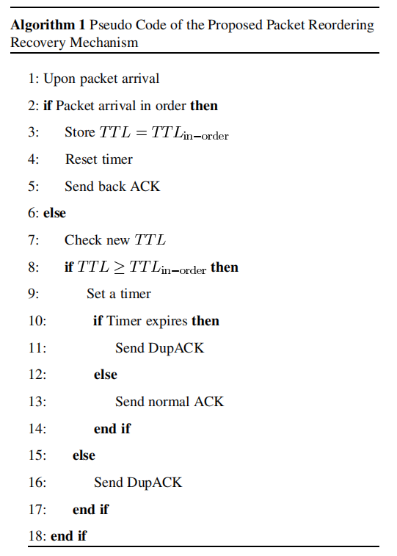
ELB (3/3)
packet reordering recovery
some packets traverse through shortest path,
while others detour
may cause TCP recovery
solution: modify TCP code at receiver
QUESTION1: what if topology changes
and shortest link becomes longer?
QUESTION2: what if alternative paths also congests?

Slide 11
PAR & DRNL (1/4)
Priority-based Adaptive Routing & 基于邻居卫星负载状态的分布式路由算法
key concept:
latitude-and-longitude-based
the satellite has no routing table
but a database recording satellites’ geographical location
distributed
a satellite decides the packet’s next hop merely
according to link congestion conditions between two satellites

Slide 12
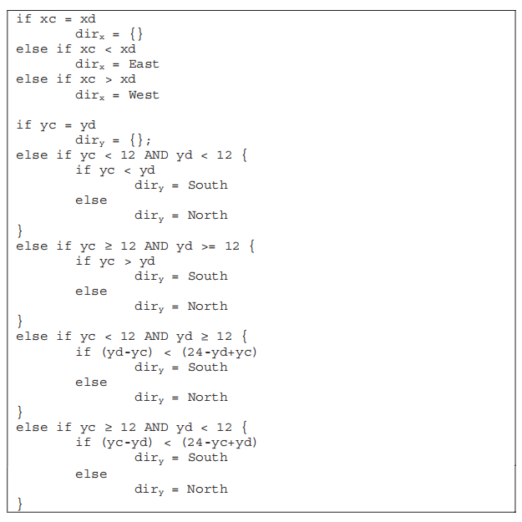
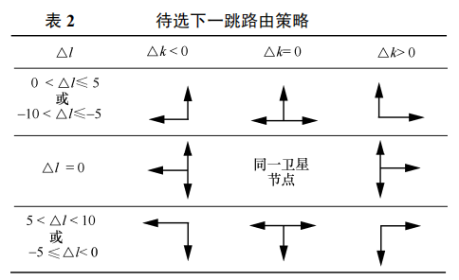
PAR & DRNL (2/4)
routing strategy
consider current satellite’s position & destination satellite’s position

Slide 13
PAR & DRNL (3/4)
PAR’s priority metric of each link
$μ=α⋅n_{t}+β⋅l_{q}+δ⋅n_{d}$
$n_{t}$: successfully transmitted data per sec (past utilization)
$l_{q}$: average queue length, $n_{d}$: dropped data per sec
$α$, $β$, $δ$: parameters, set as 0.00005
always select the link with smaller $μ$
PAR’s aging mechanism
$μ=μ^{old}⋅(1−\frac{t_{0}}{2t_{a}})+μ^{new}⋅(\frac{t_{0}}{2t_{a}})$
$t_{0}$: current time unit; $t_{a}$: aging period

Slide 14
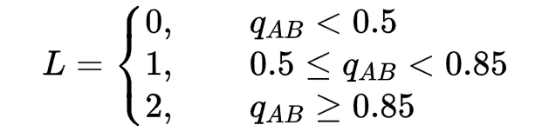
PAR & DRNL (4/4)
DRNL的链路负载状况 (vs ELB’s three states)
认为4个方向的链路各自有队列$q$
B的综合链路利用状况$q_{B}=\frac{q_{B_{1}}+q_{B_{2}}+q_{B_{3}}+q_{B_{4}}}{4}$
A到B的链路利用率$q_{AB}=0.5q_{ab}+0.5q_{B}$
A到B的链路负载等级
路由选择方法：
$$q_{B_{2}}$$
A
$$q_{B_{1}}$$
B
$$q_{B_{3}}$$
$$q_{ab}$$
$$q_{B_{4}}$$
C
根据位置得出
的可选方向
if L(B) == L(C):
0.5概率选择B
0.5概率选择C
else if abs(L(B) - L(C)) == 1:
0.7概率选择负载等级低的卫星
0.3概率选择负载等级高的卫星
else:
0.85概率选择负载等级低的卫星
0.15概率选择负载等级高的卫星

Slide 15
Thanks!

Slide 16
引用了ELB的2篇文献:
ALBR & TLR
单乾

Slide 17
Outline
Background
ALBR: Agent-based load balancing routing for LEO satellite networks
TLR: A Traffic-Light-Based Intelligent Routing Strategy for NGEO Satellite IP Networks
an improvement of ELB

Slide 18
Background (1/2)
variance user density over the globe
differentiated services
delay-sensitive vs. not sensitive
urban areas vs. rural areas vs. ocean
unbalanced traffic load
some satellites heavy loaded, while others idle

Slide 19
Background (2/2)
ELB
when a satellite is congested, it informs its neighbors to reroute
three states of a certain satellite A:
name | total queue size | operation
free state | (0, α) | none
fairly busy state | [α, β] | send a warning message to neighbors, ordering them to start searching alternative paths
busy state | (β, +inf) | send a busy message to neighbors, ordering them to send only χ portion packets via A
original path
congestion information
new path
Notes:
α β χ是参数，其具体值是计算得出

Slide 20
ALBR (1/5)
drawbacks of ELB:
only use local traffic information, which might not reflect the entire traffic load distribution
not safe from signaling congestion due to feedback packets
key concepts of ALBR
Agent-based load balancing routing for LEO satellite networks
each satellite has one:
network cost model: the statistic cost to different destination satellites
routing table: $p_{v,d}^{j} .$probability of satellite v selecting neighbor j as next hop for destination d
stationary agent: calculate ISL cost & update routing items
stationary agent launches mobile agent at regular intervals
mobile agent: migrate autonomously & gather passing satellites’ latitude/ISL cost...... to get global information

Slide 21
ALBR (2/5)
calculating ISL cost at each time interval
$ISL_{cost}=PD+QD$
$PD$: propagation delay $QD$: queueing delay
$QD=Num_{queue}×\frac{P_{avg}}{C}$
$Num_{queue}$: mean number of packets in a queue
$P_{avg}$: average packet size C: link capacity (delay-bandwidth product)
$Num_{queue}=\frac{μ_{ISL}}{1−μ_{ISL}}$
$μ_{ISL}$: mean ISL utilization, calculated through exponential forgetting function
this equation is got out of M/M/1 queueing model (assume packet arrivals and service are Poisson process)

Slide 22
ALBR (3/5)
calculating path cost at each time interval
path cost is made up of many ISL costs
for a path $s→v_{1}→v_{2}→...→v_{m}→d$,
$Pathcost_{s,d}^{v_{1}}\left(t\right)=ISLcost_{s,v_{1}}\left(t\right) +\sum_{i=1}^{m−1}{λ_{v_{i}}ISLcost_{v_{i},v_{i+1}}\left(t\right)} +λ_{v_{m}}ISLcost_{v_{m},d}(t)$
$λ_{v}$: low latitude of satellite v → tends to serve more users → more traffic load → needs adjustment
$$λ_{v}=\{\begin{matrix}e^{|lat_{v}|/90} & 0<lat_{v}<50 \\ e^{−|lat_{v}|/90} & otherwise\end{matrix}$$
most hot spots (traffic load) are within the scope of 50°N due to population distribution
why no $λ_{v_{1}}$?

Slide 23
ALBR (4/5)
ALBR description
at regular intervals, from each satellite s, a forward agent $F_{s→d}$ is launched
$F_{s→d}$ has max hop, d is randomly selected
in order to discover a path & investigate the load status of the network
use high-priority queues
at each intermediate satellite:
$F_{s→d}$ keeps memory of its path and the traffic conditions found
choose next hop based on routing table & roulette wheel selection
forward agent
s
d
backward

Slide 24
ALBR (5/5)
ALBR description
on reaching d, forward agent turns into backward agent $B_{d→s}$
$B_{d→s}$ migrates back exactly along the same path as its corresponding forward agent
what if topology changes?
use high-priority queues
interact with stationary agent on intermediate satellites, make them update their cost model & routing table
updating process: may be a little sophisticated, mostly according to aging mechanism
s
d
backward
backward agent

Slide 25

TLR (1/4)
drawbacks of ELB & key concepts of TLR:
even if the state of the next hop is “FREE”, some packets may be dropped before they are sent out if the current hop is overloaded
a satellite needs to know:
the state of its neighbor (solved by ELB)
the congestion state of the link between them (i.e. its own buffer queue size heading towards a certain neighbor)
TLR: traffic light signals of link & neighbor
concerns both current & next hop congestion

Slide 26
TLR (2/4)
traffic light of current hop (i.e. a certain ISL)
for each buffer queue:
$T_{1}$ & $T_{2}$ satisfy:
$(T_{2}−T_{1})⋅{Length}_{queue}⋅P_{avg}≥(I−O)_{max}⋅Δt$
$Δt$ is the check interval of traffic light color, $I$ & $O$ are input/output flow velocity
to make sure QOC won’t burst from below $T_{1}$ to above $T_{2}$ in $Δt$ time
and $(1−T_{2})⋅L_{queue}⋅P_{avg}≥(I^{′}−O^{′})_{max}⋅Δt$
traffic light of next hop (i.e. the satellite linked by the ISL)
just like 3 states in ELB
queue occupancy rate (QOC) | traffic light color
$$[0,T_{1}]$$ | green
$$(T_{1},T_{2})$$ | yellow
$$[T_{2},1]$$ | red

Slide 27
TLR (3/4)
final traffic light
packets are forwarded according to final traffic light
public waiting queue
observation: heavy traffic commonly at only 1 or 2 directions, while others idle
“borrow” some part from each queue to construct a public waiting queue
$L_{public}=Length_{total}⋅P_{red}^{p}$
$P_{red}$: probability of final traffic light turns red; p: num of candidate next hops (at most 2 in this paper)
traffic light of current hop | traffic light of next hop | final traffic light color
green | green | green
 | yellow | yellow
 | red | red
yellow | green | yellow
 | yellow | yellow
 | red | red
red | any | red

Slide 28
TLR (4/4)
routing algorithm
build the routing table: each orbit has an orbit speaker
collect the state information of intra orbit satellites
exchange information with orbit speakers at other orbits and broadcast it intra-orbit
request orbit speakers at adjacent orbits had better to have a direct link, or role shift will happen
source routing + real-time adjustment
actual path different from calculated path! how to recover?
endless-loop avoidance: remember id of passed satellites in packet header
more overhead!
best-next-hop color | second-best-next-hop color | where to go
green | any | best next hop
yellow | green/yellow | half and half
 | red | best next hop
red | green/yellow | second best next hop
 | red | public waiting queue

Slide 29
Thanks!

Slide 30
引用了ELB的又2篇文献
单乾

Slide 31
Outline
Background
DCCR: A Distributed Congestion Control Routing Protocol Based on Traffic Classification in LEO Satellite Networks
IADR: Dynamic Routing for Software-Defined LEO Satellite Networks based on ISL Attributes

Slide 32
Background (1/2)
variance user density over the globe
differentiated services
delay-sensitive vs. not sensitive
urban areas vs. rural areas vs. ocean
unbalanced traffic load
some satellites heavy loaded, while others idle

Slide 33
Background (2/2)
ELB
when a satellite is congested, it informs its neighbors to reroute
three states of a certain satellite A:
name | total queue size | operation
free state | (0, α) | none
fairly busy state | [α, β] | send a warning message to neighbors, ordering them to start searching alternative paths
busy state | (β, +inf) | send a busy message to neighbors, ordering them to send only χ portion packets via A
original path
congestion information
new path
Notes:
α β χ是参数，其具体值是计算得出

Slide 34
DCCR (0/4)
A Distributed Congestion Control Routing Protocol Based on Traffic Classification in LEO Satellite Networks
2021 IFIP/IEEE International Symposium on Integrated Network Management (IM)
Laboratory of Networking and Switching Technology, Beijing University of Posts and Telecommunications

Slide 35
DCCR (1/4)
key concepts
distributed routing scheme: 9 different cases based on source & destination satellites’ location
divide traffic into 3 types: according to the service’s sensitivity of latency & throughput
improvement of ELB
each satellite has 2 states: FREE & BUSY
if queue length exceeds a threshold, the states turns from FREE to BUSY
just like ELB

Slide 36
DCCR (2/4)
routing scheme
position between source S & destination D |  | routing methods
different (latitude) positions, the same plane | - | along orbital plane
relative position, different planes | outside polar region | horizontally along intra-plane(?) ISL
 | in polar region | choose the node with higher latitude as next hop
different positions, different planes | in the same polar region | case 1
 | in different polar regions | case 2
 | S: outside polar region D: in polar region | case 3
 | S: in polar region D: outside polar region | case 4
 | … | case 5
 | … | case 6

Slide 37
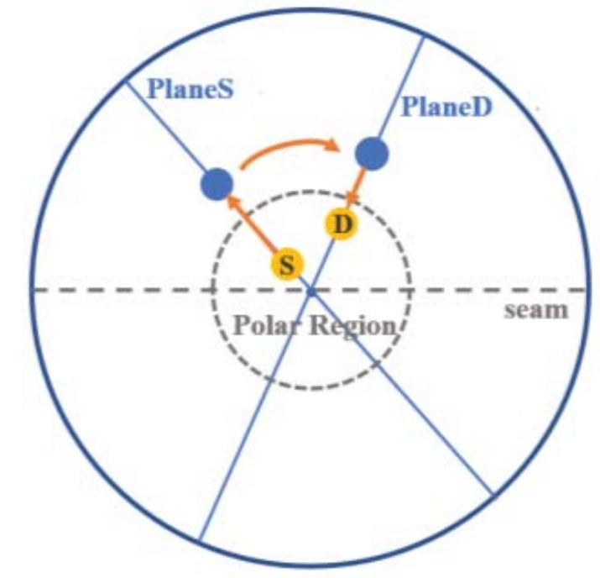
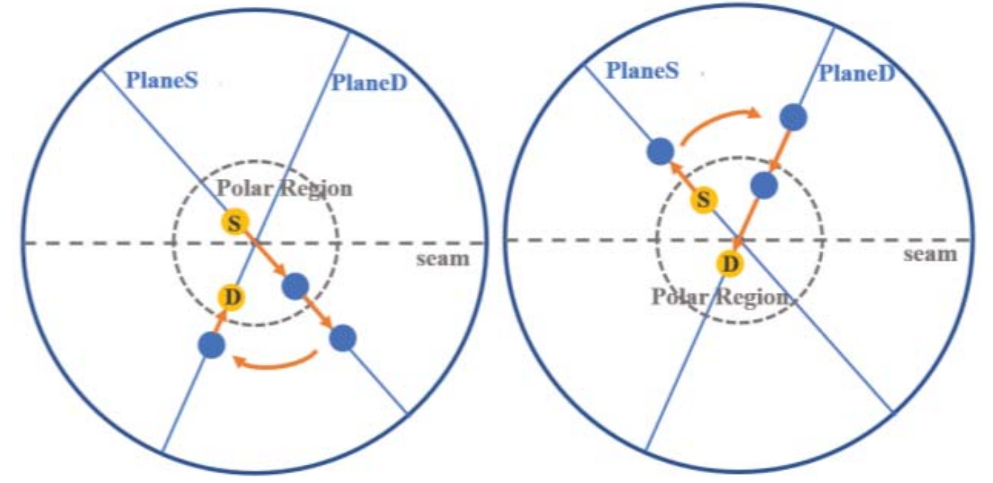
DCCR (3/4)
case 1
S and D are in different positions & different planes
S and D are in the same polar region
on the same side of the seam
on different sides of the seam

Slide 38
DCCR (4/4)
traffic classification strategy
traffic allocation
the routing scheme before increases the traffic on high-latitude satellites
traffic B: select a low-latitude path with the same hop count as the shortest one
traffic C: when the satellite is BUSY, some part of traffic C is allocated to detour
just like ELB
traffic type | character | example service
traffic A | latency-sensitive, has the highest priority, shortest path should be guaranteed | voice over IP, interactive video application
traffic B | throughput-sensitive, should be transmitted with abundant bandwidth | video on demand, large file distribution
traffic C | ordinary traffic, do best to transmit | voice message, file transfer
Notes:
因为高纬度的轨间链路更短

Slide 39
IADR (0/4)
Dynamic Routing for Software-Defined LEO Satellite Networks based on ISL Attributes
2021 IEEE Global Communications Conference (GLOBECOM)
Chongqing University of Posts and Telecommunications & University of Technology Sydney

Slide 40
IADR (1/4)
key concepts
software-defined satellite networks
consider 3 ISL attributes to construct the link utility function
use maximum deviation algorithm to adaptively calculate the weight of attribute parameters in link utility function
use ISL utility to build path utility & choose the path with highest path utility

Slide 41
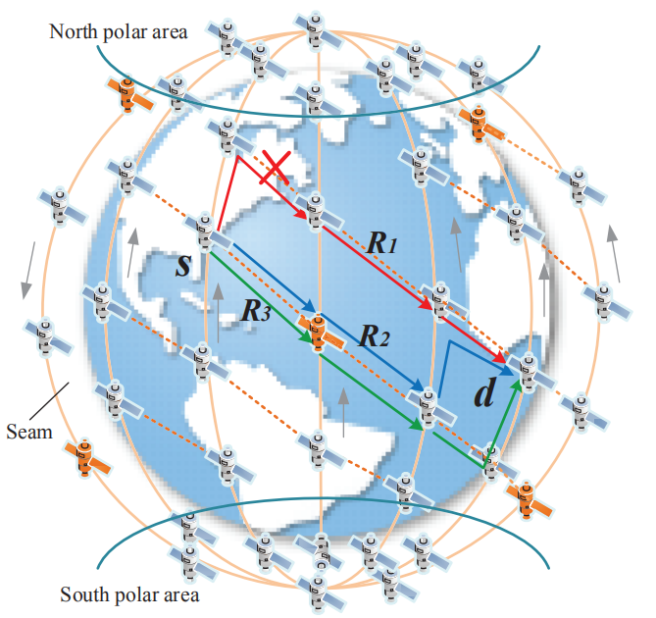
IADR (2/4)
software-defined satellite networks
control plane & data plane
control plane:
generates network topology snapshots
calculates optimal routing paths
needs to gather global information
my understanding: a centralized routing algorithm
how are satellite controllers distributed?

Slide 42
IADR (3/4)
3 attributes for each ISL
utility function of SNR of link (i, j) at any time t:$U(s)=1−Pr\{SNR_{ij}(t)<α\}$
utility function of link duration: $U(l)=\frac{l_{ij}(t)}{T}$
$l_{ij}(t)$: description is not clear in this paper, can be considered as how much remaining time the link can be maintained
T: orbital period
utility function of buffer queue:$U\left(b\right)=\sum_{j≥0}{\operatorname{Pr}\left(m+A\left(t\right)−D\left(t\right)=k,D\left(t\right)=j\right)}$
m: number of remaining packets at time t
$A\left(t\right)$: number of packets reached in period t
$D\left(t\right)$: number od packets processed by the satellite in time t
Notes:
SNR: 换句话说就是链路通断信息

Slide 43
IADR (4/4)
link utility
$U_{ij}(x)=U_{ij}(s)^{w_{s}^{ij}}⋅U_{ij}(l)^{w_{l}^{ij}}⋅U_{ij}(b)^{w_{b}^{ij}}$
$w_{s}^{ij}$, $w_{l}^{ij},$ $w_{b}^{ij}$: weight of 3 attribute parameters
$w_{s}^{ij}$+ $w_{l}^{ij}$+ $w_{b}^{ij}$=1
calculated through an adaptive maximum deviation algorithm
input: a reachable path, ISL decision attributes, link decision attribute utility
output: $w_{s}^{ij}$, $w_{l}^{ij},$ $w_{b}^{ij}$
path utility
$U(R_{i}\left(s,d\right))=\min{U_{k}^{i}(s)^{w_{s}^{k}}⋅U_{k}^{i}(l)^{w_{l}^{k}}⋅U_{k}^{i}(b)^{w_{b}^{k}}}$
$R_{i}\left(s,d\right)$: a candidate path $U_{k}$: link utility value of link $l_{k}$ in $R_{i}\left(s,d\right)$
select the path with the largest path utility

Slide 44
Thanks!

Slide 45
总结：收集链路状态和拓扑信息
&
控制路由稳定性的文献介绍
单乾

Slide 46
大纲
背景
总结：已阅读的文献中如何收集链路状态和拓扑信息
控制路由稳定性的2篇文献
OPSPF: Orbit Prediction Shortest Path First Routing for Resilient LEO Satellite Networks
BUPT, ICC 2019
A Refined Dijkstra's Algorithm with Stable Route Generation for Topology-Varying Satellite Networks
BUPT, ICDCS 2021

Slide 47
背景 (1/1)
地球上不同位置的用户密度不同
差异化服务
延时敏感 vs. 延时不敏感
城镇地区 vs. 乡村地区 vs. 海洋丛林
流量负载不均衡
一些卫星高负载，而其他卫星空闲

Slide 48
总结: 如何收集链路状态和拓扑信息？
分类 | 方法 | 简述 | 所需信息 | 收集/交换信息的方式
分布式路由 | ELB | 每颗卫星若检测到拥塞则通告邻居，邻居重新规划路由，使更少的包经过该卫星 | 自身拥塞等级：队列长度 | 把自身拥塞等级通告给邻居，未提路由表构建过程
 | PAR | 基于地理位置选择候选下一跳方向，选择其中优先级最高的方向 | 优先级：队列长度、丢包数量、成功传输的包数量 | 仅需记录自身的队列优先级，无控制报文交互
 | DRNL | 基于地理位置选择候选下一跳方向，以更大概率选择其中链路负载等级小的方向 | 链路负载等级：本卫星该方向的队列长度、该方向邻居卫星的队列总长度 | 与邻居交互自身队列长度信息
集中式路由 + 分布式修正 | TLR | 综合本跳的红绿灯信号和邻居的红绿灯信号得到最终红绿灯信号，依据最终信号选择向源路由得到的最优下一跳/次优下一跳转发（源路由+途中修正） | 红绿灯信号：队列长度 | 把自身红绿灯信号通告给邻居；每个轨道有一个发言人收集全局信息
集中式路由 | IADR | 基于链路效用函数计算路径效用函数，选择路径效用函数最大者为转发路径 | 链路效用函数：信噪比、链路持续时间、队列长度 | 基于SDN: 卫星控制器维持全局信息、进行路由选择
分布式探测全局信息 | ALBR | 运行移动代理/漫游代理，向随机目的卫星释放移动代理，移动代理在迁移过程中按概率选择下一跳 | 将沿途负载状况放入移动代理的栈中；移动代理使用高优先级队列转发 | 移动代理收集沿途链路与拥塞信息并在返回途中与途经的每颗卫星交互

Slide 49
OPSPF (0/3)
Orbit Prediction Shortest Path First Routing for Resilient LEO Satellite Networks
ICC 2019 - 2019 IEEE International Conference on Communications (ICC)
State Key Laboratory of Networking and Switching Technology, Beijing University of Posts and Telecommunication

Slide 50
OPSPF (1/3)
key concepts: static routing + on-demand dynamic routing
static routing
takes advantage of the regularity of the constellation & conducts periodic route calculation
topology changes caused by satellite movements: don’t flood LSU (link state update)
on-demand dynamic routing
topology changes caused by accidental link failure / recovery: flood LSU

Slide 51
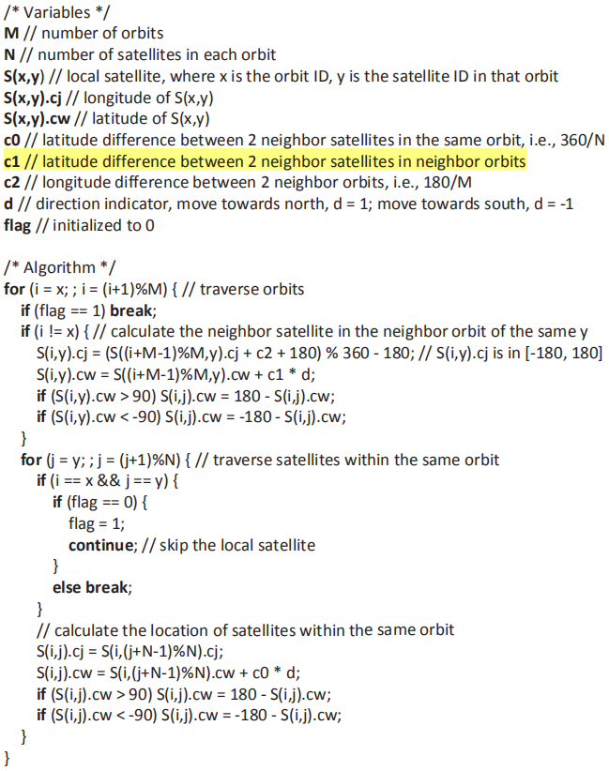
OPSPF (2/3)
static routing
a real-time satellite location prediction algorithm
given the local satellite’s location, calculate position of all other satellites
how is c1 got?
fixed phase difference between neighboring orbits?
c2
S(x-2, y)
S(x, y)
c1
S(x+1, y)
S(x-1, y)

Slide 52
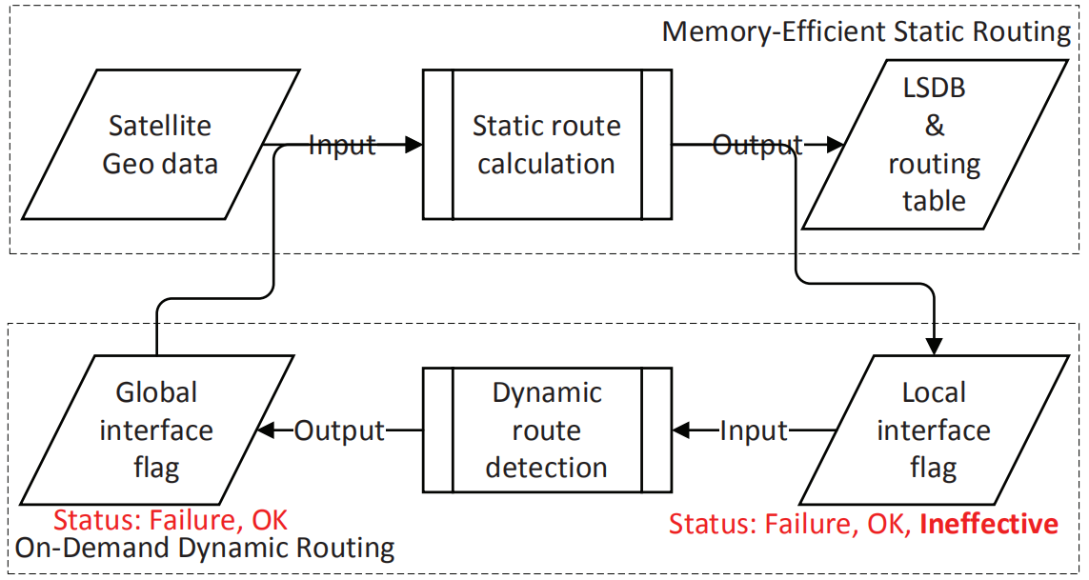
OPSPF (3/3)
embed dynamic routing into static framework
static routing module also updates the local interface flag fir each network interface
i.e. updates each ISL’s status
3 status: Failure, OK, Ineffective
link failure & recovery will trigger dynamic route flooding
detected through Hello & Keepalive packet —— classic OSPF
update local interface flag into global interface flag
2 status: Failure, OK

Slide 53
Refined Dijkstra (0/2)
A Refined Dijkstra’s Algorithm with Stable Route Generation for Topology-Varying Satellite Networks
Beijing University of Posts and Telecommunications & China Academy of Space Technology & Purple Mountain Laboratories
2021 IEEE 41st International Conference on Distributed Computing Systems (ICDCS)

Slide 54
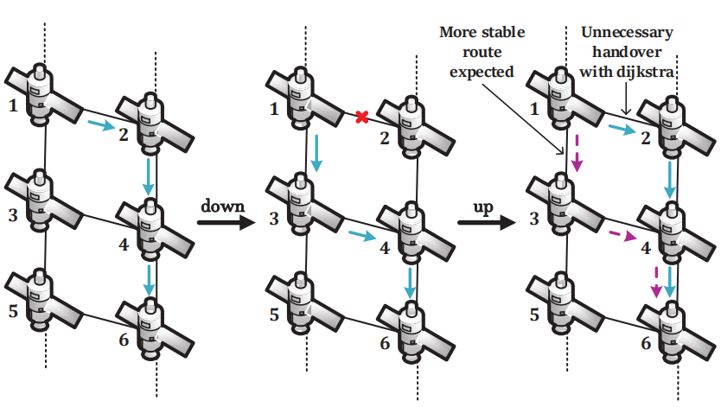
Refined Dijkstra (1/2)
motivation: equal-cost shortest paths are common in satellite network
which satellite to choose as next hop?
classical Dijkstra always selects the default next hop (e.g. select according to satellite id)
should try to maintain the end-to-end path as far as possible
but why? does it really matter whether route oscillation happens?
route recalculation takes too
much time?
Notes:
为什么要找一个存在时间尽可能长的链路？

Slide 55
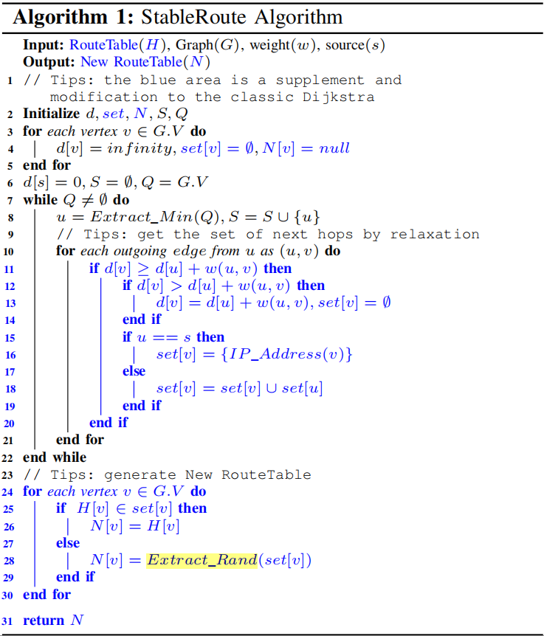
Refined Dijkstra (2/2)
every satellite needs to have global topology information
H: old route table G: new graph
set[v]: all candidate next hops from source s to satellite v
if have to change next hop to v in routing table, randomly select one in set[v]
if can predict future topology, maybe can choose the next-longest-maintained next hop in advance

Slide 56
Thanks!

Slide 57
TODO
如何从背景引入到我所调研的文献
卫星网络的挑战：拓扑动态性，频繁的链路状态变化
整理表格
以OPSPF作为最基础的方法引入

