Slide 1
Inter-satellite Routing Algorithm Based on Local Information ——Prototype
单乾
1

Slide 2
Outline
Background: characteristics of satellite network
Main idea of our local-information-based algorithm
Modifying OSPF to build a prototype
Experiment setup & results
What’s next
Notes:
联系年终总结的内容：先在OSPF的基础上修改

Slide 3
Outline
Background: characteristics of satellite network
Main idea of our local-information-based algorithm
Modifying OSPF to build a prototype
Experiment setup & results
What’s next

Slide 4
Background
satellite network vs. terrestrial network
high density
star-link: 2,4000 satellites planned
all satellites are considered as a SINGLE AS/area
fixed adjacencies
a satellite communicates with 4 neighbors
2 intra-orbit neighbors
2 inter-orbit neighbors
dynamic topology
due to movement of satellites
may cause accidental link failures
inter-orbit ISL periodically cut-downs
difficulties in maintaining link state
in OSPF, each LSA will flood through the whole area: too much overhead
however, topology can be predicted: no need to maintain all LSs
research problem: how to take advantage of satellite network to maintain LSs with high efficiency & low cost?
seam
polar ring
orbit direction
ISL
Notes:
通常的研究是把整个卫星网络视为一个AS或者区域, 但也有研究致力于把卫星网络分区（如颜博的LPIH）
periodically cut-downs的原因：极区 运动 天线对准

Slide 5
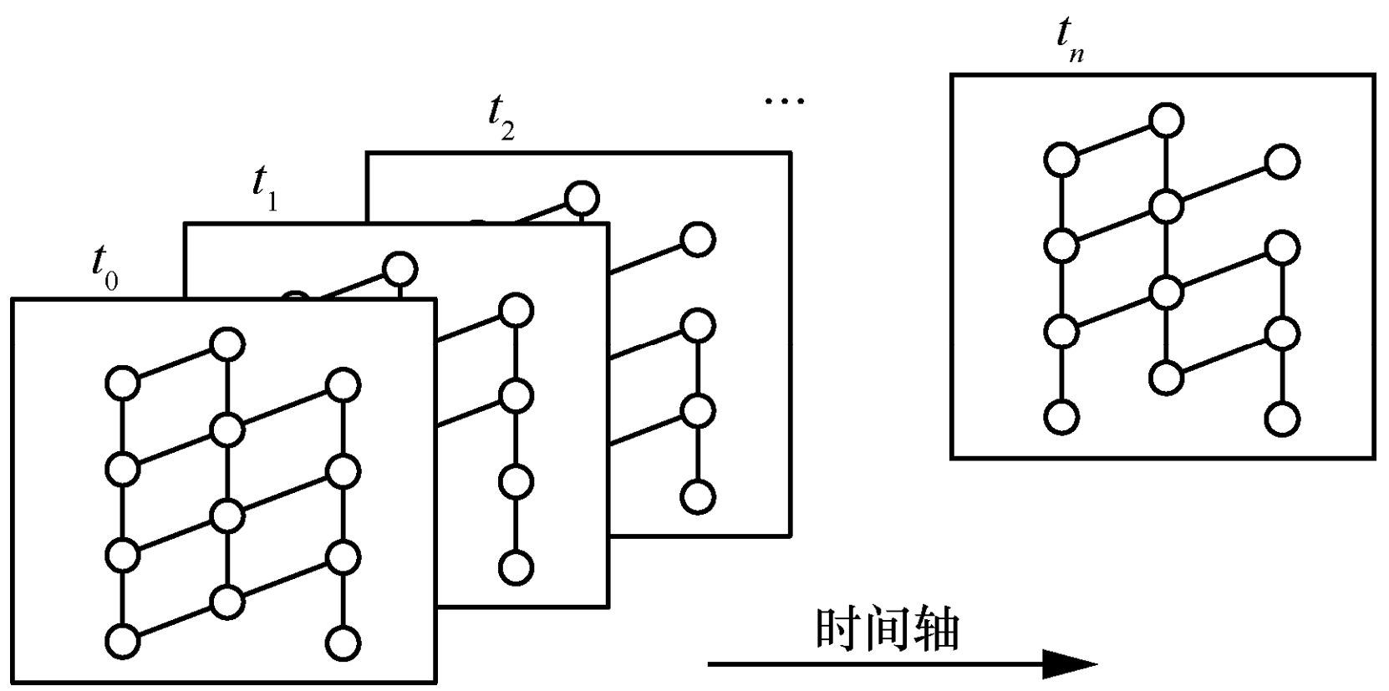
Background
predict network topology
known orbit parameters
calculate the position of any satellite at any time
fixed adjacencies
infer the link state of any ISL (according to the calculated position & fixed adjacencies)
if a satellite not in polar ring, then it has all 4 ISLs
if in polar ring, then it has only 2 intra-orbit ISLs
calculated satellite position + inferred LS = predicted topo!
not considering accidental link failures

Slide 6
Outline
Background: characteristics of satellite network
Main idea of our local-information-based algorithm
Modifying OSPF to build a prototype
Experiment setup & results
What’s next

Slide 7

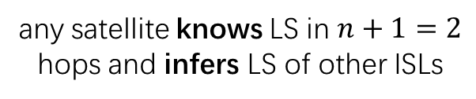

Main Idea
Local Information
content of local info: accidental failure & recovery of an ISL (“LSA”)
may contain load information in the future
how to advertise the local info: flooding procedure
a satellite floods LSAs of its directly connected ISL in an event-driven pattern
range of flooding: $n$ hops ($n$is a parameter)
assume $n=1$
any satellite knows LS in $n+1=2$ hops and infers LS of other ISLs
decide next hop using
known & inferred LS

Slide 8
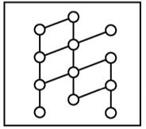
Main Idea
Inter-satellite Routing Algorithm Based on Local Information
every satellite maintains a graph of current topology
utilize predictable topology:
get the shape / adjacency of its graph
estimate the cost of edges in graph (based on propagation delay)
then utilize advertised local information:
update the shape of its graph
i.e. update the connection status of the graph
with local info
predicted graph
updated local graph
Notes:
说明为什么是updated “local” graph 因为它智能确保自己附近的拓扑是准确的，远处的链路状态仍然靠猜

Slide 9
Outline
Background: characteristics of satellite network
Main idea of our local-information-based algorithm
Modifying OSPF to build a prototype
Experiment setup & results
What’s next

Slide 10
Modifying OSPF
LSA generation in original OSPF (RFC2328 section 9, 10, 12.4)
relevant data structures:
neighbor state machine (familiar)
interface state machine
when:
“an interface’s state changes” —— RFC2328
implementation in inet: Ospfv2InterfaceState::changeState() & NeighborState::changeState()
check the current state & next state
if meet certain conditions, then call Ospfv2Area::floodLSA()
finally calls Ospfv2Interface::floodLSA(), where floods out this LSA
Notes:
简要介绍接口状态机，如接口down然后产生KillNbr事件，进而触发邻居状态机的状态转移

Slide 11
Modifying OSPF
flooding procedure in original OSPF (RFC2328 section 13)
flood an LSA hop-by-hop through the entire network
when:
a router receives a newer & more recent LSA (than its database copy)
or it has just generated an LSA
event-driven
how:
find some set of the router’s interfaces
at each interface:
encapsulate this LSA in an newly generated LSU packet
set the packet TTL = 1
send the packet out
at the next router, the same LSA instance, but a new LSU packet (TTL = 1)
implementation in inet:
LinkStateUpdatehandler::processPacket()
Ospfv2Interface::floodLSA()
finally calls MessageHandler::sendPacket() to send out the LSU packet

Slide 12





Modifying OSPF
limit the range of flooding: utilize the TTL field
when a router / satellite generates a new LSA:
when encapsulating as an LSU packet, set its TTL = $n$
when a router / satellite receives a newer & more recent LSA:
origin OSPF:
modified OSPF:
old LSU
TTL = 1
new LSU
TTL = 1
send
packet
decapsulate
process
encapsulate
LSA
LSA
LSA
LSA
do nothing
END
old LSU
TTL = $m$
decapsulate
if $m$ ≤ 1
LSA
process
LSA
LSA
send
packet
if $m$ > 1
new LSU
TTL = $m−1$
LSA

Slide 13
Modifying OSPF
parts not modified
5 types of LSA
the entire satellite network is considered as a single area
there are only Router & Network LSA
rebuilding of the routing table
retransmission of LSA
if LSU retransmission timer expires:
LSAs in retransmission list should be retransmitted
many LSA encapsulated in a single LSU packet
LSA’s origin may be different! How to set the LSU’s TTL?
left as an open issue
Now we get a naïve prototype of “Inter-satellite Routing Algorithm Based on Local Information”

Slide 14
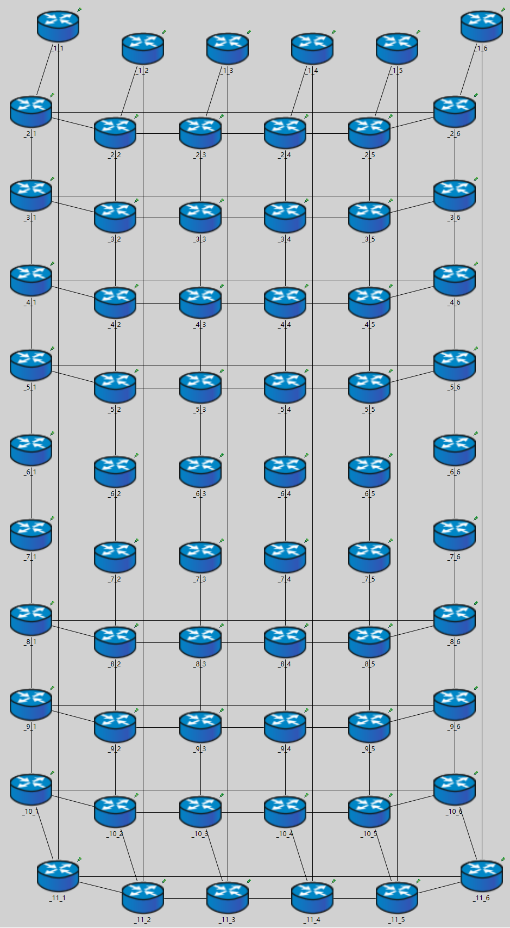
Experiment
experiment setup
static “satellite” topology
6 orbits, 11 satellites in each orbit
existence of polar ring
each ISL’s propagation delay is calculated
satellite environment hasn’t been used so far
address space
traditional IP
each interface of an ISL has a unique IP
OSPF config
between 2 satellites is a broadcast network
OSPF cost setup: according to propagation delay
N Pole
S Pole
Notes:
介绍拓扑图 每条边的传播时延是按照真实情况计算得出的
目前只是简单实验，为了简便没有使用卫星的仿真环境，而是每个节点都固定

Slide 15
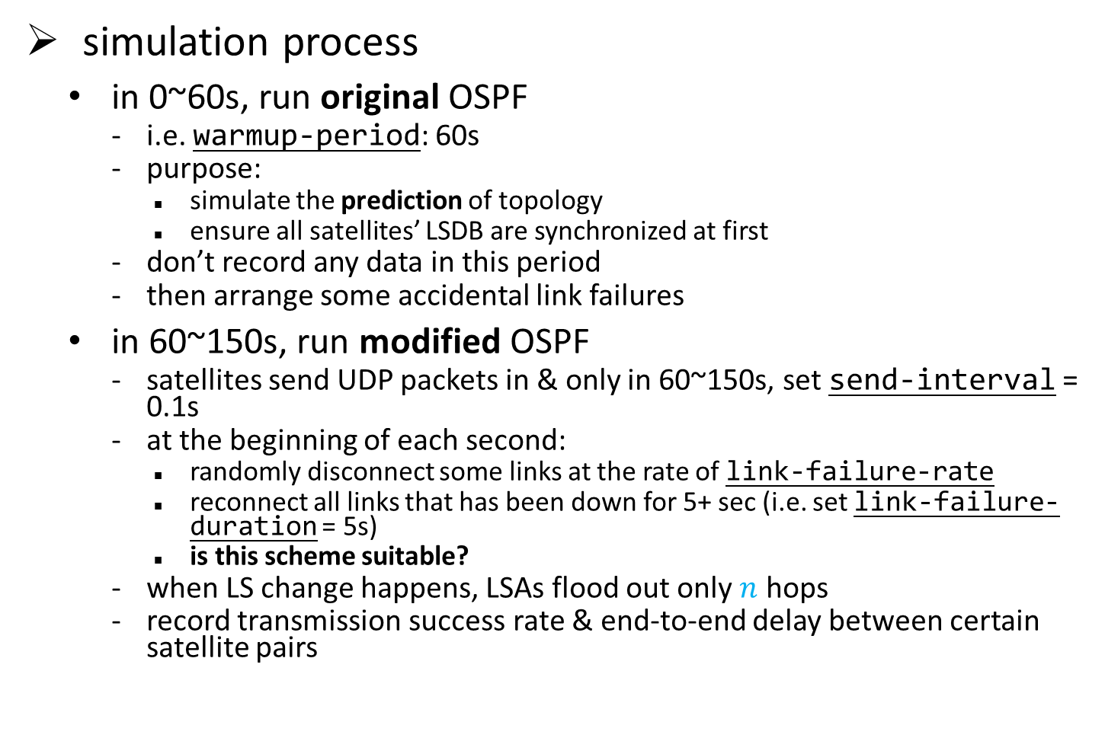
Experiment
simulation process
in 0~60s, run original OSPF
i.e. warmup-period: 60s
purpose:
simulate the prediction of topology
ensure all satellites’ LSDB are synchronized at first
don’t record any data in this period
then arrange some accidental link failures
in 60~150s, run modified OSPF
satellites send UDP packets in & only in 60~150s, set send-interval = 0.1s
at the beginning of each second:
randomly disconnect some links at the rate of link-failure-rate
reconnect all links that has been down for 5+ sec (i.e. set link-failure-duration = 5s)
is this scheme suitable?
when LS change happens, LSAs flood out only $n$ hops
record transmission success rate & end-to-end delay between certain satellite pairs
Notes:
说明前60秒热身的原因
因为在完整版的方法中，每颗卫星存一个拓扑模型

Slide 16
Experiment
simulation result: transmission success rate & end-to-end delay
a preliminary result, still needs more experiments & analysis
packets can always successfully transmitted when there are no failures
failed transmission (partially) due to routing vibration
ICMP error seen: TIME-EX
Notes:
解释图表1：这幅图是选取了一个距离为7跳的传输对，改变横坐标：LSA通告的跳数（即局部信息的通告范围），从60~150秒在不同的链路故障率下采集到的UDP包传输成功率，随N增大呈现上升趋势 (动画)
图表2：这幅图是选取了一个距离为7跳的传输对，改变LSA通告的跳数，在不同的链路故障率下采集到的UDP包的平均端到端时延
出现传输失败的原因 、在某些情况下OSPF也失败

Slide 17
Experiment
problem: vibration
1 UDP packet, satellite A forwards it to B, B forwards back to A!
reason:
optimal path from 6_6 to 4_4: 6_6 -> … -> 9_5 -> 10_5 -> 11_5 -> 11_4 -> 1_4 -> … -> 4_4
at 77s, link between 11_4 & 11_5 fails, then:
Event# | Time | Relevant Hops | Name | Source | Destination
#2042962 | 77.246'261'480 | Router_10_5 --> Router_9_5 | UdpBasicAppData-171 | 192.168.60.1:1025 (Router_6_6) | 192.168.26.2:1234 (Router_4_4)
#2043208 | 77.252'984'360 | Router_9_5 --> Router_10_5 | UdpBasicAppData-171 | 192.168.60.1:1025 (Router_6_6) | 192.168.26.2:1234 (Router_4_4)
I didn’t receive LSA! My next hop remains 10_5
9_5
9_5
9_5
10_5
10_5
10_5
I will recalculate my routing table, new next hop is 9_5
11_5
11_5
11_5
11_4
11_4
11_4
origin SPT
link failure happens
LSA floods regionally
Notes:
在实验中观察到了震荡的现象，频率未知，而且传输成功率低似乎不全是由震荡导致

Slide 18
Outline
Background: characteristics of satellite network
Main idea of our local-information-based algorithm
Modifying OSPF to build a prototype
Experiment setup & results
What’s next

Slide 19
What’s next
try to solve the confusion & vibration problem
more extensive experiments & observation
recalculate routing table when observes vibration, but how?
migrate to satellite environment
IP address -> satellite-specified address: (orbit id, intra-orbit id)
implement the method of orbit prediction
use a simpler data structure than OSPF’s LSDB & LSA (i.e. jump out of OSPF)
each LSA should be separately flooded & retransmitted
need distinct change on OSPF
more further: consider the load balance
definition of “load”
how to transmit load info between satellites
what to do after receiving load info

Slide 20
Thanks
20

