Slide 1
Inter-satellite Routing Algorithm Based on Local Information ——a unified framework
单乾
1

Slide 2
Outline
Background: characteristics of satellite network
Main idea of our local-information-based algorithm
Implementation of our method
Experiment setup & results
What’s next
Notes:
联系年终总结的内容：先在OSPF的基础上修改

Slide 3
Outline
Background: characteristics of satellite network
Main idea of our local-information-based algorithm
Implementation of our method
Experiment setup & results
What’s next

Slide 4
Background
satellite network vs. terrestrial network
high density
star-link: 2,4000 satellites planned
all satellites are considered as a SINGLE AS/area
deterministic adjacencies
a satellite communicates with 4 neighbors
2 intra-orbit neighbors
2 inter-orbit neighbors
dynamic topology: intermittent ISLs
while terrestrial networks are fixed
due to movement of satellites
may cause accidental link failures
inter-orbit ISL periodically cut-downs
difficulties in maintaining link state
in OSPF, each LSA will flood through the whole area: too much overhead
however, topology can be predicted: no need to maintain all LSs
research problem: how to take advantage of satellite network to maintain LSs with high efficiency & low cost?
seam
polar ring
orbit direction
ISL
Notes:
通常的研究是把整个卫星网络视为一个AS或者区域, 但也有研究致力于把卫星网络分区（如颜博的LPIH）
periodically cut-downs的原因：极区 运动 天线对准

Slide 5
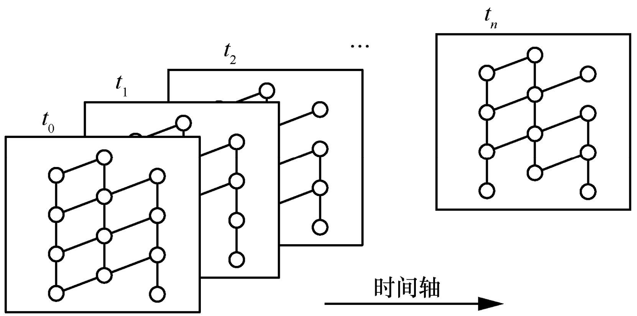
Background
predict network topology
known orbit parameters
calculate the position of any satellite at any time
fixed adjacencies
infer the link state of any ISL (according to the calculated position & fixed adjacencies)
if a satellite not in polar ring, then it has all 4 ISLs
if in polar ring, then it has only 2 intra-orbit ISLs
calculated satellite position + inferred LS = predicted topo!
not considering accidental link failures

Slide 6
Outline
Background: characteristics of satellite network
Main idea of our local-information-based algorithm
Implementation of our method
Experiment setup & results
What’s next

Slide 7
Main Idea
general link-state routing protocols (e.g. OSPF)
neighbor discovering: Hello mechanism, parameter: hello interval
neighbor relationship establishment: neighbor state machine
link state advertisement: LSA flooding procedure, parameter: flood hop
LSDB synchronization: upon receiving LSAs from other routers, each router updates its own LSDB with the newly received information
shortest path calculation: each router applies a shortest path algorithm to build routing tables
(advanced feature) load balancing: link load state is contained in protocol packets, which is determined by the length of forwarding queue
classic OSPF suits for terrestrial networks, but not satellite networks
terrestrial: few link failures, the topology is fixed on the whole
satellite: frequent link failures, may cause too much overhead for OSPF

Slide 8

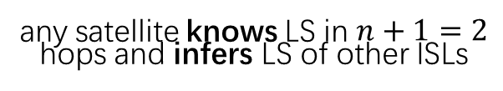

Main Idea
utilize the deterministic adjacencies of satellite networks
not requiring LSDB synchronization
advertise the time-varying LS more frequently to satellites in need
based on cognition: only “nearby” LSs are more valuable to a satellite
how to advertise the local info: flooding procedure
a satellite floods LSAs of its directly connected ISL in an event-driven pattern
range of flooding: $n$ hops ($n$is a parameter)
aim: reduce control overhead, while ensuring PDR and delay
assume $n=1$
any satellite knows LS in $n+1=2$ hops and infers LS of other ISLs
decide next hop using
known & inferred LS

Slide 9
Outline
Background: characteristics of satellite network
Main idea of our local-information-based algorithm
Implementation of our method
Experiment setup & results
What’s next

Slide 10
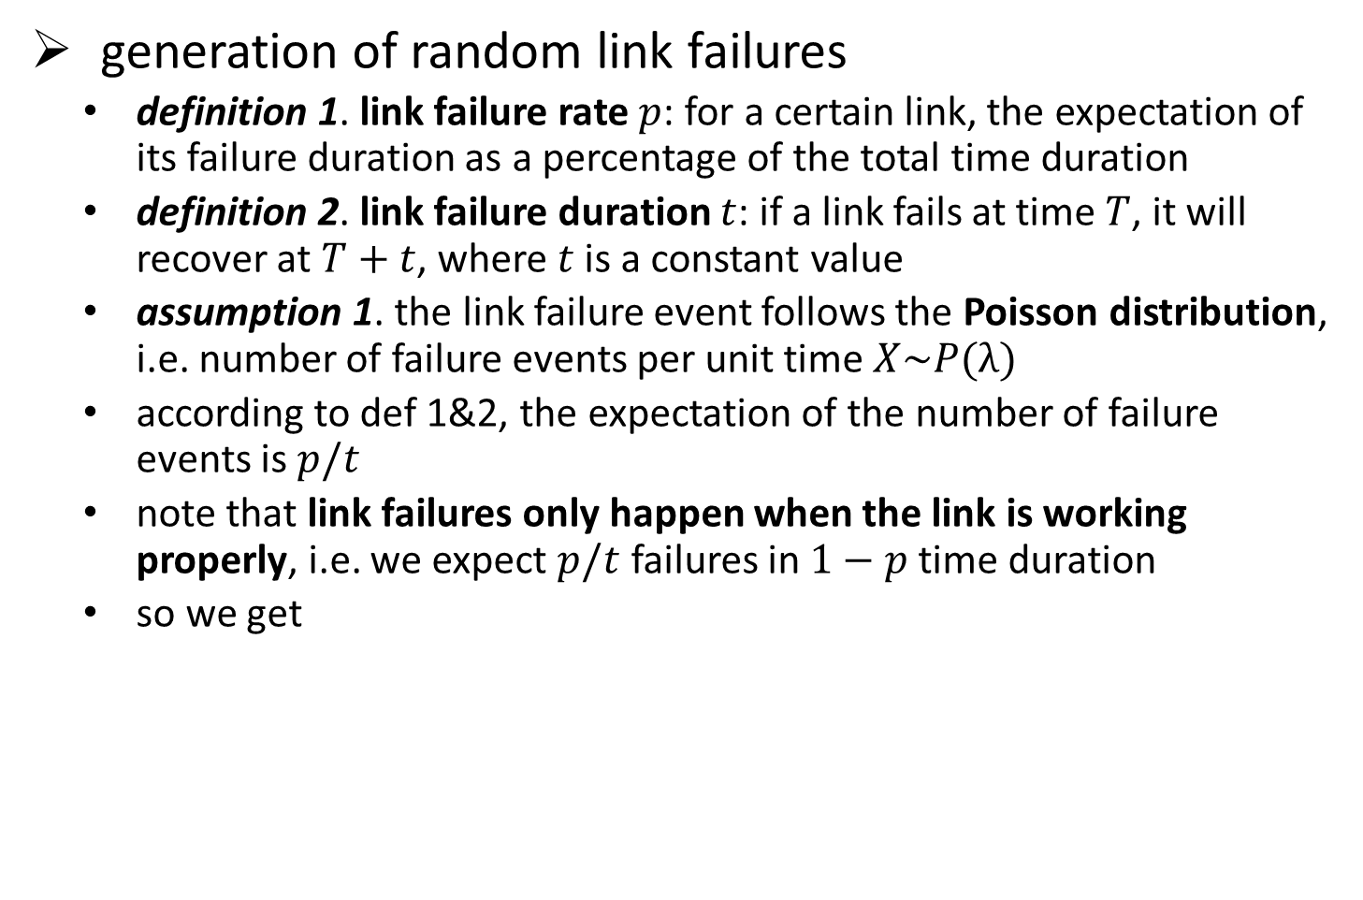

Implementation
generation of random link failures
definition 1. link failure rate $p$: for a certain link, the expectation of its failure duration as a percentage of the total time duration
definition 2. link failure duration $t$: if a link fails at time $T$, it will recover at $T+t$, where $t$ is a constant value
assumption 1. the link failure event follows the Poisson distribution, i.e. number of failure events per unit time $X\sim P(λ)$
according to def 1&2, the expectation of the number of failure events is $p/t$
note that link failures only happen when the link is working properly, i.e. we expect $p/t$ failures in $1−p$ time duration
so we get
$$λ=\frac{p}{\left.t(1−p\right)}$$
input
p
link failure event series
λ
randomly generate
input
t

Slide 11





Implementation
limit the range of flooding: utilize the TTL field
when a router / satellite generates a new LSA:
when encapsulating as an LSU packet, set its TTL = $n$
when a router / satellite receives a newer & more recent LSA:
origin OSPF:
our method:
old LSU
TTL = 1
new LSU
TTL = 1
send
packet
decapsulate
process
encapsulate
LSA
LSA
LSA
LSA
do nothing
END
old LSU
TTL = $m$
decapsulate
if $m$ ≤ 1
LSA
process
LSA
LSA
send
packet
if $m$ > 1
new LSU
TTL = $m−1$
LSA

Slide 12
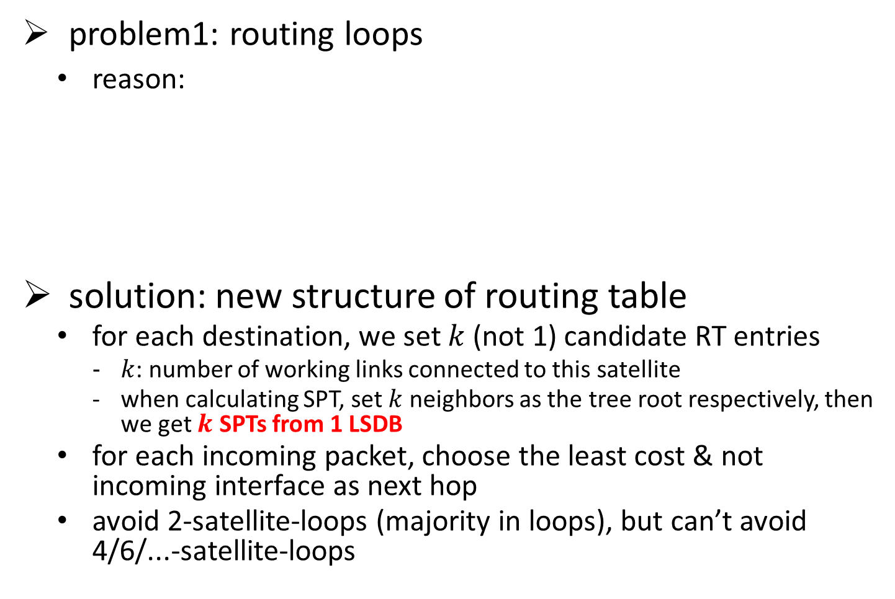
Implementation
problem1: routing loops
reason:
solution: new structure of routing table
for each destination, we set $k$ (not 1) candidate RT entries
$k$: number of working links connected to this satellite
when calculating SPT, set $k$ neighbors as the tree root respectively, then we get $k$ SPTs from 1 LSDB
for each incoming packet, choose the least cost & not incoming interface as next hop
avoid 2-satellite-loops (majority in loops), but can’t avoid 4/6/...-satellite-loops
I didn’t receive LSA! My next hop remains 10_5
9_5
9_5
9_5
10_5
10_5
10_5
I will recalculate my routing table, new next hop is 9_5
11_5
11_5
11_5
11_4
11_4
11_4
original path
link failure happens
LSA floods regionally
Notes:
在实验中观察到了震荡的现象，频率未知，而且传输成功率低似乎不全是由震荡导致

Slide 13
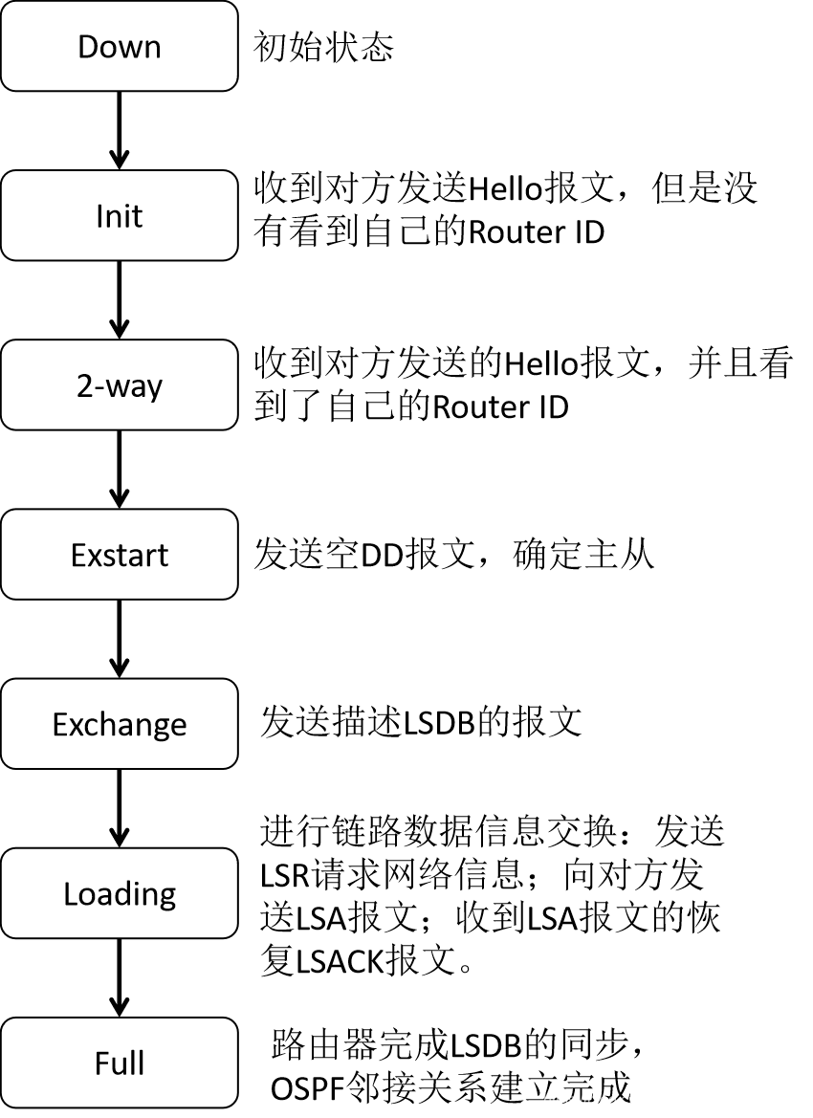
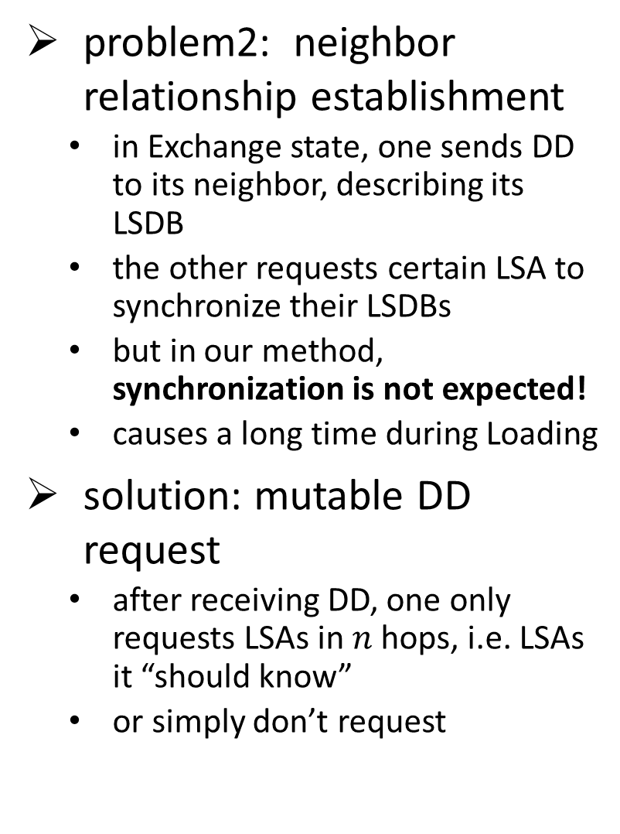
Implementation
problem2: neighbor relationship establishment
in Exchange state, one sends DD to its neighbor, describing its LSDB
the other requests certain LSA to synchronize their LSDBs
but in our method, synchronization is not expected!
causes a long time during Loading
solution: mutable DD request
after receiving DD, one only requests LSAs in $n$ hops, i.e. LSAs it “should know”
or simply don’t request

Slide 14
Outline
Background: characteristics of satellite network
Main idea of our local-information-based algorithm
Implementation of our method
Experiment setup & results
What’s next

Slide 15
Experiment
experiment setup
static “satellite” topology
6 orbits, 11 satellites in each orbit
“full connected”, i.e. each satellite has 4 links
address space
traditional IP
each interface of an ISL has a unique IP
network config
between 2 satellites is a broadcast network
link cost setup: according to propagation delay
simulation
in 0~20s, run original OSPF
simulate the prediction of topology
ensure all satellites’ LSDB are synchronized at first
in 20~120s, run our method
a single delivery pair, sends UDP at 10pkt/s (ensures no congestion)
performance metrics
average packet loss
average end to end delay
control overhead
Notes:
介绍拓扑图 每条边的传播时延是按照真实情况计算得出的
目前只是简单实验，为了简便没有使用卫星的仿真环境，而是每个节点都固定

Slide 16
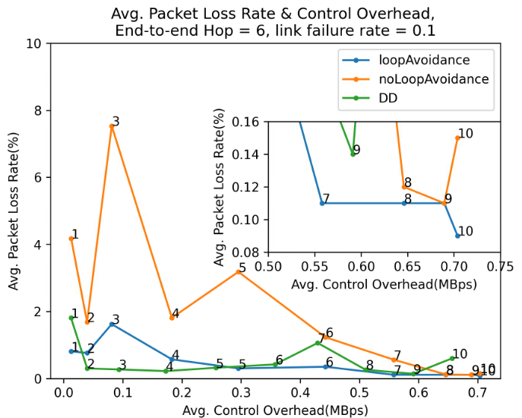

Experiment: packet loss rate
control overhead & packet loss in different $n$ (???)
$n$large enough: OSPF
each point is the average of 10 tests
new routing table structure can optimize packet loss up to 80% (“loopAvoidance” vs. “noLoopAvoidance”)
mutable DD request: less overhead, fluctuated loss rate
OSPF: overhead 0.65, loss 0.2%
Notes:
解释图表：每个点是相同的配置，在10个随机事件进行实验，取的平均值，每个点上的数字是LSA洪泛的跳数
横轴是整个网络的开销
四条线各自的含义
我们想找的是一个尽量靠左下角的点
相比原始OSPF，目前观测到的结果是可以减少90%的控制开销，同时保持和OSPF相近的传输成功率

Slide 17
Outline
Background: characteristics of satellite network
Main idea of our local-information-based algorithm
Implementation of our method
Experiment setup & results
What’s next

Slide 18
What’s next
confusion
why there are so many fluctuations?
observation: in 10 tests, only 1 or 2 tests have many packet losses, while others nearly zero packet loss. but why?
another possibly feasible loop avoidance
based on TTL & Manhattan distance between current & dest satellites
change the static topology into osgEarth environment
should add the function of topology prediction
more further: consider the load balance
definition of “load”
how to transmit load info between satellites
what to do after receiving load info

Slide 19
Thanks
19

