Slide 1
Routing in LEO Satellite Networks:
How Many Link-State Updates Do We Need?
单乾

Slide 2
Contents
Background & motivation
Design considerations of link-state routing
Design of our LoFi
Performance evaluation

Slide 3
Contents
Background & motivation
Advantages & challenges of satellite networks
Deterministic neighbor relationship in satellite networks
Design considerations of link-state routing
Design of our LoFi
Performance evaluation

Slide 4
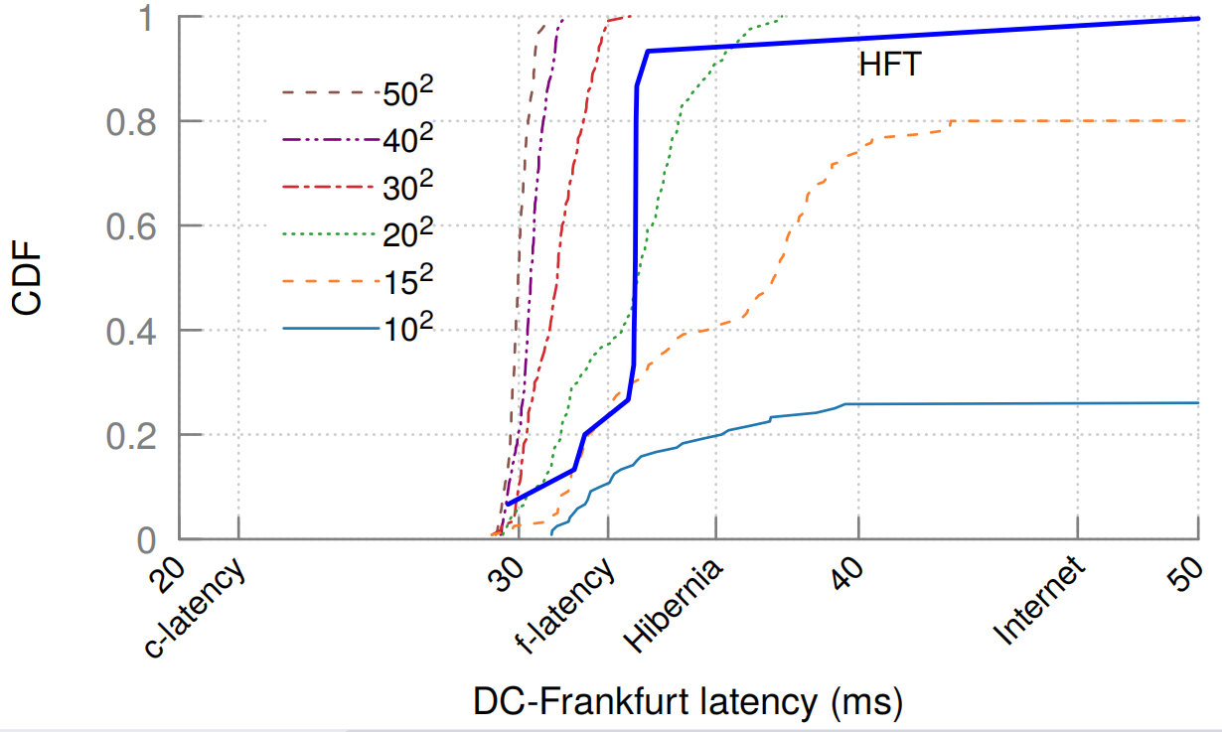

Background & motivation
Low earth orbit (LEO) satellite constellation
Lower orbit altitude (500 ~ 2000km)
Smaller satellite-ground latency (2~12ms)
Each satellite has 4 inter-satellite links (ISL)
4 neighbors
2 in the same orbit, 2 in the adjoining orbits
To unleash the potential of large-scale LEO constellation,
efficient routing and forwarding is necessary
Major challenge: unstable topology
Relative movement between satellites
Frequent ISL failure & recovery
Regular: satellite move into / out of polar region
Irregular: ISL breakdowns
ISL
Satellite we focus on
Neighbor
Notes:
解释右图：参考文献中，不同规模的星座从DC到法兰克福的传播时延的CDF
c-latency: 光速 f-latency: 直线光缆的理论时延 Hib...：跨大西洋光缆 HFT: 高频交易 金融领域专线

Slide 5
Background & motivation
Previous link-state routing protocols in satellite networks
Mainly based on OSPF
What to disseminate: coarse-grained link-states (connectivity of an ISL)
How to disseminate: flood globally
Ignore topology features of satellite networks
Topology feature: deterministic neighbor relationship
Provides prior information about the topology
Real-time connectivity of distant ISLs may not be that crucial
A new opportunity to advertise localized fine-grained link-states
Link connectivity & load
Can achieve less control overhead and better delivery
Notes:
确定性邻居关系：Satellites know the existence of ISLs and other satellites, but do not know the connectivity

Slide 6
Contents
Background & motivation
Design considerations of link-state routing
Link-state update mechanism
Semantics of link-states
Method of link-state dissemination
Trigger of link-state update
Routing calculation mechanism
Design of our LoFi
Performance evaluation

Slide 7
Design considerations of link-state routing
Link-state routing protocol
Link-state update
Routing calculation
Link-state(LS) update mechanism: what/how/when to disseminate
Semantics of LS
A metric (bandwidth / delay / a predefined cost / …)
An attribute (link type, e.g., p2p link, transit link…)
Method of LS dissemination: a common way is flooding
Normal flooding
Lightweight flooding
Trigger of LS update
Routing calculation
Notes:
A typical link-state routing protocol consists of a link-state update mechanism and a routing calculation mechanism. These two components must be properly designed to improve the content delivery performance and reduce the control overhead

Slide 8
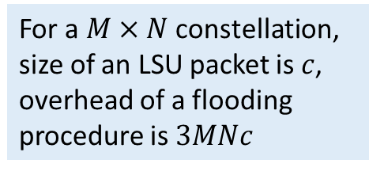
Design considerations of link-state routing
Link-state routing protocol
Link-state update
Routing calculation
Link-state(LS) update mechanism: what/how/when to disseminate
Semantics of LS
Method of LS dissemination: a common way is flooding
Normal flooding
Lightweight flooding
Trigger of LS update
Routing calculation
For a $M×N$ constellation,
size of an LSU packet is $c$,
overhead of a flooding procedure is $3MNc$
LSU, TTL=1
LSU, TTL=1
LSU, TTL=1
LSU, TTL=1
Notes:
普通的flooding：每颗卫星收到LSU后，若认为该LSU中携带了最新的链路状态信息（通过序列号确定），都会向所有接口发送LSU报文（收到该LSU的那个接口除外）
会存在较多冗余传输

Slide 9
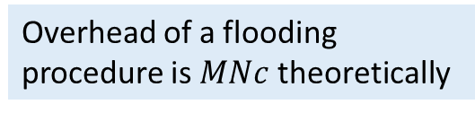
Design considerations of link-state routing
Link-state routing protocol
Link-state update
Routing calculation
Link-state update mechanism: what/how/when to disseminate
Semantics of LS
Method of LS dissemination: a common way is flooding
Normal flooding
Lightweight flooding
Trigger of LS update
Routing calculation
Satellite that detects LS change and starts flooding
Calculated flooding topology
Overhead of a flooding procedure is $MNc$ theoretically
Notes:
Lightweight flooding 是22年的一篇文献提出的
在实现上，是个每颗卫星预先存好一个按时间切片的“洪泛拓扑”，这个拓扑是一个最小生成树，收到LSU了就沿这个洪泛拓扑转发
但是这种方法对链路故障比较敏感，而且计算、存储这个洪泛拓扑会引入额外的开销

Slide 10
Design considerations of link-state routing
Link-state routing protocol
Link-state update
Routing calculation
Link-state update mechanism: what/how/when to disseminate
Semantics of LS
Method of LS dissemination: a common way is flooding
Normal flooding
Lightweight flooding
Trigger of LS update
Event-triggered mode: disseminate LSU packets when detect link-state changes
Time-triggered mode: monitor link-states periodically
Routing calculation

Slide 11
Design considerations of link-state routing
Link-state routing protocol
Link-state update
Routing calculation
Link-state update mechanism: what/how/when to disseminate
Routing calculation mechanism
Each satellite builds a graph based on its LSDB
Calculate optimal routes to other satellites using the shortest path algorithm
Each ISL is associated with a cost (i.e. semantics of link-states)
A unit (representing one hop)
Propagation delay
Queuing delay
A predefined value
…
Notes:
Lightweight flooding 是22年的一篇文献提出的
在实现上，是个每颗卫星预先存好一个按时间切片的“洪泛拓扑”，这个拓扑是一个最小生成树，收到LSU了就沿这个洪泛拓扑转发
但是这种方法对链路故障比较敏感，而且计算、存储这个洪泛拓扑会引入额外的开销

Slide 12
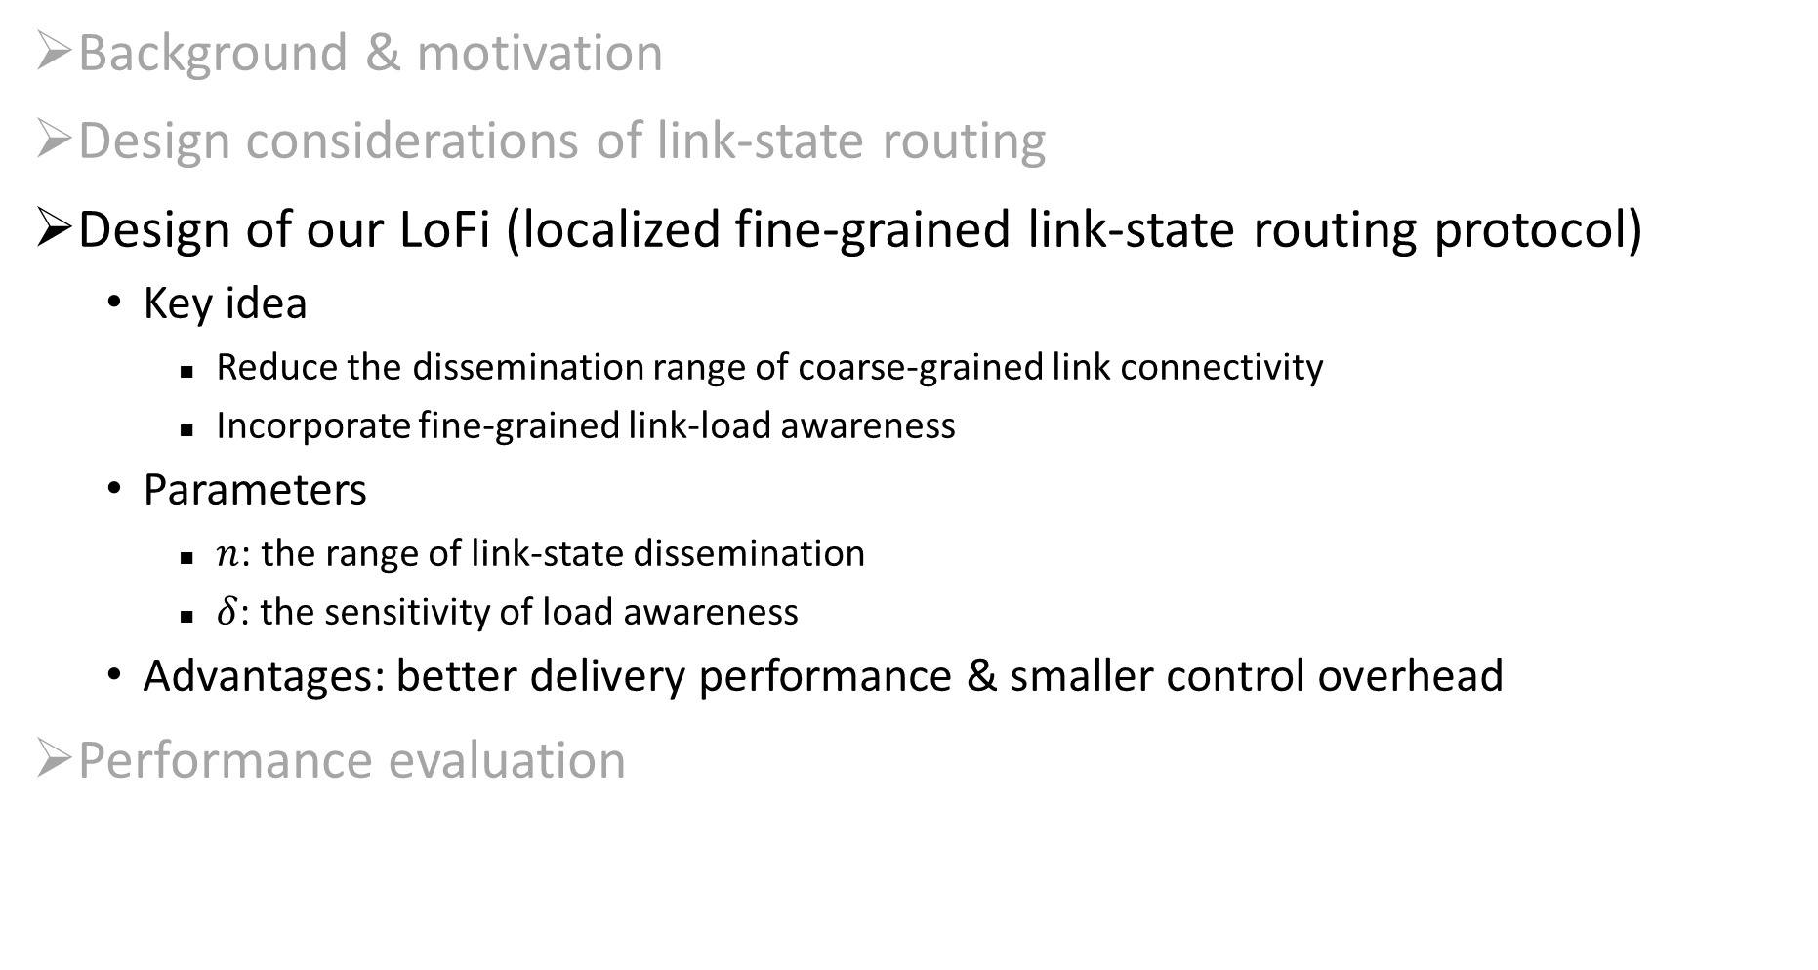
Contents
Background & motivation
Design considerations of link-state routing
Design of our LoFi (localized fine-grained link-state routing protocol)
Key idea
Reduce the dissemination range of coarse-grained link connectivity
Incorporate fine-grained link-load awareness
Parameters
$n$: the range of link-state dissemination
$δ$: the sensitivity of load awareness
Advantages: better delivery performance & smaller control overhead
Performance evaluation

Slide 13
LoFi: overview
Link-state update mechanism
Semantics of LS: link connectivity → link connectivity & link load
Method of LS dissemination: global flooding → local dissemination
Trigger of LS update: event-triggered
Routing calculation mechanism
Link-state inference: utilizing deterministic neighbor relationship
Considering both the shortest path and the backup path

Slide 14

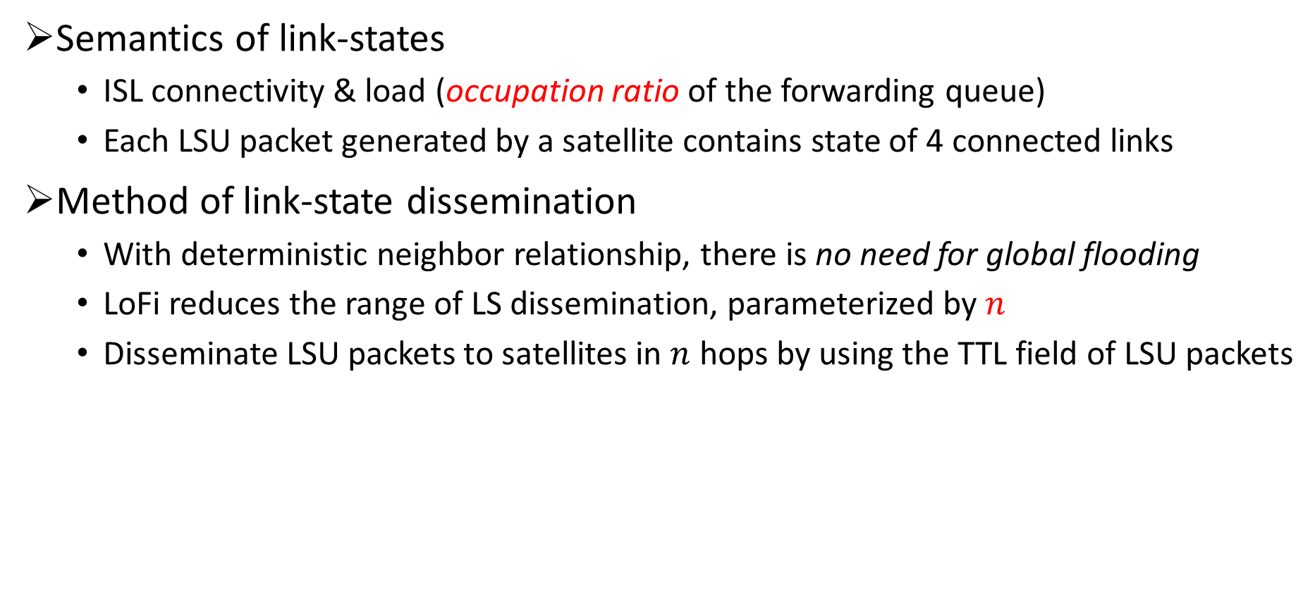



LoFi: link-state update
Semantics of link-states
ISL connectivity & load (occupation ratio of the forwarding queue)
Each LSU packet generated by a satellite contains state of 4 connected links
Method of link-state dissemination
With deterministic neighbor relationship, there is no need for global flooding
LoFi reduces the range of LS dissemination, parameterized by $n$
Disseminate LSU packets to satellites in $n$ hops by using the TTL field of LSU packets
LSU, TTL=$n−1$
LSU, TTL=$n$
LSU, TTL=$n−1$
LSU, TTL=$n−1$

Slide 15

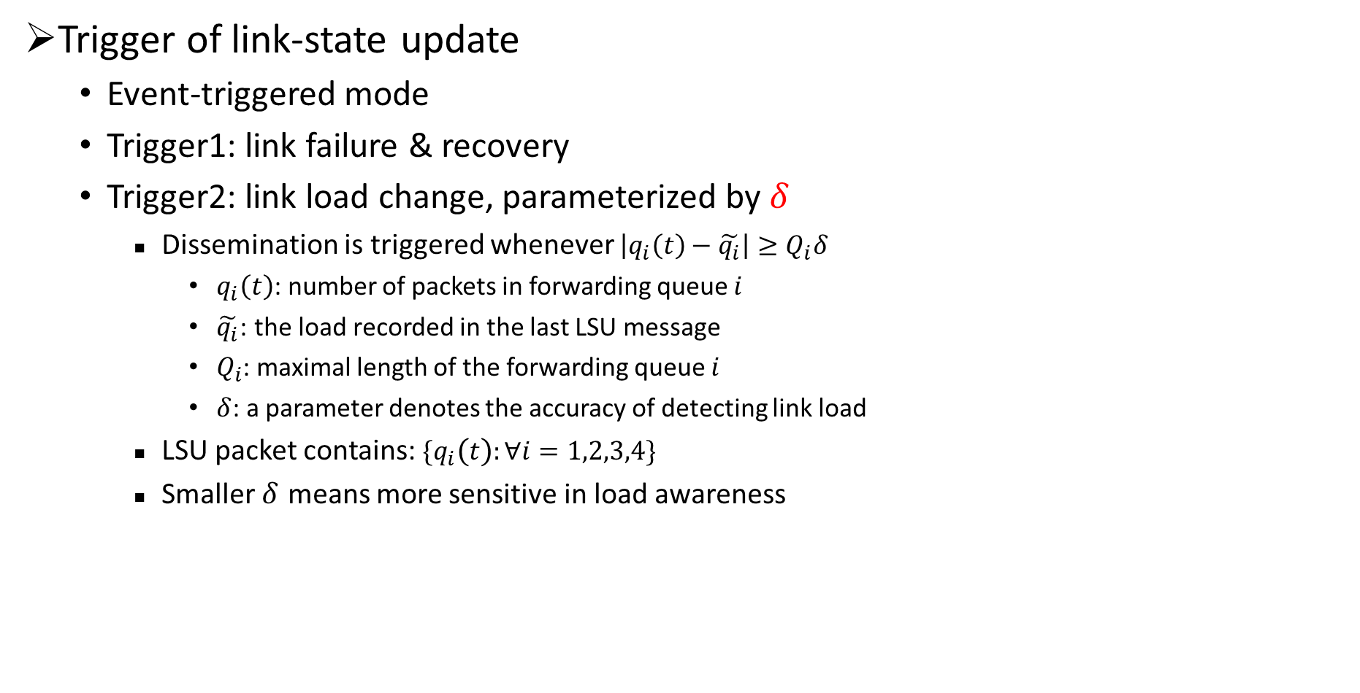



LoFi: link-state update
Trigger of link-state update
Event-triggered mode
Trigger1: link failure & recovery
Trigger2: link load change, parameterized by $δ$
Dissemination is triggered whenever $\left|q_{i}\left(t\right)−\tilde{q_{i}}\right|≥Q_{i}δ$
$q_{i}\left(t\right)$: number of packets in forwarding queue $i$
$\tilde{q_{i}}$: the load recorded in the last LSU message
$Q_{i}$: maximal length of the forwarding queue $i$
$δ$: a parameter denotes the accuracy of detecting link load
LSU packet contains: $\{q_{i}\left(t\right):∀i=1,2,3,4\}$
Smaller $δ$ means more sensitive in load awareness
$$q_{1}\left(t\right)$$
$$q_{3}\left(t\right)$$
$$q_{4}\left(t\right)$$
$$q_{2}\left(t\right)$$

Slide 16




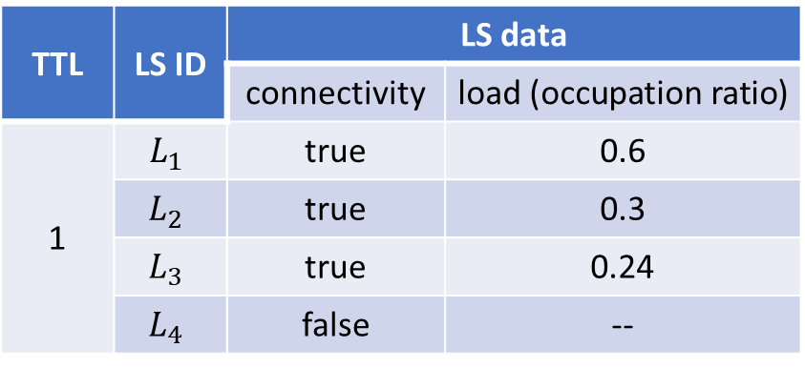

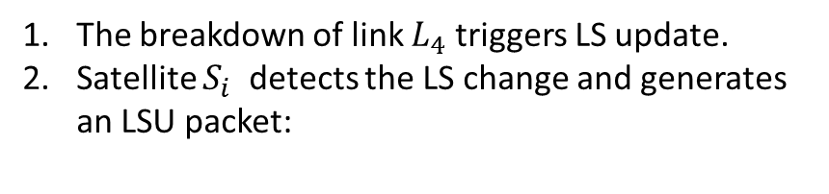

LoFi: link-state update
An example when $n = 1$
$$L_{1}$$
The breakdown of link $L_{4}$ triggers LS update.
Satellite $S_{i}$ detects the LS change and generates an LSU packet:
LSU
LSU
$$L_{3}$$
LSU
$$L_{4}$$
$$L_{2}$$
$$S_{i}$$
TTL | LS ID | LS data
 |  | connectivity | load (occupation ratio)
1 | $$L_{1}$$ | true | 0.6
 | $$L_{2}$$ | true | 0.3
 | $$L_{3}$$ | true | 0.24
 | $$L_{4}$$ | false | --
LSU
LSU
$$S_{k}$$
LSU

Slide 17

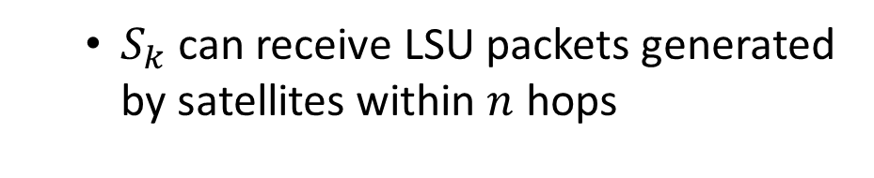
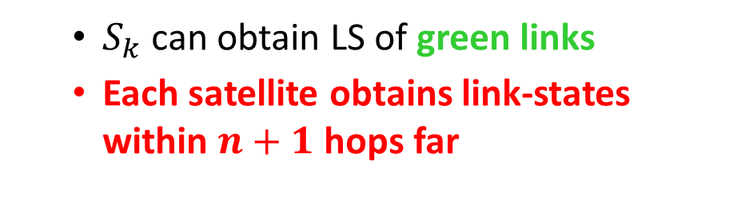


LoFi: link-state update
An example when $n = 1$
$S_{k}$ can receive LSU packets generated by satellites within $n$ hops
$S_{k}$ can obtain LS of green links
Each satellite obtains link-states within $n+1$ hops far
$$S_{i}$$
$$S_{q}$$
$$S_{p}$$
$$S_{k}$$
$$S_{j}$$

Slide 18
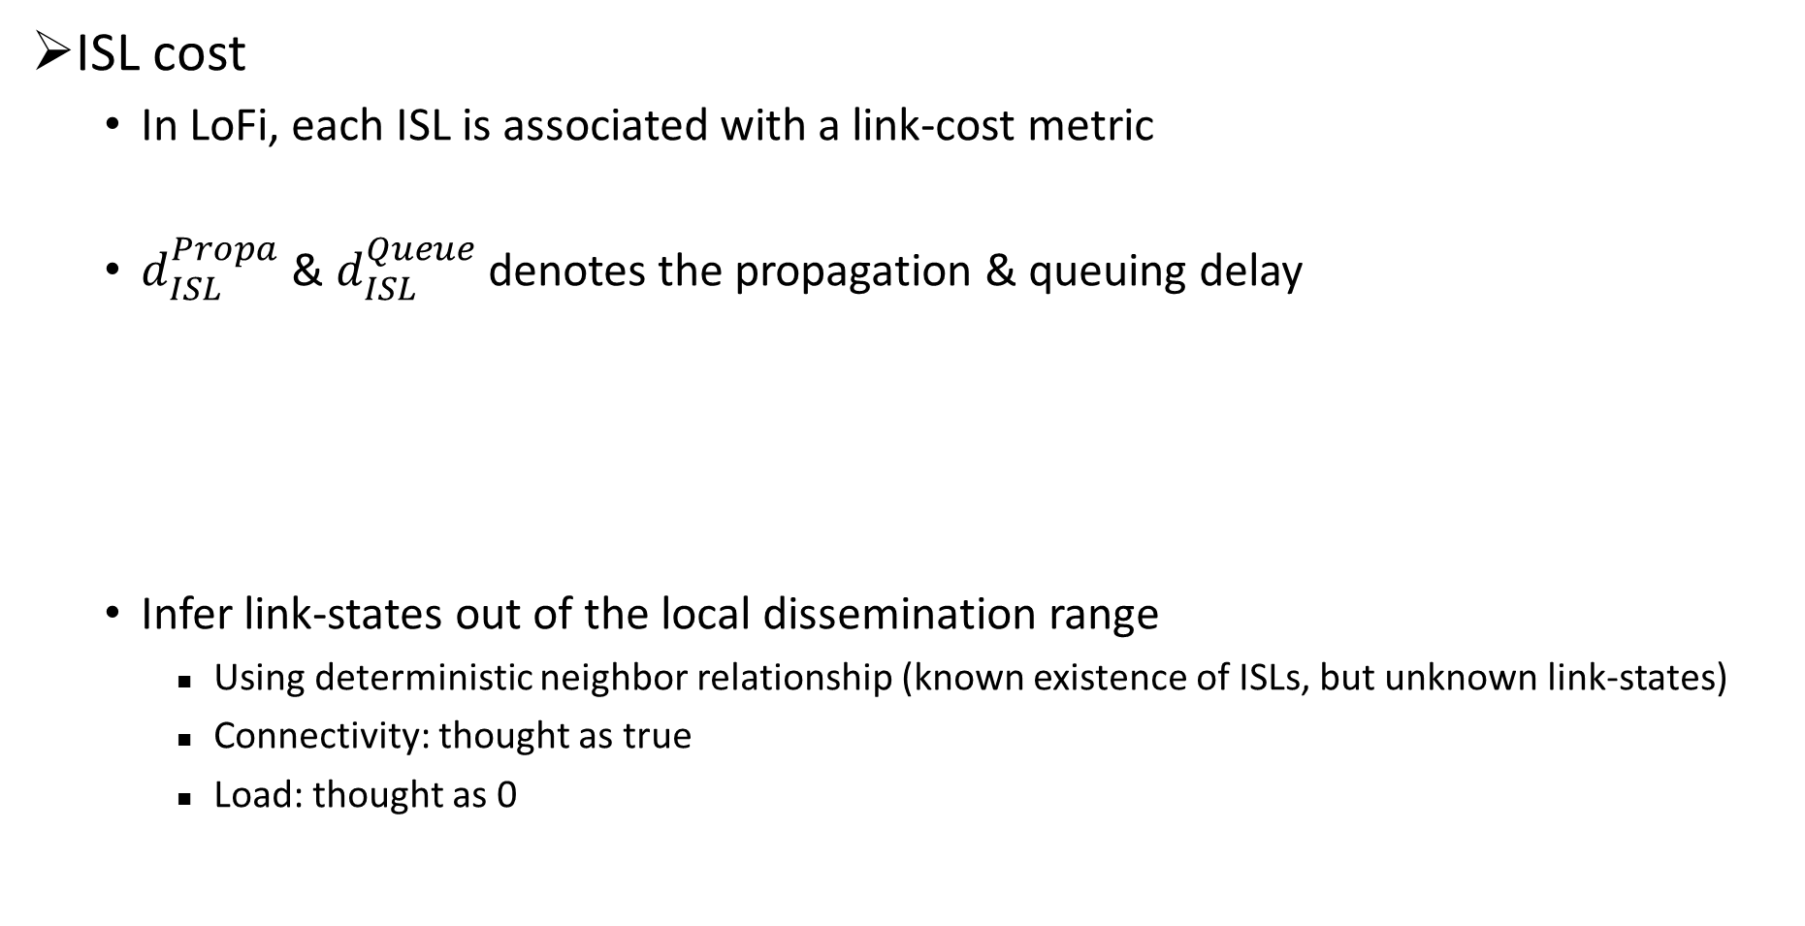
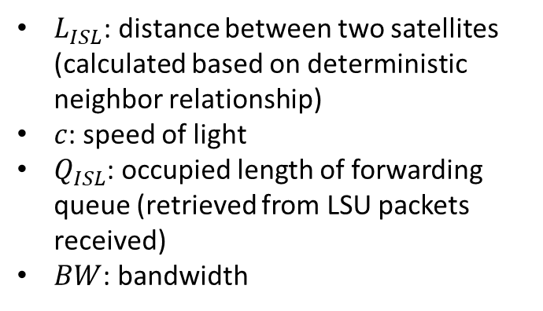
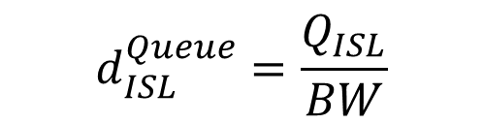
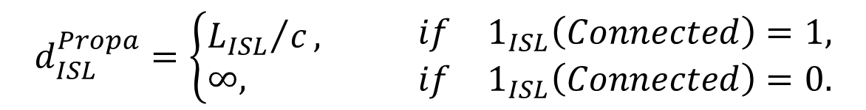
LoFi: routing calculation
ISL cost
In LoFi, each ISL is associated with a link-cost metric
$d_{ISL}^{Propa}$ & $d_{ISL}^{Queue}$denotes the propagation & queuing delay
Infer link-states out of the local dissemination range
Using deterministic neighbor relationship (known existence of ISLs, but unknown link-states)
Connectivity: thought as true
Load: thought as 0
$$Cost_{ISL}=d_{ISL}^{Propa}+d_{ISL}^{Queue}$$
$L_{ISL}$: distance between two satellites (calculated based on deterministic neighbor relationship)
$c$: speed of light
$Q_{ISL}$: occupied length of forwarding queue (retrieved from LSU packets received)
$BW$: bandwidth
$$d_{ISL}^{Propa}=\left\{\begin{aligned}&{L_{ISL}}/c, \\ &∞,\end{aligned}\right.\begin{matrix} & & if & 1_{ISL}\left(Connected\right)=1, \\ & & if & 1_{ISL}\left(Connected\right)=0.\end{matrix}$$
$$d_{ISL}^{Queue}=\frac{Q_{ISL}}{BW}$$

Slide 19



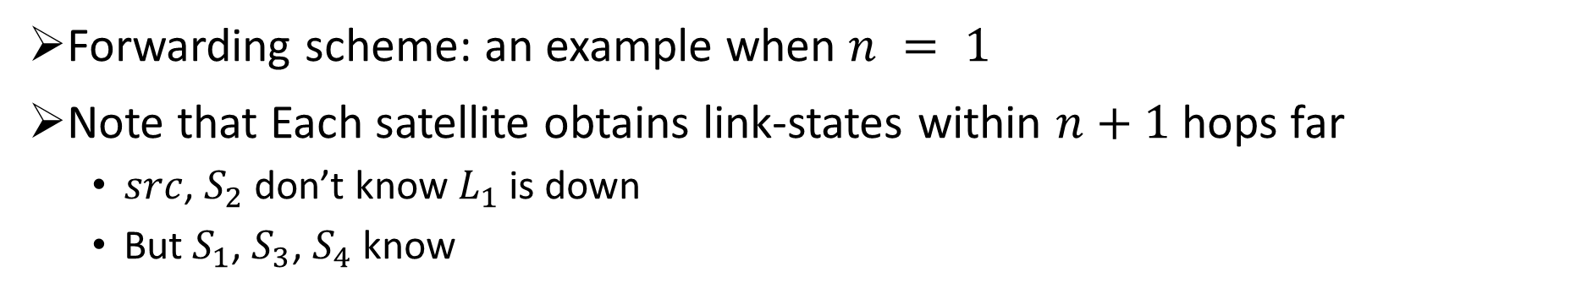





LoFi: routing calculation
Forwarding scheme: an example when $n = 1$
Note that Each satellite obtains link-states within $n+1$ hops far
$src$, $S_{2}$ don’t know $L_{1}$ is down
But $S_{1}$, $S_{3}$, $S_{4}$ know
data
$$S_{1}$$
$$L_{1}$$
$$dst$$
Due to localized LS dissemination,
satellites may not be able to directly calculate the optimal route,
but intermediate satellites can gradually correct it.
When receive a data packet, a satellite:
Check the optimal outgoing interface
If this interface is the packet came from, check the 2nd optimal interface
If and only if there is no other interfaces, send this packet back to the incoming interface
$$src$$
$$S_{5}$$
$$S_{2}$$
$$S_{4}$$
$$S_{3}$$
Calculated best route
Calculated 2nd best route

Slide 20
Contents
Background & motivation
Design considerations of link-state routing
Design of our LoFi
Performance evaluation
Experiment setup
Light-load performance
Heavy-load performance

Slide 21
Performance evaluation
Experiment setup
Packet-level simulation on inet 4.4
Constellation: Iridium-like walker-star constellation, 760km, 6 * 11
Bandwidth of ISL: 10Mbps data packet size: 1KB queue capacity: 1000packets
Irregular ISL failures/recoveries: Poisson process
Key metrics:
Control overhead: transmission overhead caused by protocol control packets
Data packet loss ratio
End-to-end delay

Slide 22
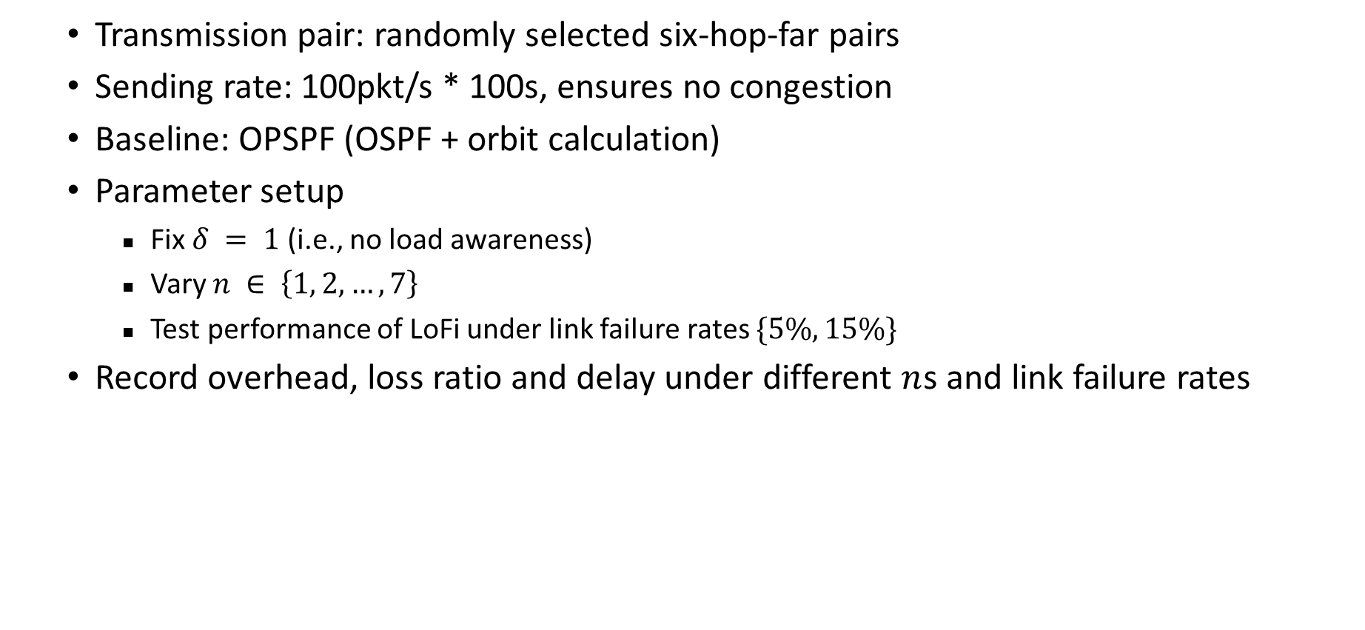
Performance evaluation: light load
Transmission pair: randomly selected six-hop-far pairs
Sending rate: 100pkt/s * 100s, ensures no congestion
Baseline: OPSPF (OSPF + orbit calculation)
Parameter setup
Fix $δ = 1$(i.e., no load awareness)
Vary $n ∈ \left\{1, 2, …, 7\right\}$
Test performance of LoFi under link failure rates $\{5\%, 15\%\}$
Record overhead, loss ratio and delay under different $n$s and link failure rates

Slide 23
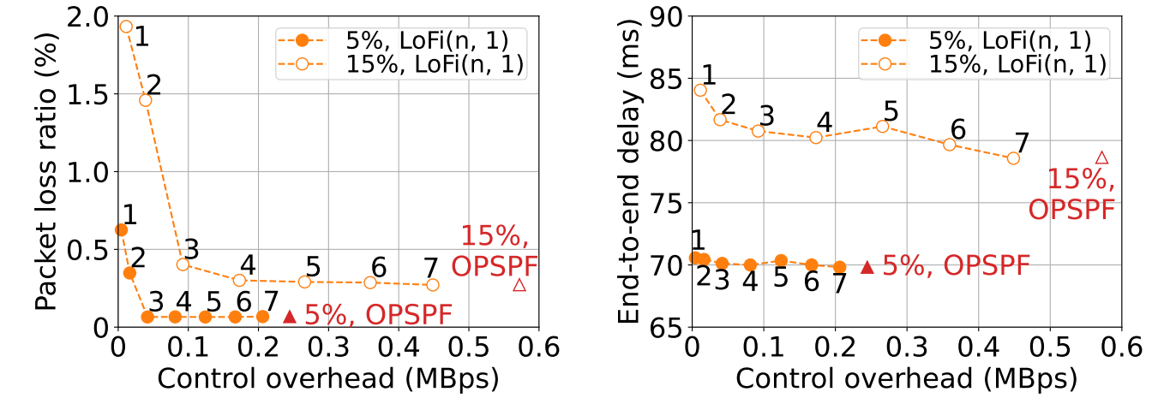

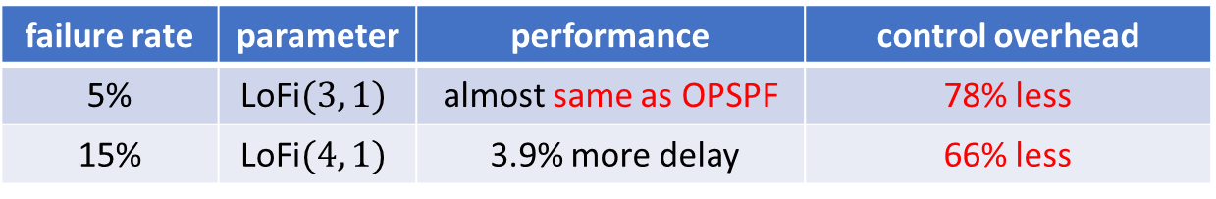
Performance evaluation: light load
Overhead, loss ratio and delay under different $n$s and link failure rates
Larger $n$ means more control overhead, but smaller packet loss ratio and smaller delay
The marginal performance gain on packet delivery is nearly zero when $n ≥ 4$
failure rate | parameter | performance | control overhead
5% | LoFi$(3, 1)$ | almost same as OPSPF | 78% less
15% | LoFi$(4, 1)$ | 3.9% more delay | 66% less

Slide 24
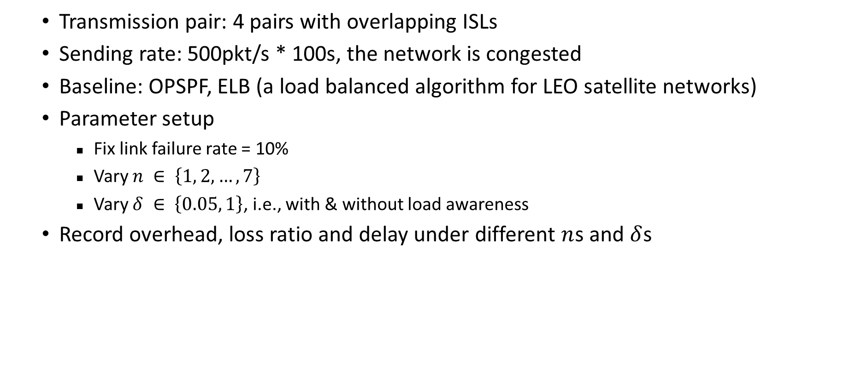
Performance evaluation: heavy load
Transmission pair: 4 pairs with overlapping ISLs
Sending rate: 500pkt/s * 100s, the network is congested
Baseline: OPSPF, ELB (a load balanced algorithm for LEO satellite networks)
Parameter setup
Fix link failure rate = 10%
Vary $n ∈ \left\{1, 2, …, 7\right\}$
Vary $δ ∈ \left\{0.05, 1\right\}$, i.e., with & without load awareness
Record overhead, loss ratio and delay under different $n$s and $δ$s

Slide 25
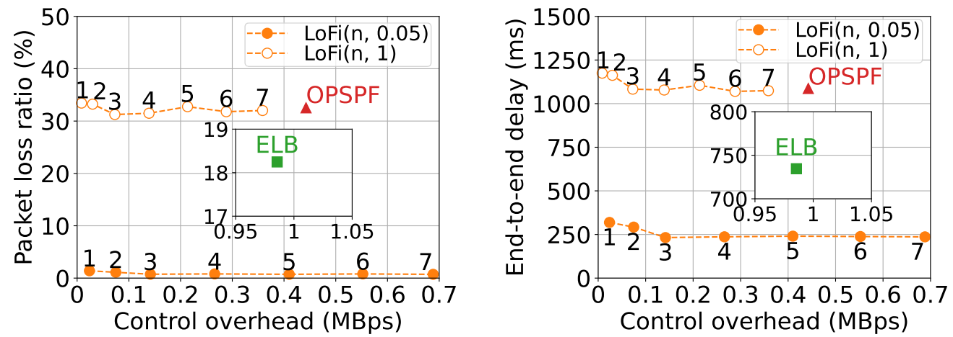

Performance evaluation: heavy load
Overhead, loss ratio and delay under different $n$s and $δ$s
LoFi$(n, 0.05)$significantly reduces packet loss ratio and delay than OPSPF & LoFi$\left(n, 1\right)$
proves the effectiveness of load awareness in LoFi
Packet delivery performance of LoFi$(n, δ)$increases in $n$.
$n = 3$can almost harness all the benefit at the cost of small control overhead
LoFi$(3, 0.05)$ outperforms ELB in terms of load balancing
Packet loss ratio: decreased by 94.4% delay: decreased by 67.6% overhead: decreased by 85.7%

Slide 26
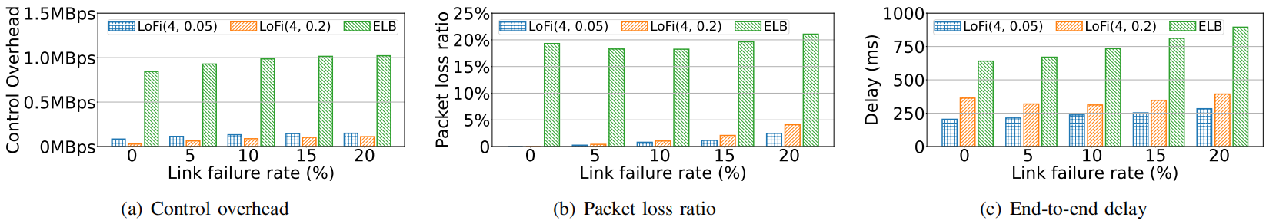

Performance evaluation: heavy load
LoFi$(4, δ)$ vs. ELB under different link failure rates
Vary $δ ∈ \left\{0.05, 0.2\right\}$, link failure rate $∈ \left\{0, 5\%, 10\%, 15\%, 20\%\right\}$
As link failure rate increases, performance of all methods gets worse
LoFi$(4, 0.05)$, LoFi$(4, 0.2)$ both outperform ELB in all three metrics
A larger $δ$ means a smaller control overhead, but worse loss ratio and delay

Slide 27
Conclusion & future works
Review the design of LoFi
Localized fine-grained link-state routing for LEO satellite networks
Key ideas
Reduce the dissemination range of link-states
Incorporate fine-grained link-load awareness
Packet-level simulations
Light-load scenarios: outperforms OPSPF in terms of smaller control overhead
Heavy-load scenarios: outperforms ELB in control overhead & performance
Future works
Implement LoFi in our container-based emulator
Try to further address forwarding loops & packet disorder issue

Slide 28
Thanks!

