Slide 1
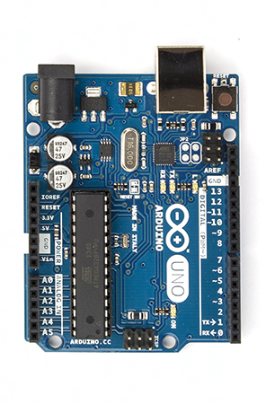
PI4ino
A Generic PI4 + CW + Carrier Arduino Beacon Controller
Freq.
Device
SPI
Connections
A0: GPS valid
A1: Lock detect, optional
A2: “TX”
A4: I²C SDA
A5: I²C SCL
• • •
Connections
13: SPI SCK
12: SPI MISO, optional
11: SPI MOSI
10: SPI SS
9: Device update
8: Device reset
7: TX to GPS, optional
6: RX from GPS
680 Ω
680 Ω
680 Ω
GPS
Receiver
Freq.
Device
I2C
Bo, OZ2M, www.rudius.net/oz2m/pi4ino

Slide 2
Freq.
Device
SPI
• • •
680 Ω
680 Ω
680 Ω
GPS
Receiver
Freq.
Device
I2C

Slide 3
Pass band of
2,4 kHz SSB
crystal filter
Small arrows are 2nd harmonics
…
200
400
600
800
1000
1200
1400
1600
1800
2000
2200
2400
2600
2800
3000
3200
3400
3600
3800
Freq [Hz]
CW tones
PI4 tones
PI4 1 kHz offset

Slide 4
Pass band of
crystal filter
…
200
400
600
800
1000
1200
1400
1600
1800
2000
2200
2400
2600
2800
3000
3200
3400
3600
3800
Freq [Hz]
CW tones
PI4 tones
WSPR
PI4 1 kHz offset
Small arrows are 2nd harmonics

