Slide 1
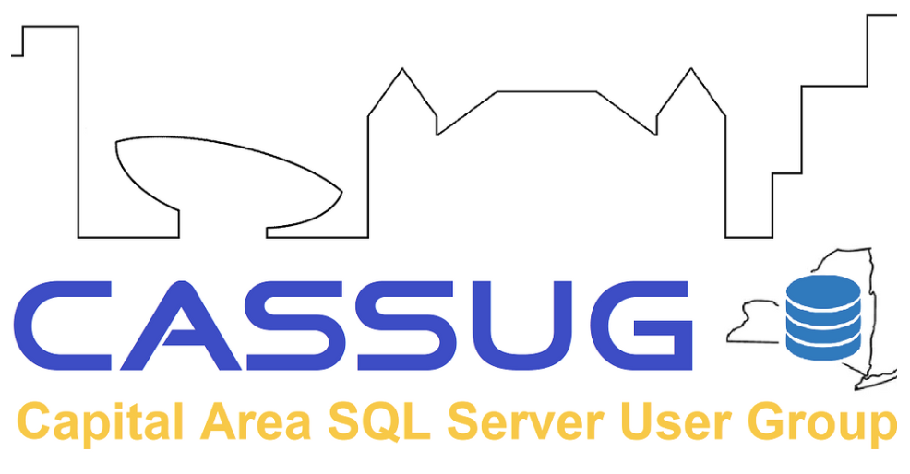
Crushing a Cloud Migration
Moving Mountains While Migrating Data
Matt Gordon
Director of Cloud Administration
Rev.io

Slide 2

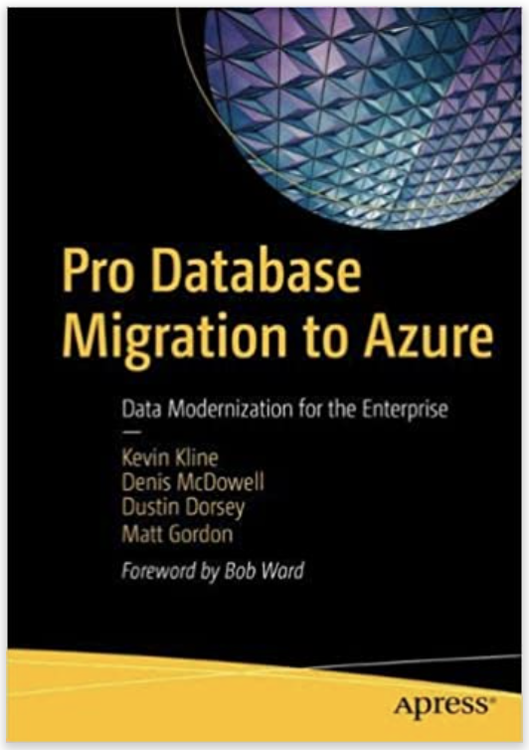
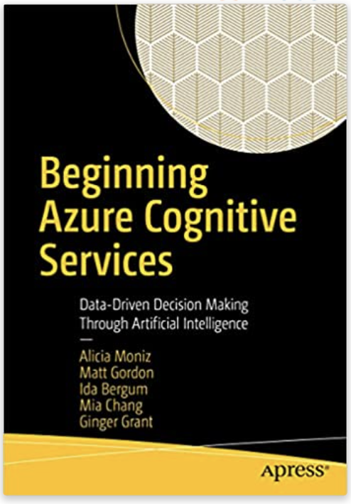
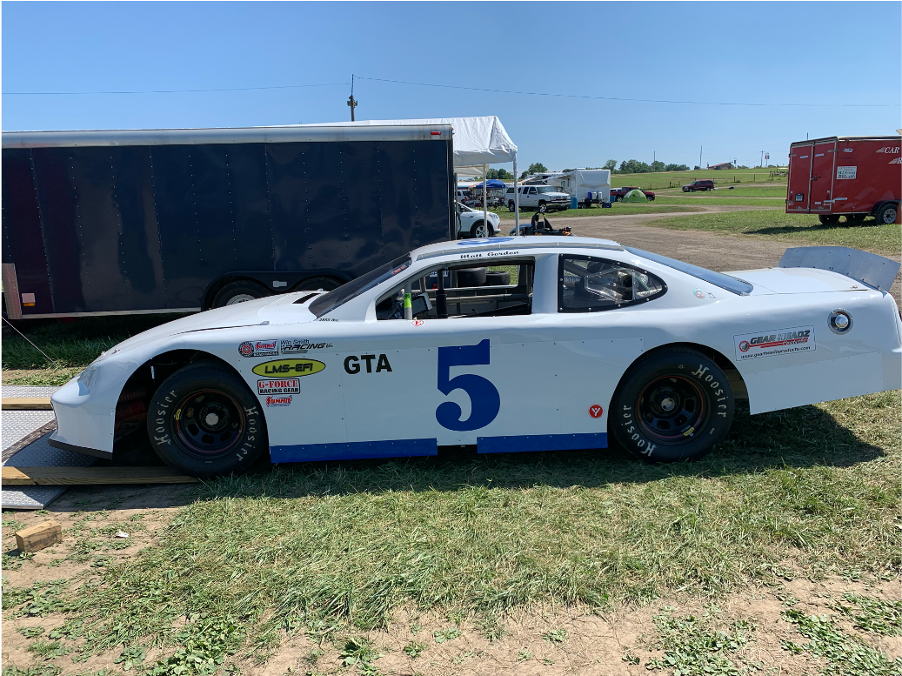

Speaker Info
Matt Gordon
Director of Data & Infrastructure
matt@sqlatspeed.com
: @sqlatspeed
www.sqlatspeed.com

Slide 3


About Me
20+ years of SQL Server experience
Microsoft Data Platform MVP
Friend of Redgate
Managed 24x7 datacenters
Worked on development teams
Domestic and international data community speaker
Leader of Lexington, KY Data Technology Group

Slide 4
LOOKING FOR A NEW JOB?
CLOUD DATA ADMINISTRATOR
CLOUD INFRA ADMINISTRATOR

Slide 5
Why are we migrating databases?

Slide 6
Migration Motivation(s)
Saving Money
IaaS vs. PaaS
Datacenter Consolidation and/or Decommissioning
My Boss Told Me I Had To Do It
Notes:
Mention getting extended security updates for three years for SQL Server and Windows Server 2008
Smart thing to do for legacy app support

Slide 7
Migration Motivation(s)
Extending SQL Server 2008 Support
Now also true for SQL Server 2012
Lifting and Shifting
Not always the right choice technology-wise
Notes:
Mention getting extended security updates for three years for SQL Server and Windows Server 2008
Smart thing to do for legacy app support
SQL 2012 extended support ends on 7/12/22
Windows 2012 extended support ends on 10/10/23

Slide 8
Who is blocking our migration?

Slide 9
Moving Mountains
What Is Standing In Our Way?
Management support
Operations team reluctance
Development team resistant to change
Notes:
Managers not bought in or giving us what we need
Operations team not comfortable with cloud or perhaps resistant to change
Dev team not wanting to lose control of their environments are resistant to things like Azure SQL Database

Slide 10
Moving Mountains
Who Is Standing In Our Way?
Security group
Networking team
DBA stalling on changes
Notes:
Security group often throws obstacles in cloud migrations…refer to cert page I sent to Tim (and add it to Resources slide)
Need to work closely with our networking team to ensure proper network security and conventions are followed in Azure…need management to pull those together for us
DBA may be uncomfortable in the cloud…discuss all the different ways to upskill them and link to Ground to Cloud workshop on Resources slide

Slide 11
Moving Mountains
Executing as an outside consultant
Keen sense of organizational politics essential
Understand the competing interests at play
Learn where the centers of power are in the organization

Slide 12
Moving Mountains
Executing as a full-time employee
Politics potentially less of a concern
Likely can work up the org chart for support to move obstacles
Great way to expand your knowledge outside the realm of data

Slide 13
WhERE are we migrating databases?

Slide 14
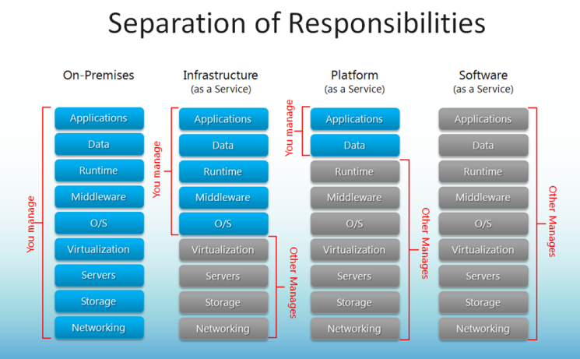
Define Your Terms

Slide 15
SQL Server on IaaS VM
Easy to lift and shift using Azure Migrate
Think about whether lift and shift is the right strategy
Did we choose this for comfort or for technical reasons?

Slide 16
Azure SQL Database - Deployment Models
Single
Fully-managed
Isolated (by logical server)
Elastic Pool
Collection of single databases
Shared set of resources (CPU, memory, etc.)
Managed Instance
Notes:
Moving away from the Single branding…

Slide 17
Azure SQL Database - Details
T-SQL support nearly equivalent to on-premises SQL Server
Does not support cross-database queries
No SQL Server Agent
Basic/Standard/General Purpose service tiers separate compute and storage (99.99% SLA)
Premium/Business Critical service tier co-locates compute and storage
Notes:
Lower tiers may experience performance degradation during maintenance
High tiers very similar to an Always On AG under the covers…likely little to no performance degradation
Don’t forget zone-redundant configuration to make your DB very resilient! (99.995% financially-backed SLA)

Slide 18
Azure SQL Database – Cost Information
DTU-based purchasing model (not valid for MI)
https://docs.microsoft.com/en-us/azure/sql-database/sql-database-service-tiers-dtu
What is a DTU?
vCore-based purchasing model
https://docs.microsoft.com/en-us/azure/sql-database/sql-database-service-tiers-vcore
Notes:
Great place to draw parallels between AG-ish tiers in both DTU and vCore licensing levels

Slide 19
Azure SQL Database Hyperscale – Basic Info
Different service tier of Azure SQL Database
Looks and acts just like Azure SQL Database
Backed by Hyperscale scale-out storage technology
Targeted to and optimized for very large workloads
Max capacity of 100 TB
Resiliency provided at the storage level
For true HA, you should provision at least 2 compute nodes
Notes:
Failover is automagic as long as proper nodes are provisioned

Slide 20
Azure SQL Database Hyperscale – More Details
Support for up to 100 TB of database size
Nearly instantaneous database backups (based on file snapshots stored in Azure Blob storage)
no IO impact on compute resources
Fast database restores (based on file snapshots)
Higher overall performance due to higher log throughput and faster transaction commit times regardless of data volumes
Rapid scale out
provision one or more read-only nodes for offloading your read workload and for use as hot-standbys
Rapid scale up

Slide 21
Azure SQL Database – Hyperscale Limits
Elastic pools not supported
Compute and storage billed separately
What does it look like?

Slide 22
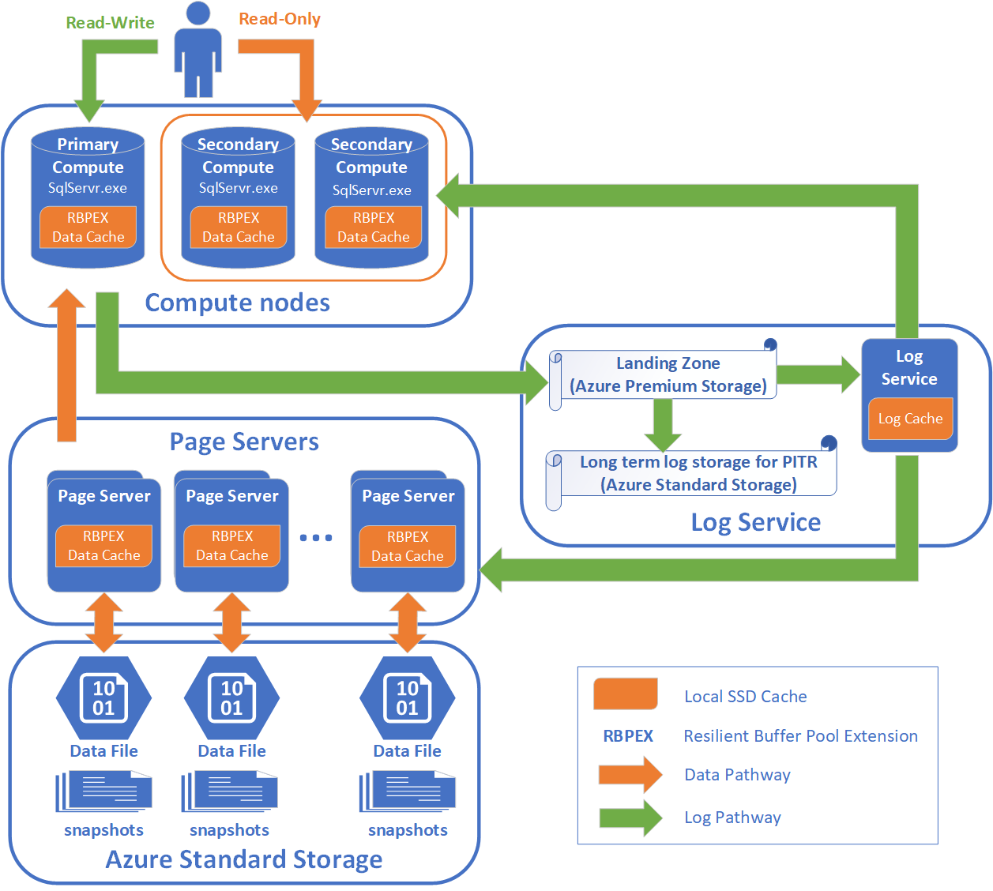
Azure SQL Database – Hyperscale Architecture

Slide 23
Azure SQL Database - Serverless
It’s not actually serverless!
Configuration settings:
Min vCores
Max vCores
Autopause delay
Intermittent, unpredictable usage patterns are best suited
Billed per second
Not the most responsive on scaling

Slide 24
Azure SQL Database - Managed Instance
Provides near 100% compatibility with on-premises Enterprise Edition
Preserves PaaS capabilities
Automatic patching & version updates
Automated backups
High availability
Using DMS (Data Migration Service) is a popular lift & shift path

Slide 25
Azure SQL Database MI – How to Connect
Secure public endpoint
Best for app access
ExpressRoute/VPN
Cross-region or access from different Vnet
Jumpbox
Need to be on same Vnet as managed instance

Slide 26
HOW are we migrating databases?

Slide 27
Migration Methods
Replication to Azure SQL
Replication to SQL Server on Azure VM
Log shipping to SQL Server on Azure VM
Export data-tier application in SSMS and save to Azure
Bulk load to Managed Instance

Slide 28
More Migration Methods
Scale Availability Group to Azure for Failover-based Migration
Azure Migrate
Log Replay Service (LRS)

Slide 29
Azure Migrate
Best suited to enterprise-wide moves
A “unified approach” of individual tools
Experience is tailored to individual server roles

Slide 30
LRS - (kinda) Log Shipping to Managed Instance
SQL Server 2008+
Full/diff/log backups w/ CHECKSUM enabled
Azure Blob Storage container
Autocomplete or continuous mode
Notes:
Continuous mode is really manual mode

Slide 31
Data Migration Assistant
Analyze a database for migration
Review feature parity
Review compatibility issues
Notes:
Mention enterprise-wide way to do this via PowerShell on Resources slides

Slide 32
Deploy to Azure via SSMS
Migrate a database to Azure using SSMS

Slide 33
Migrate using Azure DMS
Provision DMS
Perform schema-only migration
Perform offline data migration
Notes:
Ports 443, 53, 5671-5672, 9350-9354, 445, 12000 need to be open
Need to create a service principal as well

Slide 34
What did we learn?

Slide 35
Takeaways
Understand how licensing is handled in your organization
Azure Hybrid Benefit real financial incentive to choose Azure
Ensure DBAs and devs understand proper connection methods for migrated databases
Modify your maintenance procedures depending on chosen migration target

Slide 36
Takeaways
Lift and shift isn’t always the right choice
Knowing the motivation for migration is critical to making the correct technical target decision
Knowledge of organizational politics may be important to moving those mountains

Slide 37
The Shill Slide
Cognitive Services book
Database migration book

Slide 38


QR CODES FOR JOB LINKS
Cloud Infra Administrator
Cloud Data Administrator

Slide 39
Resources
Azure Security and Compliance
Microsoft Ground to Cloud Workshop
Creating Your First Azure SQL Database
Leveling Up Your Azure SQL Database Deployments
SQL Server 2008 Extended Support
Running Data Migration Assistant Enterprise-Wide
Notes:
Managers not bought in or giving us what we need
Operations team not comfortable with cloud or perhaps resistant to change
Dev team not wanting to lose control of their environments are resistant to things like Azure SQL Database

Slide 40
Thanks for attending!
Matt Gordon
Director of Data & Infrastructure
matt@sqlatspeed.com
: @sqlatspeed
www.sqlatspeed.com
https://github.com/sqlatspeed/2022_presentations

Slide 41
Heading Styling
Heading One Style, 28pt
Body content, 20pt Segoe UI (gray)
Heading Two Style, 24pt
Body content, 20pt Segoe UI (gray)
HEADING THREE STYLE, 22PT, BOLD, ALL CAPS
Body content, 20pt Segoe UI (gray)

Slide 42
Section Divider
Type 1 -

Slide 43
Section Divider
Type 2 -

Slide 44
Chart Type 1

Slide 45
Chart Type 2

Slide 46
Table
Heading 1 | Heading 2 | Heading 3 | Heading 4 | Heading 5 | Heading 6

Slide 47
Slide for Showing Developer’s Software Code
Use this layout to show software code
The font is Consolas, a monospace font
The slide doesn’t use bullets but levels can be indented using the “Increase List Level” icon on the Home menu

Slide 48
Video Title
Add subtitle

Slide 49
Deploy to Azure via SSMS
Migrate a database to Azure using SSMS

Slide 50
Speaker Info
Matt Gordon
Director of Data & Infrastructure
matt@sqlatspeed.com
: @sqlatspeed
www.sqlatspeed.com

