Slide 1
Troubleshoot and triage like a pro
DATA COMMUNITY AUSTRIA DAY 2023

Slide 2


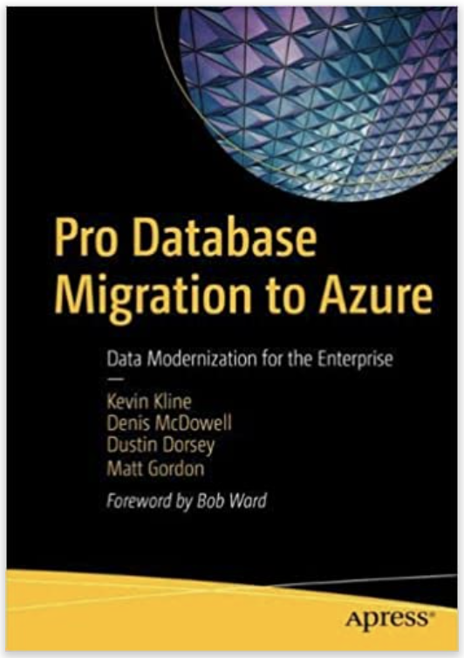
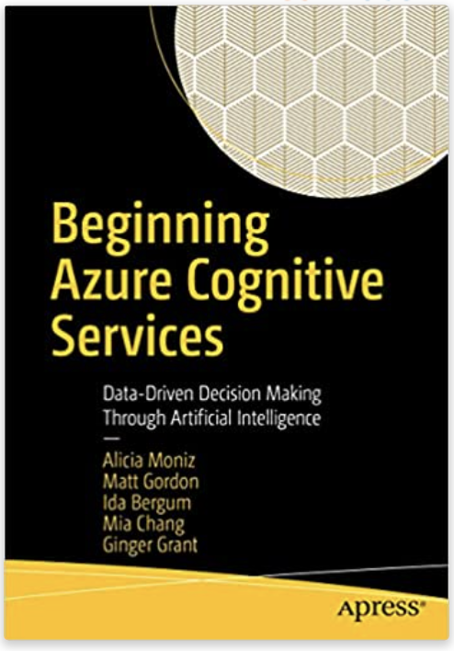
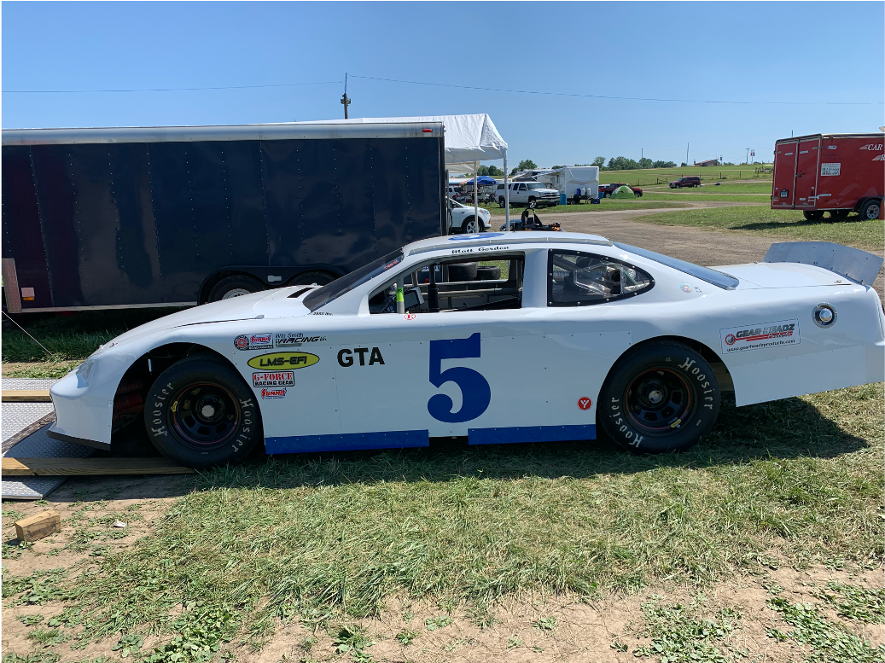
Matt Gordon
Senior Azure Architect
matt@sqlatspeed.com
: @sqlatspeed
www.sqlatspeed.com

Slide 3


About Me
20+ years of SQL Server experience
Microsoft Data Platform MVP
Friend of Redgate
Managed 24x7 datacenters
Leader of Lexington, KY (USA) Data Technology Group

Slide 4
Deepthi Goguri
DBA
dbanuggets@gmail.com
: @dbanuggets
https://dbanuggets.com/

Slide 5
About Me
7+ years of SQL Server experience
MCT
Masters in Computer Technology
Friend of Redgate
Leader of DEI User group, Microsoft data and ai south florida user group, wit volunteer

Slide 6
Why triage?
Knowing what to fix is just as important as knowing how to fix it
Prioritization matters even more when you are under pressure
Means your troubleshooting starts off with a sense of order

Slide 7
What does triage mean?
Prioritize
Issues versus incidents
Distribute
IS this truly a database issue?
Attack
Correct the relevant issues

Slide 8
Developer: My query is running slow!! DBA: okay, can you tell bit more about it? Developer: umm, IT was working fine but suddenly… Do you know why it is running slow?

Slide 9


Slide 10
Steps to Finding the problem
Cpu, memory, storage
Perfmon, DMV’s, inefficient query plan
Blocking, waits, I/0, memory
Indexes, statistics
Poorly written queries
tempdb

Slide 11
Our troubleshooting stories!

Slide 12
STORY: 4-HOUR CLIent outage
Mostly my fault
Routine availability group failover gone awry
Patience is a virtue even in high-pressure scenarios

Slide 13
Lesson learned, tools USED, and TIPs
Relax and calm down
Trust your monitoring
COMBINE GUI tools with scripts/notebooks specific to the issue at hand
Azure data studio notebooks can give you and your TEAM a dynamic runbook THAT CAN BE STORED IN SOURCE CONTROL

Slide 14
tool: quick always on monitoring
https://github.com/sqlatspeed/2022_presentations/blob/main/always_on_quick_monitoring.sql
https://github.com/microsoft/tigertoolbox/tree/master/Always-On

Slide 15
STORY: daytime CLIent outage
not my fault this time!
Storage admin validated a cluster during the day
That briefly offlines every volume
You can guess what happened next
Angry, loud hotline call

Slide 16
Lesson learned, tools USED, and TIPs
Be prepared to calm others down
Be confident in yourself and what you are seeing
Understanding complicated infrastructure (HA, DR, etc.) HELPS YOU BUILD A CASE
HOTLINES CAN BE VERY GOOD for severity 1 incidents if the right people are on them

Slide 17
STORY: “client says we’re down”
App performance had significantly degraded that afternoon
Client called and said it was down and they got a “database error”
Support passed it along as a database issue and did not engage broader infra team
Actual culprit was network latency between azure and on-premises servers

Slide 18
Lesson learned, tools USED, and TIPs
Just because somebody says the database is down doesn’t mean it is
In complicated environments escalations cross disciplines (and sometimes teams)
Ensure that every critical part of your infrastructure is baselined and monitored
This exposed a gap in our monitoring
Monitoring does not begin and end at the database level
Azure log analytics is an excellent starting point
https://github.com/MicrosoftDocs/azure-docs/blob/main/articles/azure-sql/database/metrics-diagnostic-telemetry-logging-streaming-export-configure.md

Slide 19
STORY: Application team: this is a database problem, for sure!
Application cannot make connections to database – timeout expired errors
Confused application team blame dba
No problems with the database but dba had to take the responsibility to figure out the issue
Turns out application doesn’t have proper closed sql connections in the code
Notes:
Problem: Developers receiving intermittent generic timeout expired errors for a long time. They tried to figure out the issue but strongly believed it is a database issue and blamed DBA.
DBA: Checked all the troubleshooting methods to figure out if it is a sql server or database problem. Everything seems to be working fine but application couldn’t connect to the database. There is no specific time that these errors occur. They are very frequent and in random fashion. Though I am a DBA and know its not a SQL server issue, took the responsibility to define and find the problem, took the help of the Dynatrace tool to figure out the connections not even reached out to the sql server. The sql server logs proved the same.
Worked with a developer for hours digging into the application code to find out it was a sql connection open and close code from vb code application. They opened the connections but did not explicitly close the connections. Due to this the application pool filled up with the connections not allowing any connections to connect to the server. As vb code is outdated and old, recommended to rewrite the application. After rewriting the application with proper coding standards, the problem is permanently solved.

Slide 20
Lesson learned, tools USED, and TIPs
Stepping out of the dba world for a while
Remaining calm during chaos can help get a step close to resolution
Used Dynatrace tool
Notes:
Steppping out of my comfort zone and out of my job responsibilities helped in finding the cause of the problem.
Though everyone blamed DBA, they would appreciate once they actually know what the issue was.
Being calm and focused during the chaos tells a lot about us.
Dynatrace tool and sql error logs helped finding the issue

Slide 21
STORY: backup! Not only database backups
Dropped replication, subscription
Lost metadata information
Critical reporting database down (subscriber)
Backup saved dba job
Notes:
Manager requested one of the DBA’s to temporarily resume the replication for couple of hours.
Instead of stopping the distribution job, DBA dropped the complete replication topology including the publication, subscription database and distribution database.
As we have a plan to migrate the server, I have taken a replication publication backup ahead of time which saved the metadata information for the publication
Not only the database backups, scripting out and saving the publication schema is important, especially when you are replicating large number of articles with filters on them.
This backup which I saved for the migration saved the DBA job.

Slide 22
Lesson learned, tools USED, and TIPs
Documentation matters!
Blaming doesn’t bring resolution! Fixing the problem does!
Don’t be afraid to make mistakes but make sure you have backups in place!
Notes:
Documentation matters – if there is documentation in place already and if DBA had followed it, this disaster would not have happened. Documentation matters!
Manager was mad and angry at the entire team for the inefficiency – we understand the frustration but blaming doesn’t help when solve the problem. During the disater situations, supporting each other and being there for others to resolve the issue will help as it shift the focus from “who did this” to “how to fix this quickly”
Never be afraid of making mistakes. A person who doesn’t make mistakes cannot learn and grow. But as a DBA, we need to make sure we have valid backups in place during disaster situations.

Slide 23
STORY: Don’t assume, Calm down and test
Subscriber server cannot be upgraded (used by reporting team)
Replication from sql 2012 to 2000
Replication broke due to the settings in snapshot files
Added additional job step for snapshot job fixed the issue
Notes:
Subscriber server is being used by the statistics and research team to pull some crucial data for their reporting purposes. They need the latest data.
Subscriber server is SQL 2000 but the publisher is SQL 2012. Research team want to use SQL 2000 Subscriber database and did not have any plan of migrating the server to new environments.
The plan was to have transactional replication setup netween SQL 2012 and SQL 2000 which is not possible according to Microsoft docs.
I leant from the Microsoft documentation that the subscriber can be only 2 versions lower than the publisher which is SQL 2005 but here in this case, the subscriber is SQL 2000.
I tried convincing the research team to upgrade their database but they are not ready to upgrade their application any time sooner. So, I had to setup and test the replication assuming it wont work but to my surprise, I was able to setup the replication with few challenges.
The snapshot files generated from the publication database snapshot job created .sch (schema) files with ansi_padding setting to OFF which is not compatible to the subscriber server. Distribution job failed by erroring out on one .sch file setting at a time. I had to change the setting ANSI padding setting off to on to one file at a time and start the replication job, only to figure out an another file having same issue. It is tedious to manually find all the files having this setting off and to turn on.
I used powershell script to find these settings in every .sch file in the snapshot folder for the database and turn it on. I used that script as a second step in the snapshot agent job. Added the powershell script after taking the snapshot of the database. This automagically solved the problem each time database is reinitialized which saved me many hours of time for each initialization.

Slide 24
Lesson learned, tools USED, and TIPs
Read the documentation but also do the testing
Used powershell script to fix the issue
Automation can fix issues quickly
Notes:
Read the documentation but do your testing to figure out if it may actually work. Clients may not always listen to you when you give them a wise advice. In those scenarios, you need to figure out a way to meet the requirements.
Poweshell is the king of the automation
Fixed the issue very quickly.

Slide 25
THANK YOU FOR ATTENDING!
Matt Gordon
Senior Azure Architect
matt@sqlatspeed.com
: @sqlatspeed
www.sqlatspeed.com
Deepthi Goguri
DBA
dbanuggets@hotmail.com
: @dbanuggets
https://dbanuggets.com/

Slide 26
Client outage (MG) exacerbated by me making a panicked decision (AG failover issue)
the lesson learned was to relax, calm down, work through your decision process, and execute
Client outage (MG) caused by storage admins validating a cluster during the day (which briefly offlines storage)
"hotline" call started off angry as I was yelled at for the database being down but in reality it was a storage admin's mistake
needed to de-escalate the situation with admin as things got loud and angry quickly (lesson: soft skills are important even outside of a customer facing role)
App performance degraded significantly (MG) and support declared it a database issue when in reality it was network latency between Azure and on-prem
Lesson learned is build relationships and broaden knowledge outside of your specialty (networking knowledge pays dividends in cloud world)
Replication deletion (DG)
Replication setup was scripted/backed up
“it doesn’t matter who caused the issue, it does matter how to solve the issue ASAP”
Application faced generic timeout errors (DG) while trying to connect to the database. Everything is fine from the database and no blocking issues. It turns out after lot of research that application later did not close the connections properly. With research with a developer found out that in the app layer, they have open connection statements but no close connections. That was an old app so they finally decided to fix the issue rewriting the code. It solved the issue. It took lot of time as they blamed DBA (like stats and indexes). I became a .net developer without .net knowledge to figure out the issue.
Lesson learned: When things get tensed, developers couldn’t figure out what the real issue is, when management cannot wait long to resolve the issue, and as a DBA you need to be on the spot even though you know it’s not a SQL issue can be really stressful. It is not always the proving a point that is not a SQL Server issue but walking an extra mile and walking through the path you never travelled can make things clear and help find the issue.
Publisher is 2012 and subscriber is 2000 server (DG). The subscriber is used by research and stats team and they are not even close to migrate the subscriber server but still want the replication to be setup between them. I searched in microsoft docs that this is not possible as only subscribers supported two less versions (2008 and 2005) not 2000. I decided to test it out and it worked. It threw errors while initializing as all the articles in the generated snapshot .sch files were set to ansi_padding turned off. There are thousands of articles this way. When this happened, research team couldn’t process any of her reports, causing delays in reporting their important clients. I panicked or how to solve the issue as I know that I created replication for unsupported version. I did my research and found a powershell script that can automatically search for all the files and turn the ansi_padding from off to on. I tested and added this step in the snapshot creation job as a 2nd step. This automatically took care of everything and not a single issue since then.
Lesson learnt: Test test test. Do not assume something can break or will not work. You never know. You need to create an exact test environment to build and test your plan. Research but also test to find out what exactly the issues you may face and how to resolve issue. These steps can make things possible.

